Slide 1
Capstone
Projects should...
Be driven by aggregating phenotypic information
Emphasize broad perspective on phenotypic variation
Combine phenotypes, evolution, and genes

Slide 2
Capstone
Candidate Projects
Choose classic example of evolutionary transition in a complex phenotype
Use phenotypes from multiple evolutionary studies to generate "phenotype profile" along a set of branches in the Tree of Life
Use profiles to dissect evolutionary transitions in complex phenotype along branches in ToL

Slide 3
Capstone
Candidate Projects
Based on profile, "phenoblast" the model system data for candidate genes involved
Use model systems to test hypothesis that retrieved candidate genes underly inferred phenotypic profile

Slide 4
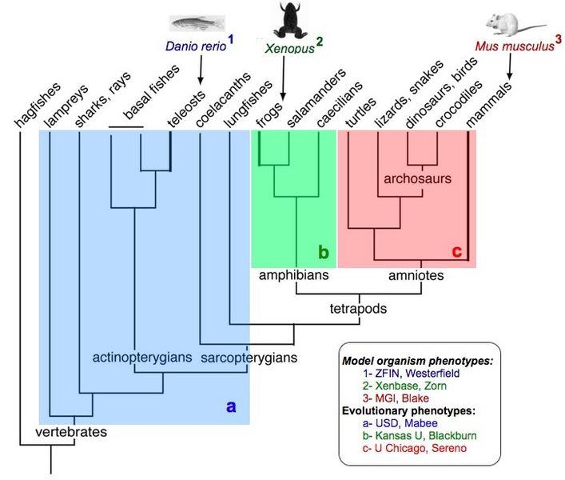
Capstone
Fin/Limb Transition

Slide 5
Capstone
Goals of Candidate Projects
Test whether we can
(1) generate previously proposed gene–
phenotype relationships,
(2) generate new knowledge for forming
questions re: genes, phenotypes, & evolution
Use informatics approach to ask "big picture" questions about phenotypes: e.g., genetic architecture, pleiotropy, morphospace, rates of change, homoplasy...

