Slide 1

Advisory Board Meeting April 26, 2012
Introductions
Background & overview of the project
Project components
Questions and discussion

Slide 2
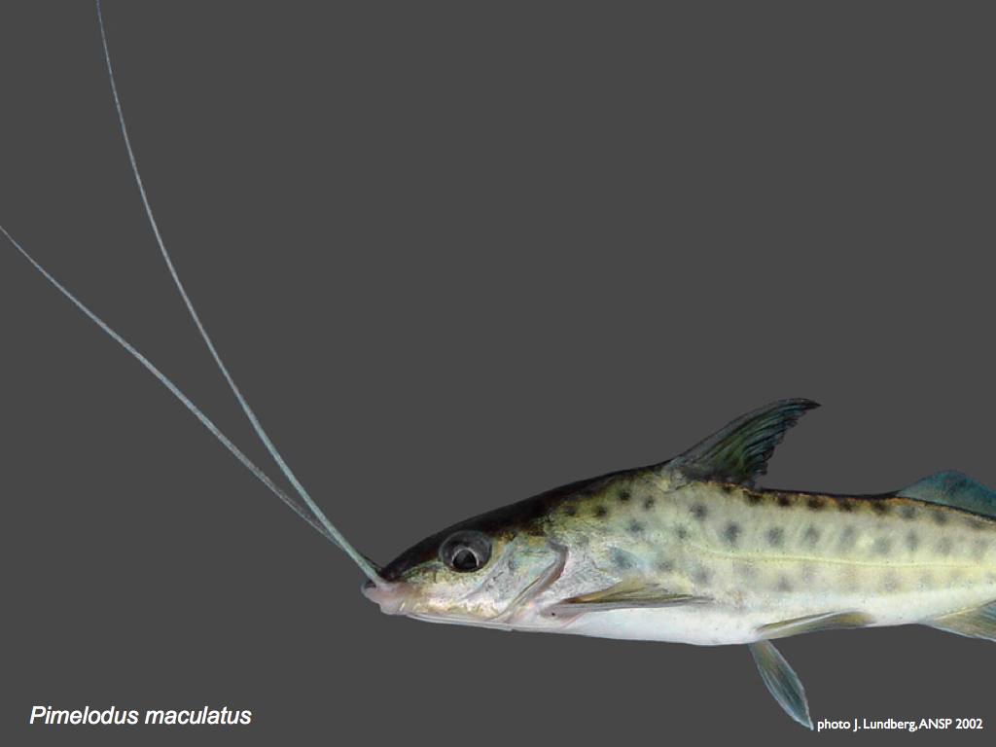

Slide 3
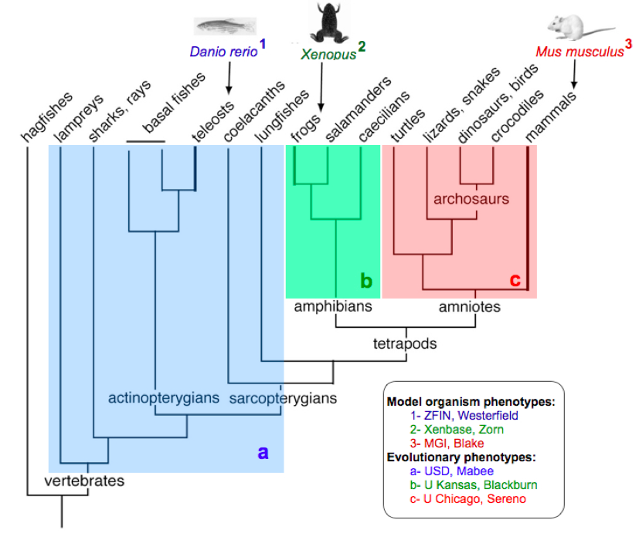
Phenoscape
zebrafish
Xenopus
mouse
teleosts
amphibians
amniotes
vertebrates

Slide 4
Duration: 48 months
July 1, 2011 to June 30, 2015
Funding: $3.3M in 2 NSF awards
U South Dakota
U North Carolina/NESCent
Knowledgebase: http://kb.phenoscape.org
Wiki: http://phenoscape.org
Blog: http://blog.phenoscape.org

Slide 5
Advisory Board
Roles
Evaluate goals, plans, progress
Share knowledge
Suggest opportunities
Help prioritize activities
Help us ameliorate our risks
Meetings
Annual virtual AB meeting
Annual F2F project meeting

Slide 6
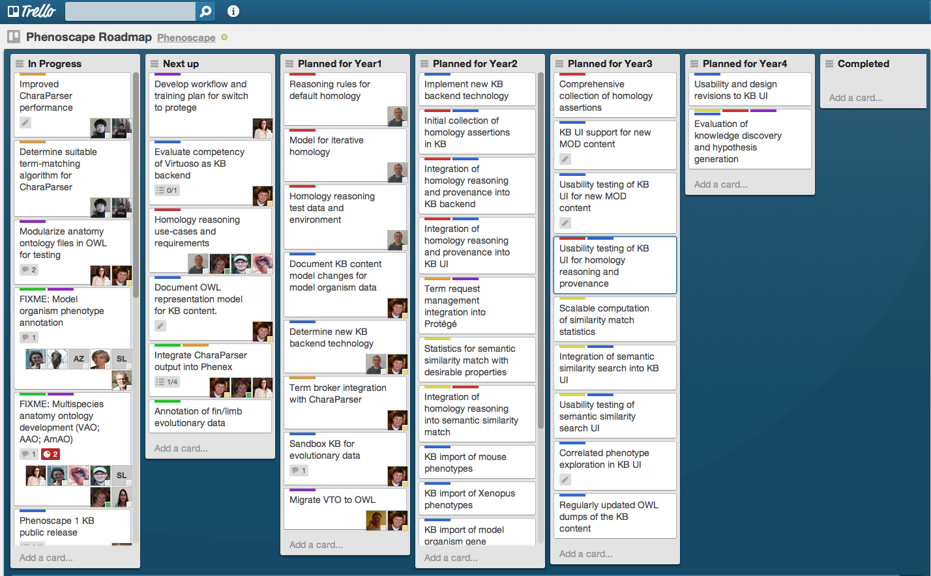
Phenoscape activities & components overview
Trello: https://trello.com/

Slide 7
Project Components
Ontology development and data curation (model orgs) - Monte
Ontology development and data curation (evolutionary orgs) - Paula
Scaling up the curation workflow - Hong
Phenoscape KB development - Jim
Homology meeting report - Hilmar
Semantic search, capstone - Todd
Outreach - Nizar

Slide 8
How can we:
Create a community of KB users?
Make sure there is a case to stakeholders for sustainability?
Support curation of additional taxa and genetic models?
Incentivize contributions of data from other researchers?
Promote community participation in maintenance of ontologies and software?

