Slide 1
Scalable Workflow
  Hong Cui, Jim Balhoff, Wasila Dahdul , Melissa Haendel, Hilmar Lapp, Todd Vision, Zilong Chang, Alex Dececchi, Nizar Ibrahim
Notes:
Motivation, objectives, participant, progress to date, immediate future plan (study different kinds of inconsistency, to inform how to improve curation guideline to improve consistency, prioritize what to address). Challenges (small corpus, ).

Slide 2
Motivation
Current workflow is primarily a manual process
  Picking phrases from natural language descriptions
  Selecting matching terms from ontologies
  Waiting for terms to be added to ontologies
  Constructing EQ statements
Issues
  Difficult to scale up + lack of consistency
  Ontology bottleneck

Slide 3
Overall Objectives
Speed up ontology building by separating ontology building from data curation
Improve data curation efficiency with NLP and machine learning

Slide 4
Participants
  Hong Cui
  Jim Balhoff
  Wasila Dahdul / Melissa Haendel
  Hilmar Lapp
  Todd Vision
  Zilong Chang
  Alex Dececchi
  Nizar Ibrahim

Slide 5

Phenotype Data Curation
Convert character and character state information from natural language descriptions to EQ statements
First dorsal-fin rays
(1) deeply branched
(2) unbranched
TAO: dorsal fin lepidotrichium PATO:branched
TAO: dorsal fin lepidotrichium PATO:unbranched
Notes:
TAO:0001418
PATO:0000402
TAO:0001418
PATO:0000414

Slide 6
Progress to Date
Prototype NLP component (CharaParser) completed
  Semi-automatically generates candidate EQ statements from character descriptions
  Participated in BioCreative Workshop, April 2012
    Preliminary evaluations
BioPortal term broker web service ready to use
  System design of integrating CharaParser and term broker to Phenex completed
Exploratory study of mapping quality phrases to ontology terms (“separable” => “detached from”)
  3 algorithms evaluated
  Results are promising, challenges remain.

Slide 7
BioCreative Results
Positive feedback on usability and reliability
Useful feedback from participating curators
Compared to a gold standard
  CharaParser did better than curators on picking key phrases from text descriptions
  CharaParser did poorer than curators on translating key phrases to ontology terms
Notes:
Summative

Slide 8
Issues in translation
  Various fixable syntactic problems
    “I-III”
    “female/male organ”
    “contact between …” etc. relation patterns
  Unmatched phrases
  Pre-composed terms in ontology
    “ceratobranchial 5 tooth”, “rib of vertebra 5”
  Curation granularity
    “Preopercular latero-sensory canal leaves preopercle at first exit and enters a plate: yes/no”

Slide 9
Immediate Future Plan
Improve CharaParser results
  Deal with many fixable issues
  Make better use of the hierarchy relations in ontologies in EQ generation
  Study consistency agreement issues
  Further evaluation of CharaParser
Integrate CharaParser to Phenex
Integrate term broker to Phenex
Integrate new system into data curation workflow

Slide 10
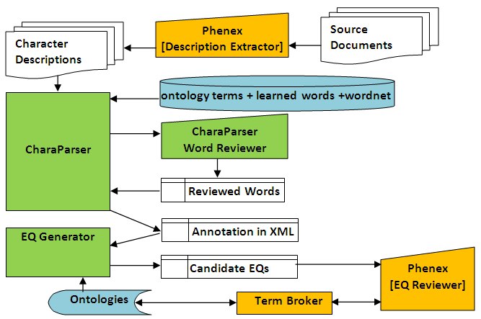

Slide 11
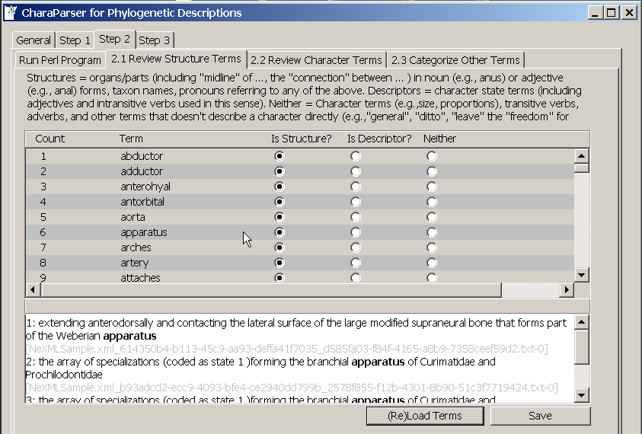

Slide 12
Deliverables
Integrated data curation system for Phenoscape
A paper on the data curation system
Collaborate on a paper on curation consistency

Slide 13
Questions for the Advisory Board
Automated systems always produce errors. What are some useful strategies that prevent these from disrupting the workflow of the user?
What other strategies should we should consider to improve the efficiency?

Slide 14
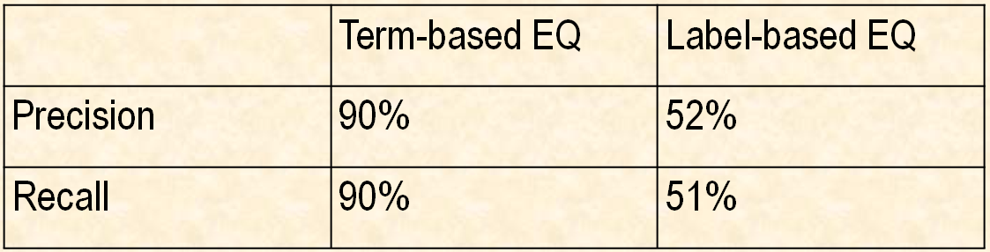
Internal Evaluation Result
Candidate EQ Generation:
  The development corpus (three publications on fishes and archosaurs) provided 1,200 character descriptions. 100 of them included in the internal evaluation benchmark.

Slide 15
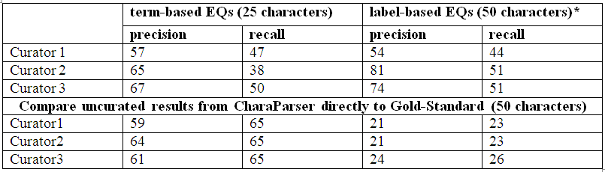
BioCreative Evaluation: Results
Overview:

Slide 16
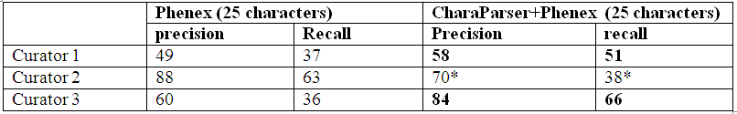

CharaParser Effect?

Slide 17
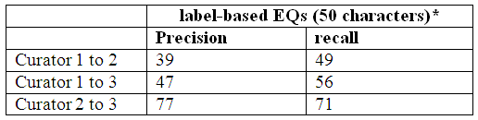
Inter-Curator Agreement

Slide 18
Factors
Development corpus too small (3 pdf files)
  Manus digits I-III and Penultimate phalanx (digits II, III), length; and ungual (digits I-III), form.
System not well configured
  Not all ontologies needed were loaded
  Triage algorithm for Sereno style didn’t take effects (6 / 50 characters)
Gold standard used in BioCreative
  over 50% of EQ statements has either broader E or broader Q parts
  On average gold standard characters are 20% longer.
Notes:
1791/89 = 20 words/character; 1250/51=25 words/characters

Slide 19
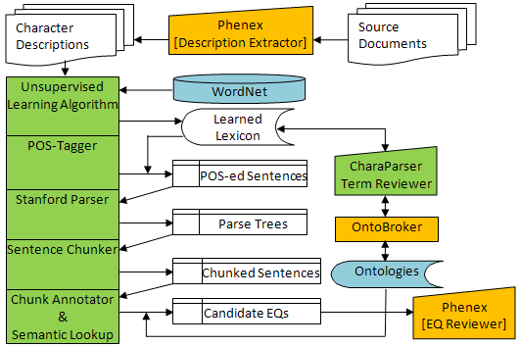
Phenotype Curation System=
CharaParser + Phenex
PCS System Schematic Diagram.

Slide 20
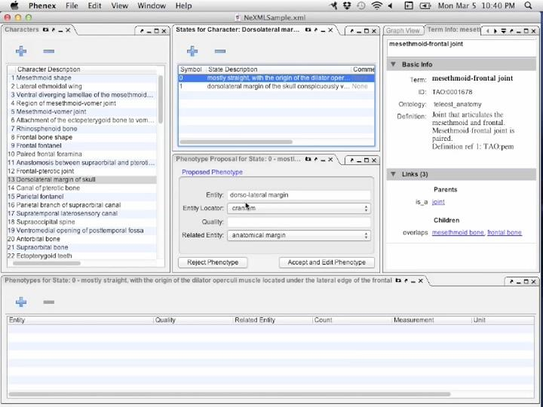
Phenex: EQ reviewer and editor

Slide 21
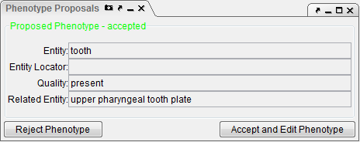
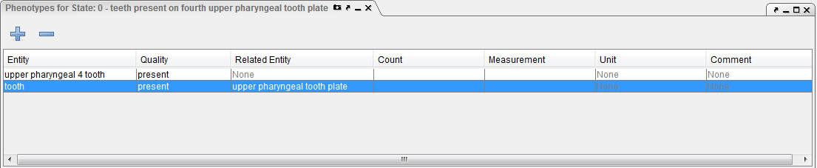
A Zoom-in View

