Slide 1
Vocabulary
Embryo
Excretory system
Organ system
Pronephric duct cell
Pronephros
Visceral organ system

Slide 2
Ontology
Embryo
Organ system
Visceral organ system
Excretory system
Pronephros
Pronephric duct cell

Slide 3
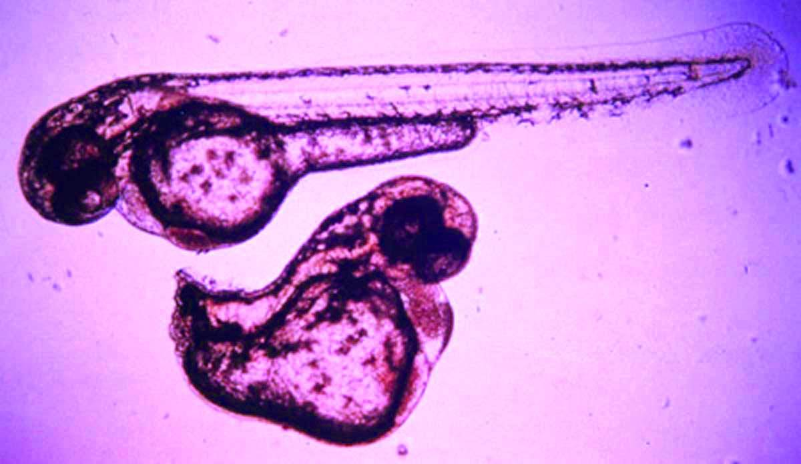

Slide 4
Phenotypic
character = entity + quality

Slide 5
Phenotypic
character = entity + quality
= body + short

Slide 6
Phenotypic
character = entity + quality
= body + short
= eye position + abnormal

Slide 7
Phenotypic
character = entity + quality
= body + short
= eye position + abnormal
= heart rate + decreased

Slide 8
Phenotypic
character = entity + quality
= body + short
= eye position + abnormal
= heart rate + decreased
AO:
entity = body
entity = eye
position
entity = heart
rate
PATO:
quality = short
quality = abnormal
quality = decreased

Slide 9
Phenotypic
character = entity + quality
Anatomical ontology
Cell & tissue ontology
Developmental ontology
Gene ontology
biological process
molecular function
cellular component
+ PATO

Slide 10
Body length of species A is short
(E₁) (T₁) (Q)
relative to body length of species B
(E₂) (T₂)

Slide 11
Body length of species A is short
(E₁) (T₁) (Q)
relative_to body length of species B
(E₂) (T₂)
}
}
}
}
}

Slide 12
X in species A and Y in species B
(E₁) (T₁) (E₂) (T₂)
are homologs when both are
geneologically descended from Z in their
(E₃)
most recent common ancestor C
(T₃)
}
}
}
}
}
}

Slide 13
X in species A and Y in species B
(E₁) (T₁) (E₂) (T₂)
are_homologs when both are
geneologically descended from Z in their
(E₃)
most recent common ancestor C
(T₃)
}
}
}
}
}
}

