Slide 1
What is an ontology and Why should you care?
Barry Smith
http://ontology.buffalo.edu/smith

Slide 2
What I do
Gene Ontology (NIHGR) (Scientific Advisor)
National Center for Biomedical Ontology (NIHGR)
Protein Ontology (NIGMS)
Infectious Disease Ontology (NIAID)
Biometrics Ontology (US Army)
Ontology for Biomedical Investigations (MGED and others)

Slide 3
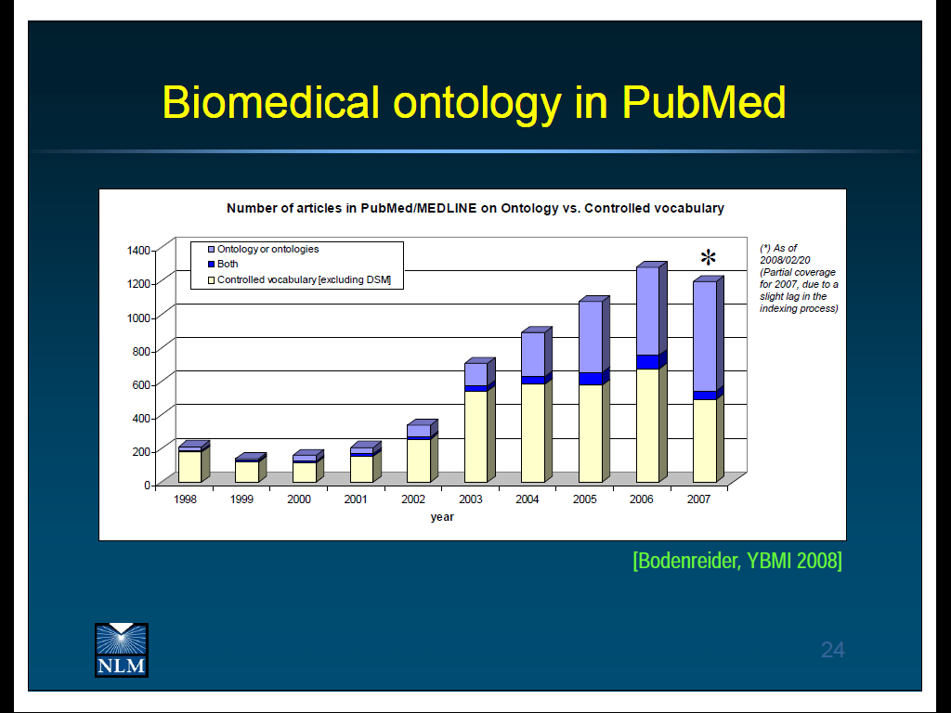
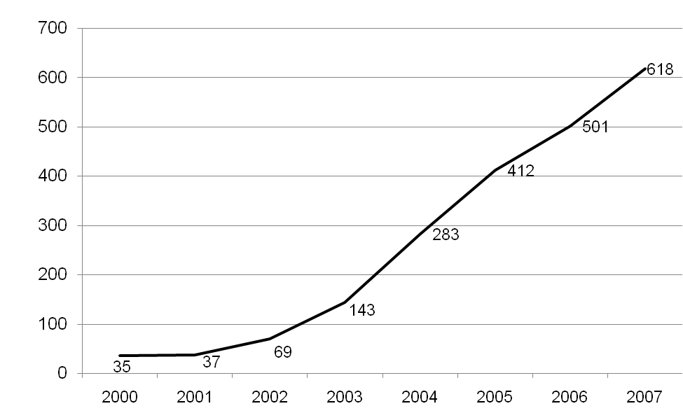
Uses of ‘ontology’ in PubMed abstracts

Slide 4
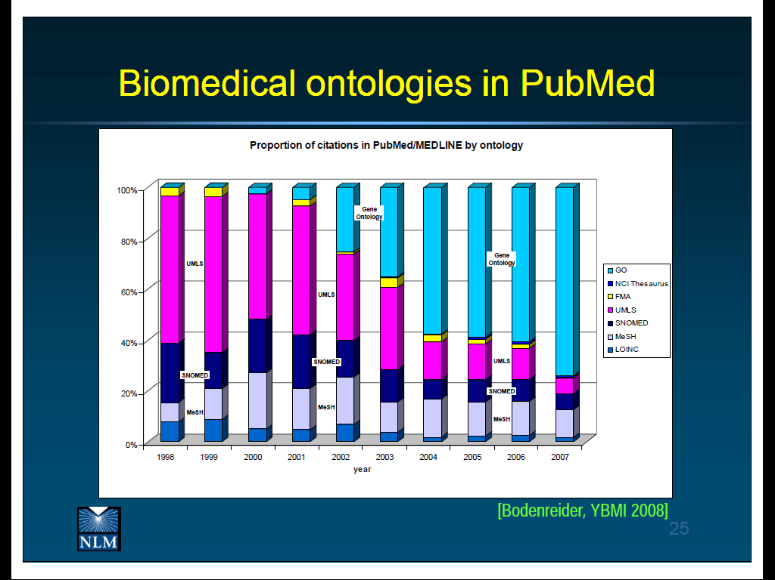
By far the most successful: GO (Gene Ontology)

Slide 5
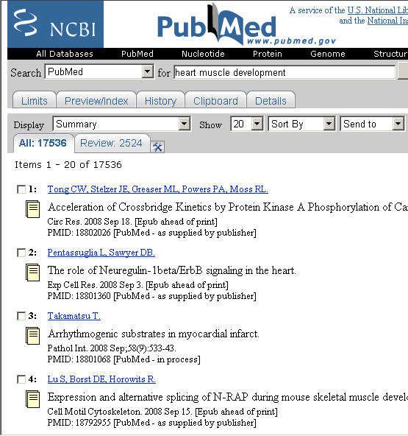
You’re interested in which genes control heart muscle development
17,536 results

Slide 6
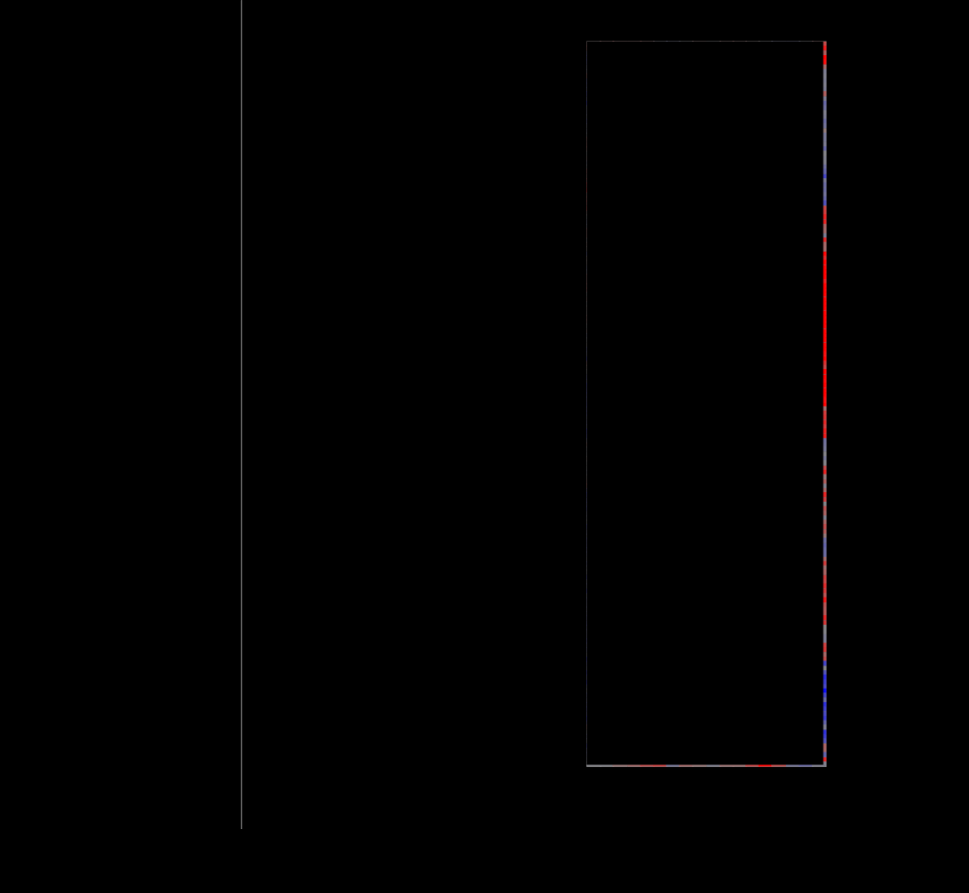
time
Defense response
Immune response
Response to stimulus
Toll regulated genes
JAK-STAT regulated genes
Microarray data
shows changed
expression of
thousands of genes.
Puparial adhesion
Molting cycle
hemocyanin
Amino acid catabolism
Lipid metobolism
How will you spot the patterns?
Peptidase activity
Protein catabloism
Immune response
Immune response
Toll regulated genes
attacked
control
Notes:
Bregje Wertheim at the Centre for Evolutionary Genomics, Department of Biology, UCL and Eugene Schuster Group, EBI.

Slide 7
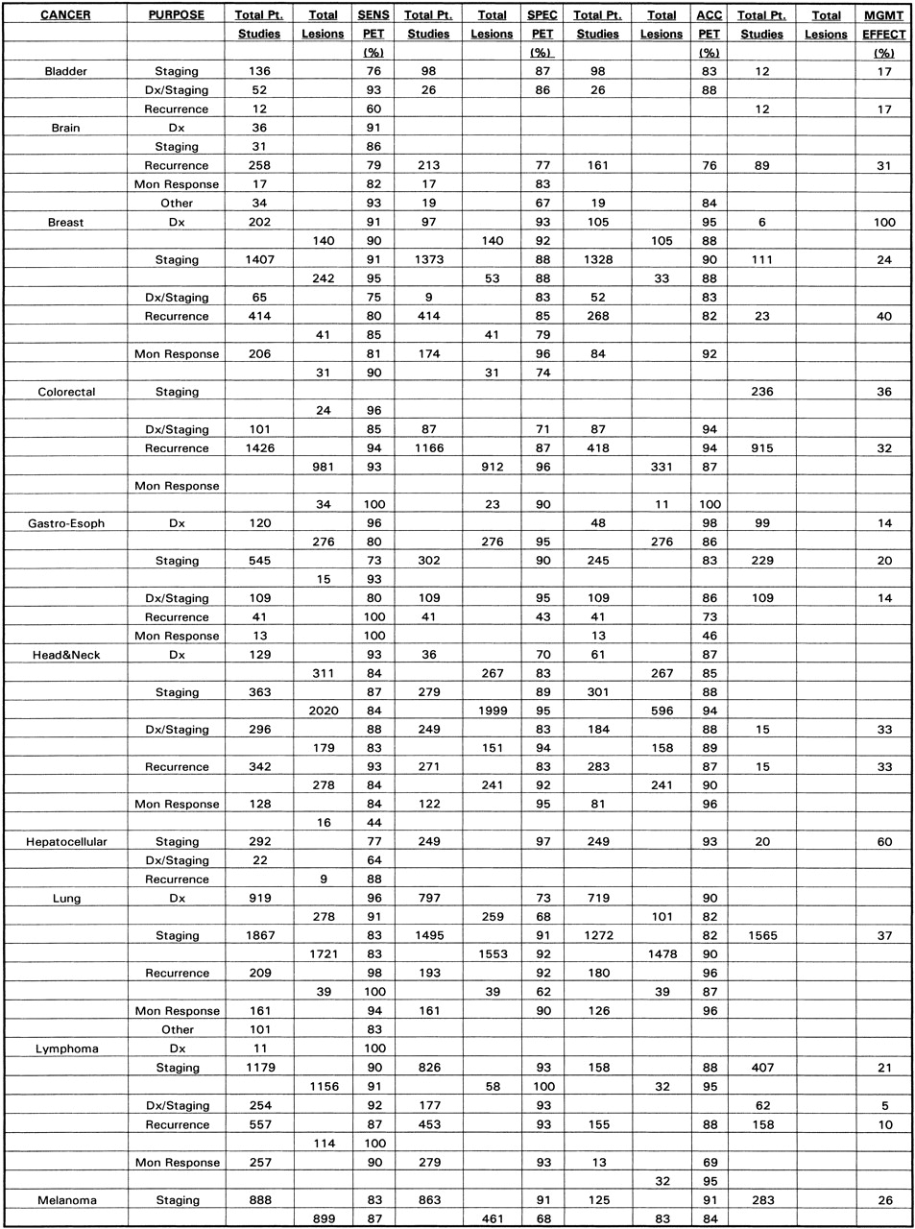

You’re interested in which of your hospital’s patient data is relevant to understanding how genes control heart muscle development

Slide 8
Lab / pathology data
EHR data
Clinical trial data
Family history data
Medical imaging
Microarray data
Model organism data
Flow cytometry
Mass spec
Genotype / SNP data
How will you spot the patterns?
How will you find the data you need?

Slide 9
How does the
Gene Ontology work?
with thanks to
Jane Lomax, Gene Ontology Consortium

Slide 10
1. GO provides a controlled system of representations for use in annotating data
multi-species, multi-disciplinary, open source
contributing to the cumulativity of scientific results obtained by distinct research communities
compare use of kilograms, meters, seconds … in formulating experimental results

Slide 11
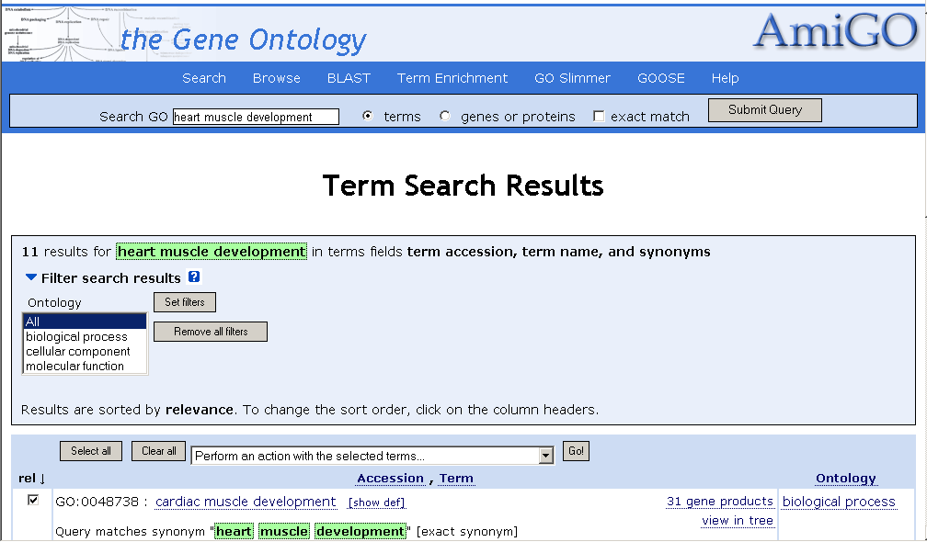
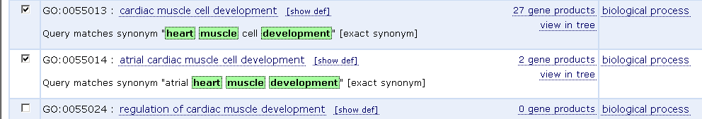

Slide 12
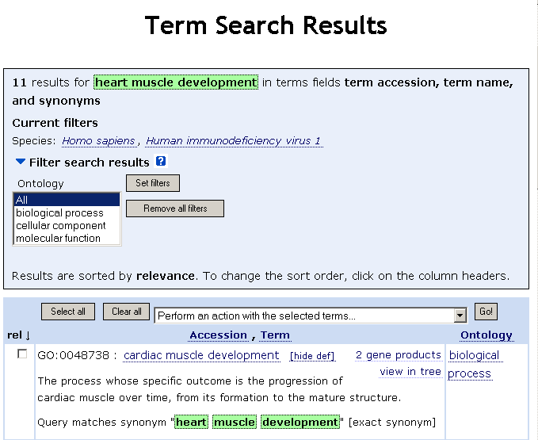
Definitions

Slide 13
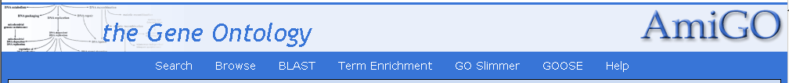
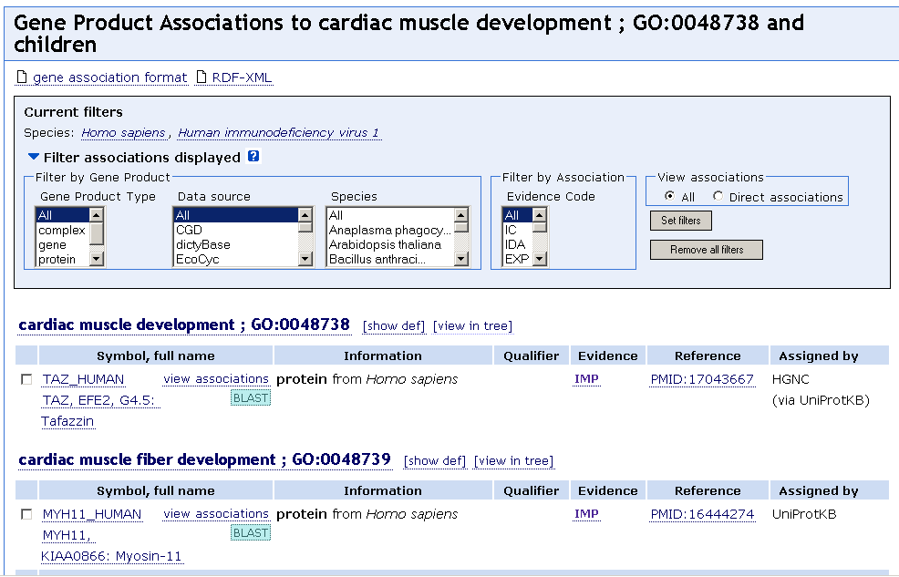
Gene products involved in cardiac muscle development in humans

Slide 14
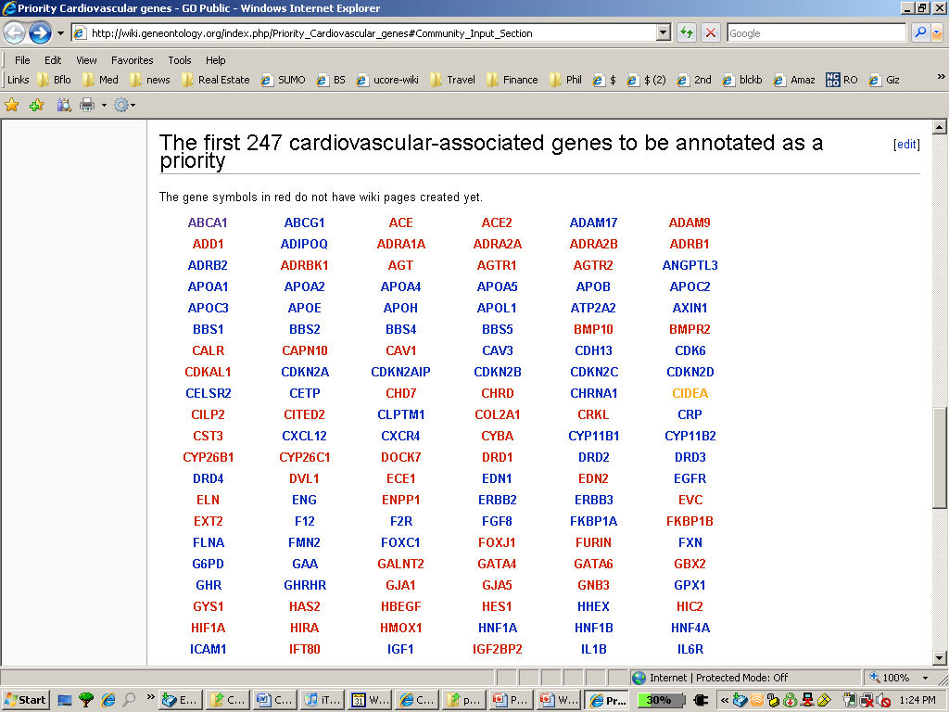
http://wiki.geneontology.org/index.php/Priority_Cardiovascular_genes

Slide 15
Questions for annotation
where is a particular gene product involved
  in what type of cell or cell part?
  in what part of the normal body?
  in what anatomical abnormality?
when is a particular gene product involved
  in the course of normal development?
  in the process leading to abnormality
with what functions is the gene product associated in other biological processes?

Slide 16
2. GO provides a tool for algorithmic reasoning

Slide 17
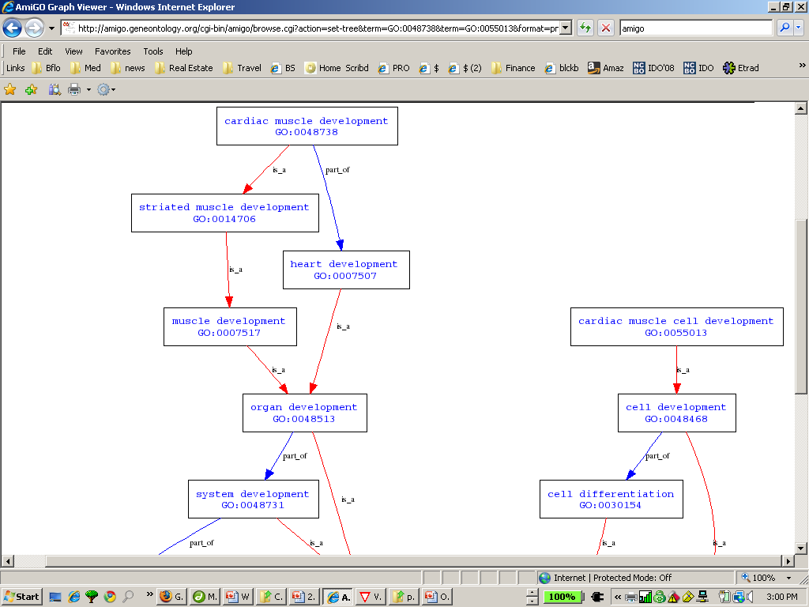
Hierarchical view representing relations between represented types

Slide 18
GO now introducing also regulates relations into its ontologies

Slide 19
3. GO allows a new kind of biological research, based on analysis and comparison of the massive quantities of annotations linking GO terms to gene products

Slide 20
Uses of GO in studies of
− role of regulation of gene expression in axon guidance during development in Drosophila (PMID 17672901)
− prevention of ischemic damage to the retina in rats (PMID 17653046)
− immune system involvement in abdominal aortic aneurisms in humans (PMID 17634102)
− how the white spot syndrome virus affects cell function in shrimp (PMID 17506900)
− relationships between protein interaction networks involving the ash1 and ash2 genes in flies and in humans (PMID 17466076)

Slide 21
GO is amazingly successful – but it covers only generic biological entities of three sorts:
  cellular components
  molecular functions
  biological processes
  and it does not provide representations of disease-related phenomena

Slide 22
Extending the GO methodology to other domains of biology

Slide 23
RELATION TO TIME GRANULARITY | CONTINUANT |  |  |  | OCCURRENT
 | INDEPENDENT |  | DEPENDENT
ORGAN AND ORGANISM | Organism (NCBI Taxonomy) | Anatomical Entity (FMA, CARO) | Organ Function (FMP, CPRO) | Phenotypic Quality (PaTO) | Biological Process (GO)
CELL AND CELLULAR COMPONENT | Cell (CL) | Cellular Component (FMA, GO) | Cellular Function (GO)
MOLECULE | Molecule (ChEBI, SO, RnaO, PrO) |  | Molecular Function (GO) |  | Molecular Process (GO)
The Open Biomedical Ontologies (OBO) Foundry

Slide 24
Ontology | Scope | URL | Custodians
Cell Ontology (CL) | cell types from prokaryotes to mammals | obo.sourceforge.net/cgi- bin/detail.cgi?cell | Jonathan Bard, Michael Ashburner, Oliver Hofman
Chemical Entities of Bio- logical Interest (ChEBI) | molecular entities | ebi.ac.uk/chebi | Paula Dematos, Rafael Alcantara
Common Anatomy Refer- ence Ontology (CARO) | anatomical structures in human and model organisms | (under development) | Melissa Haendel, Terry Hayamizu, Cornelius Rosse, David Sutherland,
Foundational Model of Anatomy (FMA) | structure of the human body | fma.biostr.washington. edu | JLV Mejino Jr., Cornelius Rosse
Functional Genomics Investigation Ontology (FuGO) | design, protocol, data instrumentation, and analysis | fugo.sf.net | FuGO Working Group
Gene Ontology (GO) | cellular components, molecular functions, biological processes | www.geneontology.org | Gene Ontology Consortium
Phenotypic Quality Ontology (PaTO) | qualities of anatomical structures | obo.sourceforge.net/cgi -bin/ detail.cgi? attribute_and_value | Michael Ashburner, Suzanna Lewis, Georgios Gkoutos
Protein Ontology (PrO) | protein types and modifications | (under development) | Protein Ontology Consortium
Relation Ontology (RO) | relations | obo.sf.net/relationship | Barry Smith, Chris Mungall
RNA Ontology (RnaO) | three-dimensional RNA structures | (under development) | RNA Ontology Consortium
Sequence Ontology (SO) | properties and features of nucleic sequences | song.sf.net | Karen Eilbeck

Slide 25
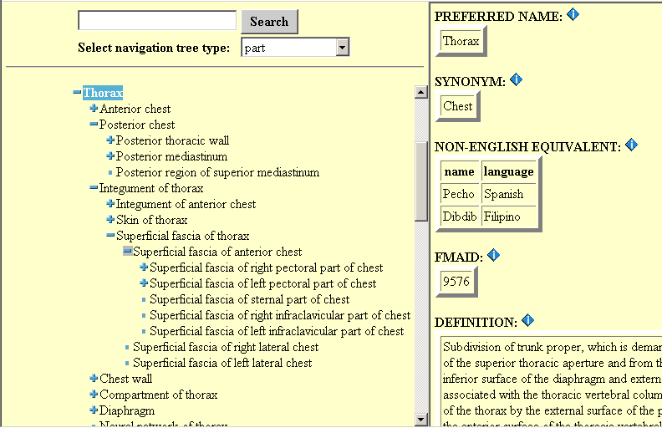
Foundational Model of Anatomy

Slide 26
Definitions
Cell =Def. an anatomical structure which consists of cytoplasm surrounded by a plasma membrane
Anatomical structure =Def. a material anatomical entity which is generated by coordinated expression of the organism’s own genes
An A =Def. a B which Cs
Notes:
… that guide its morphogenesis; has inherent 3D shape; its
parts are connected and spatially related to one another in patterns determined
by coordinated gene expression.

Slide 27
Anatomical Space
Anatomical
Structure
Organ Cavity
Subdivision
Organ
Cavity
Organ
Organ Part
Serous Sac
Cavity
Subdivision
Serous Sac
Cavity
Serous Sac
Organ
Component
Organ
Subdivision
Tissue
is_a
Pleural Sac
Pleura(Wall
of Sac)
Pleural
Cavity
part_of
Parietal
Pleura
Visceral
Pleura
Interlobar
recess
Mediastinal
Pleura
Mesothelium
of Pleura

Slide 28
OBO Foundry
recognized by NIH as framework to address mandates for re-usability of data collected through Federally funded research
see NIH PAR-07-425: Data Ontologies for Biomedical Research (R01)

Slide 29
OBO Foundry provides
tested guidelines enabling new groups to develop the ontologies they need in ways which counteract forking and dispersion of effort
an incremental bottoms-up approach to evidence-based terminology practices in medicine that is rooted in basic biology
automatic web-based linkage between biological knowledge resources (massive integration of databases across species and biological system)

Slide 30
An ontology is not a database
New databases for each new kind of data
New databases for each new project
Ontologies like the GO are a solution to the silo problems databases cause

Slide 31
A good solution to these silo problems must be:
modular
incremental
bottom-up
based on consistent, intuitive structure
evidence-based and thus revisable
incorporate a strategy for motivating potential developers and users

Slide 32
An ontology is not a terminology
Existing term lists
built to serve specific data-processing
in ad hoc ways
Ontologies
designed from the start to ensure integratability and reusability of data
by incorporating a common logical structure

Slide 33
OBO Foundry principle of modularity
one ontology for each domain
no need for ‘mappings’ (which are in any case too expensive, too fragile, too difficult to keep up-to-date as mapped ontologies change)
everyone knows where to look to find out how to annotate each kind of data
division of labor

Slide 34
RELATION TO TIME GRANULARITY | CONTINUANT |  |  |  | OCCURRENT
 | INDEPENDENT |  | DEPENDENT
ORGAN AND ORGANISM | Organism (NCBI Taxonomy) | Anatomical Entity (FMA, CARO) | Organ Function (FMP, CPRO) | Phenotypic Quality (PaTO) | Biological Process (GO)
CELL AND CELLULAR COMPONENT | Cell (CL) | Cellular Component (FMA, GO) | Cellular Function (GO)
MOLECULE | Molecule (ChEBI, SO, RnaO, PrO) |  | Molecular Function (GO) |  | Molecular Process (GO)
The Open Biomedical Ontologies (OBO) Foundry

Slide 35
Extending the OBO Foundry to evolutionary biology
GO Reference Genome Project
PATO – Phenotypic Quality Ontology e.g. as basis for comparative studies of human and model organisms
CARO – Common Anatomy Reference Ontology
PRO – Protein Ontology (ProEVO)
RNA Ontology

Slide 36
which of these terms already exist in OBO Foundry ontologies?
gene
allele
allelic variation
gene pool
genotype
population
speciation
homology
mutation
inheritance
organism
extinction

Slide 37
RELATION TO TIME GRANULARITY | CONTINUANT |  |  |  | OCCURRENT
 | INDEPENDENT |  | DEPENDENT
POPULATION | family, tribe, species, … |  |  | population phenotype | epidemic, speciation, …
ORGAN AND ORGANISM | Organism (NCBI Taxonomy) | Anatomical Entity (FMA, CARO) | Organ Function (FMP, CPRO) | Phenotypic Quality (PaTO) | Biological Process (GO)
CELL AND CELLULAR COMPONENT | Cell (CL) | Cellular Component (FMA, GO) | Cellular Function (GO)
MOLECULE | Molecule (ChEBI, SO, RnaO, PrO) |  | Molecular Function (GO) |  | Molecular Process (GO)
Adding population-level granularity to OBO Foundry

Slide 38
OBO Relation Ontology 1.0
Foundational | is_a part_of
Spatial | located_in contained_in adjacent_to
Temporal | transformation_of derives_from preceded_by
Participation | has_participant has_agent
“Relations in Biomedical Ontologies”, Genome Biology, April 2005

Slide 39
GO graph-theoretic hierarchy allows logical reasoning

Slide 40
Relation Ontology
A is_a B =def. Every instance of A is an instance of B
A part_of B =def. Every instance of A is a part of some instance of B

Slide 41
derives_from
C
c at t
C₁
c₁ at t₁
time
C'
c' at t
instances
ovum
zygote derives_from
sperm

Slide 42
transformation_of
same instance
C
c at t
C₁
c at t₁
time
pre-RNA → mature RNA
child → adult
pupa → larva

Slide 43
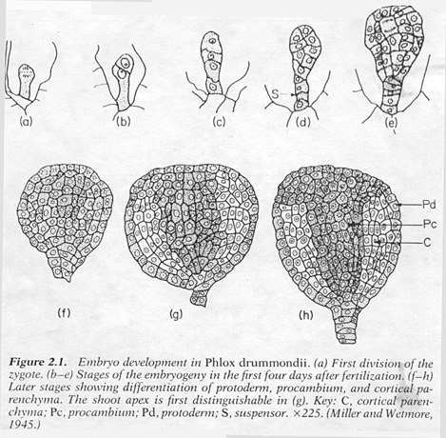
C
c at t
C₁
c at t₁
embryological development

Slide 44
two continuants fuse to form a new continuant
C
c at t
C₁
c₁ at t₁
C'
c' at t
fusion

Slide 45
one initial continuant is replaced by two successor continuants
C
c at t
C₁
c₁ at t₁
C₂
c₂ at t₁
fission

Slide 46
one continuant detaches itself from an initial continuant, which itself continues to exist
C
c at t
c at t₁
C₁
c₁ at t
budding

Slide 47
one continuant is absorbed by a second continuant
C
c at t
C₁
c₁ at t₁
C'
c' at t
capture

Slide 48
Relations proposed for RO 2.0
regulates (GO)
inheres_in
has_input
has_function
has_quality
realization_of
directly_descends_from (CARO)
homologous_to (CARO)

