Slide 1

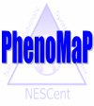


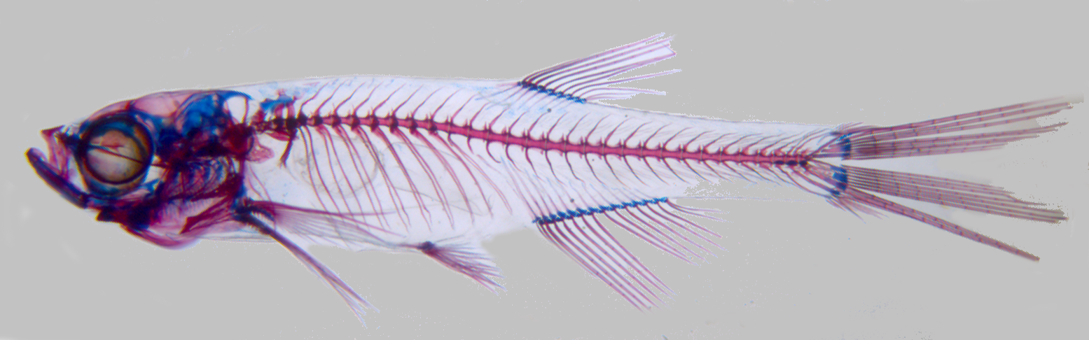
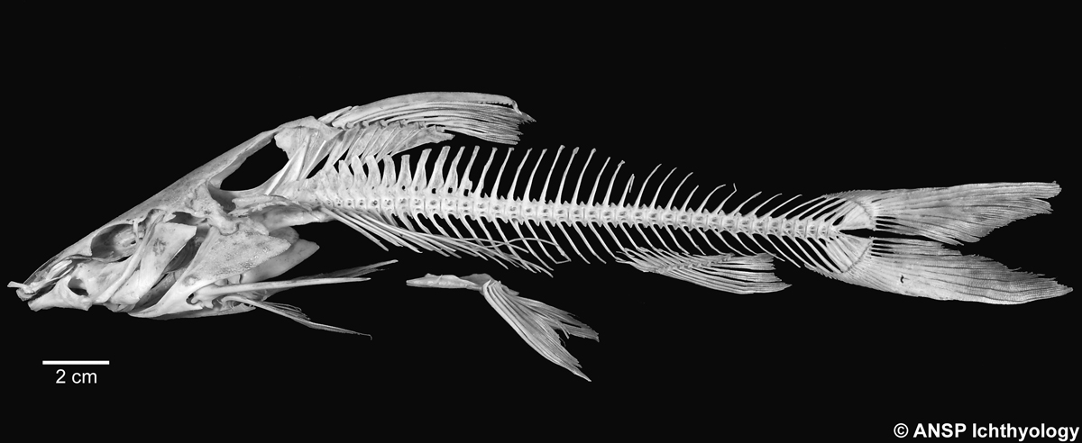
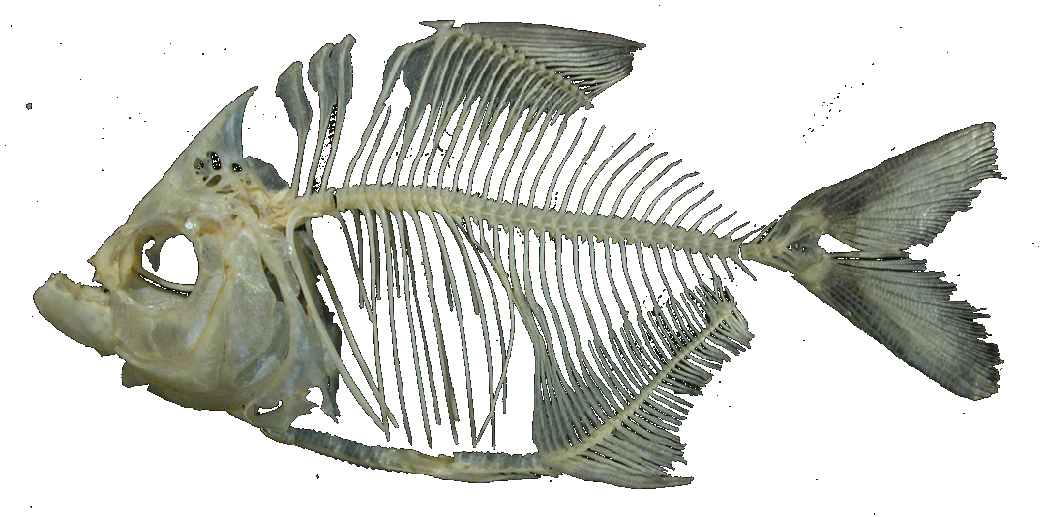
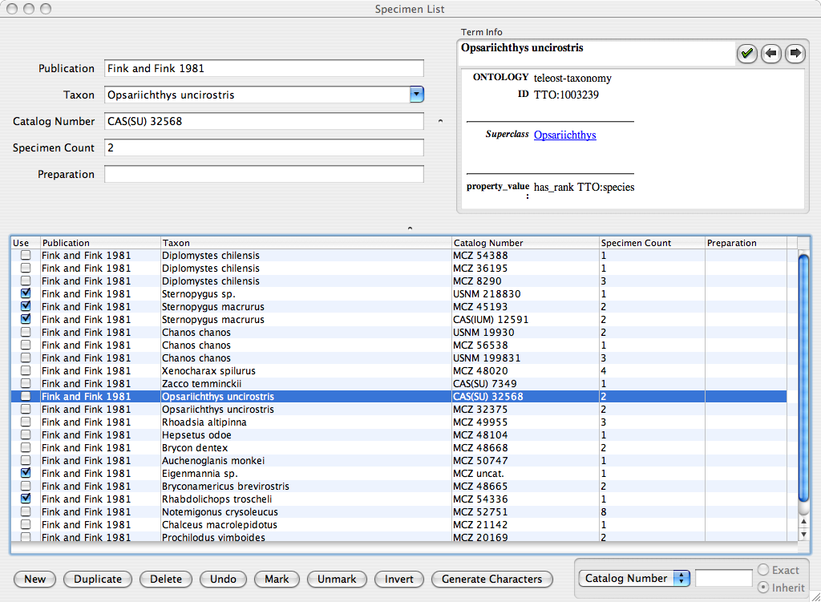
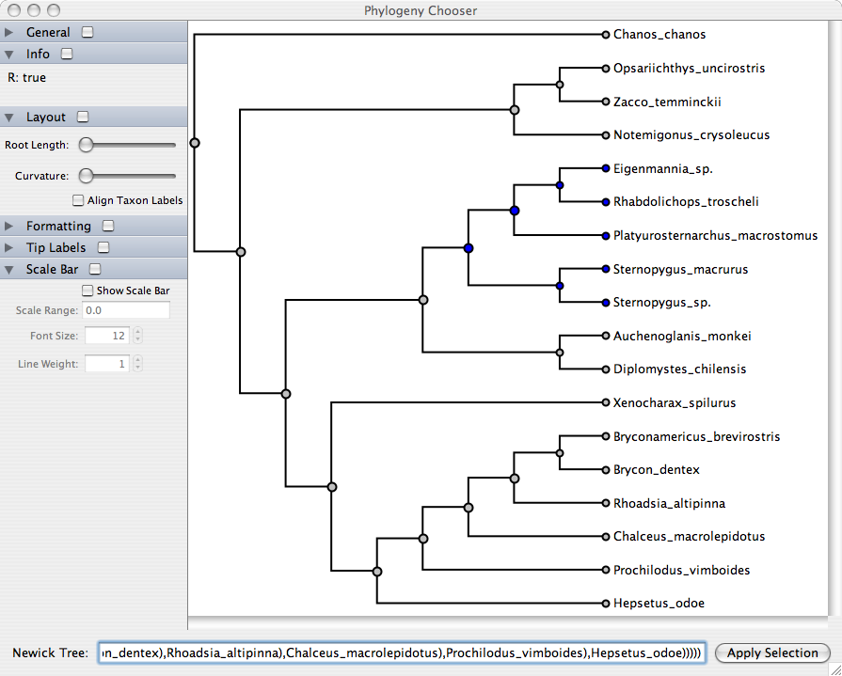
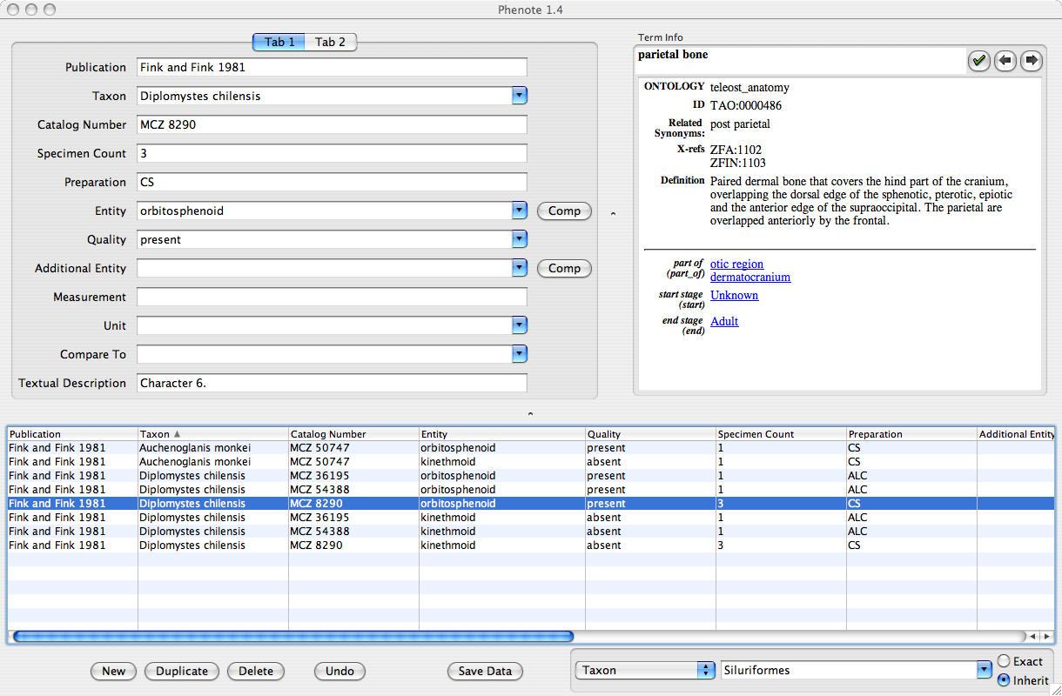
LINKING EVOLUTION TO GENOMICS USING PHENOTYPE ONTOLOGIES
Paula Mabee¹, Jim Balhoff², Wasila Dahdul^{1,3} , Hilmar Lapp², John Lundberg³,
Peter Midford⁴, Todd Vision^{2,5}, Monte Westerfield⁶
¹The University of South Dakota; ²National Evolutionary Synthesis Center (NESCent); ³Academy of Natural Sciences, Dept. Ichthyology; ⁴University of Kansas;
⁵University of North Carolina at Chapel Hill; ⁶University of Oregon, Zebrafish Information Network (ZFIN)
Taxonomy ontology
Abstract
Anatomy ontology
(multi-species anatomy ontology)
An ontology for biological taxonomy has a simple structure with the relation is_a. Some taxonomy ontologies may include terms for levels of classification (e.g., order, family, etc.) and an additional relation relating terms to their levels.
A partial Linnaean taxonomy of fishes
Infraclass Teleostei
Superorder Ostariophysi
Series Anotophysi
Order Gonorynchiformes
Family Chanidae
Gen. & sp. Chanos chanos - milkfish
Series Otophysi
Order Cypriniformes
Family Cyprinidae
Gen. & sp. Cyprinus carpio - carp
Gen. & sp. Danio rerio – zebrafish
Subseries Characiphysi
Order Characiformes
Family Characidae
Gen. & sp. Pygocentrus caribe - piranha
Gen. & sp. Cheirodon axelrodi - cardinal tetra
Infraseries Electriphysi
Order Siluriformes
Family Ictaluridae
Gen. & sp. Ictalurus punctatus - channel catfish
Family Clariidae
Gen. & sp. Clarias batrachus - walking catfish
Order Gymnotiformes
Family Electrophoridae
Gen. & sp. Electrophorus electricus - electric eel
The aim of our work is to develop tools to integrate evolutionary and model organism phenotype data using ontologies to address questions about the genetic and developmental regulation of evolutionary morphological transitions. Specifically, we are developing a multi-species anatomy ontology (Teleost Anatomy Ontology, or TAO) for the large clade of fishes that includes zebrafish (the Ostariophysi), using the existing zebrafish anatomy ontology (ZFA) as its core. We are annotating evolutionary characters from the literature using terms from the anatomy ontology in combination with terms from the Phenotype and Trait Ontology (PATO), by adapting the EQ syntax of model organism databases. We are documenting character observations from species using a taxonomy ontology developed from an expert database, the Catalog of Fishes. With a suite of database and web-interface tools that we develop to support the research queries desired by the community, this first systematic character database will enable researchers to investigate relationships between evolutionary changes in morphology and the phenotypes seen in genetically characterized developmental mutants of zebrafish. We will demonstrate the feasibility of our approach by implementing a select number of use-case queries as proof-of-concept. Here we focus on our curatorial challenges, including development of the multi-species ontology, need for modification in existing ontology and EQ editing tools to support evolutionary character annotation.
1. New entities required for new species
middle nuchal plate
1 mm
predorsal
spine
Order Cypriniformes
Danio rerio
anterior
nuchal plate
spinelet
Order Siluriformes
Pimelodus maculatus
2 cm
abdominal
scutes
Order Characiformes
Catoprion mento
Phenote for evolutionary data entry
2. Synonyms of entities of different types must be designated and defined to support reasoning. These different types of synonyms include:
    Different terms used to refer to the same bone (“true” synonyms). Examples of true synonyms include extrascapular = supratemporal, and lepidotrichia = fin rays.
    Misspelled terms that refer to the same bone, such as postemporal (incorrect spelling) = posttemporal (correct spelling).
    Differently spelled terms that refer to the same bone, such as hyomandibular vs. hyomandibula.
    Same term used for nonhomologous bones. For example, zebrafish and humans both possess a frontal bone; however, the zebrafish frontal bone is homologous to the human parietal bone. Zebrafish are missing the bone called frontal in humans. In addition, the zebrafish parietal bone is homologous to the postparietal in humans.
    Incorrect usage of the same term. For example, lacrimal and infraorbital 1 are used by ichthyologists to refer to the same bone, but infraorbital 1 in fishes is not homologous to the lacrimal bone in tetrapods; lacrimal should not be used in ichthyology.
Modern taxonomic classifications are based on inferred phylogeny, i.e. the history of ancestral-descendent and branching (diversifying) relationships of the organisms of interest. Thus, classifications should match trees.
An ontology for a phylogenetic tree can have the same simple structure as its phylogenetic classification. However, there is no agreed-upon formal definition for the relation between a phylogenetic node and its ancestor.
Phenote is a software application developed by the NCBO for the curation of biological phenotypes using ontologies. Data annotated with Phenote is based on the EQ model for representing phenotypes, combining entities from any ontology with qualities (such as from PATO). We have incorporated the new Teleost Taxonomy Ontology and Teleost Anatomy Ontology into Phenote. In addition, we have been adding new interface features to Phenote that support the unique needs of our curators in handling evolutionary data:
A phylogenetic tree for the same fishes
Evolutionary specimens require a new "Specimen List" interface
Anotophysi
Gonorynchiformes
Chanidae
Chanos chanos
Cyprinus carpio
Danio rerio
Pygocentrus caribe
Cheirodon axelrodi
Clarias batrachus
Ictalurus punctatus
Electrophorus electricus
Taxonomic publications describe multiple aspects of phenotype for each specimen or species
The Specimen List allows the curator to enter, once, all the specimens described in the publication, annotated using the Teleost Taxonomy Ontology, and then repeatedly use them within phenotype statements
The Generate Characters button creates new phenotype statements in the main window with the specimen information filled in
This functionality can be re-used by other users of Phenote for any form of character "templating"
3. Simple differences in development across species are difficult to reflect in ontology
Zebrafish and Teleost Ontology terms and relations in black
Teleost Ontology specific terms and relations in blue
Caudal fin is supported by a bony structure called the
urostyle that develops in different ways:
Urostyle unfused
(basal teleosts)
Urostyle all fused
(zebrafish)
Urostyle all fused
(most catfish)
Ostariophysi
Cypriniformes
Cyprinidae
PU1
U1
U2
PU1+U1+U2
PU1+U1+U2
develops into
develops into
develops into
Otophysi
Characiformes
Characidae
PU1
U1
U2
PU1+U1
U2
PU1+U1
U2
develops into
Phylogenetic interface facilitates curation of larger taxonomic groups
PU1
U1
U2
Characiphysi
Clariidae
Groups of related species will often share the same phenotype
Using a phylogenetic tree view of the species they're working with, curators can select nodes on the tree to apply the same phenotype statement to an entire related group of species
The selection is applied to the specimen list and then used for bulk editing within the main window.
i
vertebra
Intermediate term required to accommodate expansion of ural vertebra series in Teleost Ontology
Siluriformes
Challenge: how
to represent in ontology?
create different entities for homologous structures of different developmental origin?
use of “anatomical cluster” vs. entity?
alternatives?
caudal vertebra
i
Electriphysi
Ictaluridae
i
i
ural vertebra
i
preural vertebra
i
Gymnotiformes
Electrophoridae
i
i
i
PU2 vertebra
PU1 vertebra
U1 vertebra
U2 vertebra
CHALLENGES:
The ontology must include all published names of species and genera plus recent expert opinion on which
are valid species and genera. This complete catalog of species and generic names will thus reveal
the synonymies of all names.
The classification of species in genera and higher groups must be phylogenetically based as far as possible,
but taxa of uncertain phylogenetic relationship must also be included.
Fossil taxa must be included but are not in Eschmeyer’s Online Catalog of Fishes or NCBI taxonomy.
Specimens belonging to new but yet unnamed species must be included.
Specimens that are uncertainly identified to species must be included.
P
P
P
Filter feature allows the curator to focus on data of interest
PU1 centrum
U1 centrum
D
U2 centrum
The new filter interface in Phenote allows the curator to view only the rows matching an entered query
The curator chooses which data field to search on
Free text fields are filtered by simple text comparison
Ontology-based fields can match an entered ontology term exactly, or optionally can match any rows containing terms descending from that term in the ontology
For example, all rows describing phenotypes for various catfish species can be viewed by filtering on the term "Siluriformes", a taxonomic order from the Teleost Taxonomy Ontology
P
P
PU1+U1
D
PU1+U1
P
D
D
D
D
Urostyle unfused
(is_a anatomical cluster)
Urostyle
PU1+U1 + U2
Urostyle
PU1+U1 + U2
MEETING CHALLENGES:
Our taxonomy ontology will have a tool to track updates to species and genera in Eschmeyer’s Online Catalog of Fishes.
We will manually curate higher-level phylogenetic placement of species using results of the Cypriniformes Tree of Life project, All Catfish Species Inventory, and independent research on related groups.
Phylogenetic uncertainty will be annotated.
We will add fossil taxa as needed.
Acknowledgements
We thank NSF DBI 0641025; NIH HG002659 and the National Evolutionary Synthesis Center (NESCent) NSF #EF-0423641 for funding.

