Slide 1
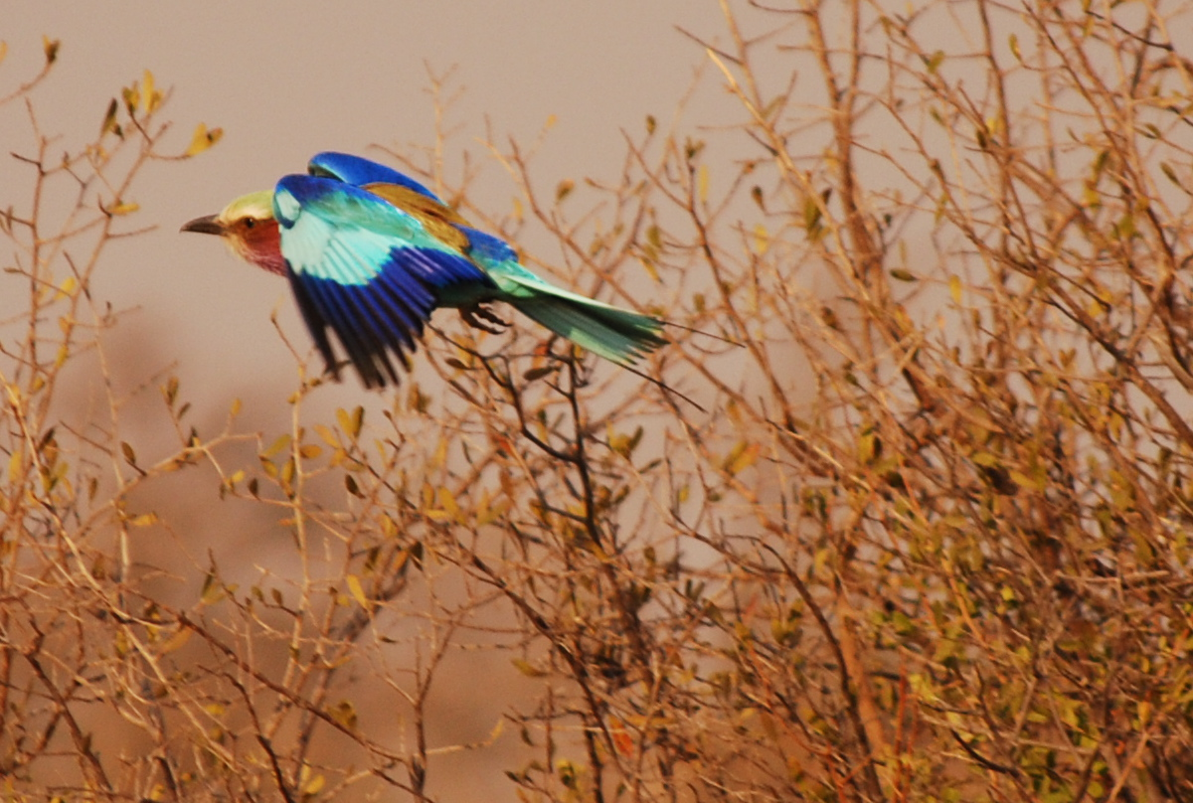
A statistical method for comparing phenotypes in the OBD
Suzanna Lewis
Data Round-up 2008

Slide 2
OBD model: Requirements
Generic
  We can’t define a rigid schema for all of biomedicine
  Let the domain ontologies do the domain modeling
Expressive
  Use cases vary from simple ‘tagging’ to complex descriptions of biological phenomena
Formal semantics
  Amenable to logical reasoning
  First Order Logic and/or OWL1.1
Standards-compatible
  Remain open to possibility of integration with semantic web

Slide 3
OBD Model: overview
Graph-based: nodes and links
  Nodes: Classes, instances, relations
  Links: Relation instances
    Connect subject and object via relation plus additional properties
  Annotations: Posited links with attribution / evidence
Equivalent expressivity as RDF and OWL
  Links aka axioms and facts in OWL
  Attributed links:
    Named graphs
    Reification
    N-ary relation pattern
Supports construction of complex descriptions through graph model

Slide 4
Experimental Design
Annotate 11 human disease genes, and their homologs
Develop search algorithm that utilizes the ontologies for comparison
Test search algorithm by asking, “given a set of phenotypic descriptions (EQ stmts), can we find…”
  alleles of the same gene
  homologs in different organisms
  members of a pathway (same organism)
  members of a pathway (other organisms)
Notes:
Gregory Bateson

Slide 5
Testing the methodology
Annotated 11 gene-linked human diseases described in OMIM, and their homologs in zebrafish and fruitfly:
Gene | Disease
ATP2A1 | Brody Myopathy
EPB41 | Elliptocytosis
EXT2 | Multiple Exostoses
EYA1 | BOR syndrome
FECH | Protoporphyria
PAX2 | Renal-Coloboma Syndrome
SHH | Holoprosencephaly
SOX9 | Campomelic Dysplasia
SOX10 | Peripheral Demyelinating Neuropathy
TNNT2 | Familial Hypertrophic Cardiomyopathy
TTN | Muscular Dystrophy
Notes:
Incomplete list of “syndromes”!!!

Slide 6
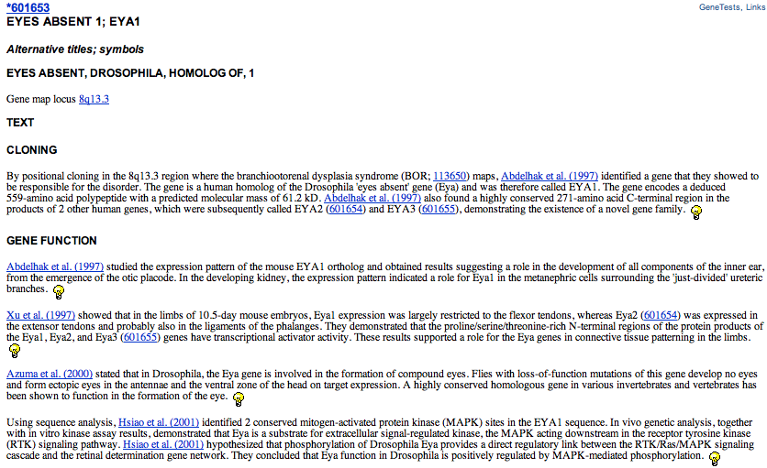
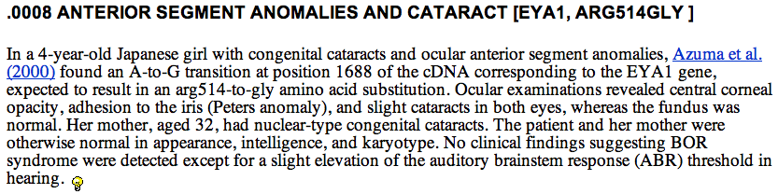
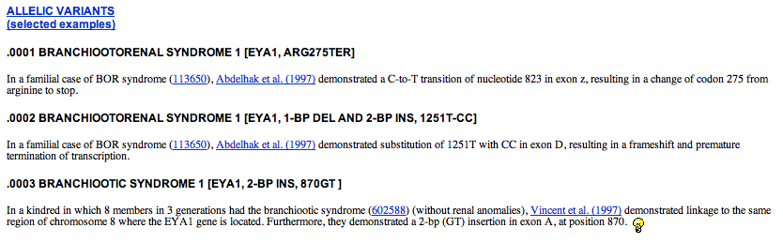
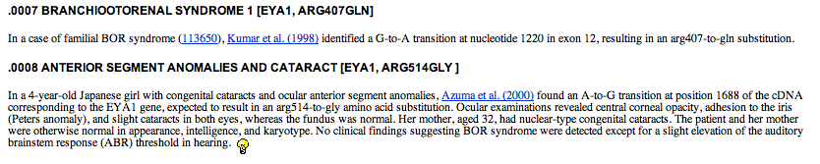
An OMIM Record

Slide 7
Annotation Results
Gene | # geno-types | phenotype statements
 |  | total | average/ allele
ATP2A1 | 5 | 16 | 3
EPB41 | 4 | 18 | 4
EXT2 | 5 | 35 | 7
EYA1* | 16 | 335 | 19
FECH | 14 | 37 | 3
PAX2* | 24 | 183 | 8
SHH | 19 | 207 | 9
SOX9* | 13 | 321 | 23
SOX10* | 15 | 192 | 12
TNNT2 | 10 | 36 | 4
TTN | 21 | 63 | 3
Total (11) | 146 | 1443
Notes:
This shows the results of the annotation effort. For the 11 genes we annotated 146 genotypes with a total of 1443 annotation statements. We performed 4 of these in triplicate (with asterisk) to check for consistency. Without getting into it, the genes annotated in triplicate revealed that the annotators had more than 75% similar annotations. (we just don’t have time in the 15 minutes to go through this.)

Slide 8
Experimental Design
Annotate 11 human disease genes, and their homologs
Develop search algorithm that utilizes the ontologies for comparison
Test search algorithm by asking, “given a set of phenotypic descriptions (EQ stmts), can we find…”
  alleles of the same gene
  homologs in different organisms
  members of a pathway (same organism)
  members of a pathway (other organisms)

Slide 9


Ontology-based similarity scoring
Measure IC of any node:
Compute ‘similarity’ by finding IC ratios between any genotypes, genes, classes, etc.
Notes:
First, you have to discuss the scoring metrics. There’s information content, and the IC ratios between things.
Nodes are deemed similar on the basis of what they have in common.
we are looking for similarity on the basis of shared annotations to classes in an ontology, or to compositional description classes
In these cases, we used inferred annotations. E.g. if geneA is annotated to Leg and geneB to Wing, they have Appendage in common.
Scoring is typically a measure of what the nodes have in common vs what one node has that the other one does not.
The basicSimilarityScore (aka class overlap) is the ratio of nodesInCommon to nodesInUnion . Recall that this includes inferred annotations. This is desirable for two reasons: it allows approximate matching for non-exact classes, and it penalises general matches in favour of specific matches.
The information content of a class is a measure of how "surprised" we are to see it in an annotation.
The pre-reasoned results are essential for finding nodesInCommon - annotations do not necessarily match exactly - they may match further up the graph.
so we do not report or double-count nodes that subsume existing nodes.

Slide 10
Ontology-based Search Algorithm
Given a query node q, we try to find hits h1, h2,... that are of the same type as q, and are similar to q in terms of their annotation profile, A(q).
First step: create an annotation profile for the thing to be searched (i.e., a gene)
The annotation profile is the set of classes used to annotate that entity, and their ancestors
Comparing annotation profiles using same similarity IC metric
c ∈ A(q) iff link(r,q,c)
link(influences,sox9,curvature-of-tibia) → link(influences,sox9,morphology-of-bone)
Notes:
Now, given that we can compute the IC ratios between any two things, then we can certainly do this for the phenotypic profiles for any two gene pairs.
Given a query node q, we try to find hits h1, h2,... that are of the same type as q, and are similar to q in terms of their annotation profile, A(q). The annotation profile is the set of classes used to annotate that entity, and their ancestors, via some relevant relation(s).
c ∈ A(q) iff link(r,q,c)
link(r,q,c) may be computed via reasoning. For example:
link(influences,sox9,curvature-of-tibia) → link(influences,sox9,morphology-of-bone)
Candidate hits are prioritized according to how close they are to the profile. They are ordered in descending order by | A(h) ∩ H(q) |, and the first N are chosen as the final set

Slide 11
Yes, we can find alleles of same gene
Gene | # geno-types | allelic phenotype profiles |  |  | phenotype statements
 |  | # alleles >0 sim ratio | average sim ratio | average IC ratio | total | average/ allele
ATP2A1 | 5 | 5 | 0.8 | 0.799 | 16 | 3
EPB41 | 4 | 4 | 0.315 | 0.422 | 18 | 4
EXT2 | 5 | 5 | 1 | 1 | 35 | 7
EYA1* | 16 | 16 | 0.226 | 0.229 | 335 | 19
FECH | 14 | 14 | 0.365 | 0.364 | 37 | 3
PAX2* | 24 | 24 | 0.068 | 0.063 | 183 | 8
SHH | 19 | 19 | 0.457 | 0.414 | 207 | 9
SOX9* | 13 | 13 | 0.207 | 0.197 | 321 | 23
SOX10* | 15 | 13 | 0.038 | 0.031 | 192 | 12
TNNT2 | 10 | 10 | 0.517 | 0.505 | 36 | 4
TTN | 21 | 19 | 0.106 | 0.1 | 63 | 3
Total (11) | 146 | 142 |  |  | 1443
Notes:
Those with astersiks (*) were done in triplicate
Really, here, the take home message is that for all 11 genes tested, nearly all (exception of two alleles) were able to search in a pairwise way and a find the other alleles of the same gene. (in bold). YES WE CAN!!!

Slide 12
Experimental Design
Annotate 11 human disease genes, and their homologs
Develop search algorithm that utilizes the ontologies for comparison
Test search algorithm by asking, “given a set of phenotypic descriptions (EQ stmts), can we find…”
  alleles of the same gene
  homologs in different organisms
  members of a pathway (same organism)
  members of a pathway (other organisms)

Slide 13
UBERON: an anatomical linking ontology
Each organism has its own anatomical ontology
To connect annotations across species, need a way to link the anatomies
Wanted an ontology that incorporated both functional homology and anatomical similarity
Created an ontology linking anatomies from ZFA, FMA, XAO, MA, MIAA, WBbt, FBbt
Notes:
To enable these queries that annotate using different anatomical ontologies, we needed a way to connect them together. We created an “uber” anatomy ontology that brings together the anatomical parts from the different anatomy ontologies. When used in our searches, the annotations to individual anatomy terms, like fish eye and human eye can be linked together through a common “uber” eye. NEED DIAGRAM HERE

Slide 14
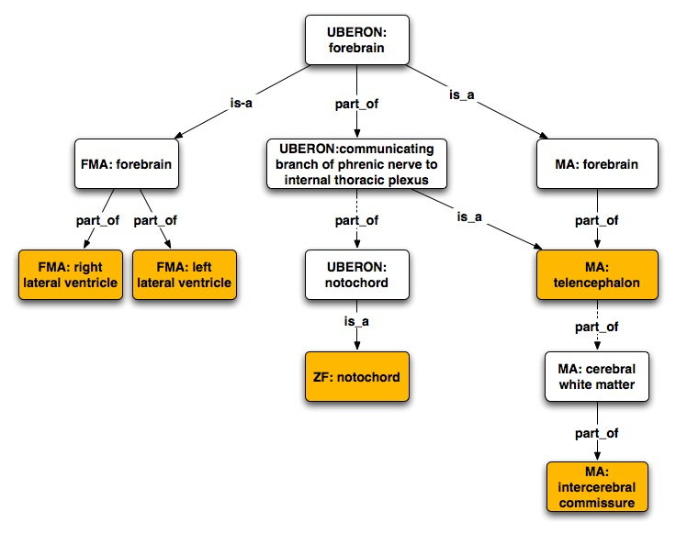
UBERON connects phenotype entities from separate anatomy ontologies
Notes:
The entities that annotations were made two in mouse, human, and zebrafish are shown in orange. Then, the links between the ontology terms have been made with the aide of the UBERON ontology… each of the annotated entities can be linked through the UBERON:forebrain term.

Slide 15
Homologs are found by similarity search
 | sim_{IC} human/ mouse | sim_{IC} human/ zebrafish
Gene
ATP2A1 | 0.047 | 0.177
EPB41 | 0.328 | 0.141
EXT2 | 0.067 | 0.050
EYA1 | 0.264 | 0.495
FECH | 0.430 | 0.101
PAX2 | 0.157 | 0.375
SHH | 0.091 | 0.253
SOX9 | 0.226 | 0.383
SOX10 | 0.380 | 0.443
TNNT2 | 0.000 | 0.118
TTN | 0.248 | 0.567
Notes:
Using the UBERON connections, we are able to find homologs of each of the human disease genes in mouse and zebrafish.
Here, we show the similarity ratio based on information content between the human-mouse and human-zebrafish homologous gene pairs. The phenotypic profiles for each gene represent a consolidation (promotion) of the phenotypic description Eqs.
Interesting things are suggested here. Its possible that some of the zebrafish homologs (EYA1, PAX2, SHH, SOX9, SOX10, TTN) might make better models than the mouse homologs for the diseases caused by the human genes.

Slide 16
Experimental Design
Annotate 11 human disease genes, and their homologs
Develop search algorithm that utilizes the ontologies for comparison
Test search algorithm by asking, “given a set of phenotypic descriptions (EQ stmts), can we find…”
  alleles of the same gene
  homologs in different organisms
  members of a pathway (same organism)
  members of a pathway (other organisms)

Slide 17
shha is phenotypically similar to homologous pathway members
zebrafish shh pathway | mouse homologs | human homologs
shha | Shh | SHH
smo | Smo
disp1 | Disp1
prdm1a | Prdm1
hdac1 |  | HDAC4
scube2
wnt11 | Wnt1, 7b, 3a, 9b, 10b | WNT6
gli1,2a | Gli2, Gli3 | GLI2
bmp2b | Bmp4
ndr1,2 |  | NDRG1
hhip | Hhip
ptc1,ptc2 | Ptch1,2
 | Rab23
 | Gas1
 | Nck1
 | Zic2
notch1a | Notch1,2
 | Gsk3b
Notes:
This table shows the list of genes known to be involved in the shh pathway that were retrieved with a similarity search using the zebrafish shh as bait. The list of zf genes is like that in the earlier slide. The mouse and human homologs are also indicated. For some, the mouse/human homologs were retrieved when the zf genes were not. This could be fore several reasons… the biggest reason is that much of the knowledge of the zebrafish pathway members comes from morpholino experiments. The morpholino data was not included in our initial analyses. One of the next steps is for us to include the morpholino data and redo this search. Many of the human homologs also are not annotated…
These lacking annotations for the human disease genes therefore represent significant deficiencies and extremely necessary resources for biological research.
The next slide shows how these genes fall in the shh pathway…

Slide 18
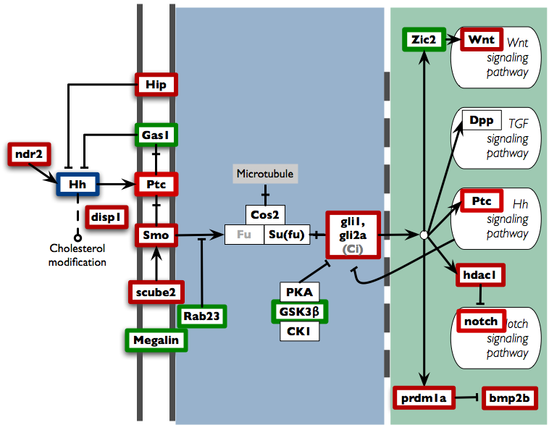
Notes:
Zebrafish SHH signaling pathway
The picture is from KEGG. Their model includes the known members of the the human HH signaling pathway. Additional genes known to be involved in the zebrafish signaling pathway have been added (gli1, gli2a, hdac1, prdm1a, bmp2b, dsp1, ndr2, scube2).
Ptc and Smo are transmembrane proteins thought to form a receptor complex for the Hh ligand (7, 8), and the Gli zinc-finger transcription factors have been demonstrated to have both activating and inhibitory roles in the Hh pathway (9–13). A second Ptc gene has been isolated, Ptch-2, which encodes a putative receptor for Shh (14, 15).

Slide 19
Potential candidates also found
Gene | Similarity | Characterization
dharma | 0.483 | Paired type homeodomain protein that has dorsal organizer inducing activity and is regulated by wnt signaling.
tbx16 | 0.401 | T-box transcription factor regulates mesenchyme to epithelial transition and LR patterning.
plod3 | 0.387 | Lysyl hydroxylase and glycosyltransferase important for axonal growth cone migration.
ntl | 0.382 | T-box transcription factor important for notochord and mesoderm development.
kny | 0.374 | Glypican component of the wnt/PCP pathway
tll1 | 0.372 | Metalloprotease that can cleave Chordin and increase Bmp activity.
copa | 0.372 | Cotamer vesicular coat complex important for maintenance of the Golgi and ER transport. Important for notochord differentiation.
sfpq | 0.369 | RNA splicing factor required for cell survival and neuronal development.
lama1 | 0.369 | Basement membrane protein important for eye and body axis development.
lamc1 | 0.367 | Basement membrane protein important for eye development
atp7a | 0.365 | Copper transporting ATPase.
atp2a1 | 0.363 | Sarcoplasmic reticulum transmembrane ATPase that mediates calcium re-uptake.
flh | 0.358 | Homeobox gene important for notochord and epiphysis development. Anterior/posterior expression determined by wnt activity.
wnt5b | 0.327 | Extracellular cysteine rich glycoprotein required for convergent extension movements during posterior segmentation.
Notes:
In addition to the known pathway members, there were many more as-yet-unlinked genes found with similar phenotypes to shha. These represent potential pathway candidates. Here we’ve summarized some likely candidates based on their characterization. This is where the real power of this method comes in… discovery!

Slide 20
Results thus far
Annotate 11 human disease genes, and their homologs
Develop search algorithm that utilizes the ontologies for comparison
Test search algorithm by asking, “given a set of phenotypic descriptions (EQ stmts), can we find…”
  alleles of the same gene
  homologs in different organisms
  members of a pathway (same organism)
  members of a pathway (other organisms)

Slide 21
Conclusions
Ontologies help
Promising new directions for ontology-based phenotype annotation
Promising ways for identifying novel pathway members, generating hypotheses to test at the bench

Slide 22
Acknowledgements
NCBO-Berkeley
Christopher Mungall
Nicole Washington
Mark Gibson
Rob Bruggner
U of Oregon
Monte Westerfield
Melissa Haendel
Cambridge
Michael Ashburner
George Gkoutos (PATO)
David Osumi-Sutherland
National Institutes of Health

