Slide 1
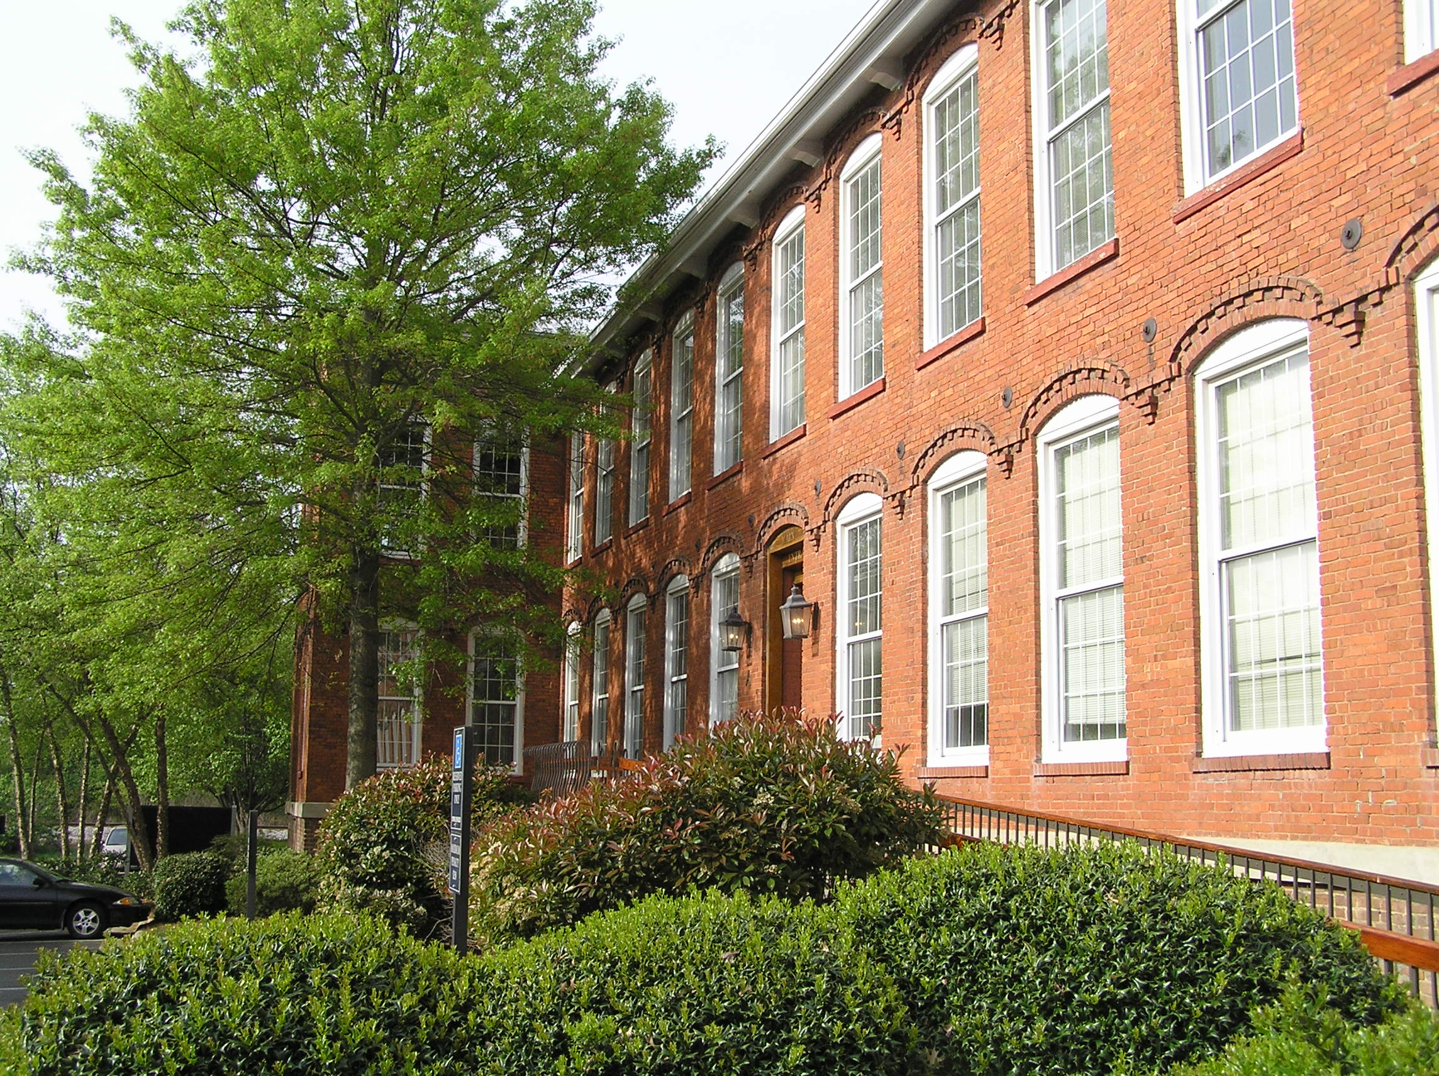
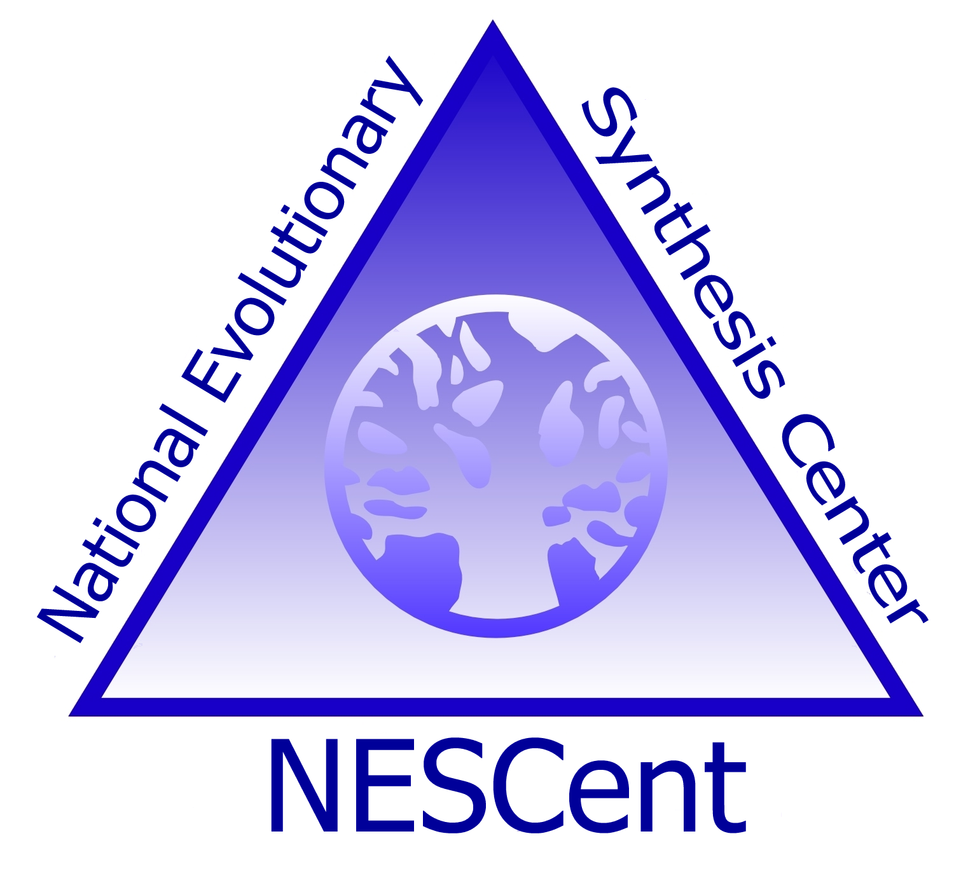
Representing evolutionary homology between entity terms used in EQ annotations
Hilmar Lapp
National Evolutionary Synthesis Center

Slide 2
What is homology?
“Two or more structures are […] homologous if they are alike because of shared ancestry.”
“This could be evolutionary ancestry, meaning that the structures evolved from some structure in a common ancestor, … or developmental ancestry, meaning that the structures arose from the same tissue in embryonal development.”
Quoted from Wikipedia.
Homology is boolean in nature, there is no ‘degree’ of homology.
Can two structures be paralogous?

Slide 3
Universal definition?
Evolutionary ancestry or developmental ancestry?
How do we disambiguate? ‘Develops-from’?
Assume that if we say
‘Structure A is-homologous-to Structure B’
we mean that Structure A and Structure B arose from an ancestral Structure C.

Slide 4
Need universal truths
Do we want to be able to make inferences from a homology statement between structures A and B?
  E.g., all species that have an instance of Structure A share a common ancestor with all species that have an instance of Structure B. That common ancestor had an instance of the ancestral Structure C.
  E.g., all structures that are is-a descendants of A are homologous to B and all structures that are is-a descendants of B

Slide 5
Need universal truths
If instances of A and B occur in the same organism or species (due to developmental homology), does the above still hold? I.e., is a species an ancestor of itself?

Slide 6
Evidence annotation for homology
Assigning homology between two structures is a hypothesis of common ancestry.
Hypotheses are made by authors, based on evidence, samples, specimens (vouchers), and references, and are published.
The acceptance of a hypothesis by others may depend on the type of evidence, degree of support (how many concurring statements), and whether it has been peer-reviewed or not.

Slide 7
Triples as data model
Triple = <subject> <predicate> <object>
Subject and object are entity terms.
A homology statement is a statement of the form
A homologous-to B,
with A and B being the entities (e.g., anatomy terms) declared homologous.
  Which of the two is to be the subject?
The statement becomes a ‘fact’ and can be used in other triples to further qualify the fact:
Homologous-to(A,B) has-author Darwin, C.
Homologous-to(A,B) inferred-from Position
Homologous-to(A,B) derived-from MorphoBank:8745
Homologous-to(A,B) published-as PMID:123456
Homologous-to(A,B) confirmed-by …

Slide 8
Storage Model
Storage in triple stores, exchange in RDF documents?
  Accommodates needs out of the box?
  Not much experience yet in the biological informatics community (yet)
Storage in a ‘traditional’ ontology schema?
  E.g., the GOdb, Chado, or BioSQL models
  Assign separate namespace (‘ontology’) to homology statements (i.e., ontology with terms only from other ontologies)
  More ‘conservative’ choice (we know what we’re doing)
  Will need to extend so that term relationships can be annotated

