Slide 1

Homology reasoning
Working group:
Hilmar Lapp (coordination);
Chris Mungall (logic formalization);
Paula Mabee, David Blackburn, Paul Sereno, Nizar Ibrahim (Comparative vertebrate morphology)

Slide 2

Motivation
Terms in multi-species anatomy ontologies are defined only using structural criteria, and not using evolutionary history.
  Yet, we know that organisms, and thus their anatomical parts have shared evolutionary history.
Broadly speaking, homologous entities are evolutionarily the “same thing”.
  We already treat the same class as the “same thing” across organisms.
  Homology in essence asserts “sameness” of different classes (across two groups of organisms).
Assertions of homology are hypotheses, made by authors, based on different kinds of evidence, and thus of differing degrees of certainty.
Computing over homology requires a formal logical framework.

Slide 3
Overall objectives
A formal, logically explicit model for computing over homology:
  Which anatomical entities are “the same”?
  In which sense (phylogenetic, iterative)?
  Between which organisms?
  Based on which evidence?
Collect a comprehensive collection of cross-vertebrate fin/limb homologies.
Evaluate model for correctness and completeness.
Do this in an OWL2 framework.

Slide 4
Progress to date
Logical model for phylogenetic homology (complete)
Test dataset of cross-vertebrate fin/limb homologies (in progress)
Test suite for reasoning model validation (started)
Use-cases and resulting requirements for reasoning model (started at Chicago meeting)

Slide 5
Formalizing homology relationships
Assertions are captured in ternary pattern:
E1 in_taxon T1 iso_homologous_to E2 in_taxon T2 as E3 in_taxon T3
Only 1-1 (phylogenetic) homology so far
Formally, A iso_homologous_to B as C is expanded to
all A derived_by_descent_from some
(C and has_derived_by_descendent some B)
and
all B derived_by_descent_from some
(C and has_derived_by_descendent some A)
Using a relation chain:
derived_by_descent_from o has_derived_by_descendent
yields A shares_ancestor_with some B

Slide 6
Progress to date
Logical model for phylogenetic homology (complete)
Test dataset of cross-vertebrate fin/limb homologies (in progress)
Test suite for reasoning model validation (started)
Use-cases and resulting requirements for reasoning model (started at Chicago meeting)

Slide 7
April 2012 Chicago meeting
Participants: Paula, Nizar, Paul, David, Hilmar
Goal: Flesh out homology use-cases for data discovery so that reasoning requirements can be nailed down.
Outcomes:
  Should converge group-specific AOs to a single vertebrate AO.
  Homonymous terms to have only a single class, with evolutionary meaning expressed through homology assertions.
  Defining “sameness” and necessary user-control for discovering phenotypes is challenging.

Slide 8
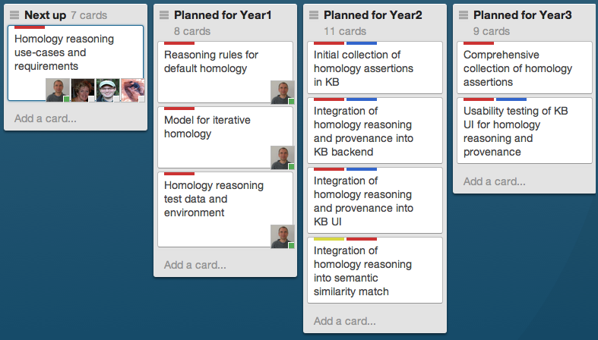
Immediate future plans

Slide 9
Anticipated Products
Well-defined relationships in OWL2 for asserting homology
Expert-curated ontology of vertebrate fins and limb homology relationships
Papers, presentations:
  Logic treatment of assertions of evolutionary sameness for organismal parts
  Testing and evaluating homology models

Slide 10
Some of the Challenges
What explanations and control do users need for homology-based inferences?
How to assess correctness and completeness of our (and in comparison other) model(s)?

