Slide 1



Development of the
Amphibian Anatomical Ontology
Anne Maglia
Department of Biological Sciences
Missouri University of Science and Technology
(formerly the University of Missouri-Rolla)
Jennifer Leopold and Analía Pugener, Missouri S&T
Susan Gauch, U. Arkansas

Slide 2
Community-identified need (ATOL)
Anatomical ontology vital to amphibian research
  Common gene expression and embryology models
Three disparate lexicons
Lack of terminological standardization limits understanding of phenotype evolution and integrative research on gene expression, embryology, and comparative anatomy
Challenge

Slide 3
Challenge
Develop an amphibian anatomical ontology that accommodates the diversity of structures present in all amphibians; include definitions, literature references, coding of phylogenetic characters, and images and annotations
…and include the domain expert community
…and maintain interoperability with other ontologies
…and do it in a reasonable amount of time
Challenge

Slide 4
AmphibAnat approach
Combine existing tools and methodologies with new approaches
  Semi-automated construction
  Ontology maintenance
  Web-based community curation
AmphibAnat

Slide 5
1. Semi-automated construction
Our challenge required automated techniques to reduce manual efforts and enhance existing, manually created ontologies by:
  Enriching concepts in the ontology
  Applying metrics to benchmark the semi-automated ontology’s suitability
Semi-automated construction

Slide 6
Semi-automated approach
Manually construct robust ontology of small subset(s) of domain (started with parts of ZFIN)
Rigorous community evaluation, augmentation, and modification of subset ontology
Seed IR software with skeleton of ontology and attempt to recreate it
Benchmark, repeat until software is reasonably accurate, then let loose on entire ontology
Semi-automated construction

Slide 7
How does IR software work?
Identify relevant electronic data sources
Use topic-specific spider to generate queries for concepts in the ontology
Collect potentially relevant documents
IR system extracts info from documents
  Pattern-based extraction methods
  Statistical natural language processing algorithms that identify and weight most important elements
Semi-automated construction

Slide 8
Benchmarking the IR software
Intrinsic benchmarking
  How well the software-based ontology reflects the concepts in the manually-developed ontology
  Can software learn preferred terminology automatically by identifying the most frequently used term from a synset, or the term most often used by authorities
Semi-automated construction

Slide 9
Benchmarking the IR software
Extrinsic benchmarking
  How well the distribution of concepts in the ontology reflects that in the literature
    Concepts with many instances may require refinement and subdivision
    Concepts with no instances may be pruned (or designated as a less preferred synonym)
Semi-automated construction

Slide 10
2. Ontology maintenance
Our needs required maintenance software that:
  Allows web-based access and collaboration
  Ensures consistency and concurrent, authorized access
  Allows query and update of context and structure
  Allows import/export of common exchange formats (e.g., OBO, OWL)
  Allows node-based access and editing privileges
Maintenance

Slide 11
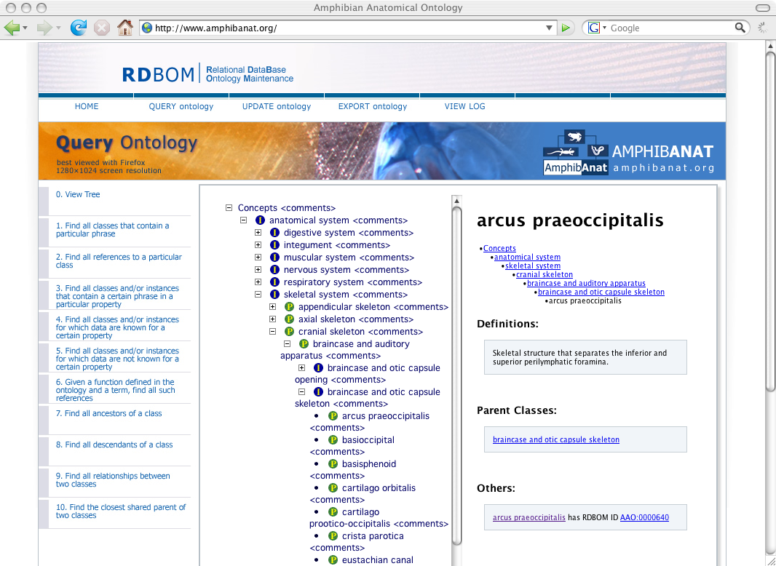
Maintenance

Slide 12
RDBOM (“red-bomb”)
Relational Database Ontology Maintenance
Features:
  Structural (e.g., ancestors/descendents) and content-based queries (e.g., all concepts with particular phrase)
  Structural updating (e.g., move/insert/delete nodes)
  Content-based updating (e.g., change the value)
  Collaborative commenting
  Security (node-based per user; multiple users)
  Version control
  Web-based access
  Generic (any ontology)
  Modularization of data
Maintenance

Slide 13
Modularization
OBO (or OWL) file
Phenote/PATO
RDBOM
Anatomical
Ontology
Phenotype
Annotation
(Character
Coding)
Taxonomy
Literature
Citations
Images and
Image
Annotations
User Comments
Transaction History
Access
Permission
Maintenance
Notes:
350 phenotype annotations, 3 model species: Salamandra, Dermophis, Xenopus

Slide 14
3. Web-based community curation
Our challenge required us to develop a virtual organization of amphibian experts
  Encourage user commenting by node
  Allow “super-user” node-based curation
    Teams and individuals take ownership of particular subsets for which they are the experts
Web-based community curation

Slide 15
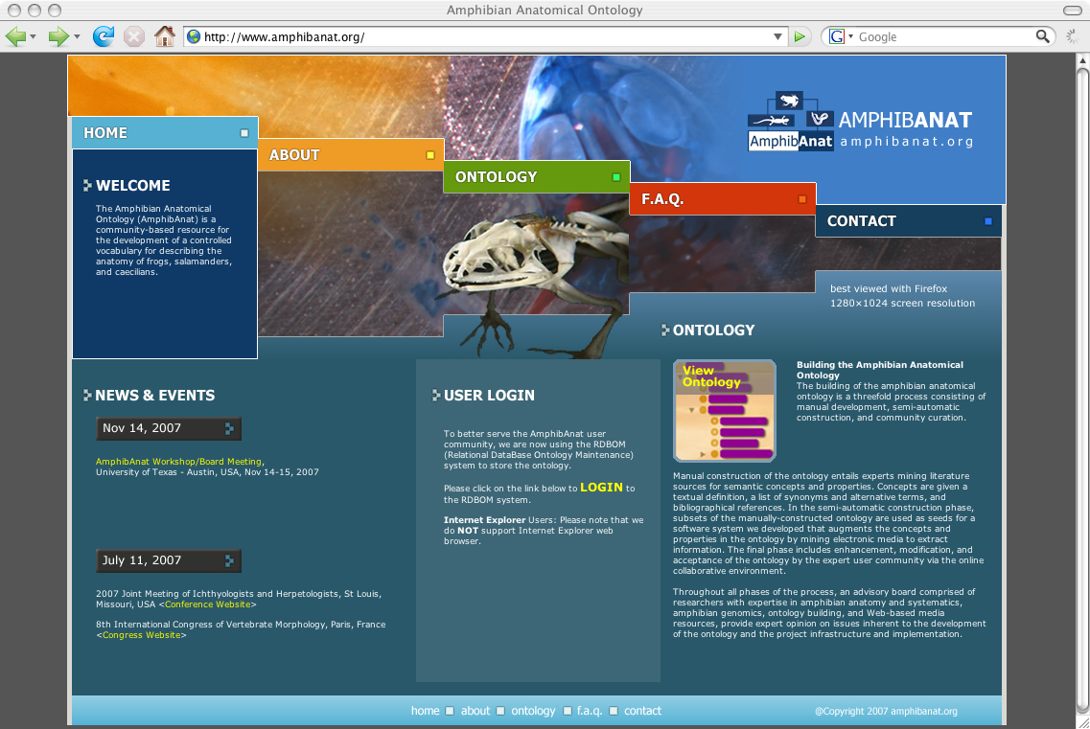
www.amphibanat.org
Web-based community curation

Slide 16
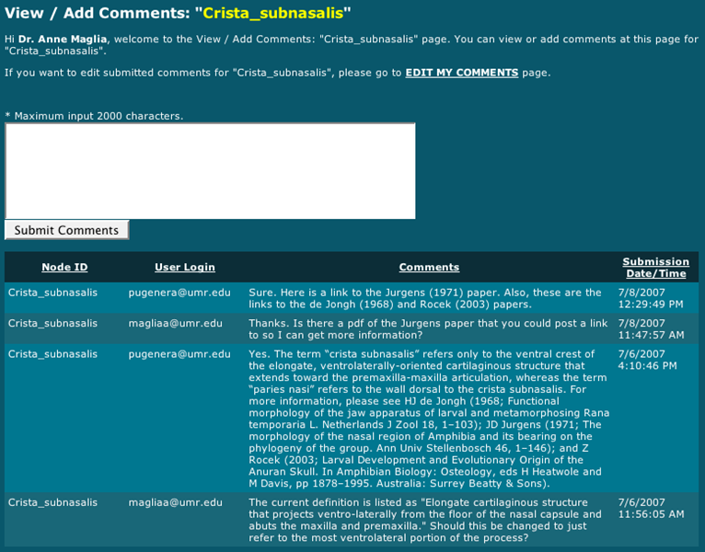
Commenting tool
Web-based community curation

Slide 17
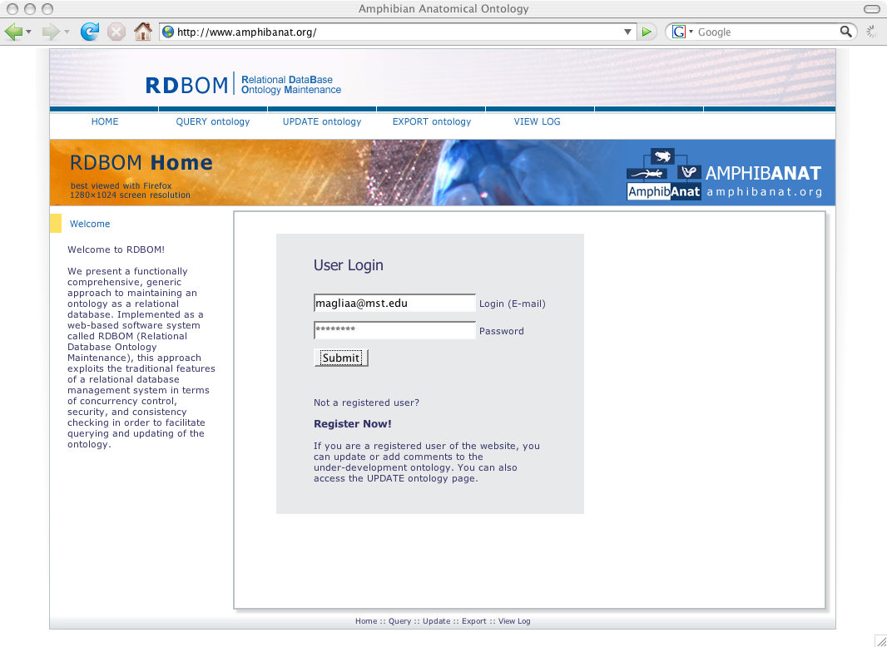
Privilege assignment
Web-based community curation

Slide 18
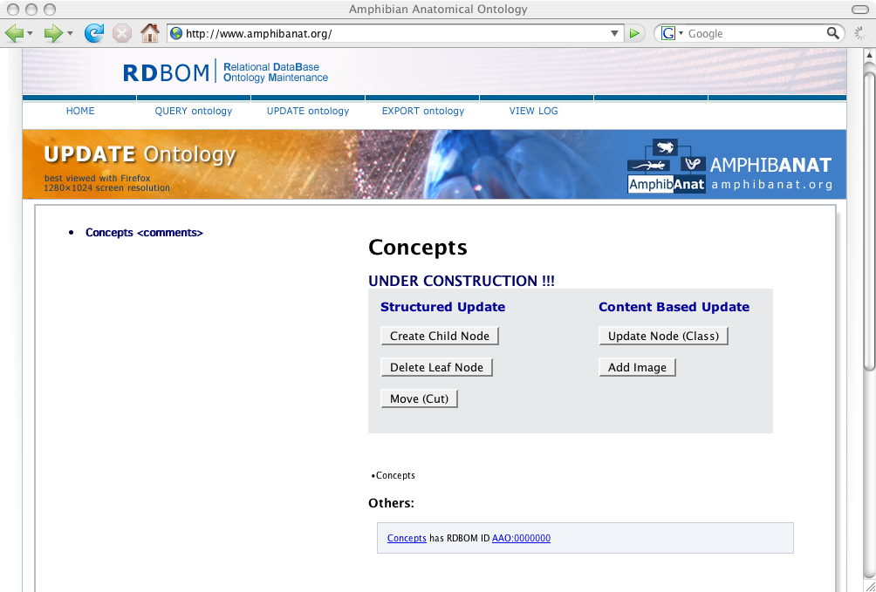
“Super-user” functions
Web-based community curation

Slide 19
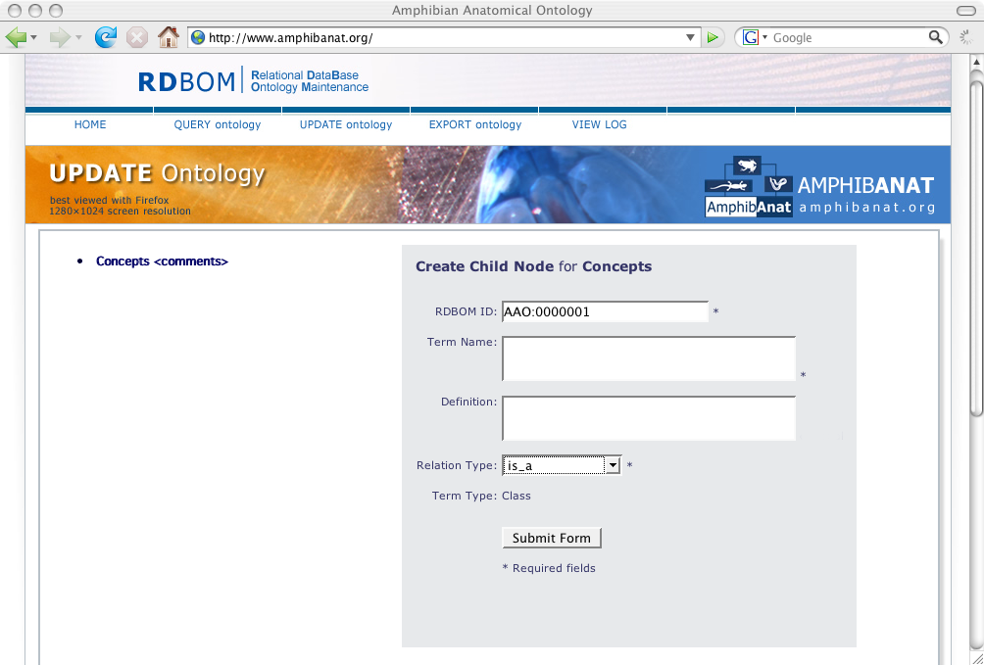
Simple interface
Web-based community curation

Slide 20
Web-based community curation
Facilitates inclusion of area expertise
Provides forum for argumentation
  E.g., definitions, homology, preferred terminology
Allows community ownership (and thus guaranteed use)
Value-added: unites diverse groups toward common goal
Web-based community curation

Slide 21
Summary
Biodiverse group with disparate lexicons required combination of existing tools and novel approaches
Semi-automated construction will help populate ontology faster, with less manual effort
Community-based curation allows user ownership, thus mining expert knowledge and facilitating use
RDBOM ontology maintenance system allows robust biodiversity data and functionality while allowing interoperability with other groups (e.g., OBO Foundry)
Summary

