Slide 1
Logical inference over phenotype knowledge bases using homology statements

Slide 2
Outline
Motivation: data mining
Ontologies and all-some relationships
Specifying homologous_to in terms of a descended_from relation
Composing relations across ontologies for data mining
Evidence and belief

Slide 3
Motivation
Reasoning/logical inference over ontology relationships is used for data exploration and analysis
  Example:
    Gene Ontology enrichment analysis
These results can be enriched for cross-species comparisons by incorporating homology
Goal:
  specify axioms that can be used for posing and answering useful questions over phenotype knowledgebases

Slide 4
Ontology Refresher
Ontology statements are about instances
  [every] iris [is] part_of [some] eye
Even if our knowledge base has no instance level data, we can still make class-level inferences
  [every] iris is part_of [some] eye
  [every] eye is part_of [some] head
  part_of is transitive
  therefore [every] iris is part_of [some] head
Notes:
e.g. gene expression data

Slide 5
descended_from
a descended_from b
if a is specified by p-a
b is specified by p-b
and p-a is a copy of p-b
aatgcgatggcc
Characteristics:
* Instance-level
* Transitive
* Reflexive
* Anti-symmetric
* Inverse: has_descendant
aatgcgatggcc
holds between
anatomical
entities
aatgcgatggcc
Rules:
we enforce a (overly strict?) constraint:
a descended_from b, a descended_from c →
b=c or a descended_from c or c descended_from a
Notes:
we can also have non-reflexive variants. we punt on specified-by for now

Slide 6
Composing relations: descended_from o has_descendant
relation formed from chaining
descended_from with inv(descended_from)
Characteristics:
* Instance-level
* Transitive
* Reflexive
* Symmetric
Rules:
a descended_from b, b has_descendant c →
a df.hd c
Notes:
we could call this relation homologous_to, but we reserve that label for the class-level relation (next slide)

Slide 7
class-level homologous to
homologous_to(X,Y,A)
⬄
[Every] X descendedFrom [some] A and
[Every] Y descendedFrom [some] A
class-level ternary relation,
expands to paired all-some axioms over
instance-level relation
homologous_to(X,Y)
⬄
exists A: homologous_to(X,Y,A)
⬄
[Every] X descendedFrom [some] (hasDescendant [some] Y)
[Every] Y descendedFrom [some] (hasDescendant [some] X)
binary class-level
relation expands to
paired all-some axioms
Characteristics:
* Class-level
* Symmetric
* Transitive
* Reflexive
No relation chaining rules at class level:
* NOT: is_a. homologous_to → homologous_to
* NOT: part_of . homologous_to → homologous_to

Slide 8
Example
Otophysi intercalarium homologous_to teleost neural arch 2
➔
[Every] Otophysi intercalarium descended from [something that] has descendant [some] Teleost neural arch 2
[Every] Teleost neural arch 2 descended from [something that] has descendant [some] Otophysi intercalarium

Slide 9
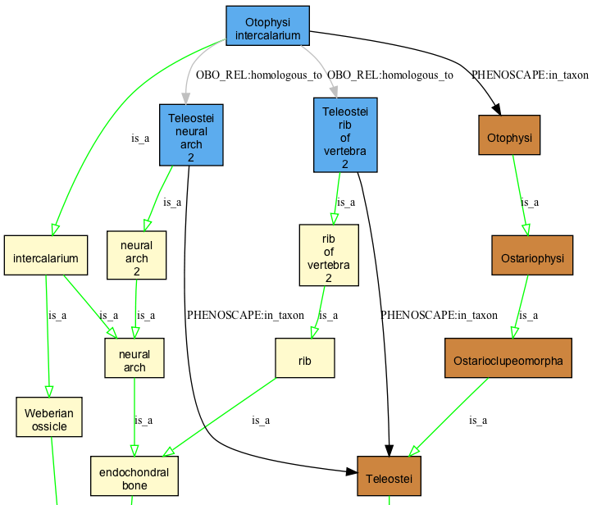

Slide 10
By treating symmetric class-level homology statements as syntactic sugar for a pair of non-symmetric all-some statements over instances we can more explicitly formulate questions involving other relations
E.g. given forelimb homologous_to bird wing, what can we infer?
  bird wing homologous_to forelimb – YES (symmetry)
  bird wing homologous_to limb – NO
  [every] bird wing df.hd [some] limb – YES
  [every] limb df.hd [some] bird wing - NO

Slide 11
Relation chains
We want to be able to exploit relationships in anatomical ontologies for data mining and hypothesis generation
  is_a
  part_of (and has_part)
  develops_from (and develops_into)

Slide 12
part_of . df . hd
instance relation formed from chaining
part_of with df.hd
a part_of b, b df.hd c → a part_of.df.hd c
Examples:
* [every] human left atrium po.df.hd [some] zebrafish heart
* [every] human hand po.df.hd [some] fish fin
* [every] human mc3 po.df.hd [some] cow cannon bone
Characteristics:
* Transitive
* Reflexive
* left-combines with part_of
p
left atrium

Slide 13
develops_from . df . hd
instance relation formed from chaining
develops_from with df.hd
a develops_from b, b df.hd c → a develops_from.df.hd c
Characteristics:
* Transitive
* Reflexive
* left-combines with develops_from
Example:
[every] claustrum bone develops_from [some] claustrum cartilage,
[every] claustrum cartilage df.hd [some] neural arch 1
→
[every] claustrum bone develops_from.df.hd [some] neural arch 1
Notes:
do we need a replaces relation?

Slide 14
Other compositions are possible
has_part .df .hd
develops_into . df .hd
part_of . df . hd . part_of
…
Inference always goes “up the graph”

Slide 15
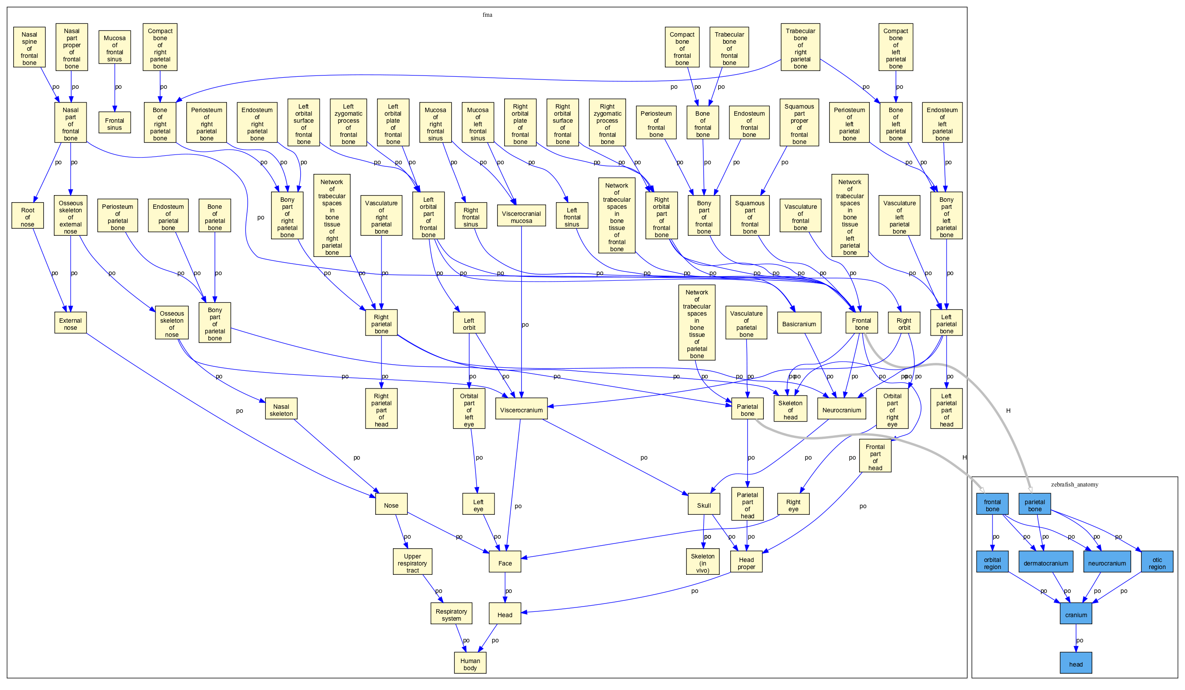

Slide 16
Combining with genes and phenotypes
Two formulations
  1. Using exhibits relation
  2. Using part_of ** NEW
Same should be used for taxa and genes
  E.g.
    (parahypophysis/rib of zebrafish with genotype trpm7-) has_quality malformed
    (zebrafish with genotype eda- has_part 0 scale)

Slide 17
Open Questions
For logical reasoning we assume all assertions are true
  homology statements are hypotheses
Reasoning in presence of conflicts
  explanation chains
  detecting inconsistencies
Probabilistic formulations?
  homology and belief networks

Slide 18
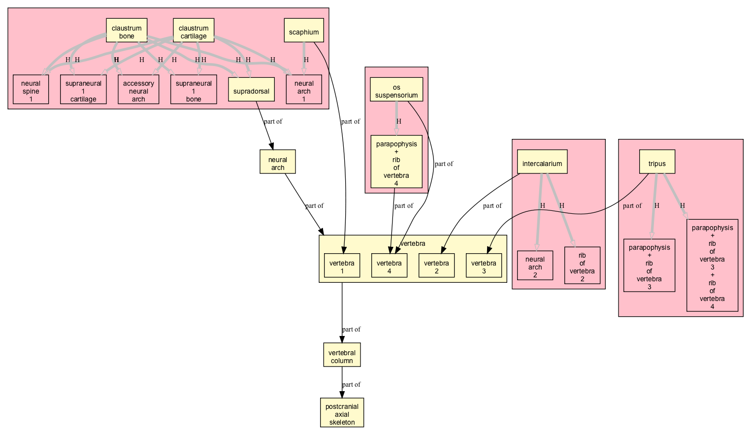

Slide 19
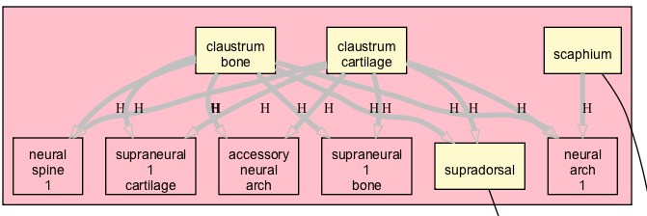
Weberian ossicle
isa/part of?
dorsal_to

Slide 20
Next steps
OWL-DL specification of homology relations
Implementation in OBD
Expand existing homology assertions beyond

Slide 22


Slide 23
genes
organism with mutation in G has abnormal quality inhering in E,
then G partly-specifies E
G has_variant A
A exhibits P
P inheres_in E
E po.ht E’
P’ inheres_in E
T’ exhibits P’

Slide 24
integument
P
P
scale
H
feather
skin

