Slide 1
Ontologies and CToL
Chris Mungall
Lawrence Berkeley Labs
Notes:
NCORB
s/core4/core1

Slide 2
Why do we need ontologies?

Slide 3
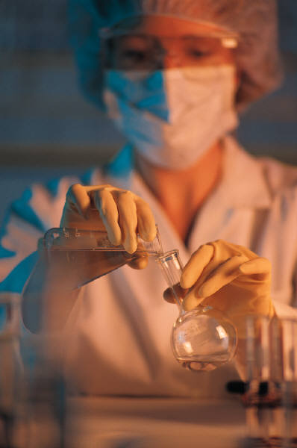
The data integration problem
Vast wealth of data residing in different databases
  Meaning of those records must be reconciled for data to be automatically integrated
Science
database
medical
database

Slide 4
Connections are not made explicit by default
Computers are not intelligent
We need to spell out interconnectedness of entities
  Specificity Bone mineralization vs ossification
  Granularity Osteocyte vs bone
  Spatial Gill membrane and branchiostegal ray
  Perspective Anatomy vs physiology
  Causally related entities
    pathways
    development
  Evolutionary Homology and descent

Slide 5
Ontologies : the key to data integration
Ontologies provide:
  rigorous, shared computable definitions for terms
  classifications and connections that can be used for database search and inference

Slide 6
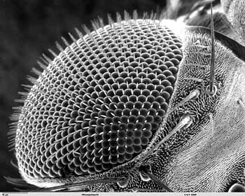
A biological ontology is:
A formal representation of some portion of biological reality
sense organ
  what kinds of things exist?
eye
disc
is_a
  what are the relationships between these things?
develops
from
eye
part_of
ommatidium

Slide 7
Good ontology design is required for data integration
Not any old ontology will do
  Data integration served poorly by poor ontologies
How do we know good ontologies?
  Types and classifications should be constructed according to science and should reflect nature
  Ontology constructed along lines of ontology best practices
    http://www.obofoundry.org
    Formal definitions and relations
    Based on distinction between types and instances
    Distinction between types and their labels

Slide 8
Linnaeus’ taxonomy of disease
Mental (genus)
  PATHETIC (species)
      citta desire to eat what is not food
      bulimia insatiable desire for food
      polydipsia continuous desire for drink
      satyriasis enormous desire for sex
      erotomania indecent desire for lovers
      nostalgia desire for country and relatives
      Tarantismus desire for dancing, often caused by an insect bite
      rabies desire to bite and lacerate the harmless
      hydrophobia aversion to drink
      cacositia aversion to food, accompanied by horror of it
      antipathia aversion to a particular object
      anxietas aversion to ordinary things, with pain in the heart
Sub
species
Notes:
See:
NOSOLOGY; everything old is new again
Michelle Bramley
Coding Matters
Vol8 Num1, June 2001

Slide 9
Celestine empire of benevolent knowledge
  JL Borges’ fictitious account of a classification of animals:
Animals-belonging-to-the-emperor
Embalmed
Tame
Sucking-pigs
Sirens
Fabulous
Stray dogs
Included in the present classification
Frenzied
Innumerable
Drawn with a fine camelhair brush
Having just broken the water pitcher
That from a long way off look like flies

Slide 10
OBO: Open Bio Ontologies
http://obo.sourceforge.net
  ~50 ontologies of variable quality
OBO Foundry
  http://www.obofoundry.org
  High quality reference ontologies
  Aim: cover all of biological reality
  Gene Ontology
  Anatomical ontologies

Slide 11
The Gene Ontology
Mid-size
  ~18,000 terms in all 3 ontologies
  ~2n,nnn links (is_a, part_of)
Each term represents a type
  Terms also have alternate labels (synonyms)
    These do not represent distinct types
    Humans use different labels to refer to the same biological pattern
      E.g: endoplasmic reticulum vs ER

Slide 12
Ontologies and annotation
Ontologies are of little practical use without annotation
  GO has ~6 million annotations linking genes and gene products to GO terms
  Mostly (but not all) MOD & Human
  Same terms are shared across species
All annotation statements have provenance
  Source/publication
  Evidence & evidence codes

Slide 13
Use of GO annotations
Database search
Database integration
Automating further annotation
Data mining and data analysis
  Microarray analysis:
    1. Extract cluster of co-exressed genes
    2. Analyses annotations for enrichment of certain terms

Slide 14
Ontologies and phenotype annotation
The next step: phenotype annotation
  Annotation of ‘mutants’ in model organisms will help understand
    Human health and disease
    Evolution and development

Slide 15
How can we represent phenotypes and traits in a computer?
The PATO ‘EQ’ methodology
Formerly known as ‘EAV’ (RIP)

Slide 16
What is a phenotype?
PATO
All phenotypes consist of:
A dependent entity
An independent entity
inhering in
(borne/carried by)
(depends on)
Shape
Color
Length
Light Sensitivity
Opacity
Bone
Ommatidium
Bristle
Retina
Lens
GO
AO
….
(mediated genetically)

Slide 17
An example ‘branch’ of PATO

Slide 18
EQ Annotation
A simple, human-readable yet computable way to describe phenotypes
Basic model: ‘EQ’ pair
  An entity (E)
    A term from one of various OBO ontologies
  A quality (Q)
    Also known as: property
    A term from PATO
The E is said to be the ‘bearer’ of the Q

Slide 19
From EAV to EQ
Previous methodology: EAV
  See Gkoutos 2004
  EQ supersedes EAV
  PATO is not a single hierarchy
All EAV annotations can be represented as EQs
  The ‘A’ is degenerate
  Examples
    A=shape V=round => Q=round
      Round is_a shape
    A=color C=pink => Q=pink
      Pink is_a color
Notes:
Not in sense of sordid; more in sense of amino acid code

Slide 20
Character Matrices and EQ
Using EQ:
  Character:
    Entity plus a general quality
    Entity + Q^{G}
  State:
    A specific quality
    Q^{S}
Constraint:
    Q^{S} is_a Q^{G}

Slide 21
 | EQ^{G}_{a} | EQ^{G}_{b} | EQ^{G}_{c} | EQ^{G}_{d} | EQ^{G}_{e} | EQ^{G}_{f}
Tax₁
Tax₂ |  |  |  |  | …
Tax₃ |  |  |  | … | Q^{S}_{e3} | Q^{S}_{f2}
Tax₄ |  |  |  |  | Q^{S}_{e4} | Q^{S}_{f4}
Tax₅ |  |  |  |  | Q^{S}_{e5} | Q^{S}_{f5}
Tax₆

Slide 22
 | EQ^{G}_{a} | EQ^{G}_{b} | EQ^{G}_{c} | EQ^{G}_{d} | EQ^{G}_{e} | shape
Tax₁
Tax₂ |  |  |  |  | …
Tax₃ |  |  |  | … | Q^{S}_{e3} | straight
Tax₄ |  |  |  |  | Q^{S}_{e4} | Y-shaped
Tax₅ |  |  |  |  | Q^{S}_{e5} | T-shaped
Tax₆

Slide 23
Anatomy and homology…

Slide 25
end

Slide 26
Evolutionary relations
Relations between two anatomical entities
    Homologous_to
Relations between an anatomical entity and an organism type (taxon)
    C part_of_organism T
    C not_part_of_organism T

Slide 27
Homologous_to
Between two anatomical entities
  C1 homologous_to C2
  Symmetric
  Includes genes
Definition:
Must be attributed
  Evidence codes
Notes:
Delete?

Slide 28
Is_a and homology
If two terms share the same is_a parent are they homologous?
  NO
However, CARO should strive to have monophyletic anatomical entities
  E.g.
    We would not have ‘eye’ in CARO
      Instead: vertebrate eye, compound eye, …
    We don’t have a structural def that covers all ‘eye’s anyway

Slide 29
Part_of_organism
C part_of_organism T
  All instances of C are part_of some organism T
Examples:
  Cell nucleus part_of_organism Eukaryote
  Apoplast part_of_organism Viridiplantae
  Mammary gland part_of_organism Mammal
  Mammary gland part_of_organism Metazoa (trivially true)
Equivalent to ‘specific-to’ relation _{(for continuants)}
  Kusnierczyk 2006, in prep

Slide 30
Not_part_of_organism
C not_part_of_organism T
  There are no instances of C that are part_of some instance of T
Equivalent to:
  T lacks C
    Forthcoming, OBO Relations ontology

Slide 31
Implementation
Should homology relations be tracked in the ontology or the database?
Should not_part_of_organism be tracked in the ontology or character matrices?

Slide 32
Ontology and epistemology
Do not confuse:
  Ontology: what exists
  Epistemology: what we know
Ontologies strive for a “nature’s eye” viewpoint
Unfortunate fact:
  We do not know everything (yet)
  Thus ontologies are imperfect, dynamic, evolving
  They are built to be as good as they can be be given current scientific knowledge
  Ontologies do not represent the knowledge, or lack of knowledge

Slide 33
Bad practice
Terms such as these should not be found in a good ontology
  Molecular function unknown
  Hypothetical protein
  Other transcription factor
  Putative homology
We represent uncertainty outside the ontology
  E.g. in metadata or annotations

Slide 34
Implementing homology relations
Require attribution
  Source (pub), agent, evidence code
Similar pattern to annotation
Oboedit does not currently support detailed attribution of relations
Solution:
  Keep separate from .obo file for now
    Exel, relational tables, annotation files, …
  But in principle can be seen as part of the ontology

Slide 35
end

Slide 37
Ontology is not nomenclature
A type can have many labels
  Preferred label (term)
  Synonyms, aliases
Types are not labels
  Types are the underlying pattern
    Identified by a formal definition
  Labels are important for doing science
    But life existed for billions of years quite happily prior to the invention of names and labels
  Good ontology separates the underlying patterns in nature from the labels used to describe them

Slide 38
Ontological relations
Types are related
Network of terms forms a graph
  Terms (nodes)
  The edge type (relation) is important
Two common relations:
  Is_a
  Part_of

Slide 39

organ
is_a
cavitated organ
is_a
Types
(represented in
the ontology)
eyeball
instance_of
Instances
(NOT represented
in the ontology)

Slide 40
Formal definition of is_a
is_a holds between types
X is_a Y holds if and only if:
  Given any thing that instantiates X at some time, that thing also instantiates Y at the same time

Slide 41
organ
is_a
cavitated organ
is_a
Types
(represented in
the ontology)
eyeball
instance_of
Instances
(NOT represented
in the ontology)

Slide 42
Taxonomies, phylogenies and ontologies
Can taxonomies by adequately represented using the is_a relation?

