Slide 1

Ontology development and evolutionary data curation
Participants:
Wasila Dahdul, Melissa Haendel, Peter Midford
Paula Mabee, David Blackburn, Alex Dececchi
Paul Sereno, Nizar Ibrahim, Lauren Conroy

Slide 2
Motivation
Taxon phenotype annotations that reflect major transitions in vertebrate skeletal evolution required for fin/limb test case

Slide 3
Overall objectives
Coordinate the development and alignment of vertebrate anatomy ontologies, with focus on the fin/limb skeleton
Develop supporting vertebrate taxonomy ontology (VTO)

Slide 4
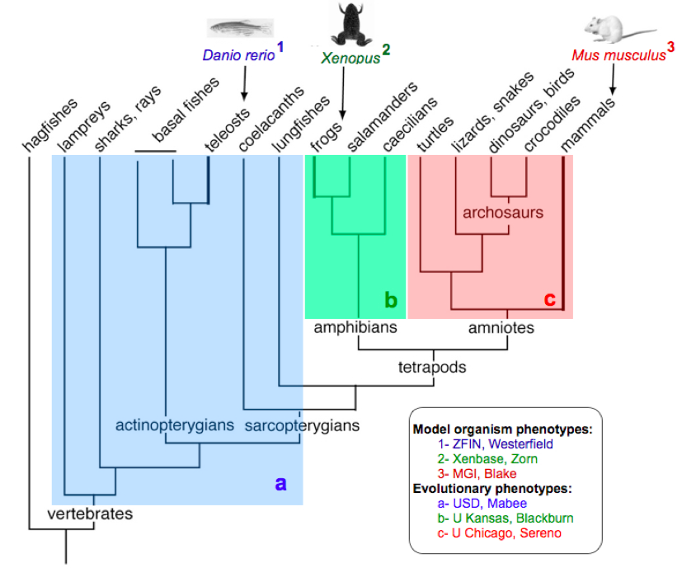
Scope of ontologies in Phenoscape
zebrafish
Xenopus
mouse
teleosts
amphibians
amniotes
vertebrates

Slide 5
Ontology Progress to date
Integrating teleost, amphibian, and amniote ontologies into Vertebrate Anatomy Ontology (VAO)
Agreed upon a uniform terminology for limbs
Resolved bone tissue vs. organ distinction
Collaboratively improved musculoskeletal cell (CL) and GO process terms
Settled on strategies for ontology synchronization
Ongoing monthly conference calls, mailing lists, and wiki documentation

Slide 6
What we have now
equivs
CARO
uberon
Uberon-skeletal portion
imports
AMAO
VAO
Taxon equivs
TAO
AAO
TAO-skeletal portion
AAO-skeletal portion
EMAPA+
MA
FMA
ZFA
XAO

Slide 7
Ontology coordination issues
Have overlap between a number of different ontologies
Need logically consistent orthogonal ontologies to query across taxa
Need easily edited in a timely fashion
Need proper attribution of ontology contribution
Will all work together to modularize across taxa and distribute effort

Slide 8
Taxonomy ontology
Vertebrate Taxonomy Ontology (VTO) released
Fishes (from CAS database)
Amphibians (from AmphibiaWeb)
Amniotes (from NCBI and IOU)
Extinct vertebrates (PaleoDB)
Strengthening connection to NCBI by converting xrefs to altIDs

Slide 9
Immediate plans
Adopt Protégé 4 ontology editor and OWL2 format
Document workflows for ontology updates

Slide 10
Ontology modularization strategy
One of the benefits of using protégé is the use of a modular imports strategy
Enables much easier reuse of external ontologies
Easy to annotate classes and properties for UI display (e.g., preferred labels)
ontology-metadata.owl
caro.owl
uberon-mireot.owl
pato-mireot.owl
vertebrate_skeletal_anatomy.owl
ro-mireot.owl
Cl-mireot.owl

Slide 11
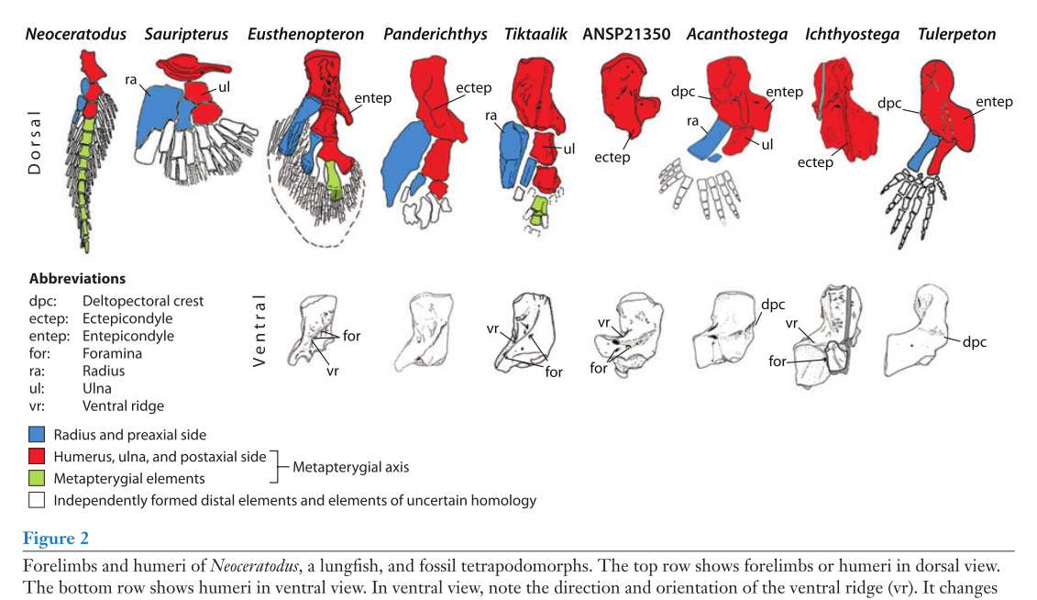
Evolutionary phenotype curation
Aim: Transform characters for fin/limb from published phylogenetic studies into ontology terms (EQ)
Clack, J. A. (2009). The Fin to Limb Transition: New Data, Interpretations, and Hypotheses from Paleontology and Developmental Biology. Annual Review of Earth and Planetary Sciences, 37(1), 163-179

Slide 12
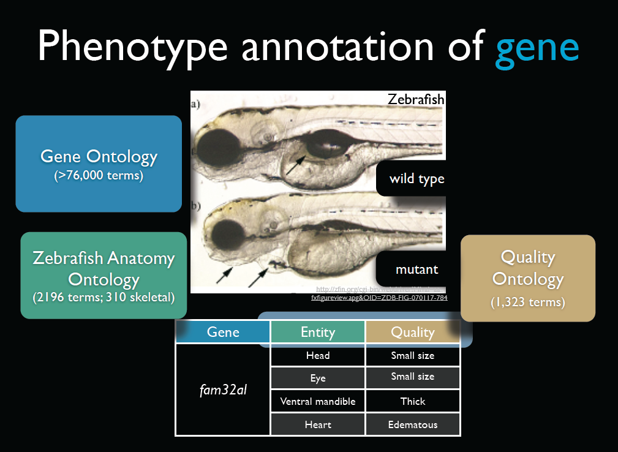

Slide 13
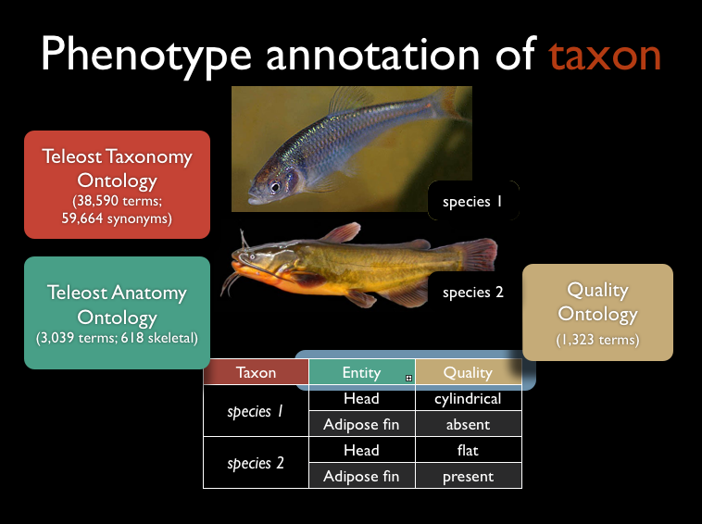

Slide 14
Curation Progress to Date
66 papers selected for fin/limb test case curation
PDFs acquired (online, ILL, scanned); OCR formatted
Initiated or completed character x taxon matrices, EQ phenotypes, and taxon lists
Phenex curation software updated to allow for collaborative editing using file synchronization software (DropBox)

Slide 15
Presentations & Papers
Papers:
Bone concepts paper (in revision)
Vertebrate Anatomy Ontology paper (in revision)
White paper on what kinds of phenotype aggregation questions that can (and cannot) be addressed?
Pitfalls of this type of project
Taxonomy paper
Meetings:
Society of Vertebrate Paleontology (October, 2012)
Joint Meeting of Ichthyologists and Herpetologists (August, 2012)

Slide 16
Questions for the advisory board
How give ownership/attribution to a community within a modular set of ontologies(e.g., VAO within Uberon)?
How to clarify maintenance responsibilities and develop mechanisms to sustain ontology and data curation?

Slide 18
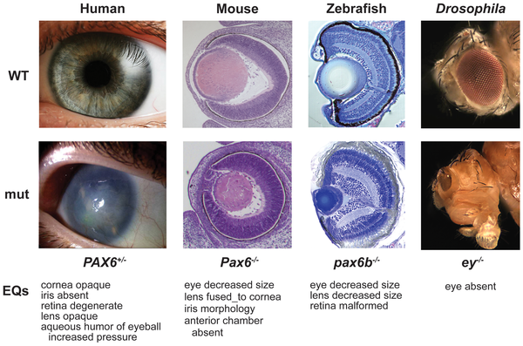
Profiles
Washington et al. 2009

Slide 19
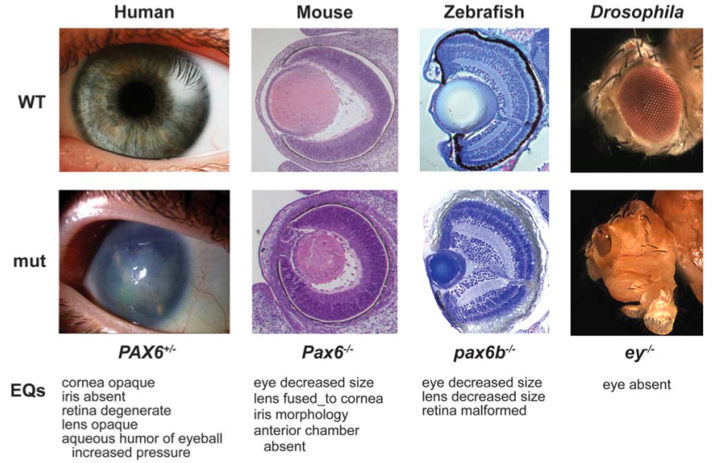
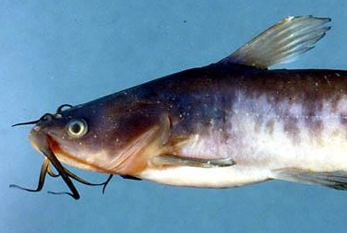
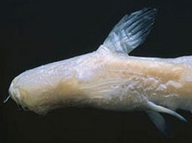
Translational biodiversity
Catfish
Ameiurus
nebulosus
Trogloglanis
pattersoni
gene?
EQ: eye absent
Fig. 1, Washington et al., 2010
http://tolweb.org/Trogloglanis/69910
Notes:
Can we leverage the information from model organisms to understand evolutionary phenotypes? Conservation would lead us to believe that we can.
Can the genetic/devo basis for the blindness of the blind cat Trogloglanis be understood through such translation?
image of Trogloglanis: http://tolweb.org/Trogloglanis/69910
image of Ameiurus nebulosus: Mark Sabaj Perez

