Slide 1
Integration of morphological and genetic data via ontologies
Fish Working Group III
Paula Mabee & Monte Westerfield

Slide 2

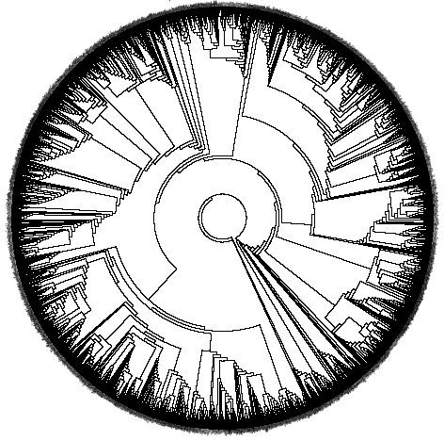
1. Cypriniformes: Evolutionary morphology
2. Zebrafish: Developmental morphology
3. Ontologies: Evolutionary-Developmental morphology
Notes:
3,500 described species

Slide 3
Goals:
Co-query the zebrafish phenotype and genetic data with evolutionary anatomical data.

Slide 4
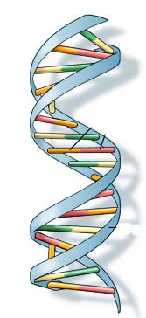
Model organism (zebrafish):
Mutagenesis produces phenotypes
Mutagenesis
Phenotype 1
Phenotype 2
Phenotype 3
Notes:
Approach to understanding genetic controls on morphology in model organisms is traditionally via mutagenesis. Lines of novel mutant phenotypes are maintained by model organism communities. 20,000 lines so far for zebrafish.
http://ghr.nlm.nih.gov/dynamicImages/understandGenetics/basics/DNA.jpg

Slide 5
Morphology Mutant/gene
Zebrafish phenotypes (relative to wt):
Maxilla: size reduction sox9ahi1134
Dentary: size reduction sox9ahi1134
Retroarticular: loss edn1
Opercle: size reduction; loss sox9ahi1134; lockjaw
Ceratohyal: shape change val
Branchiostegals: numberdecrease edn1
Branchiostegals: shape change she, stu, edn1-MO
Opercle: lost edn1, lockjaw
Opercle: size increase edn1
Hypobranchials: loss val
Ceratobranchial 5: size reduction sox9ahi1134
Arches 2—5: reduced or absence lockjaw
Arches 4—6: loss duckbill, flathead
Ethmoid: loss chameleon, cyclops, detour, etc.
Trabeculae: fused chameleon, cyclops, detour, etc.
Pectoral fin: loss Fgf24-MO
Median fins: loss lepidotrichia finless
Scapulocoracoid: loss sox9a loss
Neural and hemal spines: alignment chordin
Notes:
Here is list of morphological parts that are modified in mutants
And here is a list of the genes that they map to
These are changes in morphology relative to wt. 1 species.
But morphology is connected to genes!

Slide 6
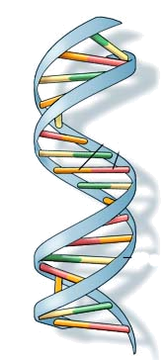
Evolution also produces phenotypes
Mutation, Gene Flow, Selection, Drift
Species A
Phenotype
Species B
Phenotype
Species C
Phenotype
Notes:
From the ToL perspective, of course, mutation initially produces the phenotype, but the processes here make particular phenotypes common.
http://ghr.nlm.nih.gov/dynamicImages/understandGenetics/basics/DNA.jpg

Slide 7
But, the genetic bases of morphology unknown
Mutation, Gene Flow, Selection, Drift
?
Species A
Morphology
Species B
Morphology
Species C
Morphology
Notes:
But in contrast to the model organism community, genetic bases are not known.
http://ghr.nlm.nih.gov/dynamicImages/understandGenetics/basics/DNA.jpg

Slide 8
Morphology
Cypriniform fish speces (rel. to outgroup)
Branchiostegal rays: number
Basibranchial 2: T-shaped
Basibranchial 4: development
Basibranchial 4: shape keeled
Basihyal: shape
Basihyal tooth plate
Copula 3
Hypobranchial 3: development
Hypobranchial 4
Ceratobranchial 5: size
Ceratobranchial 5: teeth
Infrapharyngeals; number
Infrapharyngeal 1: presence
Epibranchial 1: uncinate process
Pharyngeal teeth: rows
Interhyal: size
Ceratohyal: shape
Anterior ceratohyal: shape
Genes
?
Notes:
Characters from zebrafish relatives, the cypriniform fishes.

Slide 9
Candidate genes for evolutionary changes in Cypriniformes
Genes
Mutant
morphologies
Evolutionary
characters
Zebrafish
Many fishes
Notes:
I have now established the reason for links between evolutionary morphology databases and genetics databases

Slide 10
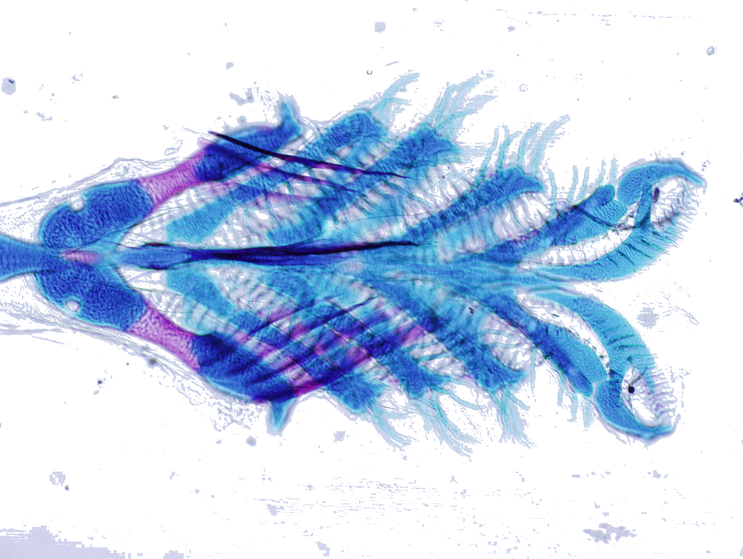
1. Search for candidate genes
Observe on tree: Ceratobranchial 5 evolves in shape across fishes
Query zebrafish db: What genes might be responsible for this variation?
Notes:
What can we do with this? We can use ontology…..search zebrafish mutants

Slide 11
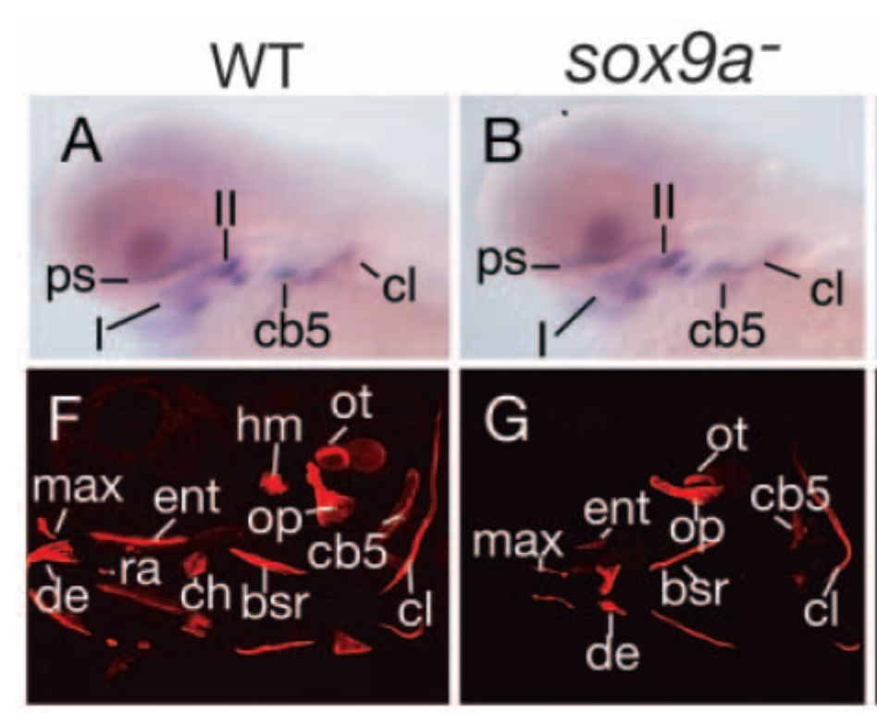
Search zebrafish mutant db….
Results: Ceratobranchial 5 shape modified in:
Mutant Gene(s) Expression Reference(s)
sox9ahi1134 sox9a 1 Fig Yan et al. ‘05
Yan (2005)s
Notes:
Using ontology, search zebrafish mutants

Slide 12
Working group 1: Ontology
Anatomical ontologies:
  Boot camp: ZFIN educated CToL on concept and value of ontologies
  CToL edited and is extending ZFIN ontology
  Ontologies necessary for evolutionary anatomy databases to relate to MOD databases
    Outside of POC, no multispecies ontologies yet developed

Slide 13
Basic working group strategy
Goal 2: Common syntax
  Frame systematic characters using entities from anatomical (AO) and qualifier (PATO) ontologies and map them to a skeleton taxonomic ontology.

Slide 14
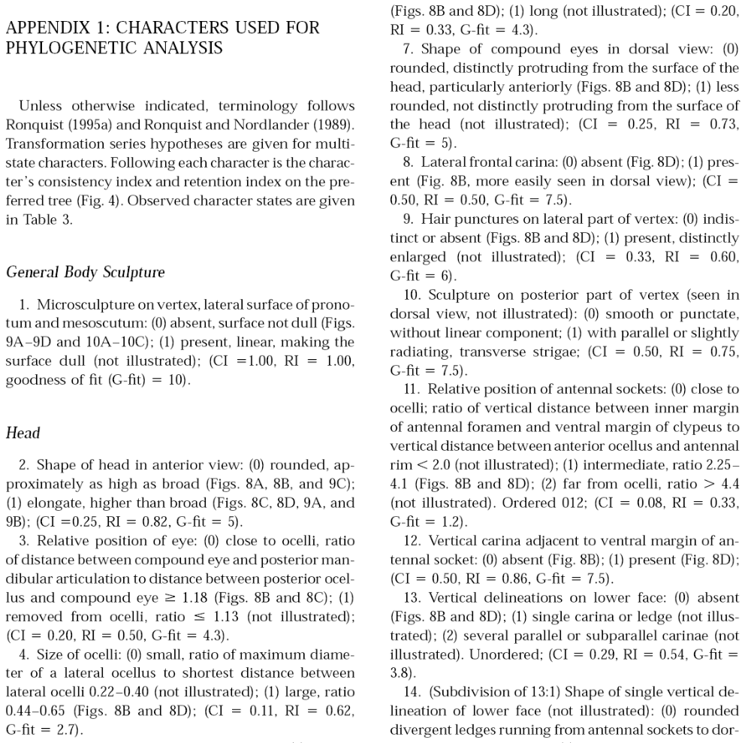
Morphological characters are traditionally stored as free text
Fontal-Cazalla, 2002
Notes:
For well over a century, morphologists have recorded these features in text and graphics in the literature. This, of course, has made comparing features across papers very difficult. Same characters not used, etc.
The internet, combined with various software tools has transformed the way that we are doing morphology. Virtually every ToL has in place, is putting in place a db, to share and pool data in real time.

Slide 15
Character in free-text:
Character in EAV syntax:
Character: “Number of basibranchial elements present”
Character states: two, three, four
Entity: Basibranchials
Attribute: Number
Value: two, three, four
Notes:
We are working with the molecular consortium to establish a way to include the additional detail typically recorded in evolutionary studies, in anticipation that they will also require this in the future.
Million and a half sp. described over several hundred years in sentence form, because this is how people have commnicated. However, we want computers to.

Slide 16
Working group 2: Syntax and examples
Syntax for describing anatomy, using ontologies
  ZFIN and NCBO colleagues working on phenotype syntax (EAV, EQ)
  ZFIN + CToL tested syntax on character examples and concluded that specific extensions of the basic syntax are necessary for systematic characters (e.g. multiple entities). No examples were inconsistent with above phenotype syntax.
  *Syntax will work for systematic characters
    Benefits: interoperability with MODs; interoperability among evolutionary databases (as they develop)

Slide 17
WG3: Goal 1: Homology
Homology relationships must be exactly defined and consistently used in evolutionary morphology ontologies
Need to

Slide 18
New relationship type: Homologous_to
To be refined and added to OBO Sourceforge

Slide 19
WG3: Goal 2: Homology Evidence Codes
Inferred from:
  HIA Homology Inferred from Author (Attribution) (similar to TAS, Traceable Author statement)
  HIP Homology Inferred from Position
  HIC Homology Inferred from Composition (tissues, embryonic & adult; molecular constituents)
  HID Homology Inferred from Development (ontogeny)
  HIS Homology Inferred from Shape/structure
  HIP: Inferred from Phylogeny
  Not homologous: Co-occurance

