Slide 1

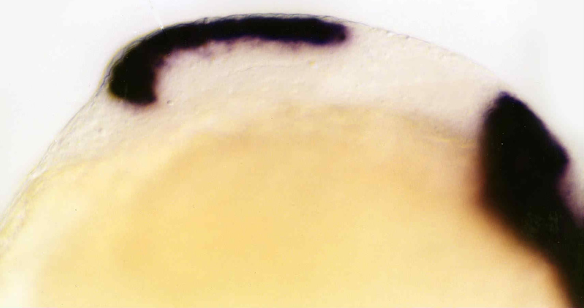
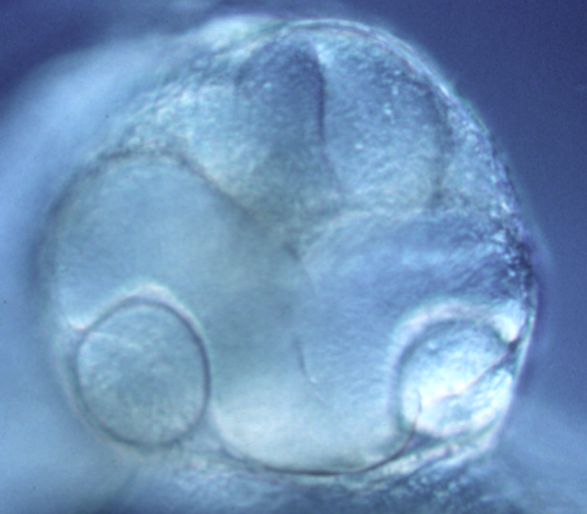
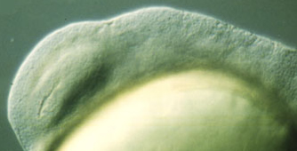
Model Organism Databases: Community Data Sharing
Supported by NIH P41 HG002659 &
the University of Oregon

Slide 2

ZFIN Staff:
Judy Sprague, director
Scientific curation:
Leyla Bayraktaroglu
Yvonne Bradford
David Fashena
Ken Frazer
Melissa Haendel
Doug Howe
Jon Knight
Sridhar Ramachandran
Barbara Ruef
Holle Schaper
Amy Singer
Ceri vanSlyke
Database administration:
Sierra Moxon
Brock Sprunger
Genome annotation:
Adam Frankish
Richard Gibson
Jonathan Mudge
Harminder Sehra
Software engineering:
Tom Conlin
Nathan Dunn
Christian Pich
Prita Mani
Kevin Schaper
Xiang Shao

Slide 3
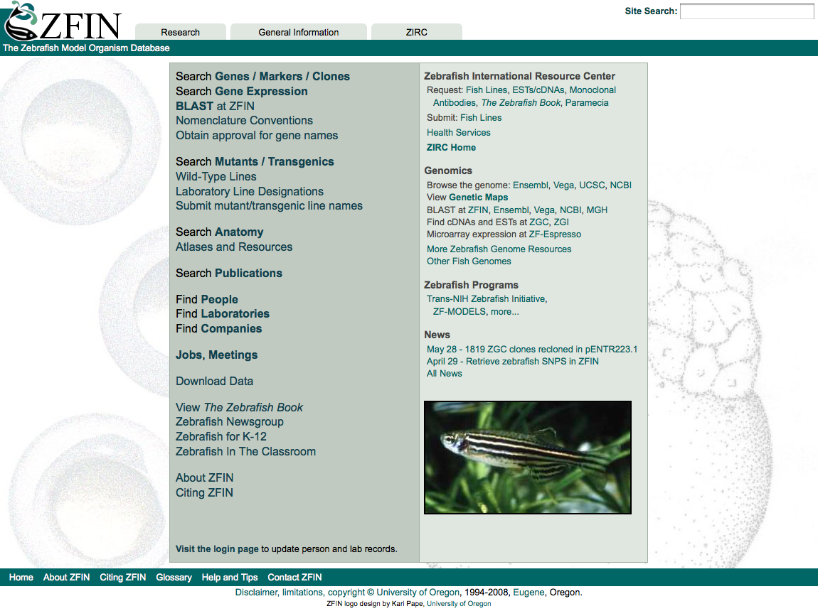

Slide 5
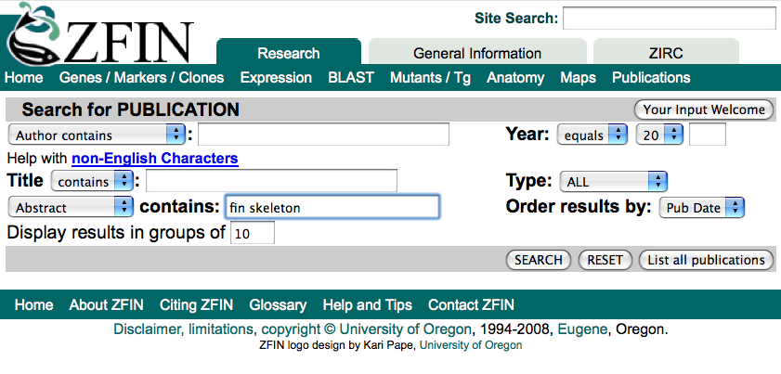

Slide 6
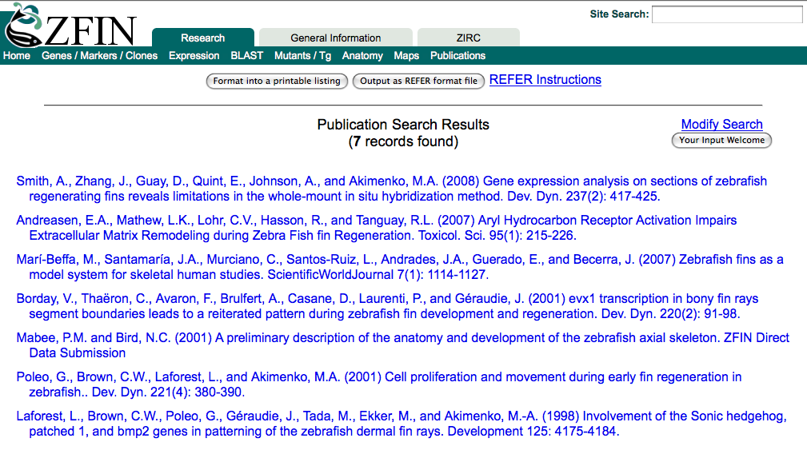

Slide 8
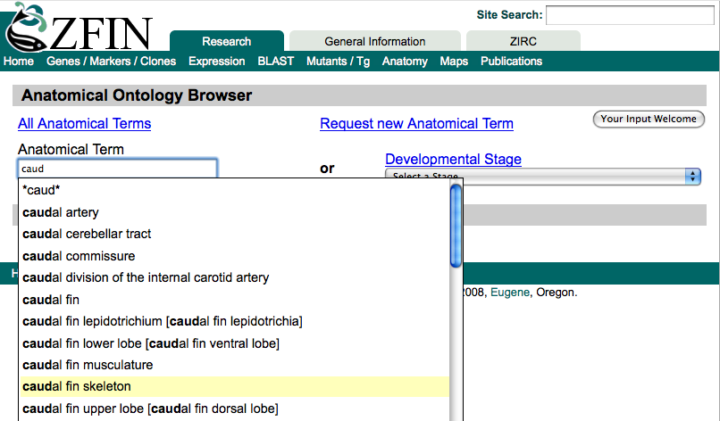

Slide 9
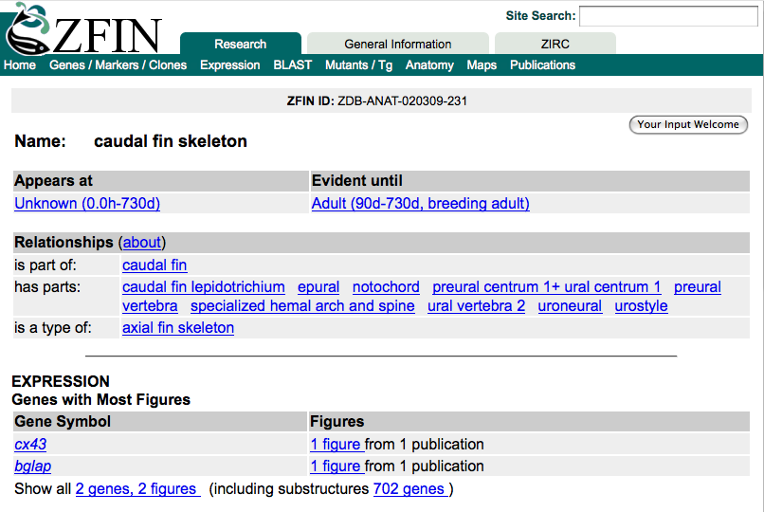

Slide 10
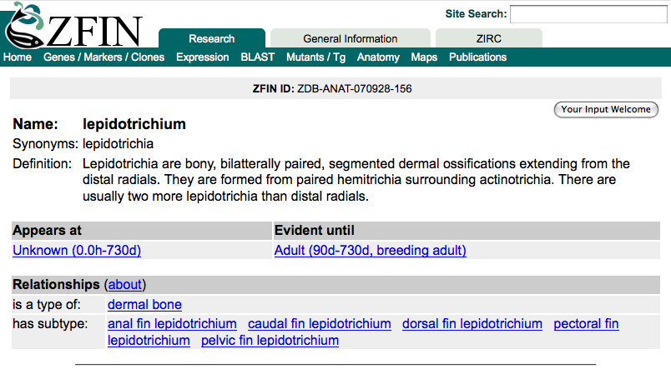

Slide 11
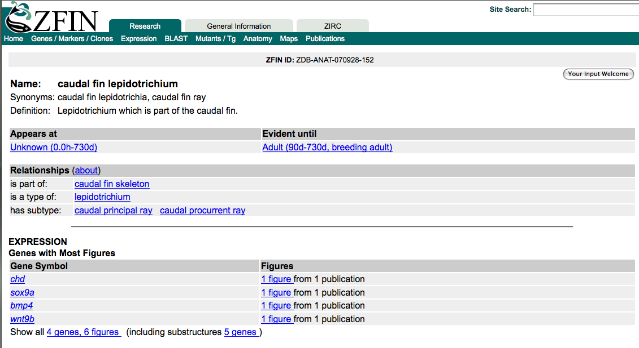

Slide 12
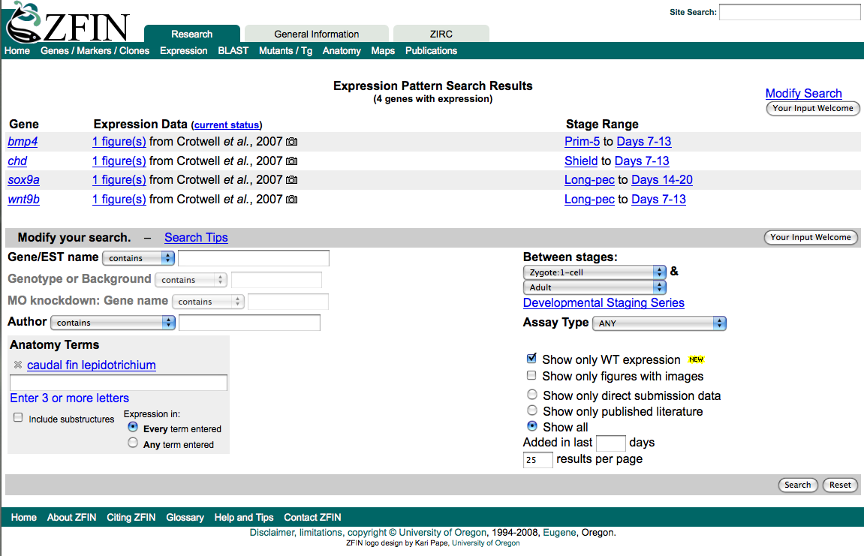

Slide 13
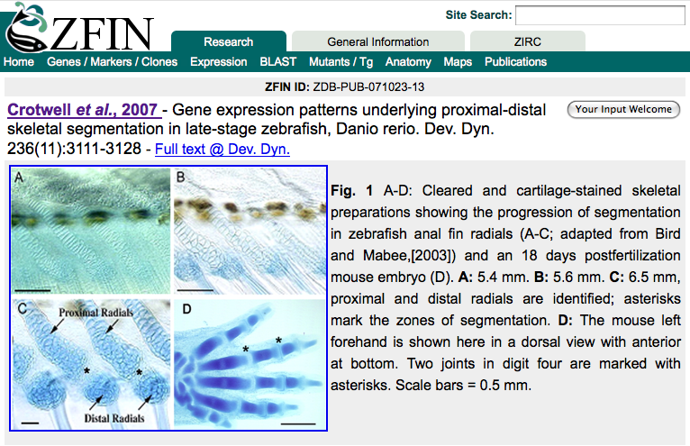

Slide 14
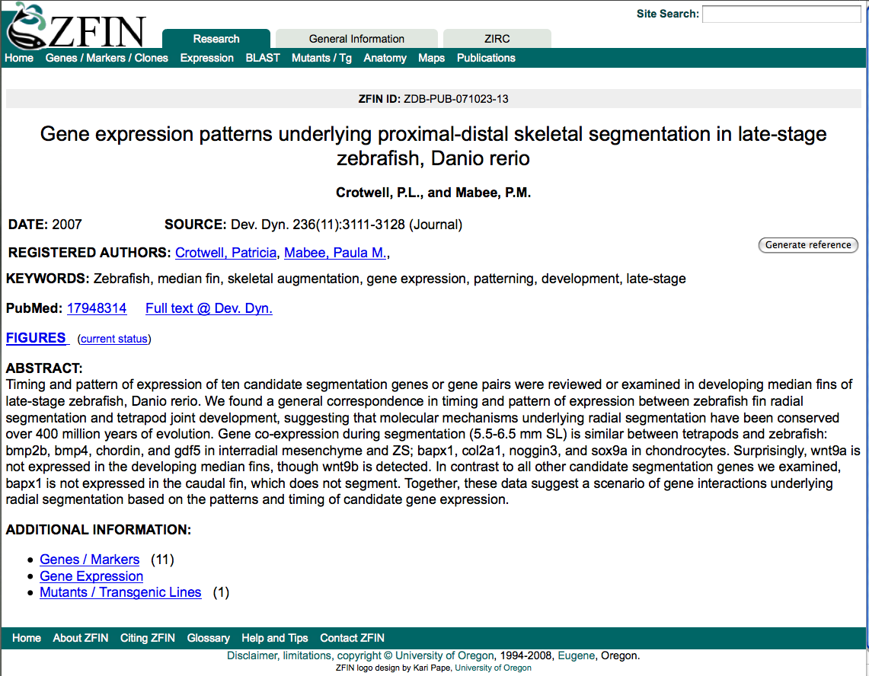

Slide 17
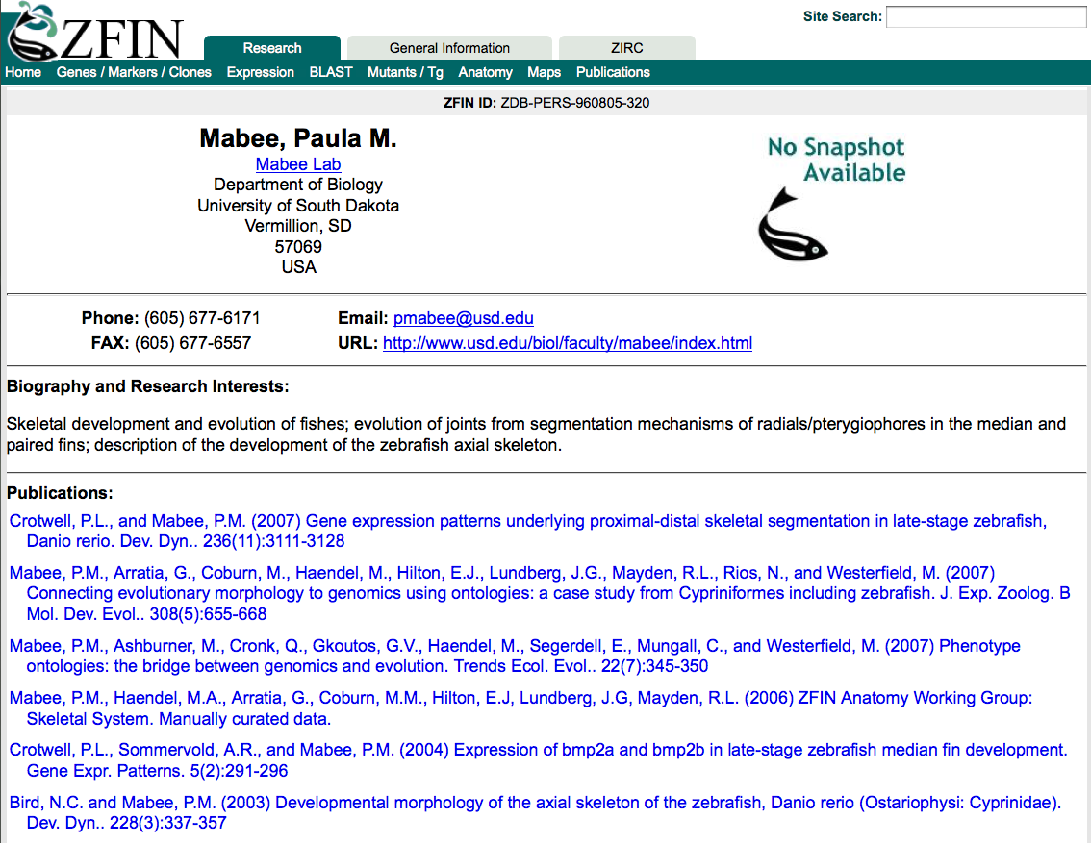
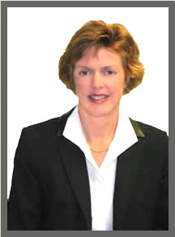

Slide 18
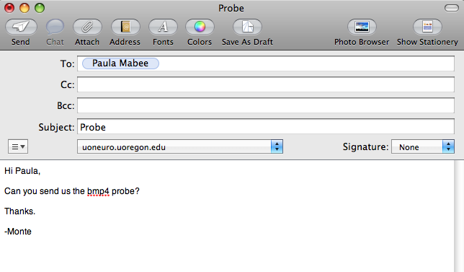

Slide 19
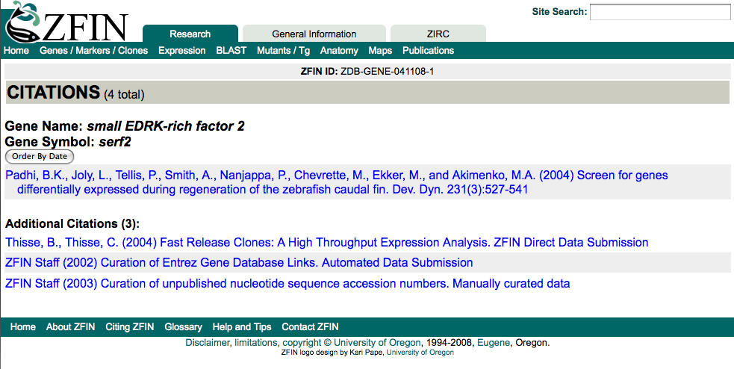

Slide 20
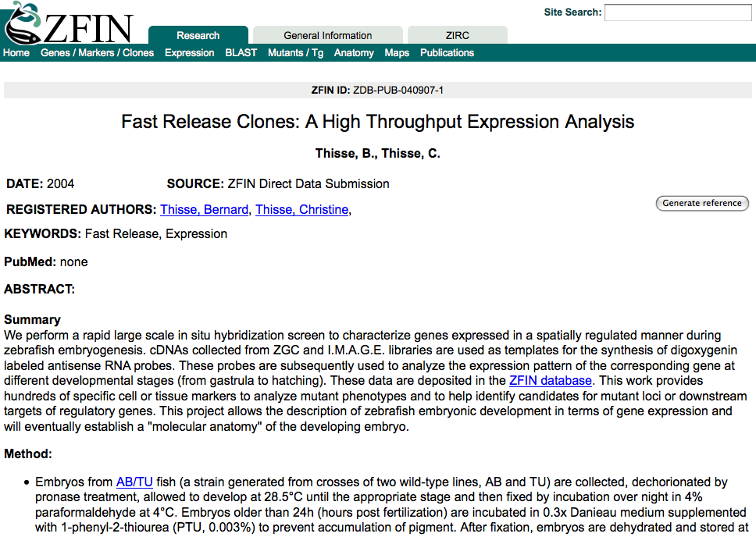

Slide 21
Model Organism Databases: Community Data Sharing
Recognized as a community resource
Ownership
Where’s my publication?

