Slide 1
Introductory comments and Fish Working Group 3 focus
Paula Mabee

Slide 2
Review: Working group 1: Ontology
Anatomical ontologies:
  Boot camp: ZFIN educated CToL on concept and value of ontologies
  CToL edited and is extending ZFIN ontology
  Ontologies necessary for evolutionary anatomy databases to relate to MOD databases
    Outside of POC, no multispecies ontologies yet developed

Slide 3
Working group 1: Defined (some) user needs
Co-query the zebrafish phenotype and genetic data with evolutionary anatomical data.

Slide 4
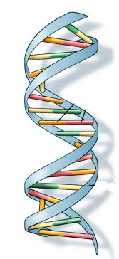
Model organism (zebrafish):
Mutagenesis produces phenotypes
Mutagenesis
Phenotype 1
Phenotype 2
Phenotype 3
Notes:
Approach to understanding genetic controls on morphology in model organisms is traditionally via mutagenesis. Lines of novel mutant phenotypes are maintained by model organism communities. 20,000 lines so far for zebrafish.
http://ghr.nlm.nih.gov/dynamicImages/understandGenetics/basics/DNA.jpg

Slide 5
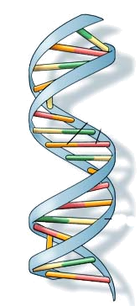
Evolution also produces phenotypes
Mutation, Gene Flow, Selection, Drift
Species A
Phenotype
Species B
Phenotype
Species C
Phenotype
Notes:
From the ToL perspective, of course, mutation initially produces the phenotype, but the processes here make particular phenotypes common.
http://ghr.nlm.nih.gov/dynamicImages/understandGenetics/basics/DNA.jpg

Slide 6
But, the genetic bases of morphology unknown
Mutation, Gene Flow, Selection, Drift
?
Species A
Morphology
Species B
Morphology
Species C
Morphology
Notes:
But in contrast to the model organism community, genetic bases are not known.
http://ghr.nlm.nih.gov/dynamicImages/understandGenetics/basics/DNA.jpg

Slide 7
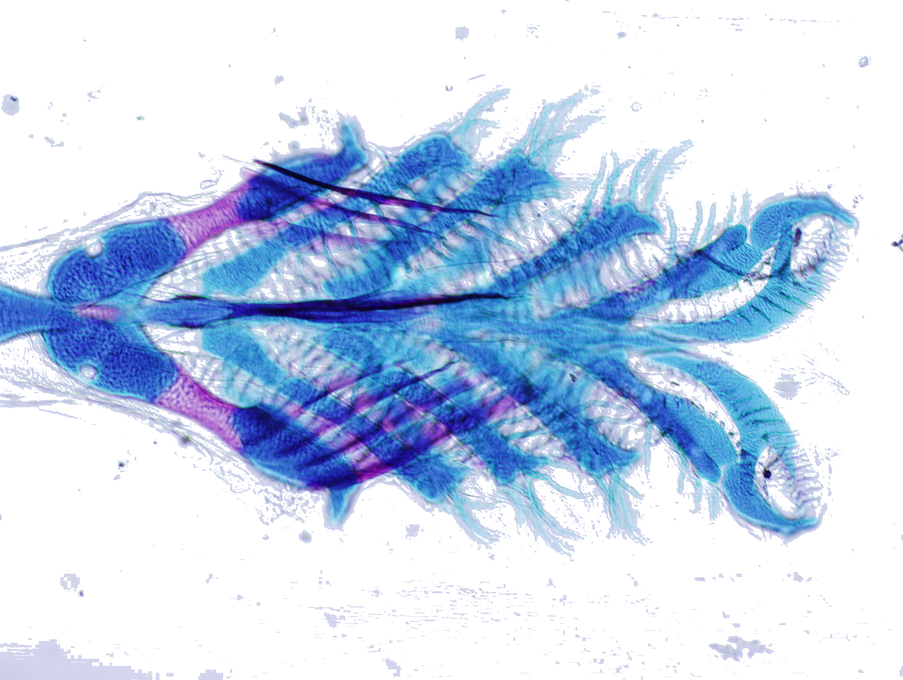
Example, user need 1. Search for candidate genes
Observe on tree: Ceratobranchial 5 evolves in shape across fishes
Query zebrafish db: What genes might be responsible for this variation?
Notes:
What can we do with this? We can use ontology…..search zebrafish mutants

Slide 8
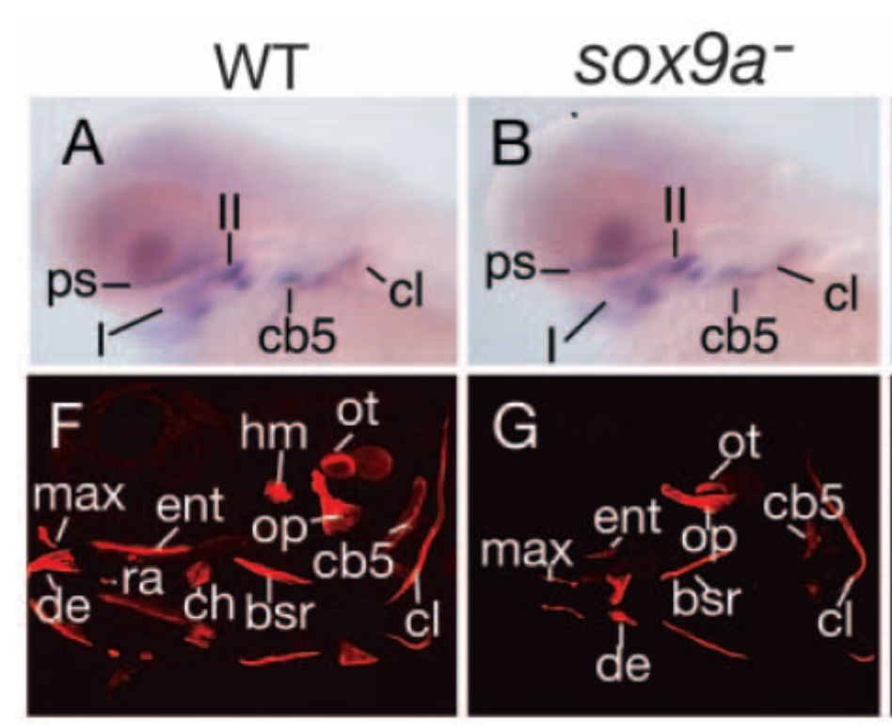
Search zebrafish mutant db….
Results: Ceratobranchial 5 shape modified in:
Mutant Gene(s) Expression Reference(s)
sox9ahi1134 sox9a 1 Fig Yan et al. ‘05
Yan (2005)s
Notes:
Using ontology, search zebrafish mutants

Slide 9
Example, user needs: 2. Search for character correlation
Observe on tree: Four characters support the monophyly of clade.
Query zebrafish db: Independent or correlated?
A
B
C
D
E
F
G
H
Dentary reduced
Maxilla reduced
Ceratohyal reduced
Opercle reduced
Notes:
Taxa across top
Lines rep history
Tic mark rep evo changes that occurred in that particular lineage in the past

Slide 10
Search zebrafish mutant db….
Results: Dentary, opercle, maxilla size co-regulated [in part] by sox9a
Conclude: Support for monophyly of clade is not as strong as it appears
A
B
C
D
E
F
G
H
Dentary reduced
Maxilla reduced
Ceratohyal reduced
Opercle reduced
Notes:
In sox9ahi1134 mutants these dermal bones were reduced vs. wild-type, whereas others were relatively unaffected (Yan, 2005)
I mentioned lepidoptera and plants here in relation to ontology development

Slide 11
Morphology Mutant/gene
Zebrafish phenotypes (relative to wt):
Maxilla: size reduction sox9ahi1134
Dentary: size reduction sox9ahi1134
Retroarticular: loss edn1
Opercle: size reduction; loss sox9ahi1134; lockjaw
Ceratohyal: shape change val
Branchiostegals: numberdecrease edn1
Branchiostegals: shape change she, stu, edn1-MO
Opercle: lost edn1, lockjaw
Opercle: size increase edn1
Hypobranchials: loss val
Ceratobranchial 5: size reduction sox9ahi1134
Arches 2—5: reduced or absence lockjaw
Arches 4—6: loss duckbill, flathead
Ethmoid: loss chameleon, cyclops, detour, etc.
Trabeculae: fused chameleon, cyclops, detour, etc.
Pectoral fin: loss Fgf24-MO
Median fins: loss lepidotrichia finless
Scapulocoracoid: loss sox9a loss
Neural and hemal spines: alignment chordin
Notes:
Here is list of morphological parts that are modified in mutants
And here is a list of the genes that they map to
These are changes in morphology relative to wt. 1 species.
But morphology is connected to genes!

Slide 12
Morphology
Cypriniform fish speces (rel. to outgroup)
Branchiostegal rays: number
Basibranchial 2: T-shaped
Basibranchial 4: development
Basibranchial 4: shape keeled
Basihyal: shape
Basihyal tooth plate
Copula 3
Hypobranchial 3: development
Hypobranchial 4
Ceratobranchial 5: size
Ceratobranchial 5: teeth
Infrapharyngeals; number
Infrapharyngeal 1: presence
Epibranchial 1: uncinate process
Pharyngeal teeth: rows
Interhyal: size
Ceratohyal: shape
Anterior ceratohyal: shape
Genes
?
Notes:
Characters from zebrafish relatives, the cypriniform fishes.

Slide 13
Candidate genes for evolutionary changes in Cypriniformes
Genes
Mutant
morphologies
Evolutionary
characters
Zebrafish
Many fishes
Notes:
I have now established the reason for links between evolutionary morphology databases and genetics databases

Slide 14
Review: Working group 2: Syntax and examples
Syntax for describing anatomy, using ontologies
  ZFIN and NCBO colleagues working on phenotype syntax (EAV, EQ)
  ZFIN + CToL tested syntax on character examples and concluded that specific extensions of the basic syntax are necessary for systematic characters (e.g. multiple entities). No examples were inconsistent with above phenotype syntax.
  *Syntax will work for systematic characters
    Benefits: interoperability with MODs; interoperability among evolutionary databases (as they develop)

Slide 15
Basic working group strategy
User syntax consistent with MODs:
  Frame systematic characters using entities from anatomical (AO) and qualifier (PATO) ontologies and map them to a skeleton taxonomic ontology.

Slide 16
Discussed Characters
Homologous features that vary across species
Contain historical information (are synapomorphic) at particular hierarchical levels in phylogeny
Notes:
First step: discover characters

Slide 17
Character + Character state = Character….
Character
State
Character
  E1 + A V
  (intercalar, shape) (rounded)
AO
PATO
homologous_to
E2 = Vertebra 2

Slide 18
Workshop 3 goal 1: Homology
Homology relationships must be exactly defined and consistently used in evolutionary morphology ontologies

Slide 19
New relationship type: Homologous_to
To be refined and added to OBO Sourceforge

Slide 20
Goal 1: What relationships are required for evo anatomy ontologies?
Homology: Homologous_to? Namespace? Table?
  Homology among Entities
  Homology among E+A (characters) + V (character states)?
Other?
  Not_quite_synonymous_with, but older usage (i.e. one term is preferred by whole or part of community)
  Serially_homologous to
  Not_homologous_to (=NULL?)

Slide 21
Goal 2: Define Homology Evidence Codes
Inferred from:
  Topology (=position?)
  Composition
  Development (ontogeny)
  Appearance (=form?)
  Personal comm.
  Literature
  Character congruence (phylogenetic congruence)

