Slide 1
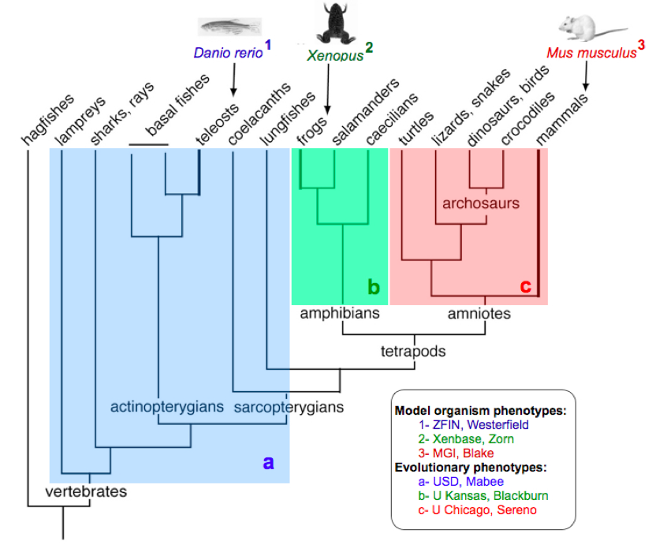
Model organism phenotypes
ZFIN
Xenbase
MGI
zebrafish
Xenopus
mouse
teleosts
amphibians
amniotes
vertebrates

Slide 2
Model organism phenotypes: (Monte, Ceri, Yvonne, Aaron, Christina, Judy, Terry)
zebrafish
Xenopus
mouse
teleosts
amphibians
amniotes
vertebrates

Slide 3
Model organism phenotypes
Aim
Annotate skeletal phenotypes for fin and limb for genetic mutants from zebrafish, Xenopus, and mouse
Milestones
Curation of phenotypes & gene expression
Incorporate phenotype & gene expression into KB
Develop pipelines for uploading Xenbase and MGI data to Phenoscape

Slide 4
Model organism phenotypes
Progress – ZFIN (as of April 2012)
61,000 phenotypes for ~4000 genes
800 of these are fin phenotypes
~2,000 publications
direct submissions

Slide 5
Model organism phenotypes
Progress – MGI
6100 limb phenotypes for 2500 genotypes
phenotypes curated as MP (mammalian phenotype) terms
MP terms mapped to EQ (complete for limb)
mappings are maintained up to date

Slide 6
Model organism phenotypes
Progress – Xenbase
XAO is_a and develops_from complete, all terms defined
VAO skeletal terms added to XAO
gene expression curated from all 123 legacy papers with limb data (200 images, 81 genes)
curators trained in phenotype curation at NESCent

Slide 7
Model organism phenotypes
Immediate future plans – ZFIN
import gene expression data into Phenoscape
keep up the good work!

Slide 8
Model organism phenotypes
Immediate future plans – MGI
continue curation
maintain limb MP->EQ mappings
develop pipeline to import mappings into Phenoscape
import anatomy terms & developmental stages (EMAPA) into Phenoscape
import gene expression data into Phenoscape

Slide 9
Model organism phenotypes
Immediate future plans – Xenbase
continue curation
develop pipeline to import data into Phenoscape KB
import gene expression and phenotype data into Phenoscape

Slide 10
Model organism phenotypes
Deliverables
complete & up-to-date phenotype & gene expression data for 3 model organisms
paper – methods & challenges of integrating such data

