Slide 1
Where we were last we met…
CARO and how it relates to you

Slide 2
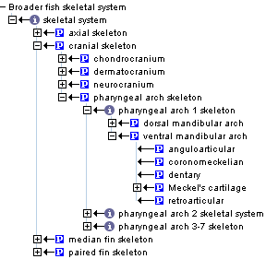
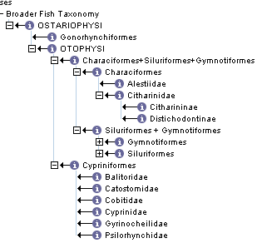
Taxonomy links to a multi-species fish anatomy ontology
Fish Anatomy ontology (BAO)
Taxonomy
in_organism
not_in_organism

Slide 3
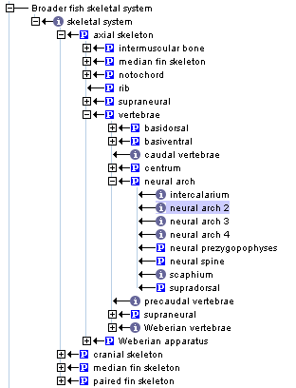
Homology assignment between two anatomical structures

Slide 4
Homology assignments are based on specific kinds of evidence
IP: Inferred from Position
ID: Inferred from Development
IC: Inferred from Composition
Each homology assignment is associated with reference to a physical piece of evidence, a person, or literature.
Taxa1:entity1
Taxa2:entity2
EC
attribution
Teleostei:supradorsal | Otophysi:Claustrum | IP,ID | Britz.Hoffman.2006
Teleostei:supradorsal | Otophysi:supraneural1 | ID | Coburn.Futey.1996

Slide 5
Goal is to agree upon:
evidence codes
types of entities that can be assigned a homology relationship
Many types of homology statements:
Homology between sister entities within sister taxa
Homology between groups of structures, even though none of the parts may be homologous e.g. forelimbs
c. Homology between structures at the level of some parent in the ontology e.g. vertebrate heart and fly heart are homologous as contractile vessels but not as hearts
d. Homology statements often refer to a taxonomic level e.g. neural arch 2 and intercalarium are homologous at the level of vertebrata.
e. Homology between a derived character and its ancestral state – between an entity in single taxon and an entity within a whole clade

Slide 6
CARO: canonical anatomy reference ontology
National Center for Biomedical Ontology (NCBO) sponsored a workshop to begin creation of CARO 9/06
Represents all organisms
High level classes can be used by other anatomy ontologies
Structural axis of classification, will link to function ontology
Defined relationships between structures
Integration and different views of anatomically related data

Slide 7
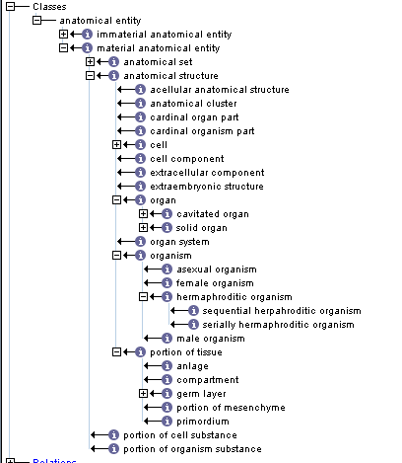
CARO

Slide 8
How does CARO relate to the cTOL project?
cTOL’s BAO is a testing grounds for CARO
How deep can CARO be?
How is taxonomy linked to anatomical structures?
Does CARO have representation of homology, or is this a separate set of data?
How will CARO integrate the anatomy of many species?
The answers to these questions are not so different from how cTOL will integrate anatomical structures of 10,000 species of fish, represent taxonomy and homology.
CARO will provide the structure and relations for the cTOL AO (and others)

Slide 9
Discussion points from the CARO meeting
Do we need a relationship in OBO-REL to define homology? This is a symmetric relation between sisters and it is the relationship that requires evidence and attribution.
Should homology assignments be a top-down or bottom up approach?eg. Pairs of taxa vs. CARO-centric assignments? RE:domain experts are required. It might be easier to enlist help in a pairwise manner.
Homology needs to be captured for similarity searches. Text or synonym searches are insufficient. Does CARO take into account homology or is it a separate data set?
If two structures are deemed homologous, how does this information transfer down is_a chains? Need use cases.

Slide 10
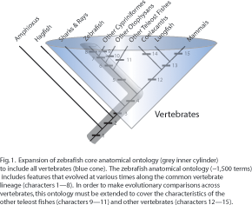
Homologous structures are already implicit within MODs ontologies

