Slide 1


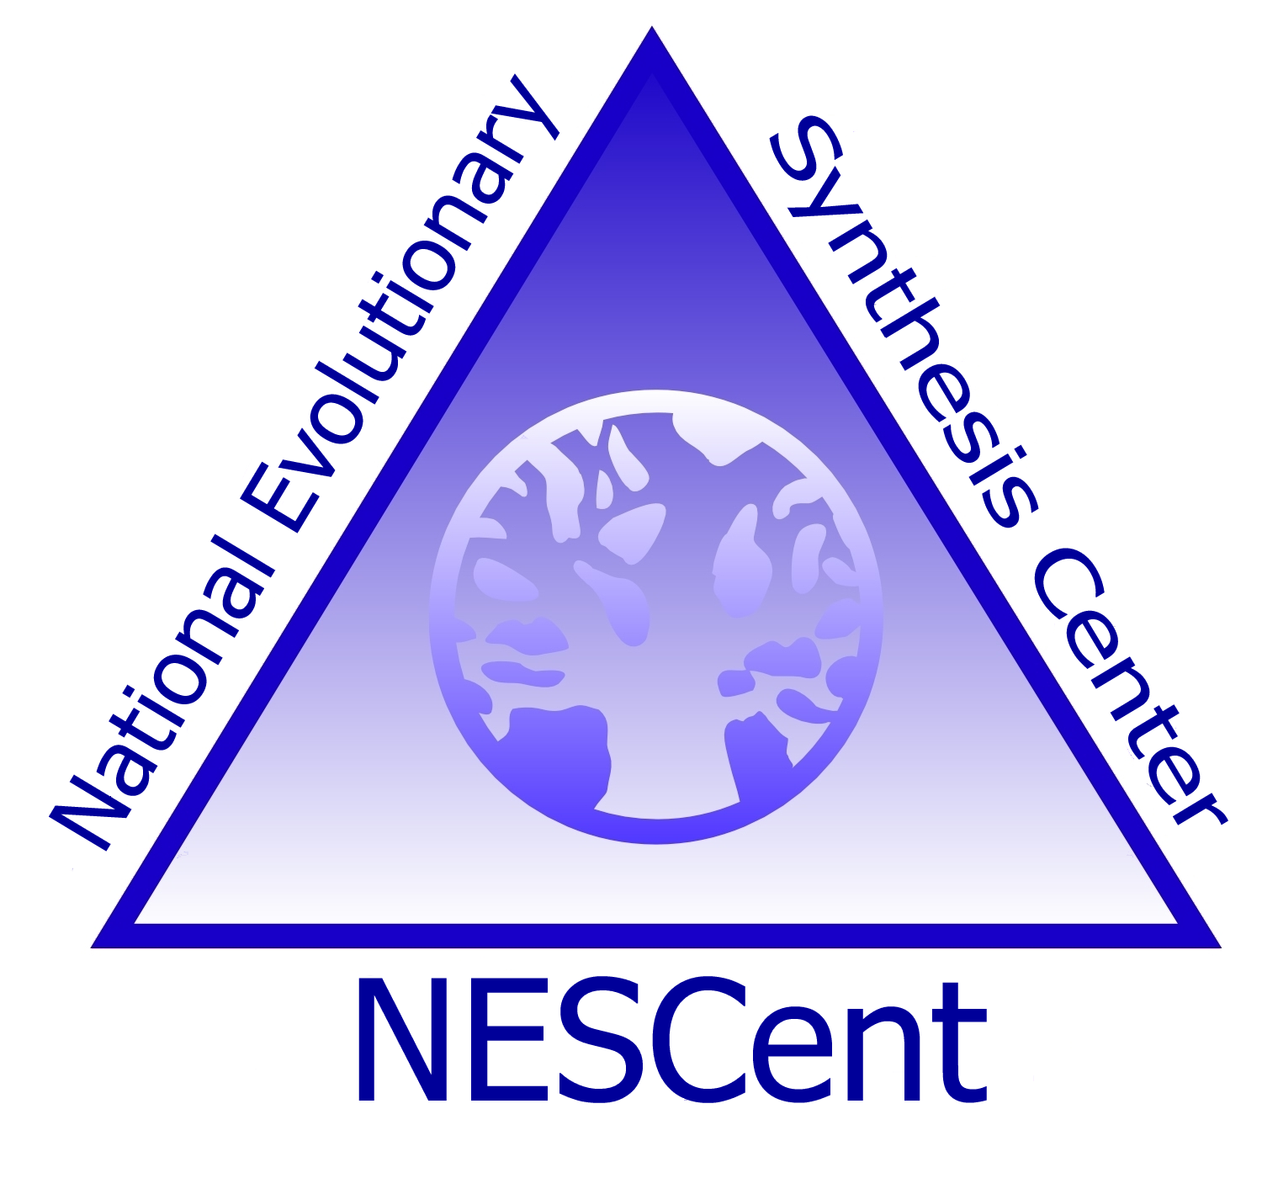

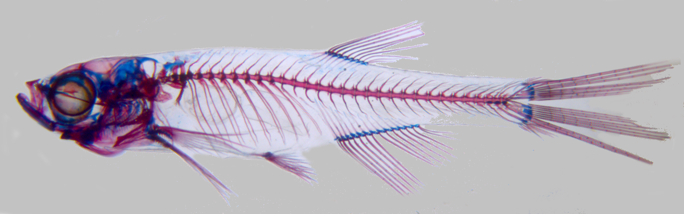
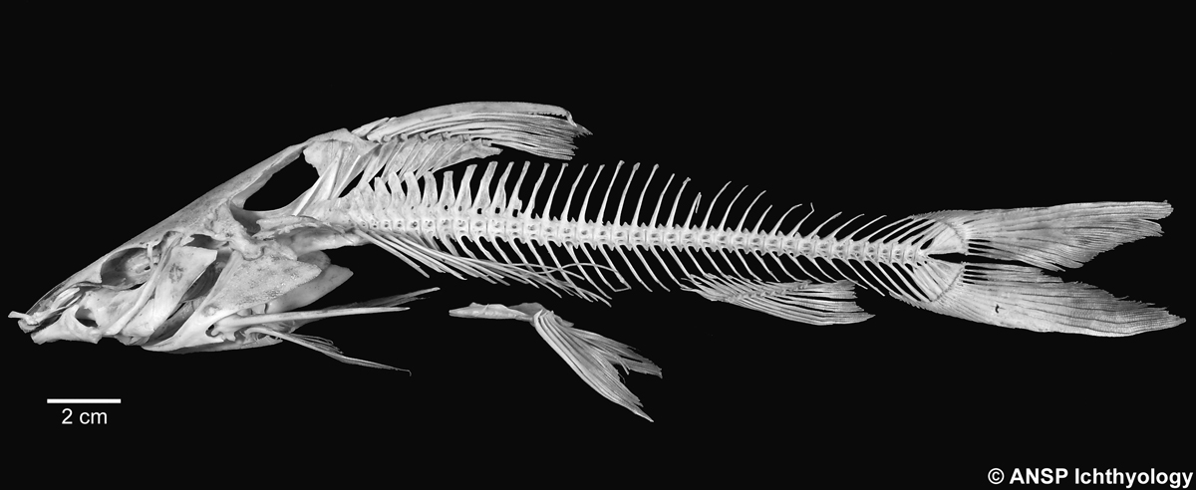
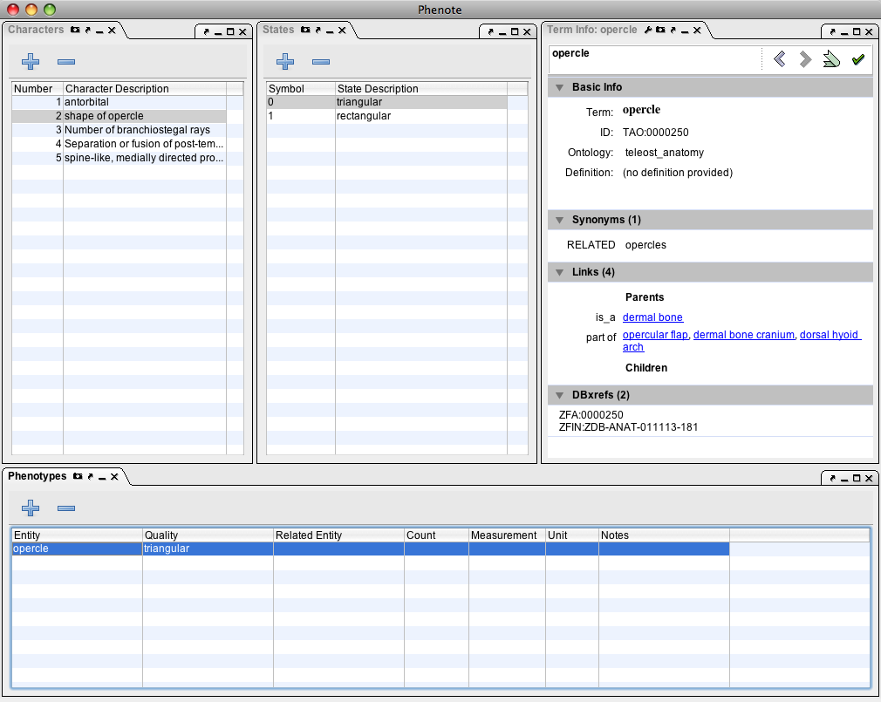
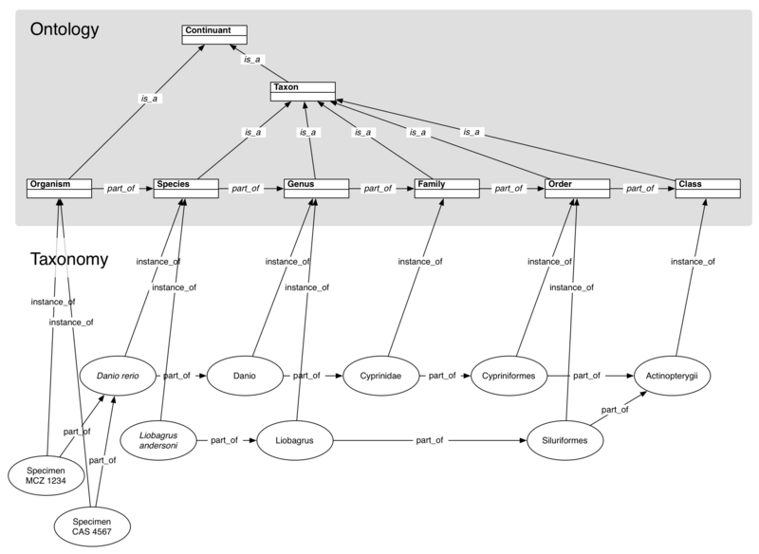
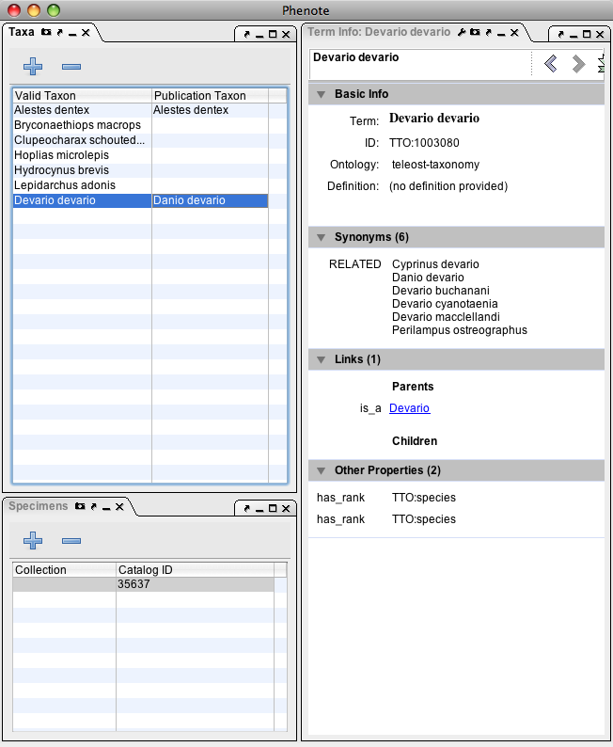


LINKING EVOLUTIONARY MORPHOLOGY TO GENOMICS USING ONTOLOGIES
Paula Mabee¹, Jim Balhoff², Wasila Dahdul^{1,3} , Hilmar Lapp², John Lundberg³,
Peter Midford⁴, Todd Vision^{2,5}, Monte Westerfield⁶
¹The University of South Dakota; ²National Evolutionary Synthesis Center (NESCent); ³Academy of Natural Sciences, Dept. Ichthyology; ⁴University of Kansas;
⁵University of North Carolina at Chapel Hill; ⁶University of Oregon, Zebrafish Information Network (ZFIN)
Multi-species anatomy ontology
Overview of the Phenoscape project
Taxonomy ontology
The Teleost Anatomy Ontology (TAO) is a multi-species anatomy ontology for teleost fishes that was developed by our group in September 2007. Development of the TAO is currently centered on the skeletal system, since it is often the focus of evolutionary studies in ichthyology and genetic studies in zebrafish.
Although systematists have collected comparative morphological data for decades, it has been rendered in free-form text and is not computable. Even seemingly straightforward comparisons across taxa, such as examining evolutionary patterns of characters from the same body region (e.g. head) or of the same quality (e.g. shape changes), cannot be made broadly without a database and some means of computation. Ontologies, or structured vocabularies with semantically defined relationships, provide such means and facilitate integration with other databases, including genetics databases from model organisms. Using ostariophysan fishes, we are prototyping a system with an ontology-based character database and generalizable tools to integrate evolutionary and model organism phenotype data. This system is designed to meet the top-priority needs of the evolutionary community concerning development and evolution of morphology. These include mapping characters on trees and identification of clades in which traits vary (quick retrieval of character state distributions), correlation matrices of traits, identification of candidate genes, and phenotypic BLAST to discover similar phenotypes and similar OTUs. Such queries will help address large-scale questions about the genetic and developmental regulation of evolutionary morphological transitions.
To date we have laid the groundwork for character annotation through the development of multiple ontologies, curatorial tools, and careful consideration of how to deal with homology, types of evidence, and voucher specimens. We have developed a multi-species anatomy ontology for teleost fishes (Teleost Anatomy Ontology) using the existing zebrafish anatomy ontology as its core. We have developed new components for Phenote, an open source software application, to facilitate the annotation of evolutionary characters from the literature using terms from the teleost anatomy ontology in combination with terms from the Phenotype and Trait Ontology (PATO) and Spatial Ontology (BSPO), following and adapting the Entity/Quality syntax of model organism databases. New components of Phenote include integration with traditional character matrices via NeXML, browsing characters and annotating states with EQ descriptions, and annotating taxa and specimens with ontology identifiers. We are documenting character observations from individual species whose names are drawn from a taxonomy ontology (Teleost Taxonomy Ontology) that we developed based on an expert database, the Catalog of Fishes. Phenoscape will enable researchers to investigate relationships between evolutionary changes in morphology and the phenotypes seen in genetically characterized developmental mutants of zebrafish.
We have submitted the TTO (Teleost Taxonomy Ontology) to the OBO Foundry and put it into production. The current version of the TTO is a tree of taxonomic terms, connected by the relation is_a, and a set of rank terms (e.g., order, family, etc.), which are associated with taxonomic terms with a special ‘has_rank’ relation. This ontology is generated from a database dump from Eschmeyer’s Catalog of Fishes (CoF). The tool will also allow updates and extract limited sets of taxonomic synonyms from the Catalog of Fishes. The update tool currently extracts the original name and the current valid name from the CoF, though we are working to extract the synonyms listed in a status comments field. We have also added, via manual curation, taxonomic updates from several area experts in Catfish, Characiformes, and Cypriniformes as well as several fossil taxa. This ontology currently contains 30,800 species and over 35,000 total terms.
What is an ontology?
An ontology is a controlled vocabulary consisting of terms, their definitions and relationships. For example, the TAO term ‘basihyal’ has the following definition, synonyms and relationships to other terms:
term name: basihyal
id: TAO:0000316
def: ”Endochondral bone that is the median and anteriorly projecting element of the ventral hyoid arch."
synonym: "basihyoid"
synonym: "glossohyal"
xref: ZFA:0000316
endochondral bone
ventral hyoid arch
basihyal cartilage
part_of
is_a
Taxonomic_rank
is_a
is_a
develops_from
Species
Genus
is_a
is_a
is_a
basihyal
has_rank
Family
Order
Class
Danio rerio
is_a
has_rank
is_a
has_rank
is_a
has_rank
is_a
has_rank
The primary relations used in the TAO are is_a, part_of, and develops_from. We recently added new anatomical relations (overlaps for representation of joints, and homologous_to - described below), and have proposed several new relations (attached_to and connected_to) to better represent anatomical diversity.
Danio
Cyprinidae
Cypriniformes
Actinopterygii
Curation and Update Process
Changes to the TTO come from either the CoF, taxonomic revisions from area specialists, or curators identifying taxa that are needed for annotating a publication. Curators submit their changes to the request tracker. Area specialists can submit their revisions as Excel files, which in some cases are directly processed by TTO Update.
TAO requires many new terms
Zebrafish, Danio rerio
The TAO was originally cloned from the single-species Zebrafish Anatomy Ontology. We maintain synchrony between the two ontologies (see below) but the TAO requires many new terms to encompass the morphological diversity present in teleost fishes.
Phenote for evolutionary data entry
Catalog of
Fishes
update
TTO Update
TTO
1 mm
pelvic fin
hemal spine
middle nuchal plate
spinelet
Catfish, Pimelodus maculatus
Phenote is a software application developed by the National Center for Biomedical Ontology for the curation of biological phenotypes using ontologies. Data annotated with Phenote is based on the Entity/Quality (EQ) model for representing phenotypes, combining entities from any ontology with qualities (such as from the Phenotype and Trait Ontology, PATO). We have incorporated the new Teleost Taxonomy Ontology and Teleost Anatomy Ontology into Phenote. Phenote provides facilities for loading ontologies and easily selecting terms. In addition, we have created a custom interface to Phenote that supports the unique needs of our curators in handling evolutionary data:
Area specialists
revision
Manual commit
anterior
nuchal plate
TTO term
request
tracker
Teleost-discuss
Mail list
TTO administrator
Curators
pelvic fin
hemal spine
Character/character state-oriented Phenote interface
The next step
We are working on changing the taxonomy from a traditional hierarchy of is_a relations to representing species and higher taxa as individuals, related by part_of. This is the first step towards representing taxa as clades, which will allow better interoperability between the TTO and phylogenies. The taxonomy will become a network of individuals, with the ranks in an ontology (see below).
New term addition
Browse the list of characters, character states and taxa directly from a character matrix file
Compose EQ phenotype descriptions - ontological descriptions of character states - using anatomy and phenotype ontologies
Choose taxa directly from the Teleost Taxonomy Ontology (TTO)
Growth of the TAO is enabled by term requests from anatomy curators and feedback from the ichthyological community through the teleost-discuss mailing list. The TAO is updated frequently to include new terms, refined definitions, synonym additions, and structural changes. Updates that also apply to the Zebrafish Anatomy Ontology (ZFA) are made during synchonization.
Anatomy curators
request term
TAO term request tracker
email sent to….
Teleost-discuss
Need new anatomy term
community
e-mail
community decision
TAO administrator
adds new term
TAO
synchronization
ZFA
Above: Entering EQ phenotypes to describe a character state in Phenote
Homology
Terms in a multi-species anatomy ontology are structurally defined, and homology is not implied if the same term is used in annotations for different species. Likewise, homology is not implied if differently named terms share structural characteristics. Homology links are important in the use of multi-species ontologies to clarify homology relations between terms.
We have developed a method for homology designation by recording homology statements outside of the ontology, as an annotation with attribution and evidence codes. Homology statements are hypotheses, and users of our database will have the option of viewing competing hypotheses of homology when they occur.
Embedding EQ into traditional character data via NeXML
Systematic data are commonly stored within the familiar NEXUS file format for character matrices
NeXML is a new XML version of NEXUS - it is more robust, and easier to process and integrate custom annotations, such as ontology-based EQ phenotypes
EQ data are stored using the PhenoXML format, embedded within NeXML
Taxon TTO identifiers are stored as custom annotations to taxa in the taxa block
Ontology annotations should be safely round-tripped within NeXML by upcoming versions of Mesquite, while free-text data can be edited at any time within either Phenote or Mesquite
Links
Homepage: http://www.phenoscape.org
Blog: http://blog.phenoscape.org
Email discussion: phenoscape-discuss@lists.sourceforge.net
Phenote homology table
Above: Editing taxa in Phenote by selecting from
a taxonomy ontology
Acknowledgements
We thank NSF DBI 0641025; NIH HG002659 and the National Evolutionary Synthesis Center (NESCent) NSF #EF-0423641 for funding.

