Slide 1
Overfitting and Underfitting in Machine Learning
AIAA 2711 — Spring 2025
Member A · Member B · Member C
1 / 14
Notes:
Welcome everyone. My name is [Speaker 1], and together with [Speaker 2] and [Speaker 3], we will present our study on overfitting and underfitting in machine learning. (10s)

Slide 2
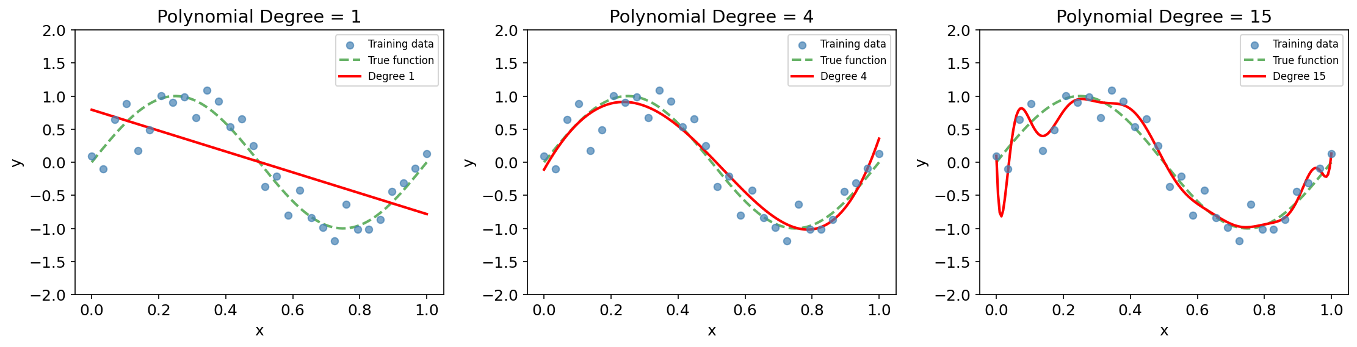
The Hook: Which Model Do You Trust?
✨ Vote by show of hands: degree 1, degree 4, or degree 15?
Interactive Question
Which polynomial would you trust to predict a NEW data point?
2 / 14
Notes:
[INTERACTION] Show 3 plots. Ask audience: 'Which polynomial would you trust to predict a new data point?' Quick hand raise for degree 1, 4, 15.
'This is the fundamental tension in ML — too simple vs too complex. Today we derive the mathematics behind WHY this happens and HOW to fix it.' (50s)

Slide 3


Formal Definitions
Training Error:
Underfitting
E_train is HIGH — model too simple. Both training and test errors are large.
Test Error:
Overfitting
E_train ≪ E_test — generalization gap. Model memorizes noise in training data.
Key Message
The generalization gap (E_test − E_train) is our diagnostic tool.
3 / 14
Notes:
Define training and test error formally. Underfitting = high training error; overfitting = large gap between train and test. 'The generalization gap is our diagnostic.' (40s)

Slide 4
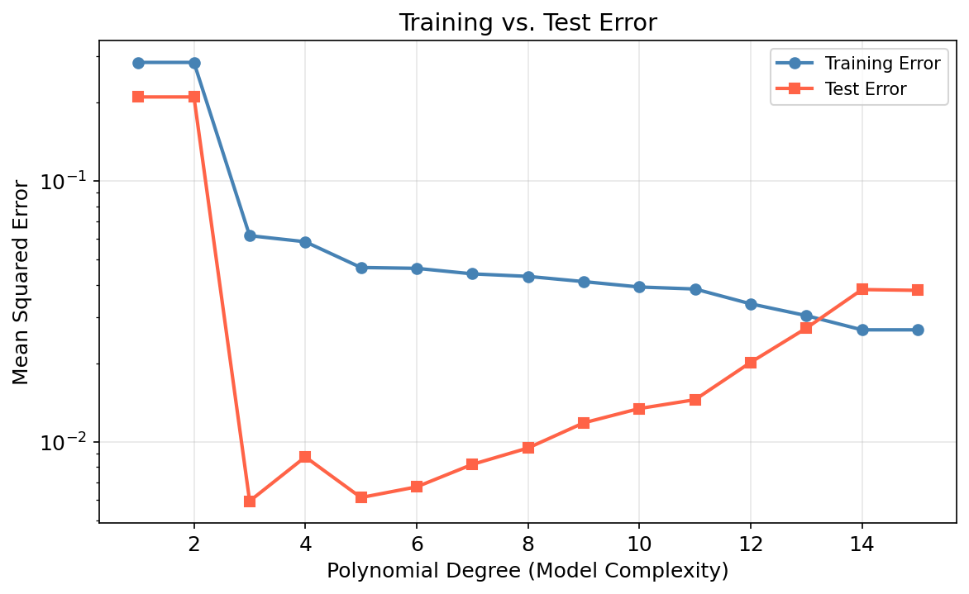
Why Does Test Error Follow a U-Shape?
• Training error ↓ monotonically with complexity
• Test error is U-shaped
• Minimum near degree 3–5
The Answer:
Bias-Variance Decomposition (uses expectation & variance from Weeks 9–10)
4 / 14
Notes:
Training error always decreases, but test error has a U-shape. The sweet spot is around degree 3–5. We explain this via bias-variance decomposition. 'This uses expectation and variance from Weeks 9 and 10.' (20s)

Slide 5

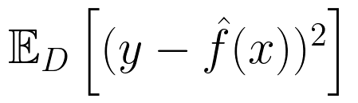
Bias-Variance Decomposition: Setup
Data Model:
Key Point
f(x) : true underlying function
ƒ̂(x) : model trained on dataset D
ε : irreducible noise (Gaussian)
The expectation is over ALL possible training datasets D. We ask: on average, across all training sets we could draw, how far off is our model?
Our Goal — decompose:
5 / 14
Notes:
Set up the bias-variance framework. y = f(x) + noise. We train f-hat on dataset D. The key insight: expectation is over ALL possible training sets D. (40s)

Slide 6

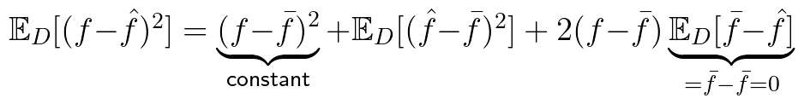
Bias-Variance Derivation: Step-by-Step ★
Step 1: Substitute y = f + ε and expand
Cross-term: ε is independent of ƒ̂, and f is fixed, so E[ε(f − ƒ̂)] = E[ε] · E[f − ƒ̂] = 0 · (…) = 0 Also: E[ε²] = σ²
Step 2: Let ƒ̄ ≡ E_D[ƒ̂], add-subtract ƒ̄
Cross-term: E_D[ƒ̄ − ƒ̂] = ƒ̄ − E_D[ƒ̂] = ƒ̄ − ƒ̄ = 0 (by definition of ƒ̄)
6 / 14
Notes:
[CORE SLIDE 6a - Step through EVERY term]
Step 1: Substitute y=f+eps, expand square -> 3 terms. Cross-term: eps independent of f-hat, E[eps]=0, so cross-term=0. E[eps^2]=sigma^2.
Step 2: Let f-bar = E_D[f-hat]. Add-subtract f-bar, expand -> 3 terms. Cross-term: E_D[f-bar - f-hat] = f-bar - f-bar = 0 by definition. (50s)

Slide 7
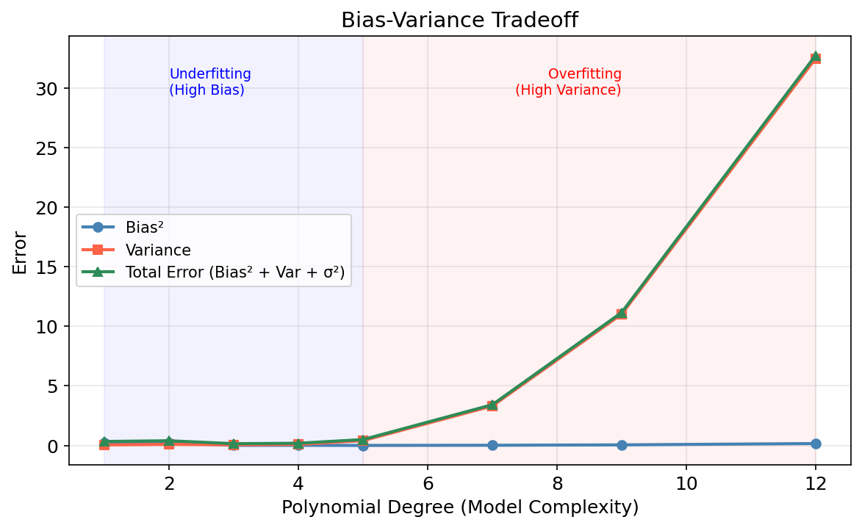
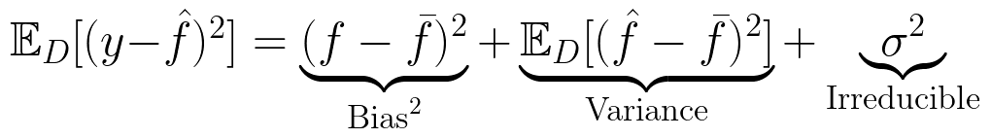
Bias-Variance: Result & Verification
Combining Steps 1 & 2:
Interpretation:
Bias²
Variance
Avg model's distance from truth High bias → underfitting
Prediction fluctuation across datasets High variance → overfitting
Complexity ↑ → Bias ↓ Variance ↑ | Complexity ↓ → Bias ↑ Variance ↓
Monte Carlo verification 200 independent datasets
σ² = irreducible noise floor — no model can beat this
7 / 14
Notes:
[CORE SLIDE 6b] Present boxed result. Interpret: Bias = avg model distance from truth (underfitting). Variance = prediction fluctuation (overfitting). sigma^2 = noise floor.
[POINT TO FIGURE] Monte Carlo with 200 datasets: blue=bias drops, orange=variance rises, sum = U-shape, minimum at degree 3-4. 'Theory predicts, experiments confirm.' (40s)

Slide 8


Regularization: Constraining Complexity
High variance → overfitting. Fix: constrain model complexity.
Ordinary Least Squares (no penalty):
Ridge Regression (L2 penalty):
Course Connection
The L2 norm is the Euclidean norm from Week 3.
8 / 14
Notes:
[Speaker 2] 'We know WHY overfitting happens — high variance. How do we FIX it? By constraining complexity. Ridge adds an L2 penalty — the Euclidean norm from Week 3.' (30s)

Slide 9

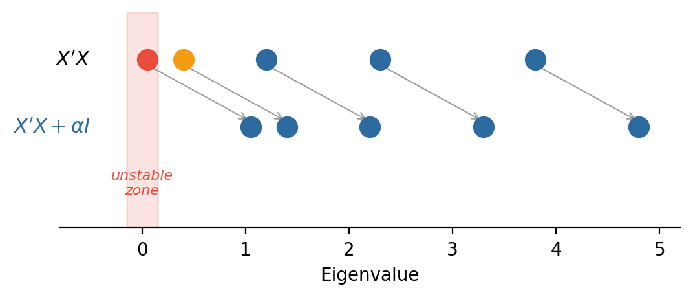
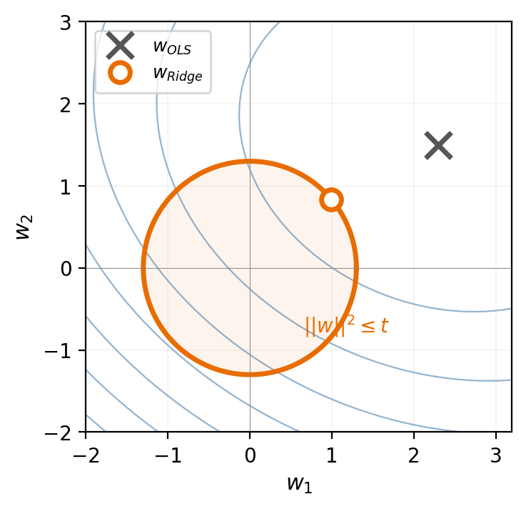
Ridge: Closed-Form & Two Interpretations
Closed-form:
vs. OLS: (X'X)⁻¹ X'y — only +αI
① Eigenvalue Perspective (Week 5)
② Lagrangian Perspective (Week 9)
min ||y−Xw||² s.t. ||w||² ≤ t α = Lagrange multiplier
αI shifts eigenvalues right → stabilizes inversion → reduces variance
Larger α → smaller ball → simpler model
Key Insight
Adding αI trades a SMALL bias increase for a LARGE variance decrease.
9 / 14
Notes:
Ridge closed-form: only difference from OLS is +alphaI.
[POINT TO LEFT FIGURE] Eigenvalue view: small eigenvalues make OLS unstable. Adding alpha shifts all eigenvalues right, stabilizing inversion.
[POINT TO RIGHT FIGURE] Lagrangian view: Ridge is constrained optimization. The circle is ||w||^2 <= t. The ellipses are loss contours. The tangent point is the Ridge solution.
'Small bias increase buys large variance decrease.' (80s)

Slide 10
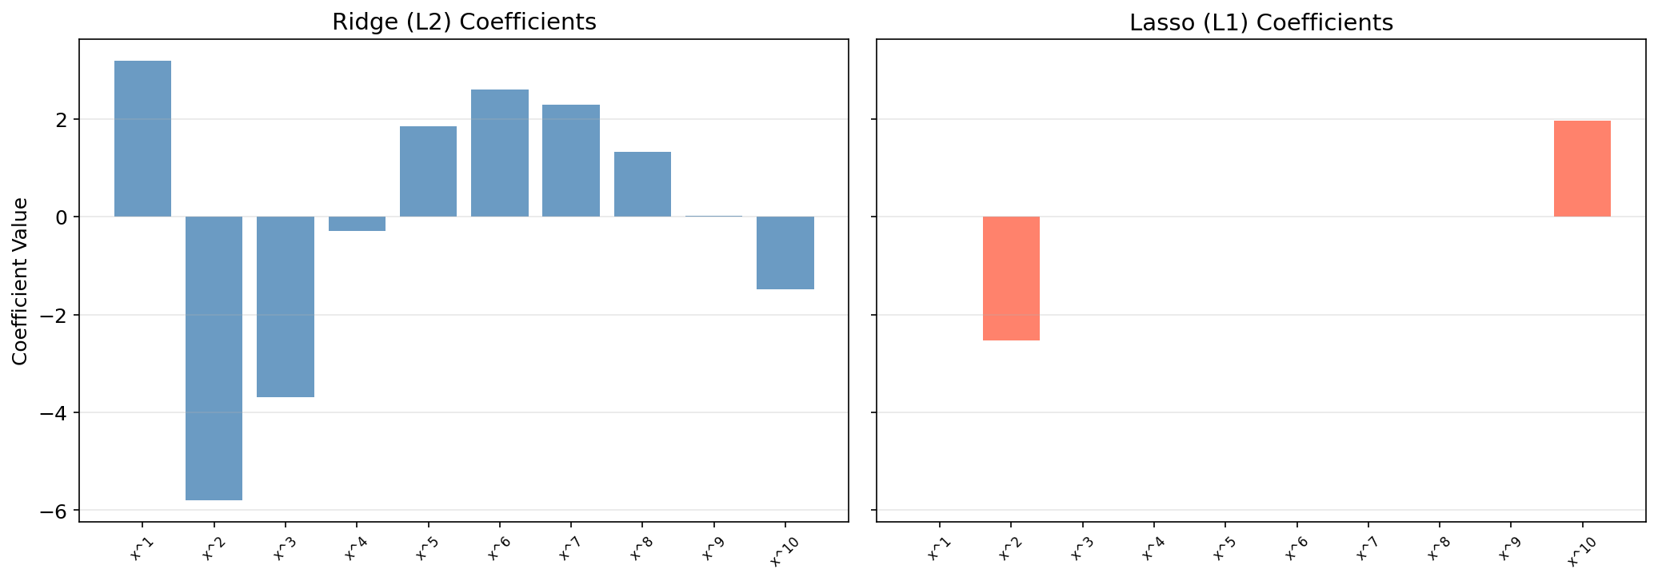

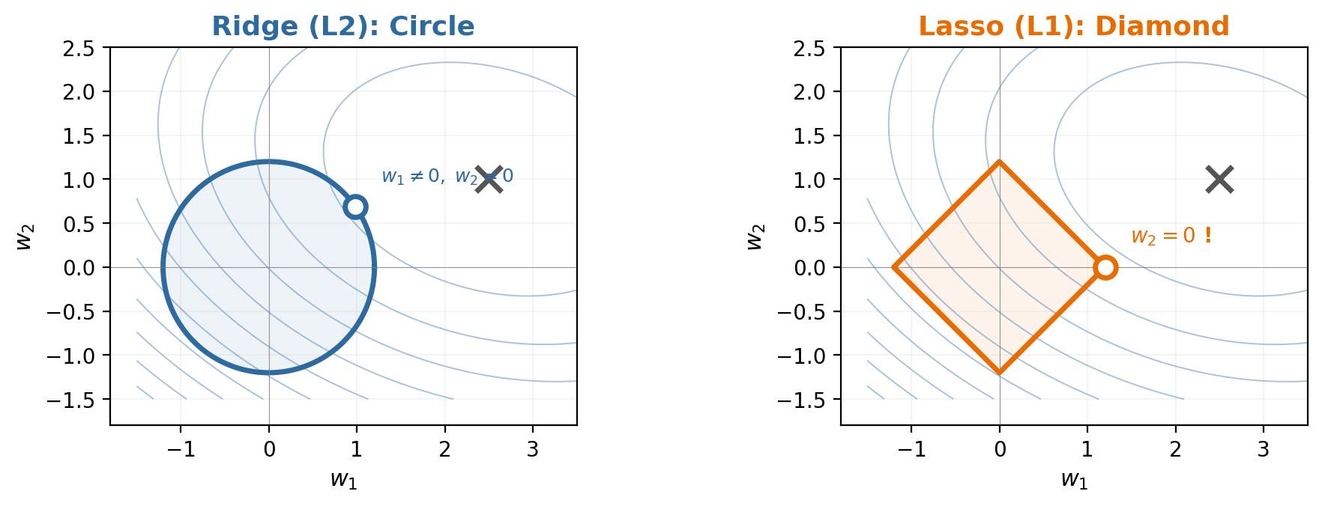
Lasso & L1 vs L2 Geometry
Lasso (L1 penalty):
L2 circle → smooth shrinkage | L1 diamond → corners on axes → sparse solutions
Geometric Insight
The L1 ball has corners on coordinate axes. The optimum lands on corners → coefficients become exactly zero. Lasso = regularization + feature selection.
10 / 14
Notes:
[POINT TO LEFT FIGURE] L2 ball = circle, tangent point not on axes (both w1 and w2 non-zero). L1 ball = diamond with corners ON axes. The contour hits a corner -> w2=0. That's sparsity!
[POINT TO RIGHT FIGURE] Ridge coefficients shrink smoothly. Lasso coefficients drop to exactly zero one by one.
'Lasso = regularization + feature selection.' (60s)

Slide 11
Choosing α: K-Fold Cross-Validation
How to choose the regularization parameter α?
Step 1: Partition
Step 2: Train
Step 3: Average
Step 4: Select
Partition data into K equal folds
Train on K−1 folds, evaluate on fold k
Average the K evaluation scores
Select α that minimizes CV error
Key Advantage
Unbiased test error estimate WITHOUT a separate validation set — every data point used for both training and evaluation.
11 / 14
Notes:
'How to choose alpha? K-fold cross-validation. 4 steps: partition, train, average, select. Gives unbiased test error estimate without separate validation set.' (30s)

Slide 12
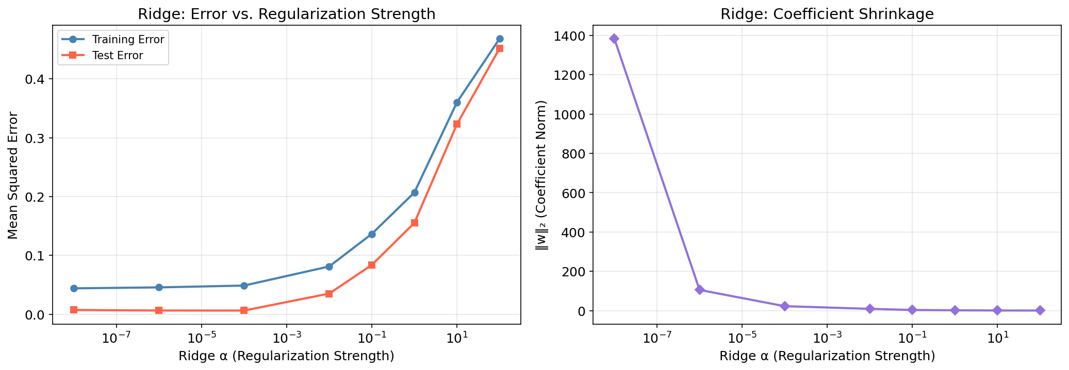
Experimental Verification: Theory → Experiment
① U-Shaped Test Error
② Bias↓ Variance↑
③ Ridge Shrinks Coefficients
Test error first drops, then rises as polynomial degree increases
Monte Carlo (200 datasets): bias drops, variance rises
As α increases, coefficients shrink and test error drops
✅ Confirmed
✅ Confirmed
✅ Confirmed
All three theoretical predictions confirmed experimentally. Theory predicts, experiments verify.
12 / 14
Notes:
[Speaker 3] 'Three predictions, three experiments, all confirmed.
[POINT TO LEFT] Prediction 1: test error is U-shaped with complexity. Our polynomial experiment confirms it.
[POINT TO MIDDLE] Prediction 2: bias drops, variance rises. Monte Carlo with 200 datasets shows exactly this crossover.
[POINT TO RIGHT] Prediction 3: Ridge shrinks coefficients. As alpha increases, weights shrink and test error finds a sweet spot.
'Theory predicts, experiments confirm.' (50s)

Slide 13
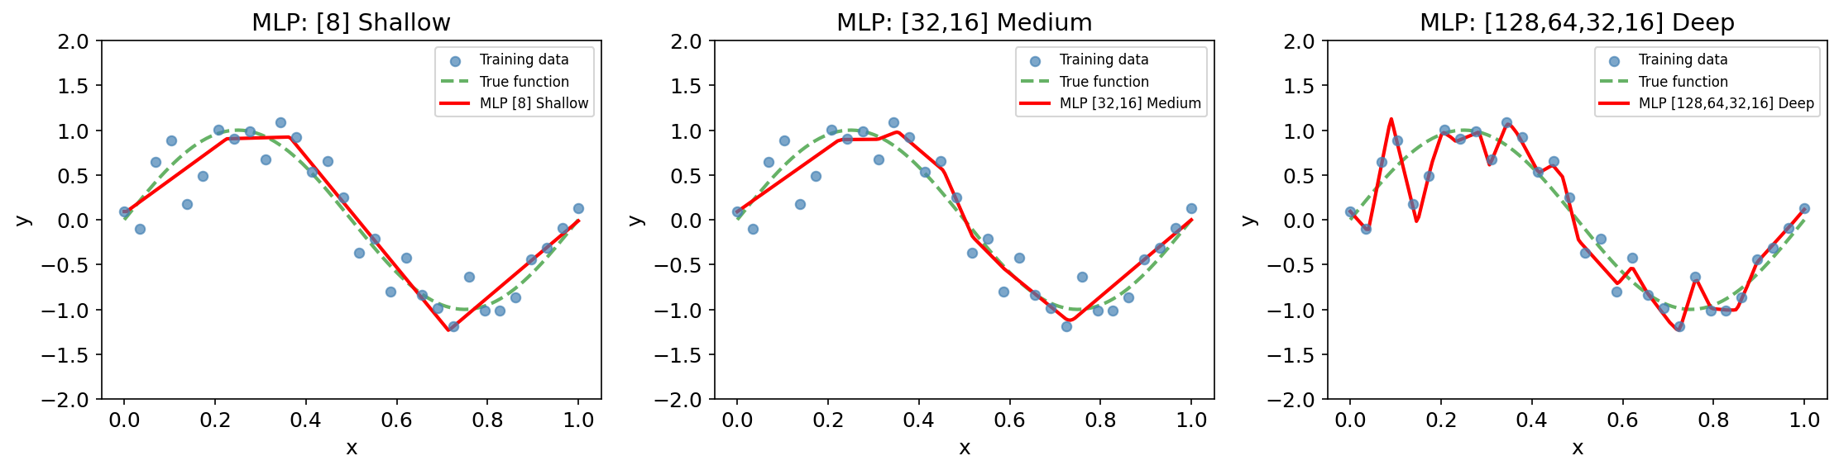
Beyond Polynomials & Key Takeaways
3 Key Takeaways
① Bias-Variance Decomposition
explains the underfitting/overfitting tradeoff mathematically
② Regularization (Ridge L2 / Lasso L1)
controls complexity via norm penalties
③ Cross-Validation
Same bias-variance principle applies to neural networks.
selects the optimal balance point
13 / 14
Notes:
'Same principle applies to neural networks — shallow underfits, deep overfits. 3 takeaways: (1) B-V decomposition explains tradeoff; (2) Regularization controls complexity; (3) Cross-validation selects balance point.' (40s)

Slide 14
Quick Challenge & Q&A
Scenario:
A model achieves 99% training accuracy but only 60% test accuracy. Q1: Is this overfitting or underfitting? Q2: What would you recommend to fix it?
Answer:
Generalization gap = 39% → Overfitting (high variance) → Add regularization / reduce model complexity / collect more data
Thank You — Questions?
14 / 14
Notes:
[INTERACTION] Read scenario. Pause 5s for audience thinking.
'Generalization gap is 39% — clearly overfitting. Fix: add regularization or reduce complexity.' Thank you. Open for Q&A. (30s)

