Slide 1
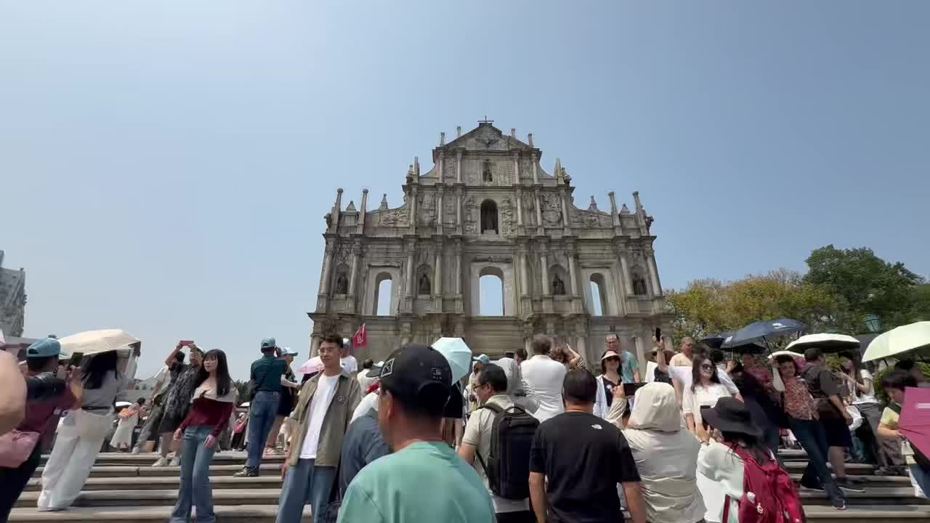
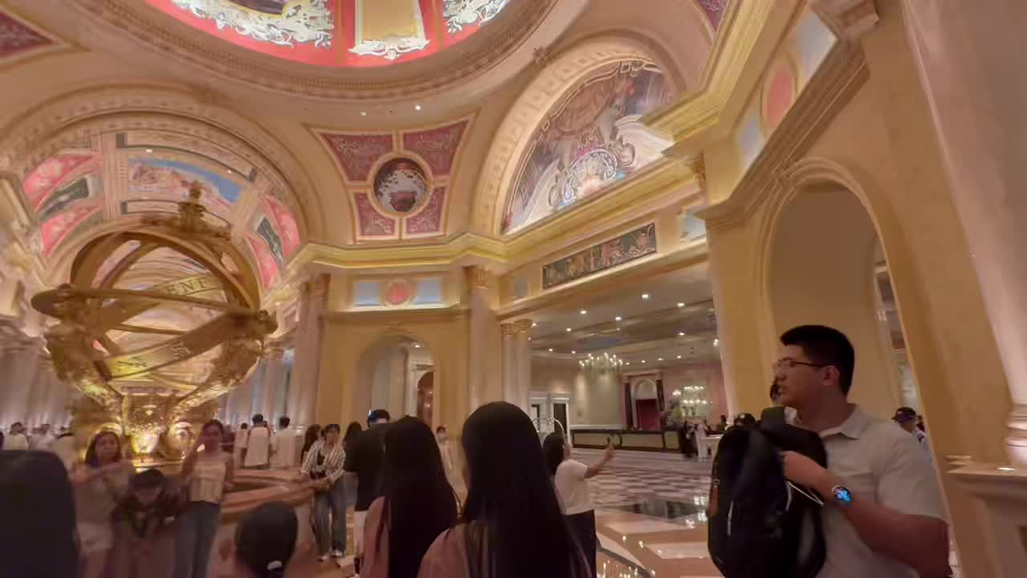
Walking Through
Many Macaus
How Urban Spaces Translate Cultural Identity
穿行于多个澳门：城市空间如何翻译文化身份
UCUG1600 Final Presentation

Slide 2
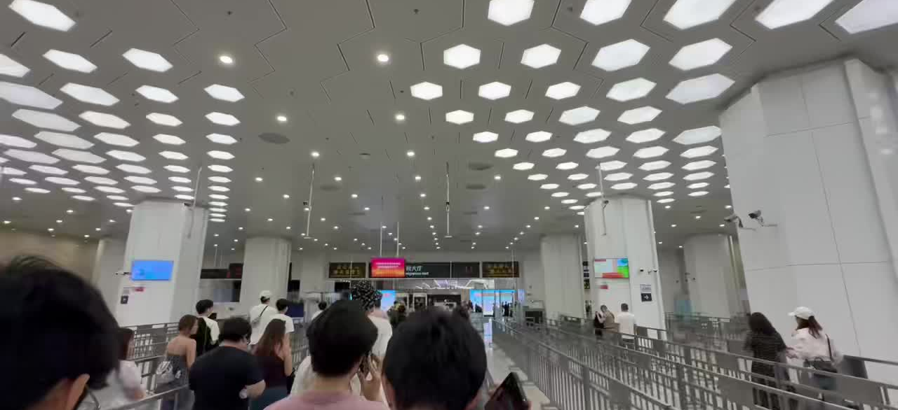
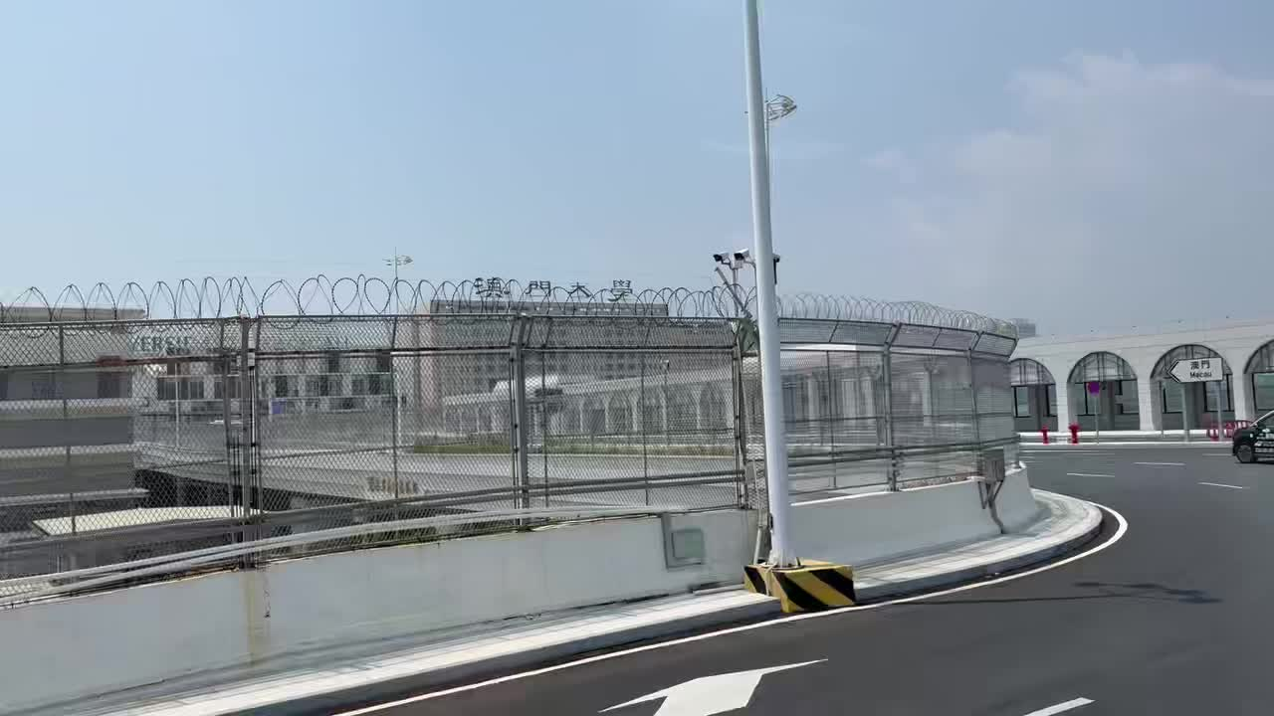
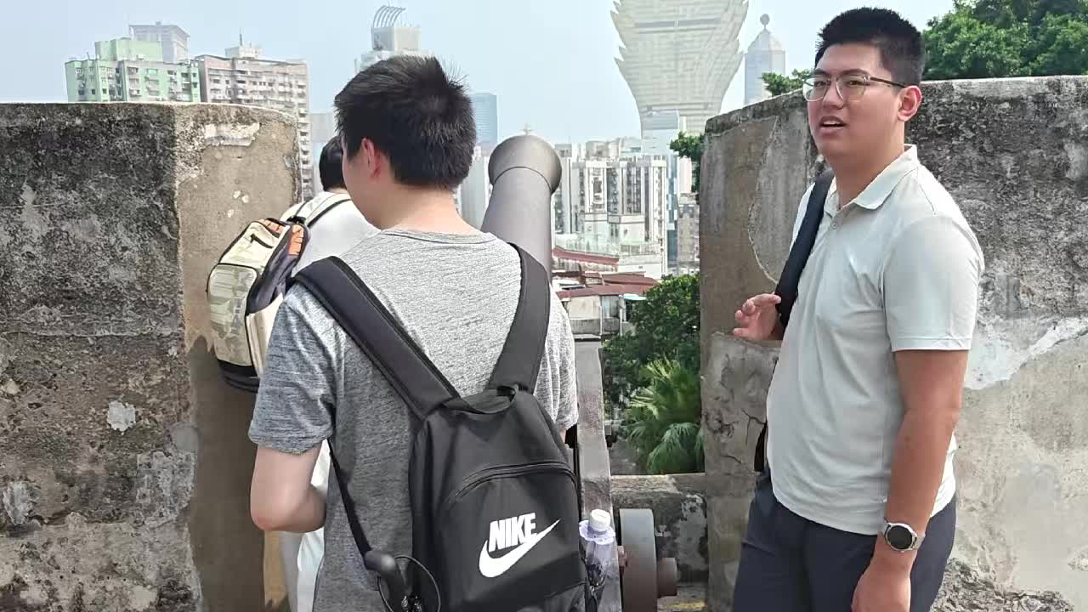
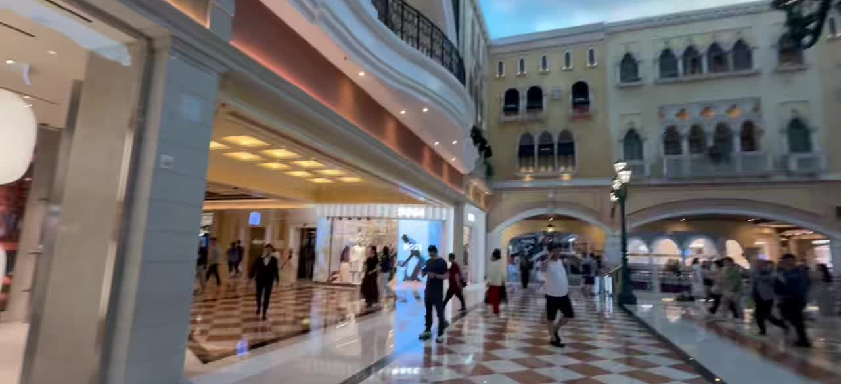
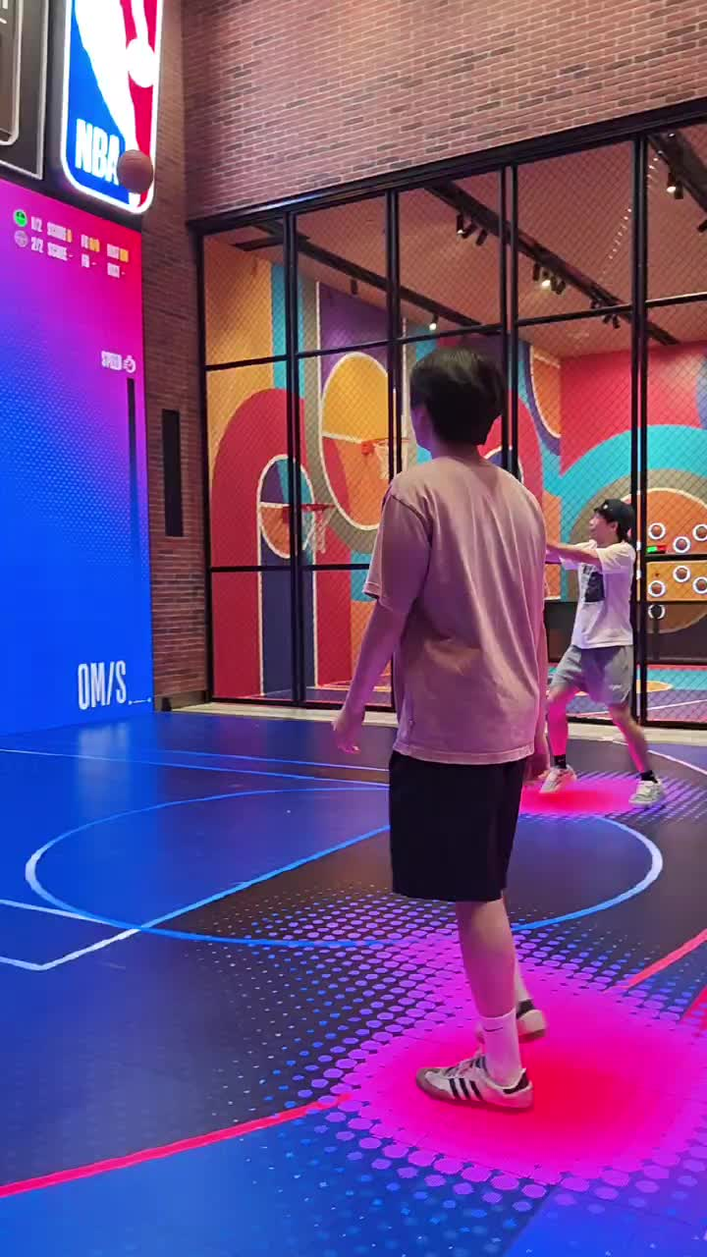
OPENING
One route, many cultural identities
开场先让观众跟着路线移动，而不是先听概念。
Border
Movement
Heritage
City view
Venetian
NBA
播放视频：E:\Project\1600\slide\assets\opening_montage.mp4
UCUG1600 Intercultural Communication | Fieldwork in Macau
02

Slide 3
RESEARCH TURN
AI gave us an entry point, not the final answer
AI 是头脑风暴工具；fieldwork 负责修正问题。
After fieldwork
Before fieldwork
The route itself became the framework.
Bilingual street names
双名街道
critical revision
Instead of forcing the data into AI-generated topics, we asked how different urban spaces translate Macau's cultural identity.
Soundscape map
声音地图
UCUG1600 Intercultural Communication | Fieldwork in Macau
03

Slide 4
METHOD
How do spaces communicate culture?
研究问题与方法：直接观察、影像记录、路线分析、感官观察。
How do Macau's urban spaces communicate multiple cultural identities through language, architecture, sound, consumer symbols, and movement?
Direct observation
Photo / video documentation
Walking route analysis
Sensory notes
直接观察
照片与视频记录
路线分析
声音与氛围观察
No formal interviews: our claims focus on observable public-space symbols, not personal opinions.
UCUG1600 Intercultural Communication | Fieldwork in Macau
04

Slide 5
ROUTE
Our route became our framework
每次地点转换，都是文化解释框架的转换。
1
2
3
4
5
6
Border
Coach / Hotel
Streets
Heritage
Transit
Spectacle
口岸
大巴与酒店
大三巴周边
大三巴 / 大炮台
公交转场
威尼斯人 / NBA
Route is not background information. It is the analytical structure.
UCUG1600 Intercultural Communication | Fieldwork in Macau
05

Slide 6
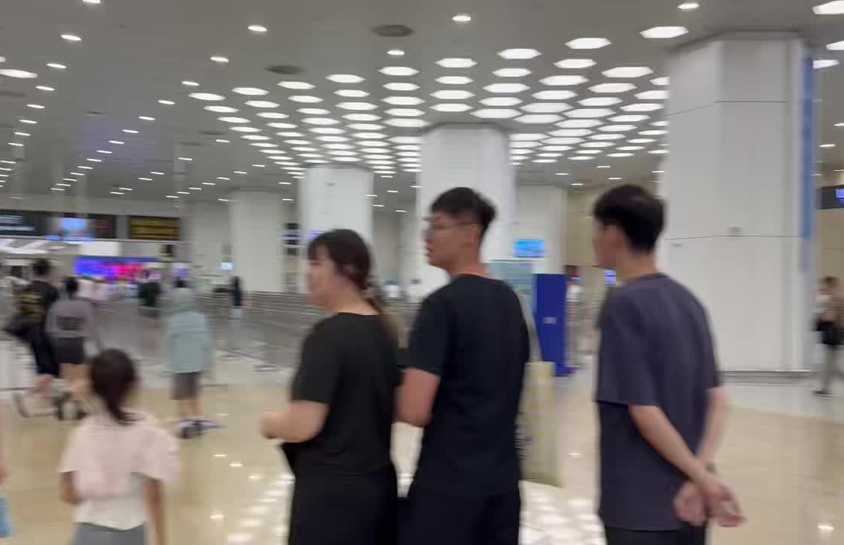
MACAU AS BORDER
Entering another cultural order
进入澳门首先是一种边境与秩序的体验。
Claim
Before seeing landmarks, we experienced queues, signs, checkpoints, buses, and spatial order.
Self / Other
Non-verbal order
Port / wayfinding / crossing
UCUG1600 Intercultural Communication | Fieldwork in Macau
06

Slide 7
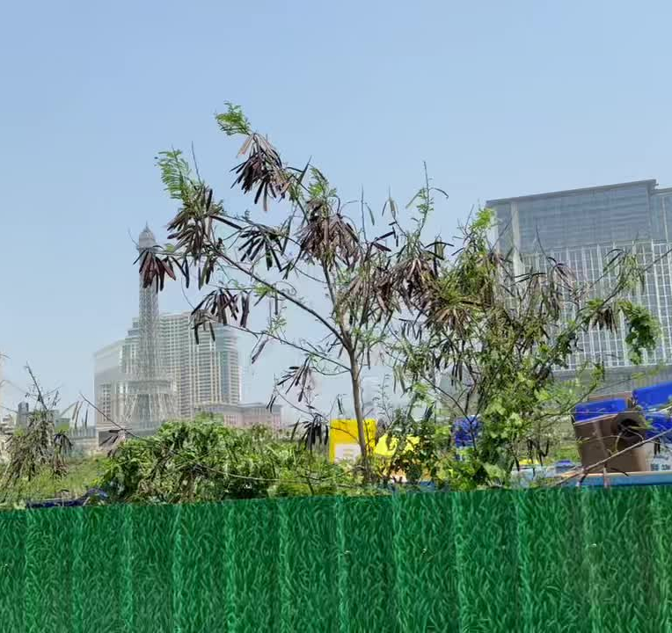
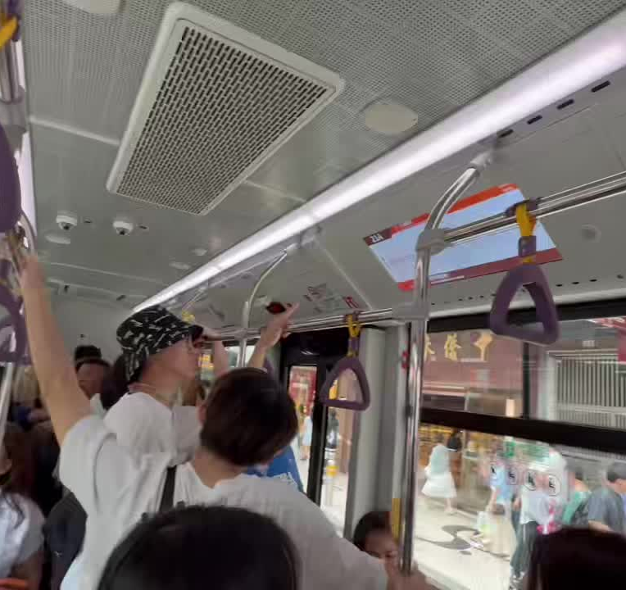
MOVEMENT
Movement changed what we could see
观察不是静止发生的，而是在车窗、公交与步行中发生。
coach window
Cotai skyline
public transit
Intercultural communication happened not only inside places, but also between places.
UCUG1600 Intercultural Communication | Fieldwork in Macau
07

Slide 8
Macau as Heritage
Heritage is not silent;
it tells a story.
The Ruins of St. Paul's presents Macau through Catholic memory, Portuguese colonial history, and world heritage.
Crowds and tourist photography also turn heritage into a contemporary tourism narrative.
UCUG1600 Intercultural Communication | Fieldwork in Macau
08

Slide 9
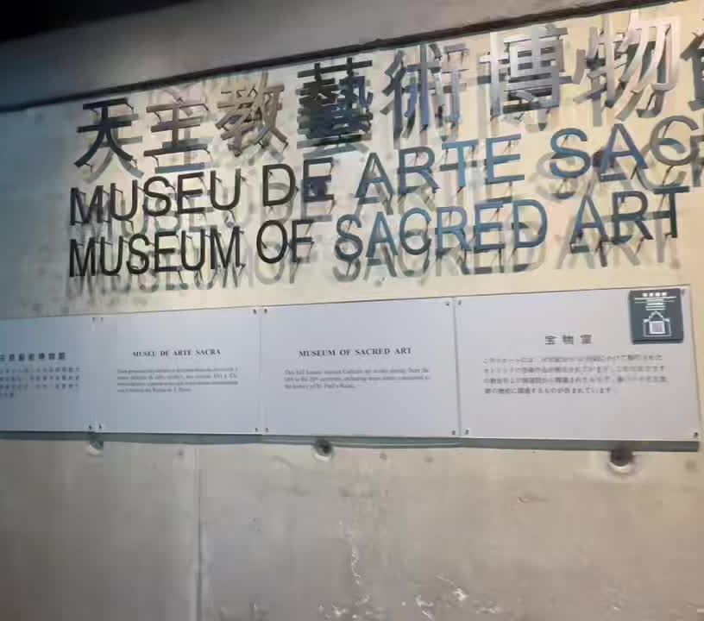
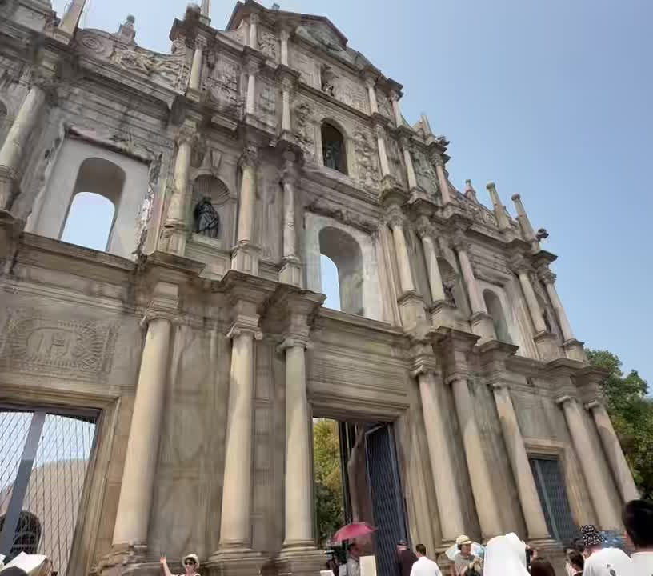
HERITAGE DEPTH
From sacred memory to city view
同一组遗产空间把宗教记忆、历史遗址与现代城市放在同一画面。
sacred memory
stone / facade / visitors
history looking at modernity
Standing inside a historical site, we look at the modern city: history and modernity appear in the same frame.
UCUG1600 Intercultural Communication | Fieldwork in Macau
09

Slide 10
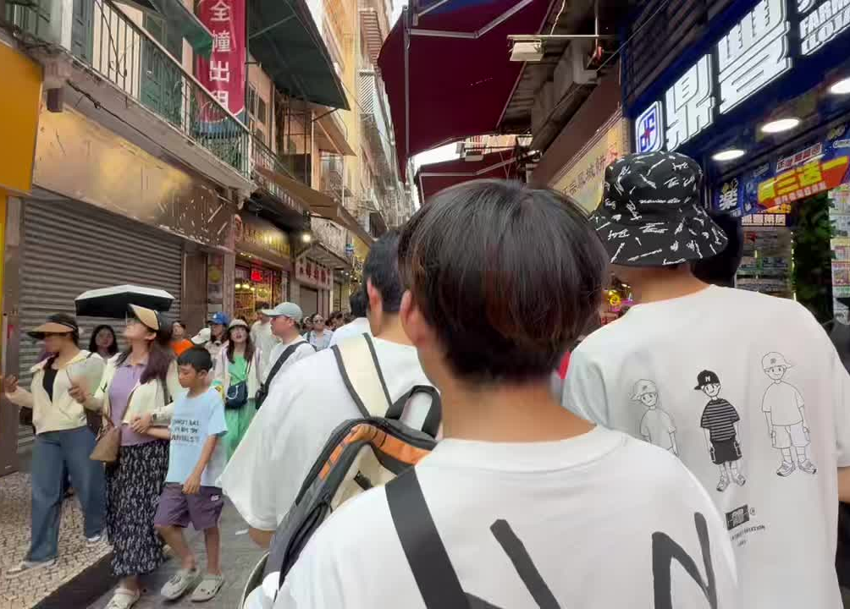
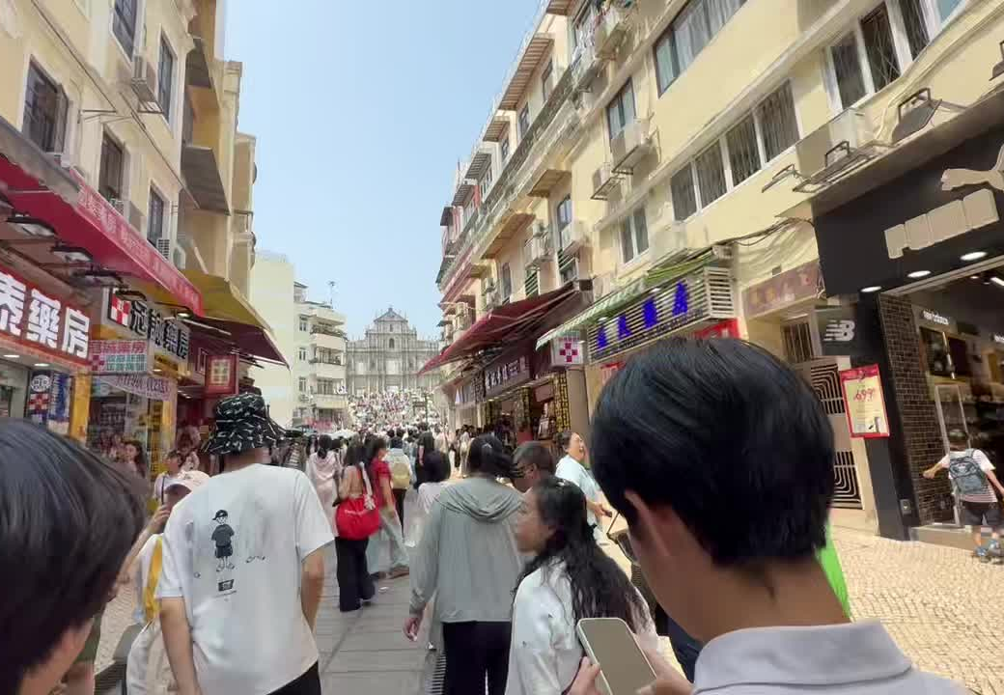
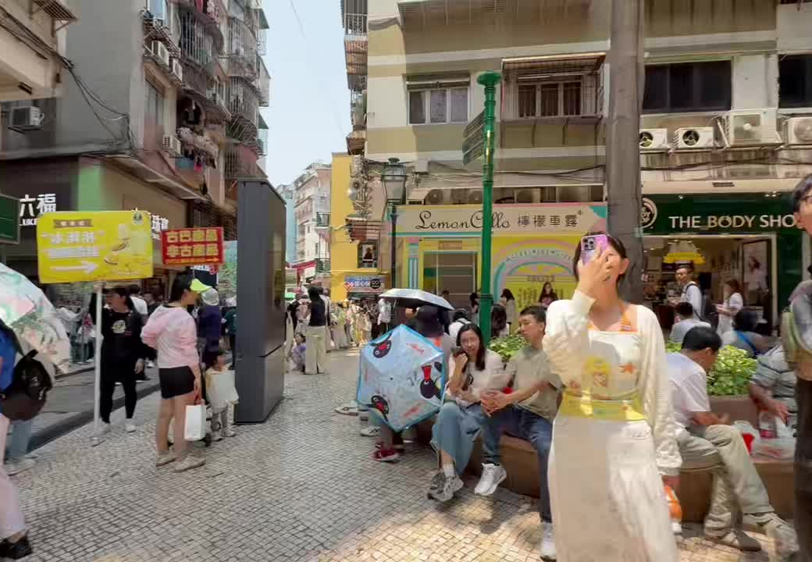
EVERYDAY STREET
Culture also happens in ordinary streets
街道、招牌、小吃、人流和餐饮空间共同构成日常澳门。
street to landmark
dense signs
AI reminded us to notice street names. Fieldwork showed that linguistic landscape also appears in shop signs, menus, displays, crowds, and movement.
food street / signs / crowd
UCUG1600 Intercultural Communication | Fieldwork in Macau
10

Slide 11
SENSORY LAYER
Sound helped us distinguish spaces
声音不是独立声景研究，而是辅助理解空间差异的非语言层。
Border
broadcasts / footsteps / queues
Historic street
crowds / shop calls / visitor languages
Heritage site
photo sounds / guide voices / open-space echo
Venetian & NBA
indoor music / screens / game sounds
We treat sound as a sensory layer, not as a full systematic audio study.
UCUG1600 Intercultural Communication | Fieldwork in Macau
11

Slide 12
Macau as Global Spectacle
A designed Europe
inside Macau
Contrast
St. Paul's is inherited heritage.
The Venetian is designed heritage-like spectacle.
The Venetian creates a global consumption experience through European facades, domes, canals, lighting, and shopping routes.
UCUG1600 Intercultural Communication | Fieldwork in Macau
12

Slide 13
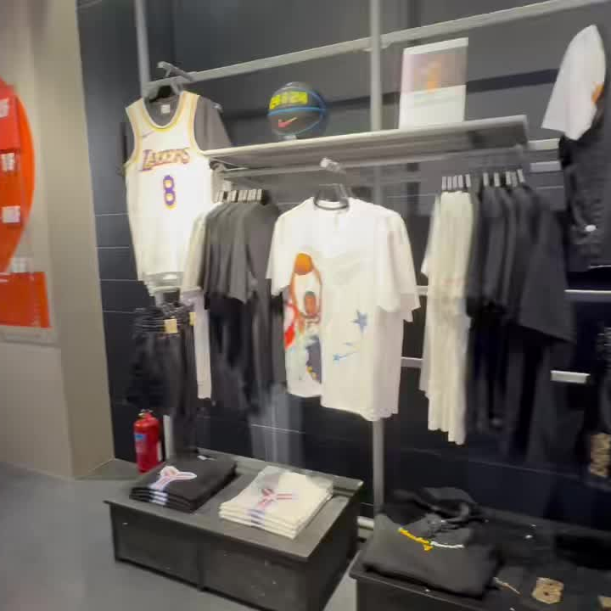
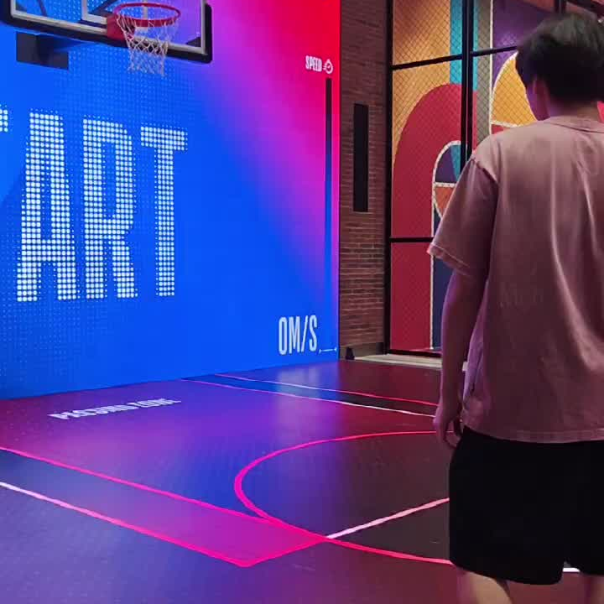
GLOBAL POPULAR CULTURE
Global culture becomes interactive
NBA 店说明跨文化交流也发生在全球品牌、商品和身体参与中。
merchandise
interactive play
screen / score / game
American sports culture is commodified, gamified, and experienced through physical participation.
UCUG1600 Intercultural Communication | Fieldwork in Macau
13

Slide 14
SYNTHESIS
Four spaces, four translations of Macau
这些不是分散景点，而是四种翻译澳门的方式。
Border
Heritage
Everyday Street
Global Spectacle
Macau as...
Macau as...
Macau as...
Macau as...
regulated crossing space
religious and colonial memory
lived commercial street
consumption and popular culture
Self / Other
non-verbal order
cultural memory
storytelling
linguistic landscape
sensory observation
globalization
cultural performance
Intercultural communication is spatial switching: moving through different systems of meaning.
UCUG1600 Intercultural Communication | Fieldwork in Macau
14

Slide 15
Conclusion
Macau is not one story
translated into two languages.
It is many cultural stories experienced through movement.
The value of our fieldwork was not proving the AI-generated topic, but revising it through what we actually saw, heard, and recorded.
澳门不是一个故事被翻译成两种语言，而是多个文化故事在人的移动中被不断体验。

