Slide 1
UCUG 1808 | Sport in Society
Space, Body Image, and Resistance Training Avoidance
32
female student survey respondents
3
亚洲女大学生校园健身房空间、身体意象与阻力训练回避研究
semi-structured interviews
Core thesis: the main barrier is not lack of interest, but uneven access inside the gym.
15 min
six-person presentation
Final Group Research Project | 2026 Spring Semester

Slide 2
WHY IT MATTERS
A gym can be open to everyone while some zones remain hard to enter.
健身房名义上开放，不等于每个训练空间都被同等体验为可进入。
Spatial threshold
Mirrors, open sightlines, crowding, and equipment layout make free weights feel high-risk for beginners.
Public equipment
Gendered belonging
is not the same as
felt access.
When most visible users are experienced men, female beginners may feel tolerated rather than expected.
Digital body ideals
Social media shapes exercise goals, but its effect is not always direct or one-dimensional.
Framing from report introduction and literature review
02

Slide 3
RESEARCH QUESTIONS
The project links space, media ideals, and negotiated participation.
三个研究问题分别对应空间、媒介和行动策略。
We treat avoidance as a situated behavior, not a fixed personal trait.
RQ1
How do campus gym space and gym intimidation shape avoidance of resistance training?
RQ2
To what extent do internalized social media beauty norms shape exercise preferences?
RQ3
How do female students negotiate between health goals and digital body ideals?
Research questions from report introduction
03

Slide 4
METHOD
We use participant-level survey evidence plus interviews, with exploratory limits.
这次新增逐名作答矩阵，可做构念得分、信度和探索性相关。
N = 32
What the updated data supports
female college students in the core survey sample
Frequencies and item means
100%
N = 3
Construct scores + Cronbach's alpha
100%
Spearman correlations + group comparisons
100%
one-on-one semi-structured interviews
No regression, mediation, prediction, or causal claims.
Methodology: participant-level survey matrix + semi-structured interviews
04

Slide 5
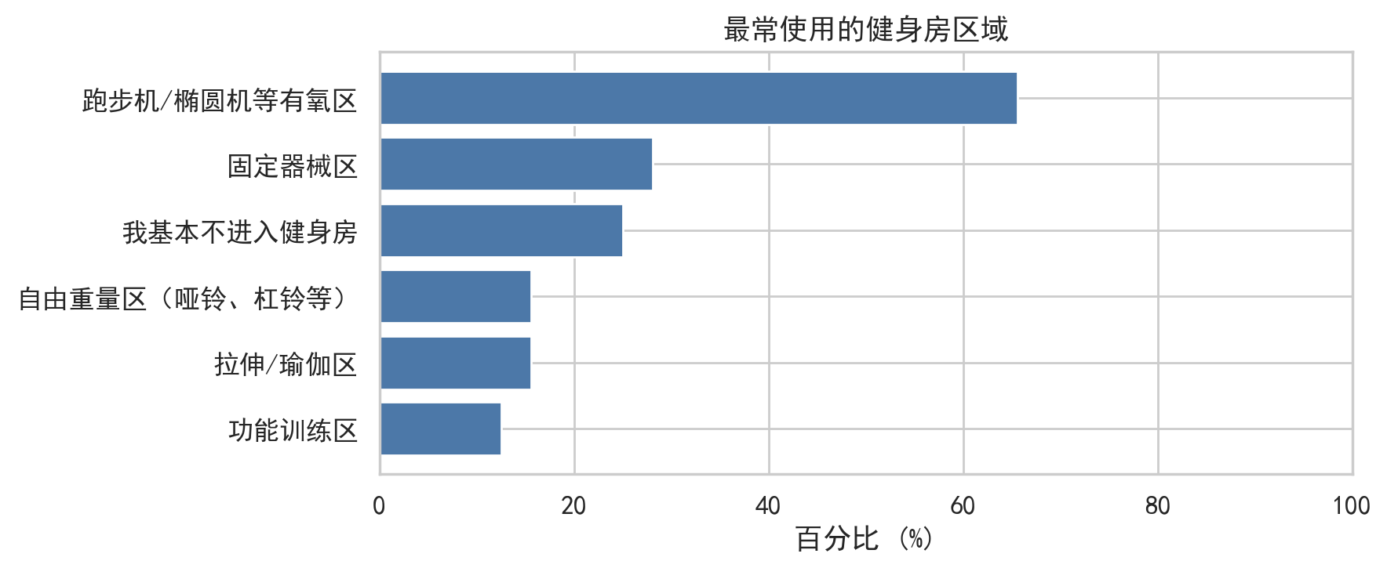
SAMPLE PATTERN
Students use the gym, but not the free-weight area.
样本不是不运动，而是在健身房内部呈现区域分化。
78.13%
have used the campus gym
65.63%
most commonly use cardio areas
15.63%
most commonly use free weights
Most-used gym areas
Survey descriptive results, N=32
05

Slide 6
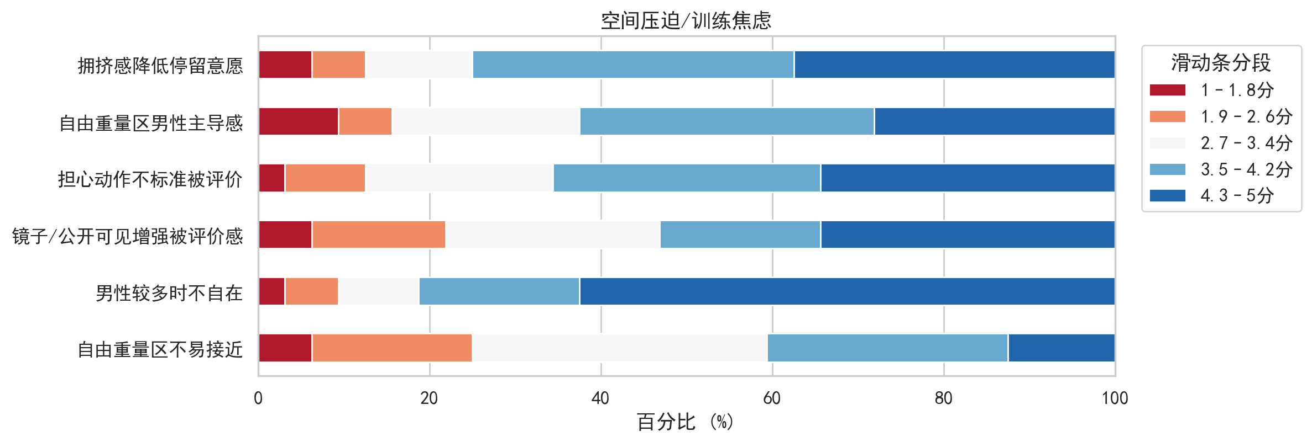
RQ1 FINDING
Spatial pressure is the clearest mechanism behind free-weight avoidance.
男性占多数、拥挤、动作错误羞耻共同构成空间门槛。
Spatial pressure/training anxiety
M=3.72
Short-item reliability
alpha=.81
Association with avoidance
rho=.65
Free-weight users report less pressure
2.60 vs 3.92
68.75% avoided at least sometimes; pressure correlates with avoidance (p<.001).
Participant-level support
Participant-level scores, Spearman correlation, and avoidance frequency
06

Slide 7
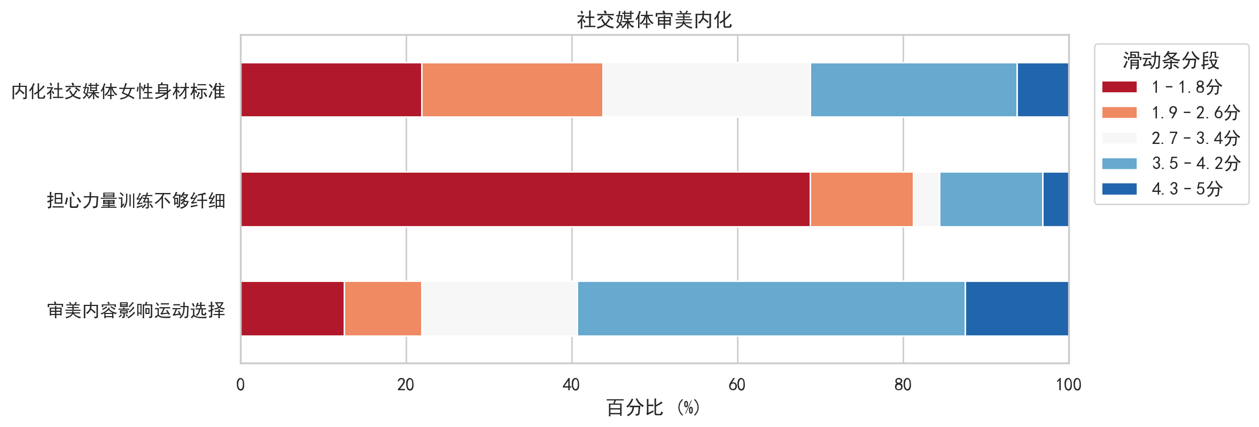
RQ2 FINDING
Media ideals shape choices, but fear of muscle is not the main barrier.
审美内容有影响，但“怕练壮”在本样本中很弱。
59.38%
say aesthetic content affects exercise choice
81.25%
low agreement with fear of not being slim enough
0%
selected 'do not want visible muscles' as an avoidance reason
Social media aesthetic items (alpha=.76)
Q21-Q23; media-avoidance rho=.31, p=.084
07

Slide 8
INTERVIEW EXPLANATION
The numbers point to visibility, beginner shame, and gendered atmosphere.
访谈将描述性数字转化为具体场景机制。
“The strength area has mirrors, so you can see others and feel more seen.”
“Most people training there are men, so girls may feel distance from the atmosphere.”
P1 / spatial visibility
P2 / male-dominated atmosphere
“I am a beginner. I worry I do not know the equipment or my form is wrong.”
“I see the idea that strength training is unattractive, but I do not agree.”
P3 / beginner threshold
P3 / limited media internalization
Representative interview quotes translated and condensed for presentation
08

Slide 9
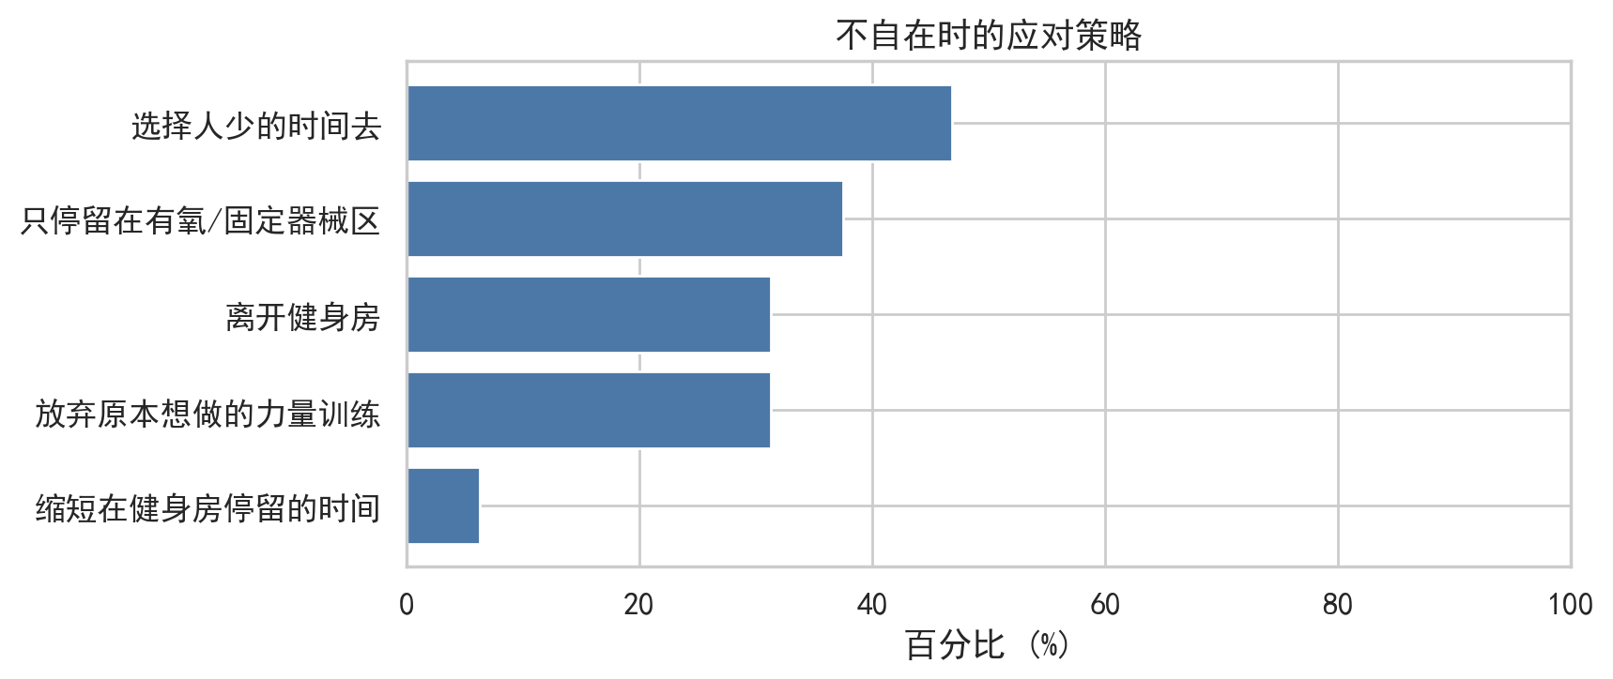
RQ3 FINDING
Avoidance often looks like negotiation, not total withdrawal.
女生常通过错峰、同伴、换区域和降低可见性来协商进入。
Choose less crowded times
46.88%
Stay in cardio/fixed-machine areas
37.5%
Give up planned strength training
31.25%
Leave the gym
31.25%
The strategy is to make entry feel more controllable.
Coping strategies
Survey coping strategy table + interviews
09

Slide 10
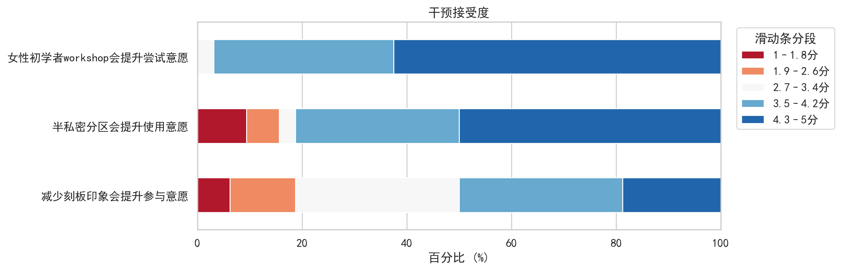
IMPLICATIONS
The intervention target is entry cost, not individual courage.
实践重点不是要求女生更勇敢，而是让新手更容易开始。
96.88%
support women's beginner strength workshops
81.25%
support semi-private zones or visual screening
50.00%
Intervention preference (M=3.98)
support reducing stereotypes around women's strength training
Q25-Q27; pressure-preference rho=.67, p<.001
10

Slide 11
LIMITATIONS
The evidence is exploratory, even with participant-level analysis.
研究结论需要谨慎表达，不能外推为所有亚洲女大学生。
Small N
N=32 survey respondents and 3 interviewees; limited campus context.
What we can claim:
associations and patterns in this sample, not causality.
Unbalanced groups
Only 5 frequent free-weight users; group tests are exploratory.
Measurement limits
Contextualized short items, not full validated scales.
Methodology and discussion limitations
11

Slide 12
CONCLUSION
The core barrier is beginner access in a gendered space.
核心结论：阻力训练回避更主要表现为空间和新手门槛问题，而不是单一审美内化问题。
1
dare to enter
2
know how to use
3
keep training
敢进入
会使用
能持续练习
Thank you.

