Slide 1
ㅜ
Presentation
Persistence and Change
Attitudes toward North Korea and Unification
Sanghoon Park
Univ. of South Carolina
Jaeyoung Hur
Yonsei Univ.

Slide 2
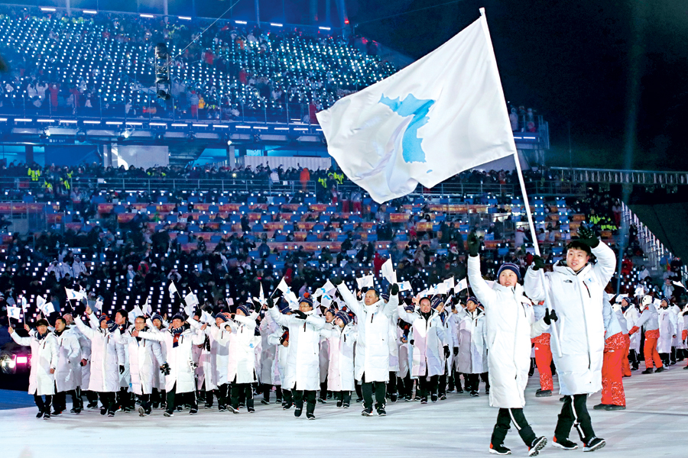
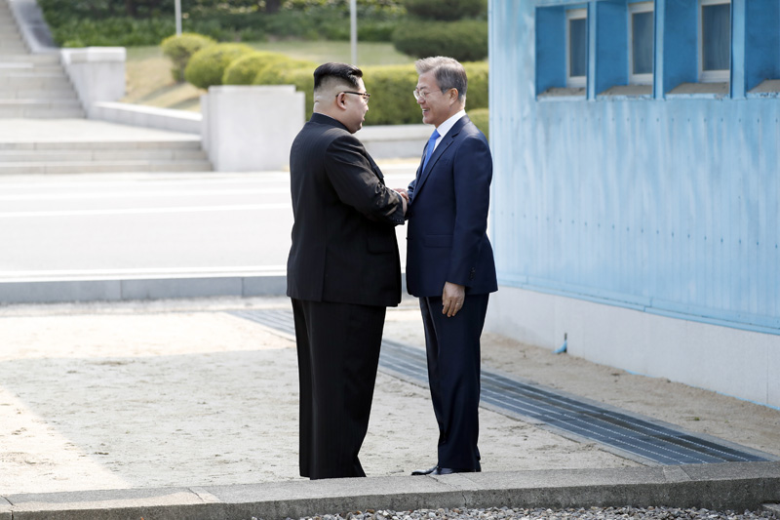
01
Motivations
01
02
Pyeongchang Winter Olympics
4. 27 Panmunjom Declaration
NK sent athletes, cheering squads, and art troupes
The Panmunjom Declaration for Peace, Prosperity and Reunification of the Korean Peninsula
Notes:
Motivations of research
The inter-Korean relationship faced several historical events in 2018. After the new administration pursues cooperative policies with North Korea, North Korea sent athletes to the Pyeongchang Winter Olympics. It seems a signal that South Korea and North Korea enter into the new state of their relationship. Also, the two Korea’s leaders meet at Panmunjom to delare for peace, prospertity and unification.

Slide 3
01
Research Question
Changes of Inter-Korean relationship in 2018-2019
Inconsistent N.K. and Unification policy by administrations
Does the 4.27 Panmunjom Declaration lead to fundamental Changes for the Inter-Korean Relationship?
Does the Panmunjom Declaration have changed the attitudes and perceptions of Koreans toward North Korea and unification?
Notes:
The dramatic changes in Inter-Korean relationship made South Koreans expect ‘better future.’ however, we need to remind that inter-Korean relationship has varied by different administrations. Although Moon Jae-in administration turned to the N.K. cooperative stance, whether it will be succeed is not guaranteed.
Existing studies explain the impacts of ‘historical events’ between North and South Koreas. However, Koreans have experiences inconsistent policies and N.K.’s Intermittent provocation .
Here, we ask a question that does the 4.27 Panmunjom declaration lead to fundamental changes for the inter-Korean relationship.
In particular, we examine whether the attitudes and percpetikons of South Koreans toward North Korea and unification have changed.

Slide 4
02
Literature Reviews
Bridging political events and factors affecting the attitudes
Factors affecting inter-Korean relations inevitably influenced by major political events surrounding inter-Korean relationships.
Political events such as a consensus between the two Koreas
Can drive actual and theoretical changes by affecting attitudes toward (or images of) North Korea and unification in South Korea (Kim et al. 2003; Kim 2017; Kim et al. 2008)
Notes:
Previous studies present various factors that are expected to affect the attitudes toward North Korea and Unification. For a long time, nationalism-based legitimacy of unification explained why we “should” pursue the unification. However, as the time of division lasts, political factors, or cost-benefits approaches emerge to explain the attitudes of South Koreans. Also, some scholars argue that a group of people who has similar experience will show similar attitudes, and those attitudes might vary across the groups (generations).
Although previous literature has provided various explanations, they do not consider the possible impact comes from outside such as external event. In inter-Korean relationship, we have observed several “unexpected” political events drastically shift the game of inter-Korean relationship.
Thus, we can expect that the factors affecting inter-Korean relationship might be influenced by major political events. Some studies argue that political events between South and North can drive actual or theoretical changes by affecting attitudes toward North Korea and unification among South Koreans.

Slide 5
02
Literature Reviews
South Korean experienced varying policy cycles
Members of South Korean society have experienced conflictive or cooperative events with North Korea for several decades.
The same type of events may have various influences.
Notes:
Some people expect the Panmunjom Declaration will change the inter-Korean relationship. In fact, various media suggested the prospect of Korean peninsula would be better, and after the declaration, President Moon’s approval exceeded 80%.
However, does the declaration bring fundamental changes to us as we expected? South Koreans have experienced varying policy cycles by different administrations. Conservative administrations tended to take a strong stance against North Korea, while liberal administrations led the engagement policy as a basis for reconciliation and cooperation.
I means that members of South Korea have already experienced the similar type of events and its failure.

Slide 6
02
Literature Reviews
Changed South Korean Society
The younger generations experienced tensions between the two Koreas
More likely to have formed a negative perception of North Korea and unification (Hur, 2014).
Generations have been changed
Cooperation with North Korea, Pro-unification → Strong against North Korea, Anti-unification (Bae, 2018).
Notes:
Also, the members of society have changed. During the ten years of conservative administration, we have experienced conflictive relationship with North Korea. The younger generations are the groups who experienced the tensions between the two Koreas. Thus, some propositions of the younger in terms of attitudes toward North Korea and unification may not hold any more.

Slide 7
03
Research Design
Examine the changes in attitudes toward North Korea
Generations mainly experienced conflict between South and North
Can show more negative attitudes toward North Korea and unification
Otherwise, generation under cooperative moods between South and North can expect improvement of inter-Korean relstionships
H1:
The younger generation (20s & 30s) show more negative attitudes toward North Korea than other generations, even after the Panmunjom Declaration.
Notes:
We examine the changes in attitudes toward North Korea. We expect that generations mainly experienced tensions and conflicts between South and North for a long time are more likely to show more negative attitudes toward North Kroea and unification.
Otherwise, generations under cooprative moods between South and North can expect improvement of inter-Korean relationships. Thus, we draw the first hypothesis that the younger generation show more negative attitudes toward North Korea than other generations, even after the Panmunjom Declaration.

Slide 8
03
Research Design
Examine the changes in attitudes toward unification
The cost and benefits of unification vary depending on the conditions
Negative responses to the unification may be due to the negative prospects
H2:
The prospects for unification affect the need for unification
differently across generations
H2-1:
The more positive prospects, the more likely the older generations (the 50s, 60s) will favor unification.
H2-2:
Even the more positive prospects, the younger generations are less likely to support unification.
Notes:
Next, we also examine the changes in attitudes toward unification. According to recent studies, the cost and benefits of unification are dominant explanations to justify unification. However, the utilities of unification can vary depending on the conditions.
When we state the Panmunjom Declaration is a positive signal about the prospects of unification, the respondents will show different attitudes conditional on the varying prospects.
The second hypothesis is: [Read the second hypothesis].
In particular, we expect that the more positive prospects one expect, the more likely the older generations will favor unificiation. However, we also expect that even the more positive prospects they expect, the younger generations are less likely to support unification.

Slide 9
03
Data
KBS National Unification Consciouness Survey (2018)
Surveyed: August 3 – 7, 2018
Weighted population proportion by gender, age, region
N = 1,000 (over the age of 19)
The least time difference from the Panmunjom Declaration
Notes:
Our sample is from the KBS National unification consciousness survey of 2018. It is surveyed from August 3rd to 7th in 2018. The size of sample is 1,000 over the age of 19. We think the sample is the most relevant to examine the research question due to the least time difference from the Panmunjom Declaration.

Slide 10
03
Data
DV
Attitudes toward North Korea: Leadership and General State
Notes:
The first dependent variable is the attitudes toward North Korea. We have two indicators to show it. The first is the attitudes toward North Korean leadership, and the second is the attitudes toward general North Korea as a state.

Slide 11
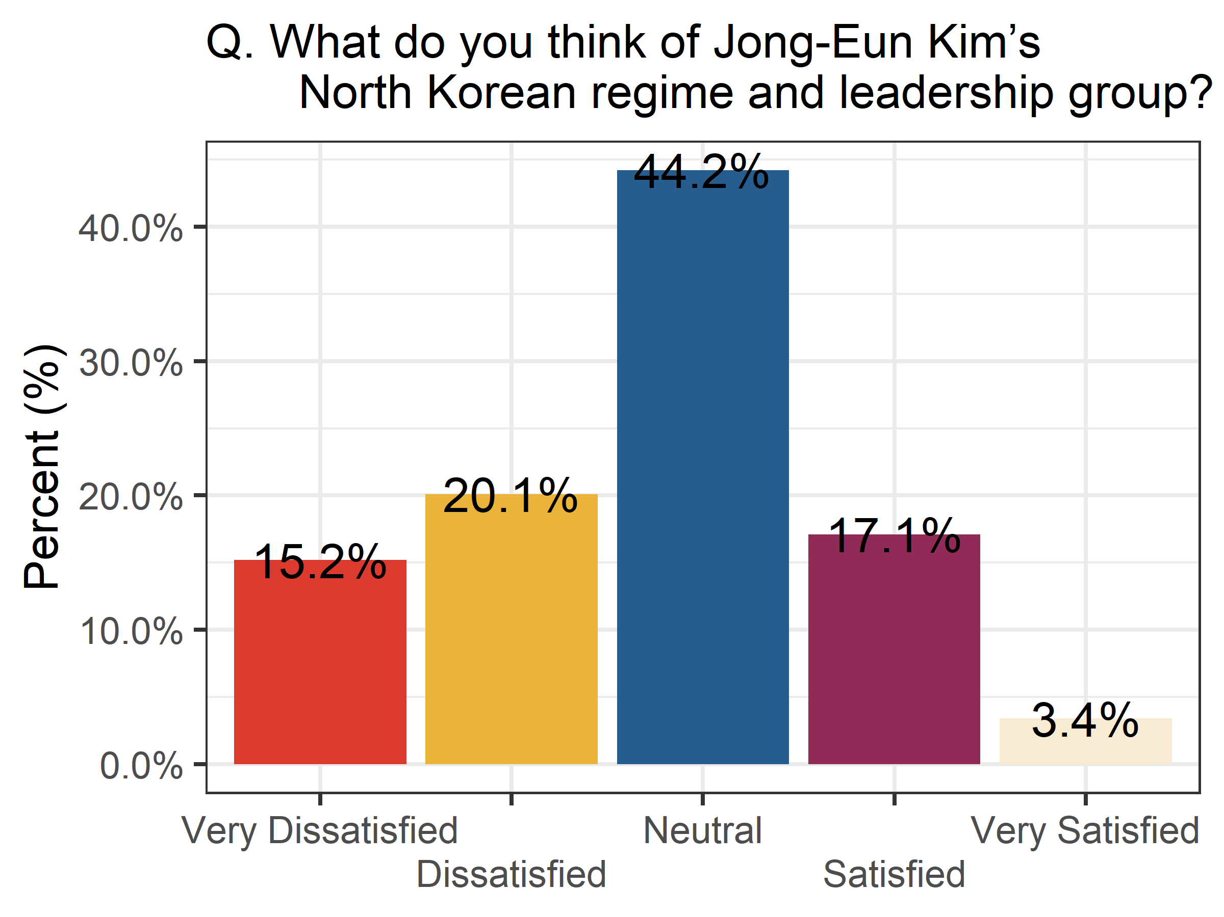
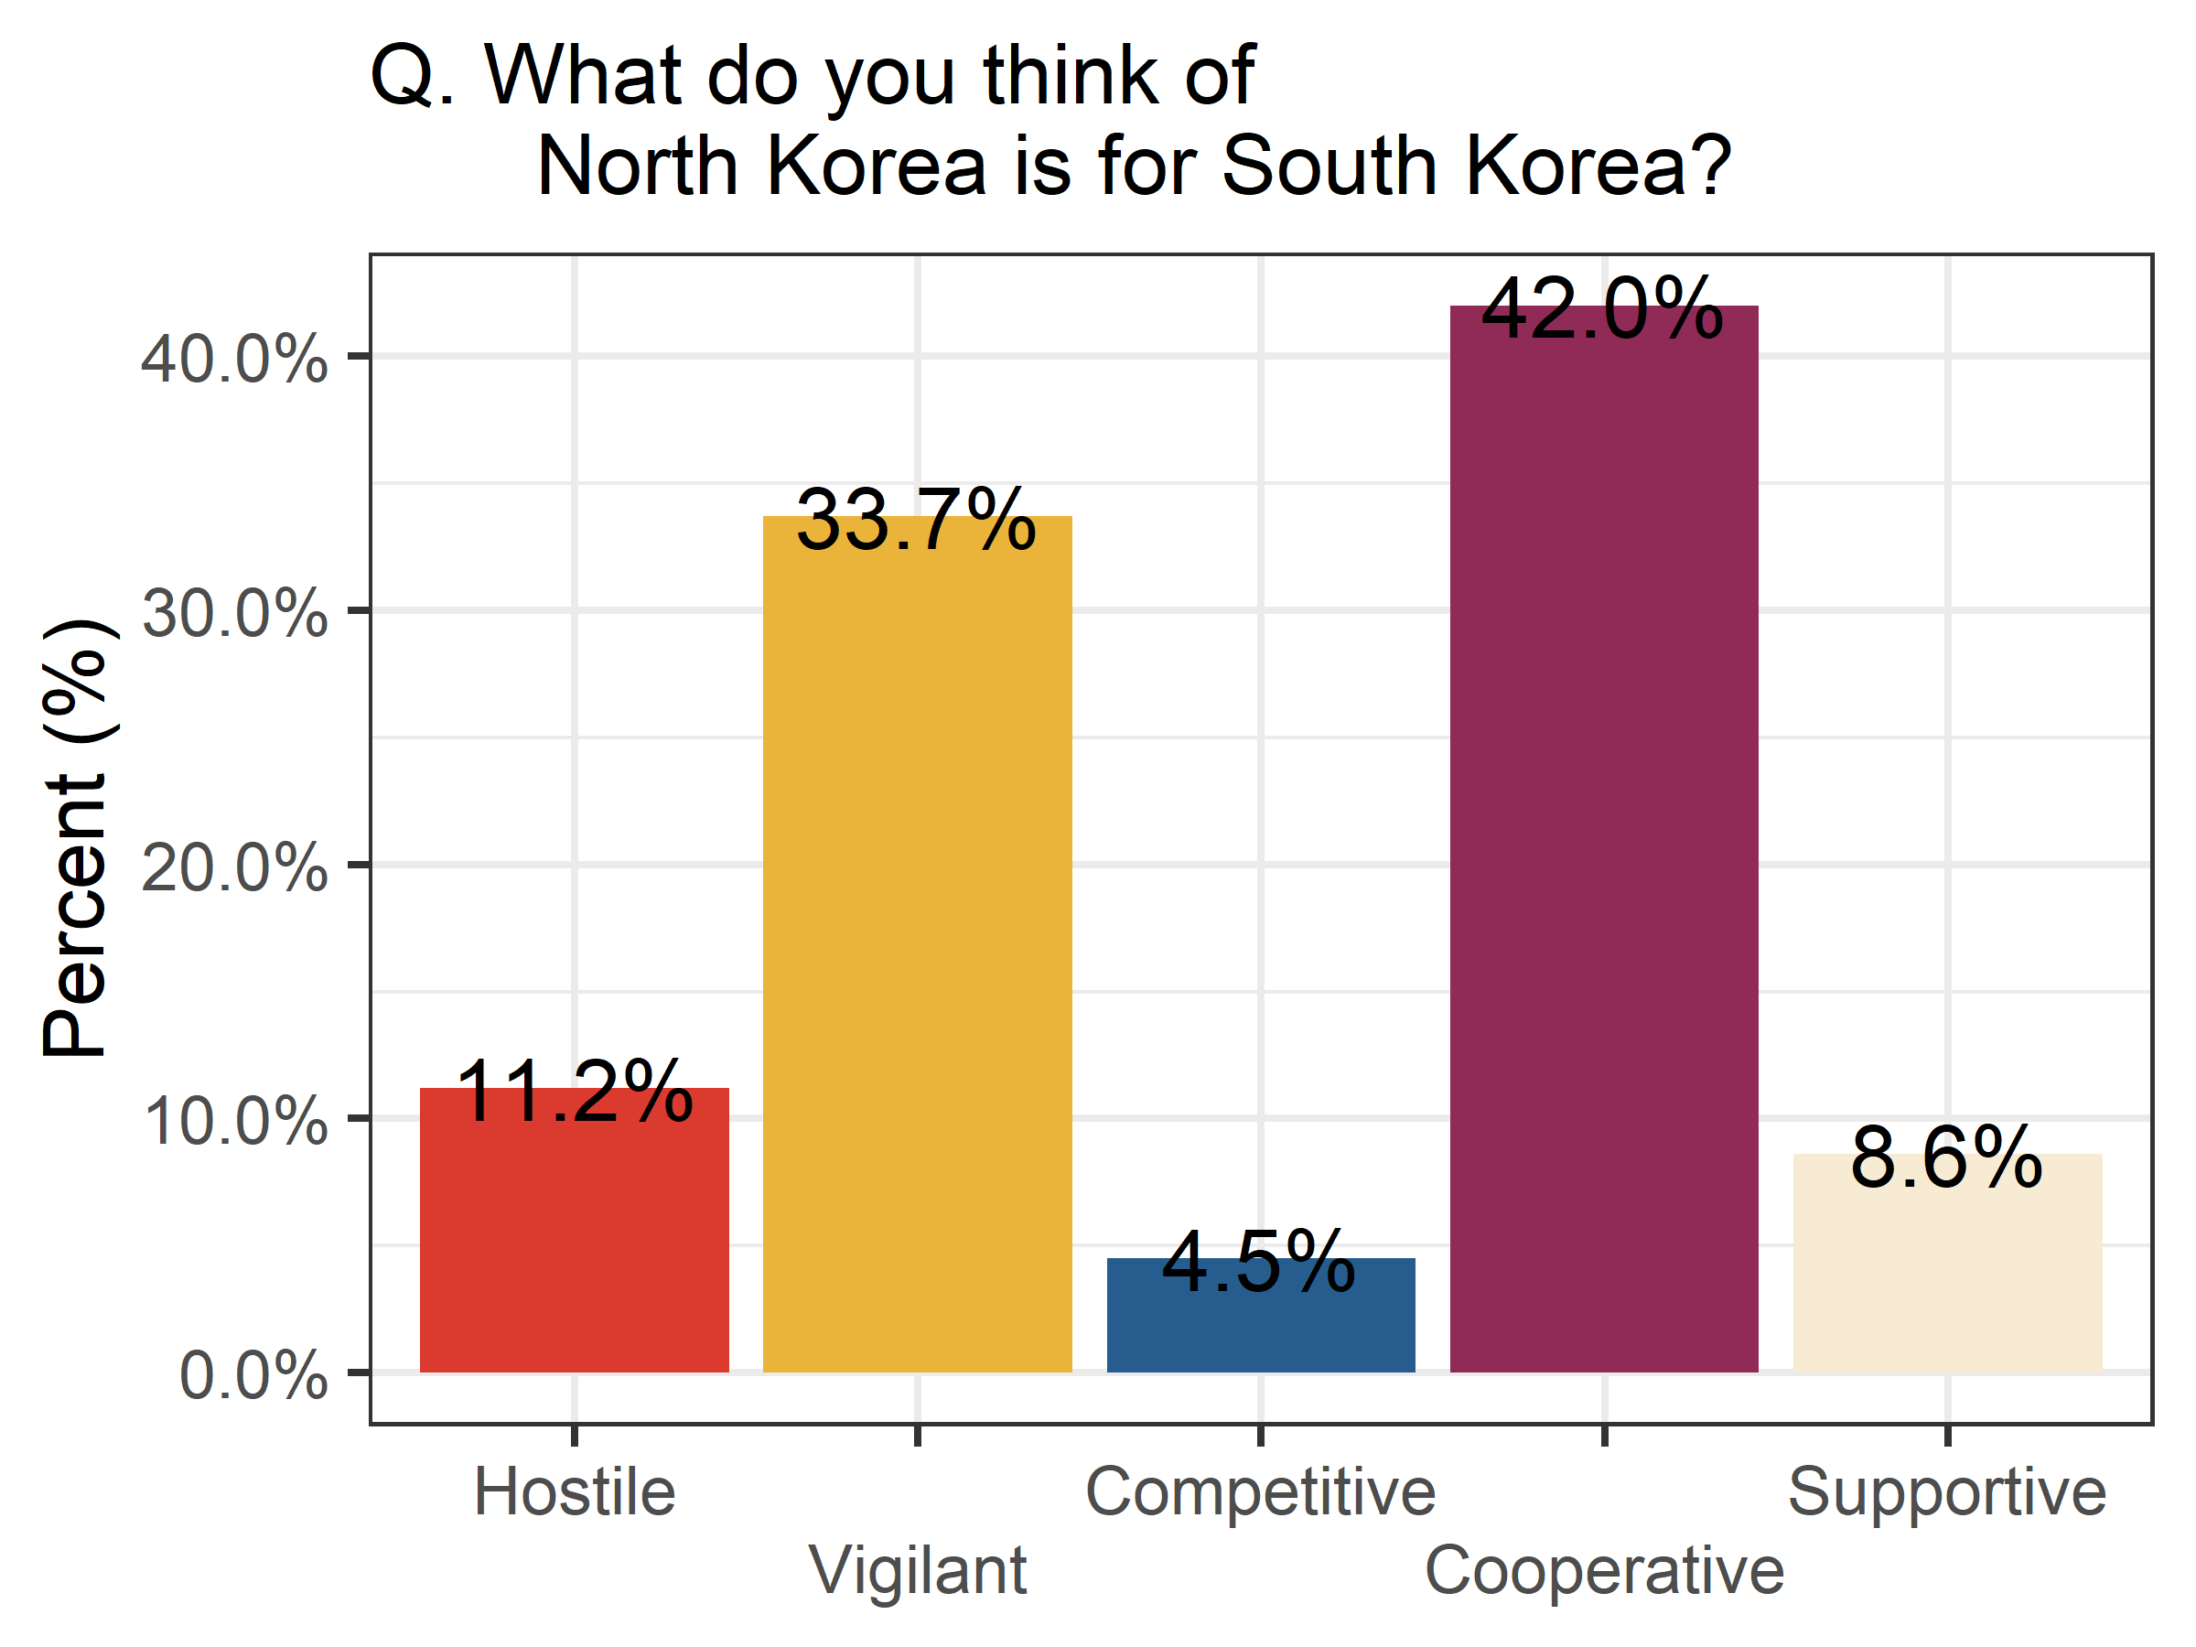
03
Data
Notes:
When we looked at the distribution of attitudes toward North Korea after the Panmunjom Declaration, we can see that there is a difference between the attitudes toward North Korean leadership and North Korea in general. First, the responses on the North Korean leadership were mostly reserved (“Neutral,” 44.2%). Otherwise, respondents showed a feeling of antipathy (35.2%) rather than favorability (20.5%). Similarly, respondents to the question of North Korea in general show that they rarely think of North Korea as a competitor (4.5%). It reflects the perceptions of the political, economic, and social gaps between the two Koreas that South Koreans have experienced for 70 years, which means that North Korea is no longer competing against South Korea at the system level. The most frequent response is to recognize North Korea as a “cooperative” entity (42%), followed by a view of being a “vigilant” entity (33.7%). It confirms that after the Panmunjom Declaration, respondents are still dissatisfied with the North Korean leadership.
At the same time, however, respondents perceive North Korea as an inevitable entity with which to interact to solve the inter-Korean relationship and other problems concerning the Korean peninsula.

Slide 12
03
Data
DV
Attitudes toward North Korea: Leadership and General State
Attitudes toward Unification
Notes:
The second dependent variable is the attitudes toward unification.

Slide 13
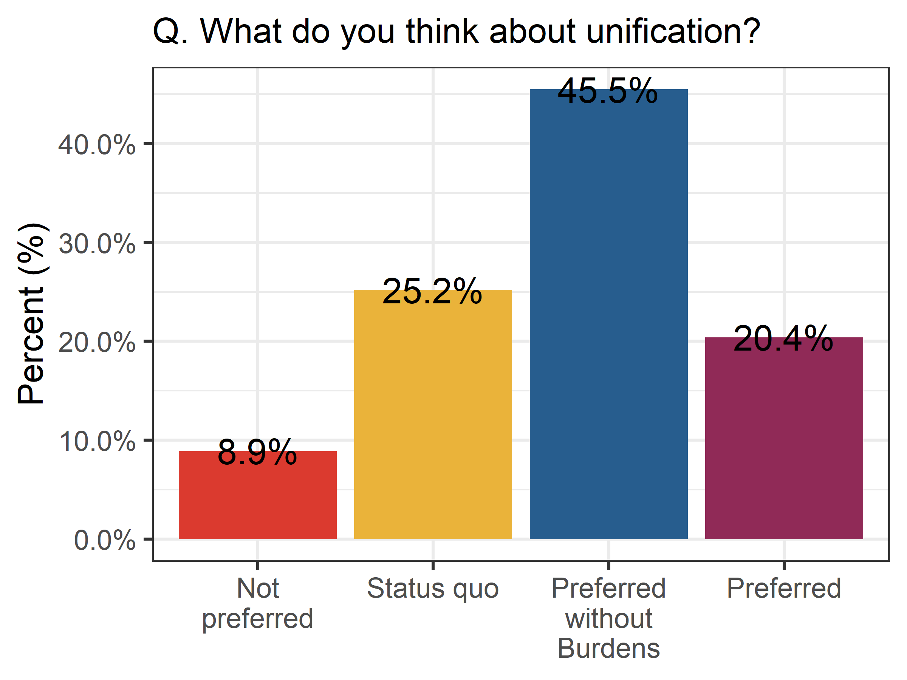
03
Data
Notes:
The most frequent response is the opinion that respondents prefer unification if it creates no burdens (45.5%).
Only 8.9% of respondents say that they do not prefer unification.
A quarter of the respondents answer that they prefer the status quo (25.2%), and only 20.4% say they prefer unification unconditionally.

Slide 14
03
Data
DV
Attitudes toward North Korea: Leadership and General State
Attitudes toward Unification
EV
Generation: categorical, 10-year units based on age
Prospect of unification
Notes:
One of the main explanatory variables in this study is generational. We investigate how the generations are associated with the attitudes toward North Korea and unification after the Panmunjom Declaration. Generations are categorical variables measured in 10-year units based on age.
The other explanatory variable of interest is the prospect of unification. The longer the period of unification, the more negative the prospect. We coded that the most negative prospect as 1, and the most positive prospect as 6.
Finally, we control for other variables that can potentially affect the attitudes toward North Korea and unification. The variables include the regions where respondents live, gender, education level, income level, evaluations of North Korea policies under the Jae-In Moon administration, all drawn from the KBS survey data.

Slide 15
04
Methods
Discrete dependent variable
DVs are ordered, discrete variables
Ordered logistic regression model
Coefficients of ordered logistic regression seem linear, but imply nonlinear relationship between explanatory variables and the dependent variable.
Present the first differences in predicted probabilities and predicted probabilities of key explanatory variables’ effects.
Notes:
As the dependent variable is ordered and discrete, we use ordered logistic regression model.
However, as the coefficients of ordered logistic regression is not intuitive to understand the results, we will present the first differences in predicted probabilities and predicted probabilities of key explanatory variables’ effects.

Slide 16
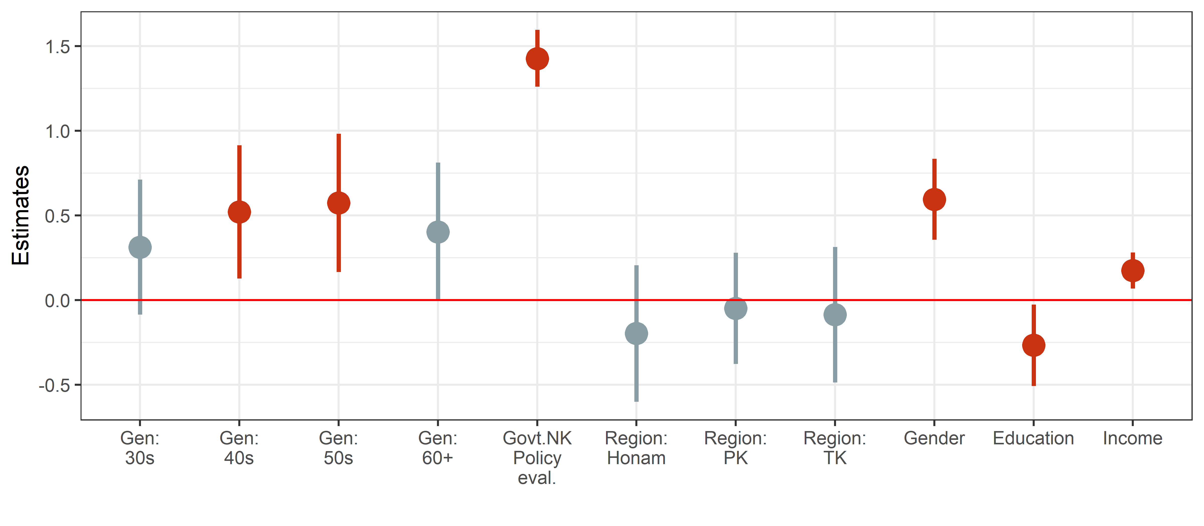
04
Attitudes toward North Korea after the Panmunjom Declaration
Notes:
The first model is about attitudes toward North Korea after the Panmunjom Declaration.
As the general N.K. attitudes show no significant differences across the generations, here, we present the model of attitudes toward North Korean leadership.
The 40s and the 50s show statistically significant differences compared to the 20s. It means that the 40s and the 50s are more likely to be favorable toward North Korean leadership than the 20s.

Slide 17
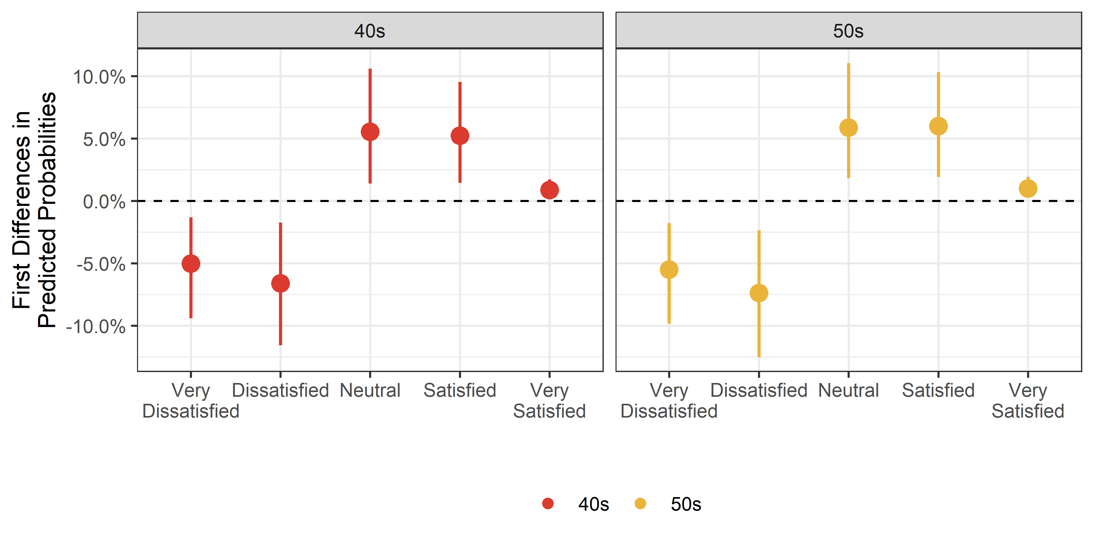
04
Attitudes toward North Korea after the Panmunjom Declaration
Notes:
The plot of the first differences in predicted probabilities show that the 40s and the 50s are more likely to be satisfied with the North Korean leadership while they are less likely to be dissatisfied with the North Korean leadership.

Slide 18
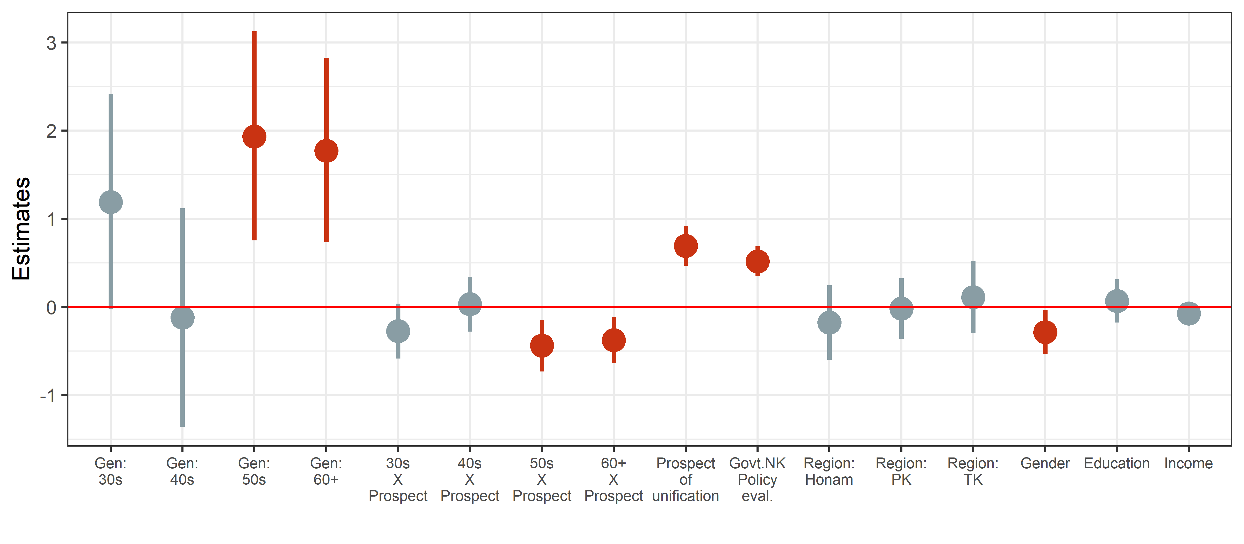
04
Attitudes toward Unification after the Panmunjom Declaration
Notes:
Next, the second model shows how the attitudes toward unification by different generations are conditional on prospects of unification. The results show that the 50s and 60s are more likely to be positive toward unification compared to the 20s. The 30s and 40s are not significantly different from the 20s.

Slide 19
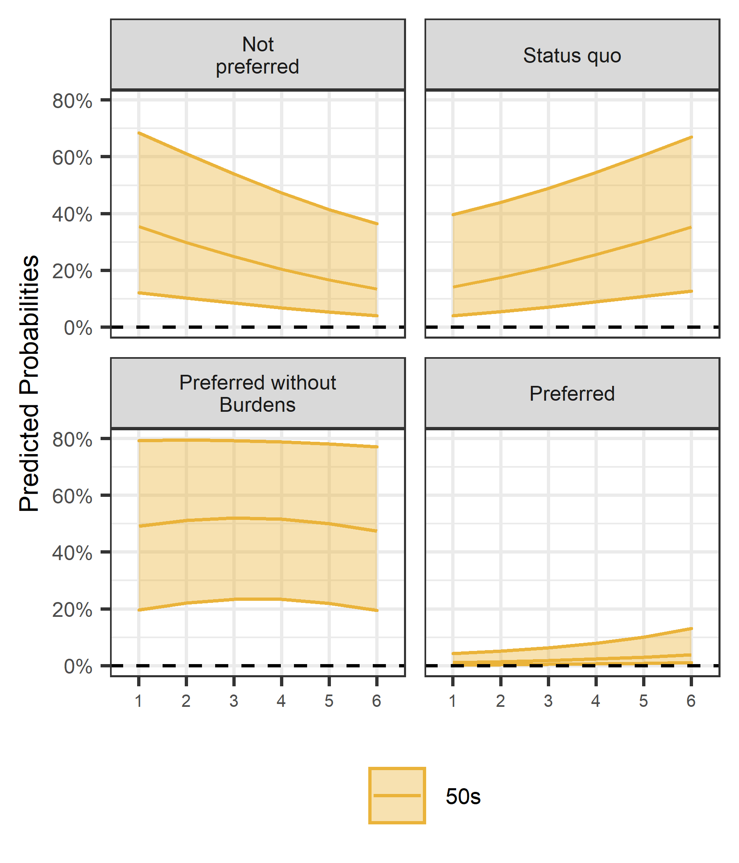
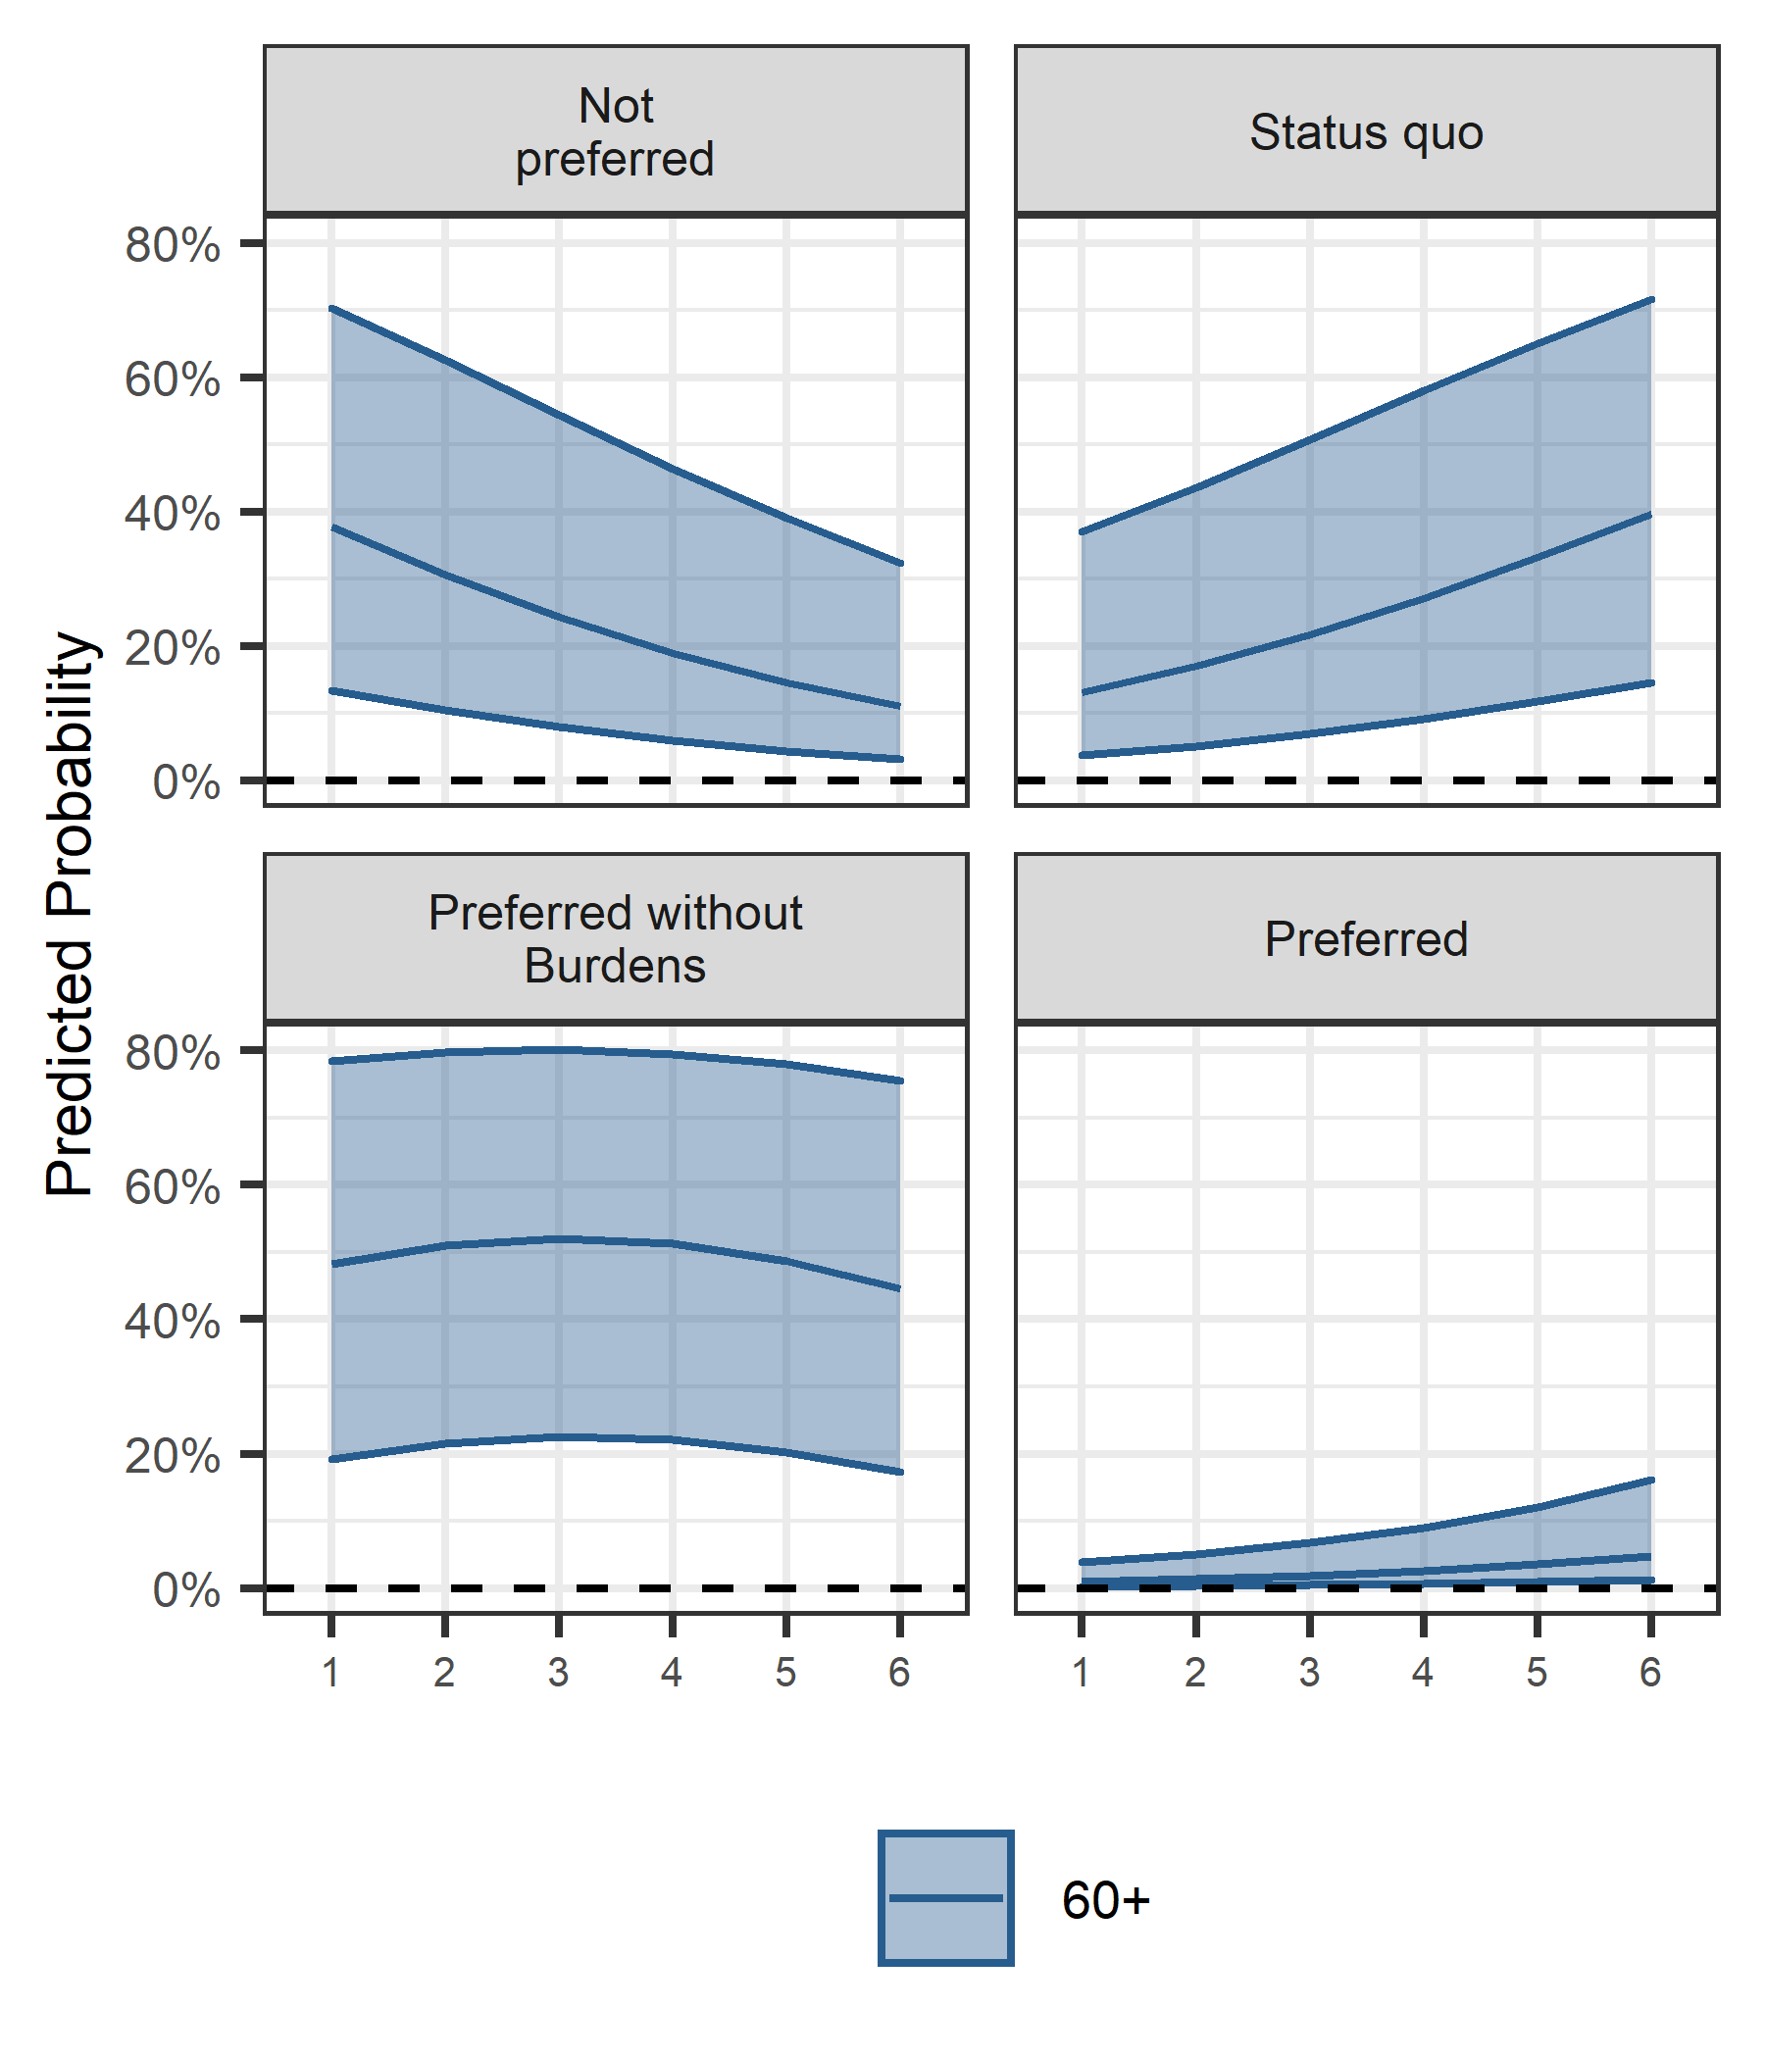
04
Attitudes toward Unification after the Panmunjom Declaration
Notes:
We estimate the predicted probabilities of each generation group that how their choices of the unification are conditional on the prospects of unification. The plot of the 50s and 60s shows that as the prospects become positive, they are less likely to choose “not preferred” and “Status quo.” Otherwise, as the prospects become positive, they are more likely to support unification.

Slide 20
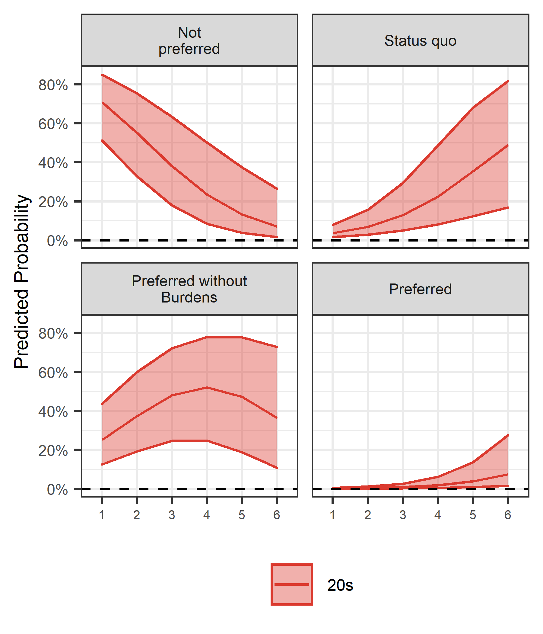
04
Attitudes toward Unification after the Panmunjom Declaration
Notes:
We estimate the predicted probabilities of each generation group that how their choices of the unification are conditional on the prospects of unification. The plot of the 50s and 60s shows that as the prospects become positive, they are less likely to choose “not preferred” and “Status quo.” Otherwise, as the prospects become positive, they are more likely to support unification.

Slide 21
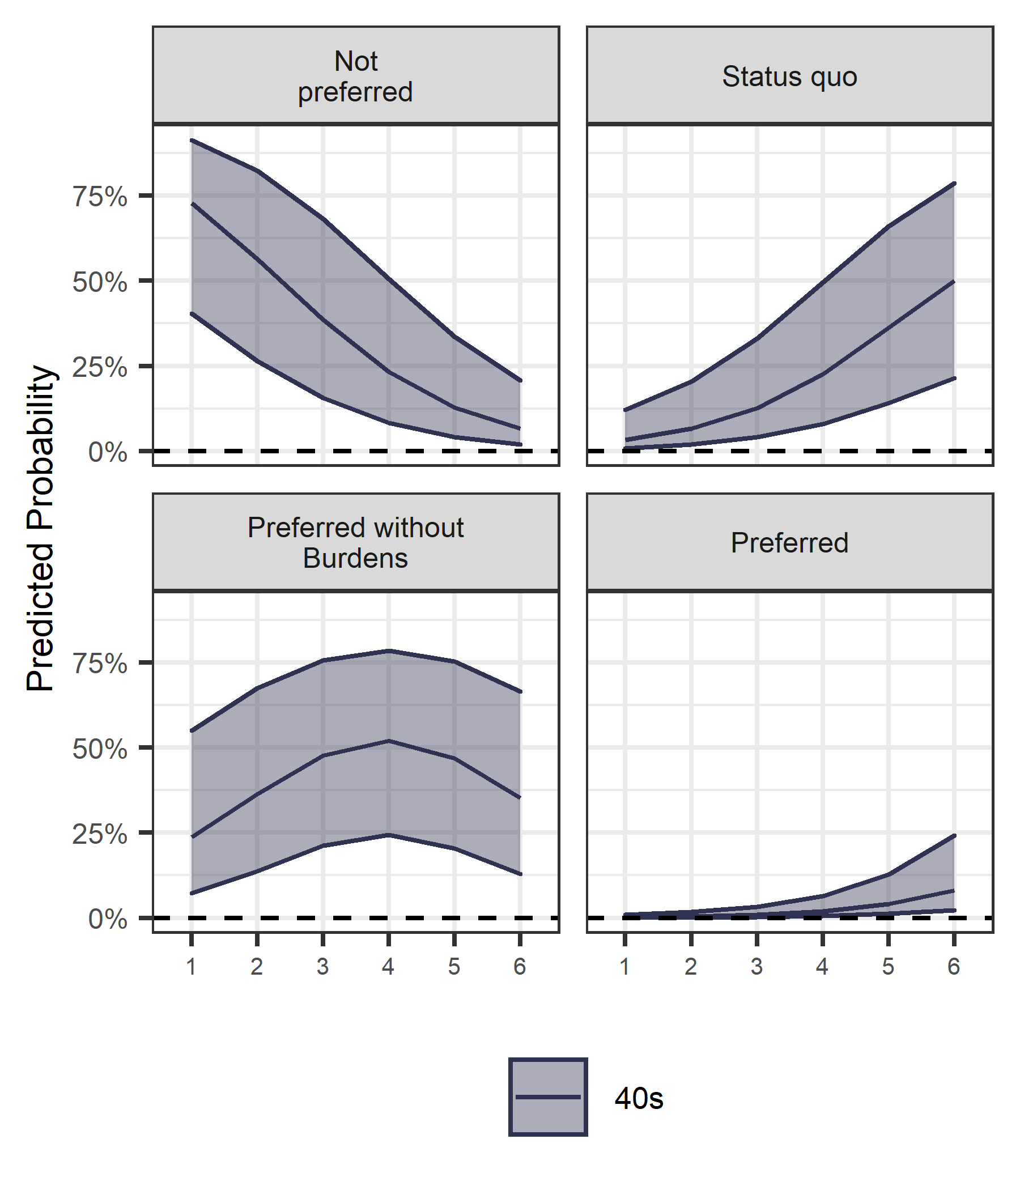
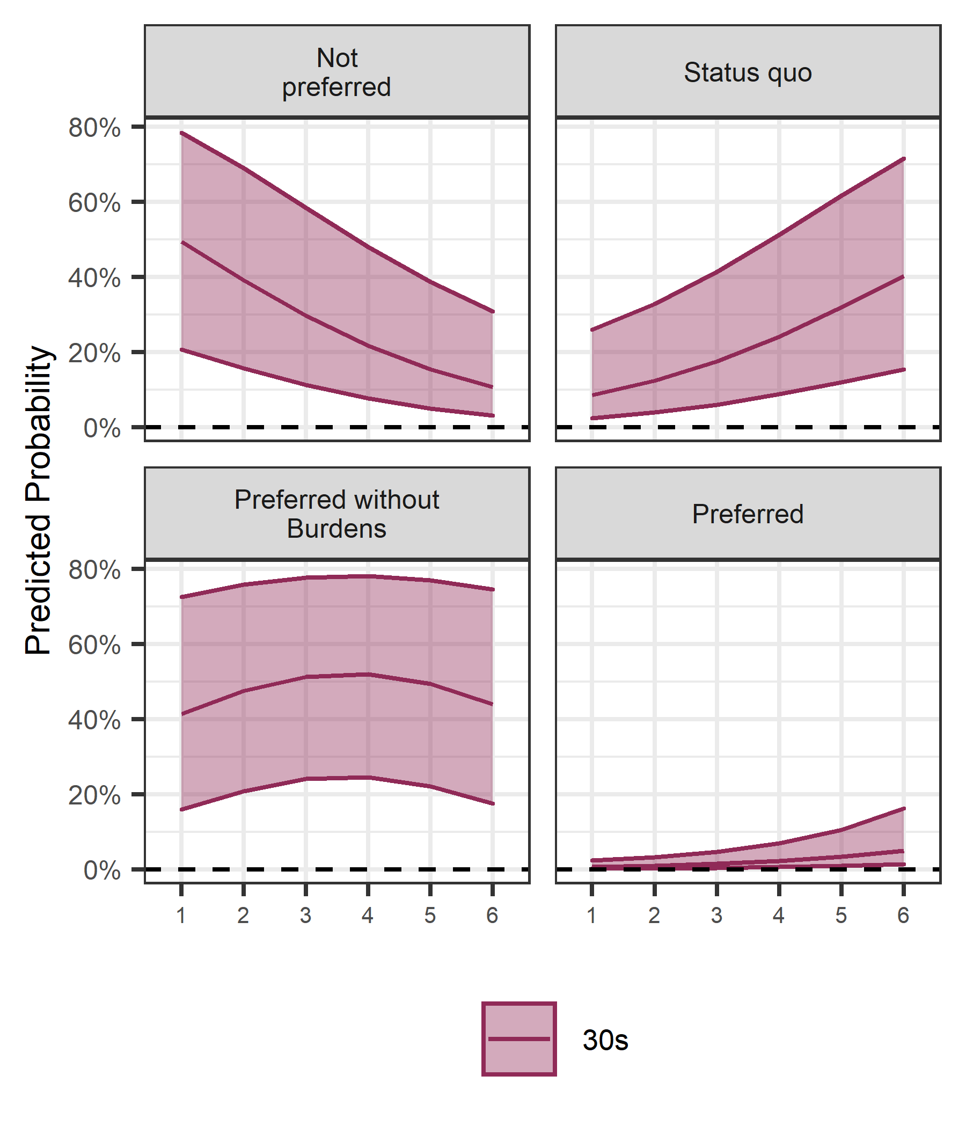
04
Attitudes toward Unification after the Panmunjom Declaration
Notes:
Then, how about the 20s, 30s, and 60+? Interestingly, the trends are not so different in the predicted probabilities. The only different can be seen at the panel of “preferred without burdens.” The 20s, 30s, and 40s show greater variations in the predicted probabilities as the prospects of unification vary.

Slide 22
05
Conclusion
Hypothesis 1
Hypothesis 2
The younger generation (20s & 30s) show more negative attitudes toward North Korea than other generations, Even after the Panmunjom Declaration.
The prospects for unification affect the need for unification differently across generations.
Partially confirmed
Confirmed
The younger generations show more negative attitudes only toward North Korean leadership as well as 60+ does.
The 30s and 40s are statistically insignificant compared to the 20s.
However, the 40s and 50s are more likely to be favorable toward North Korean leadership compared to the 20s.
However, the 50s and 60+ are more likely to be favorable toward unification as the prospects of unification become positive compared to the 20s.
Notes:
In sum: [just read the slides.]

Slide 23
05
Implications
The significant events driving changes in inter-Korean relations can be made on the supply side, but we should also pay attention to the changes that appear in the ordinary people, who are the consumers, and other parties of the inter-Korean relationship.
Also, to establish the justification logic of unification based on generational changes, it is necessary to ensure long-term consistency in at least unification and North Korea policy.
Lastly, we should not overestimate that it brings fundamental changes in attitudes toward North Korea and unification.
Notes:
Attitudes toward North Korean
- The 20s, 30s, and 60+ still show negative attitudes toward North Korean Leadership.
- However, all generations do not show different attitudes toward North Korea as general.
- It implies that South Koreans distinguish the leadership and the general, and present different attitudes toward them.
- Also, unlike previous literature, the 20s and 30s show clearly negative toward North Korean leadership as well as the 60s do.
Attitudes toward Unification
- Although the 50s and 60+ seem different from the other generations on average, they are not so different even after the Panmunjom Declaration.
- When we look into the predicted probabilities to choose each category of dependent variable, the clear difference only exists in “Preferred without burdens.”
- It implies that although the unification does not require burdens, the 20s, 30s, 40s is less likely to prefer it if the prospects are negative (takes long time).
- However, the 50s and 60+ show less variations for the “preferred without burdens.” which means they prefer unification regardless of prospects if there is no burden.

Slide 24
Thank You

