Slide 1
Web Development for Beginners
April 4, 2026

Slide 2
Week 1: Foundations & How the Web Works
What Is Web Development?
Examples?

Slide 3
Why Learn Web Development?

Slide 4
A Short History of the Web

Slide 5
1989
2000
First website created
Simple text websites
Styled and interactive websites
Full applications (like apps)
1990
Today

Slide 6
How the Web Works (Big Picture)
You (Browser)
↓
Type URL (google.com)
↓
DNS (Find address)
↓
Server (Where website lives)
↓
Files sent back (HTML, CSS, JS)
↓
Browser displays website

Slide 7
What Is a Browser?
A browser is software that:
Opens websites
Reads code
Displays web pages
Examples?

Slide 8
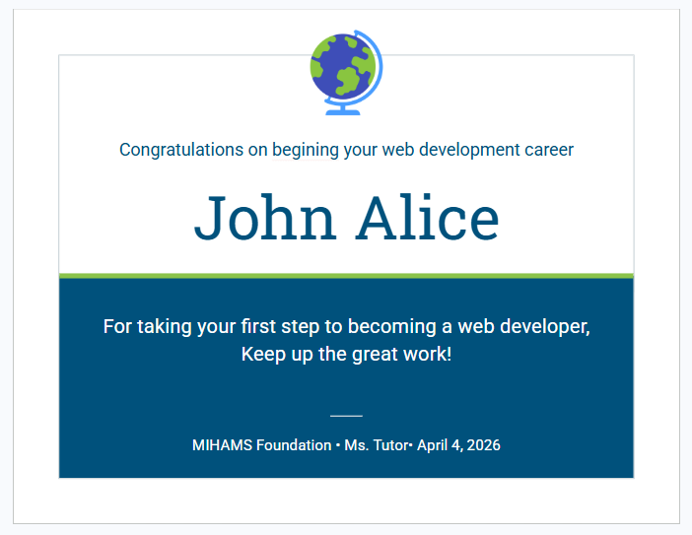
First Project: Build a html template of this award/recognition

