Slide 1
chronicle Showcase
Philippe Heymans Smith

Slide 2
This is how a chronicle report looks
This is a showcase of the outputs possible with the {chronicle} R package. For a complete how-to, please refer to the package’s github page.

Slide 3
Barplots
chronicle::add_barplot()
Simple bar plot

Slide 4
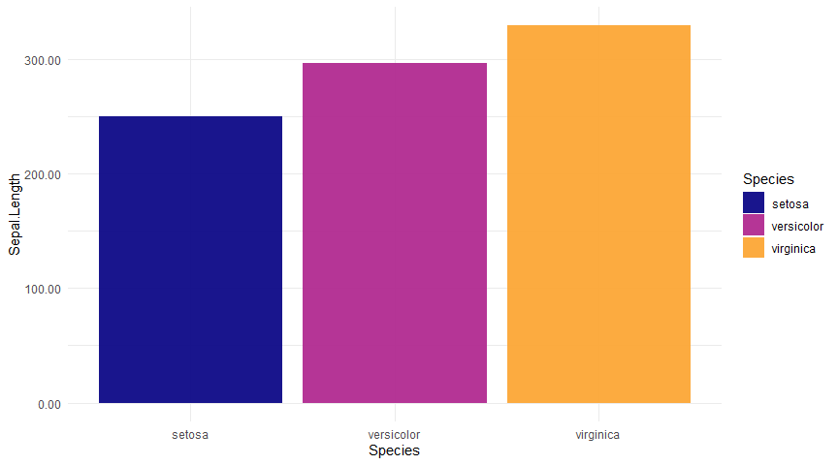

Slide 5
Bars broken by other group

Slide 6
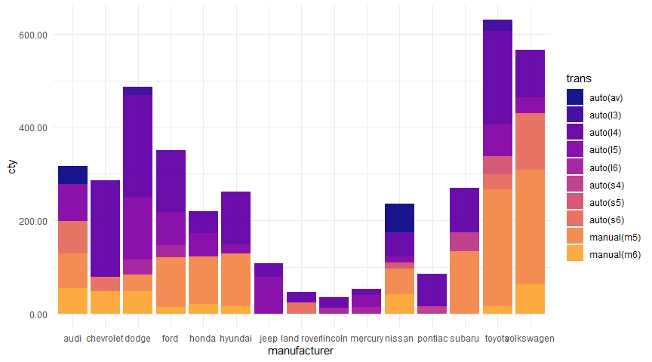

Slide 7
Bars sorted by value

Slide 8
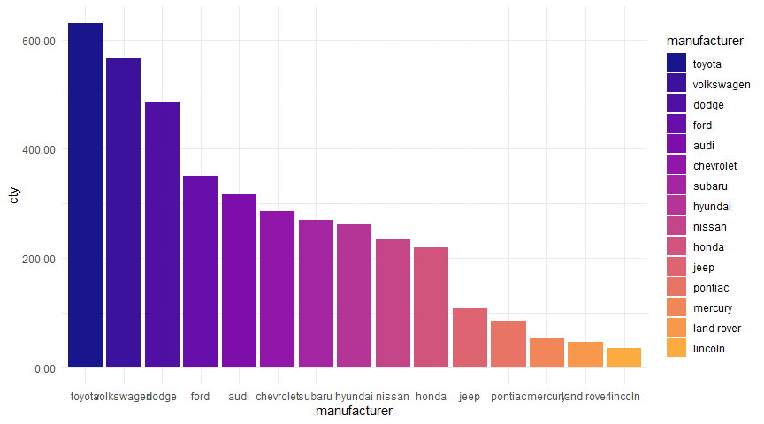

Slide 9
Bars sorted by value and broken by another column

Slide 10
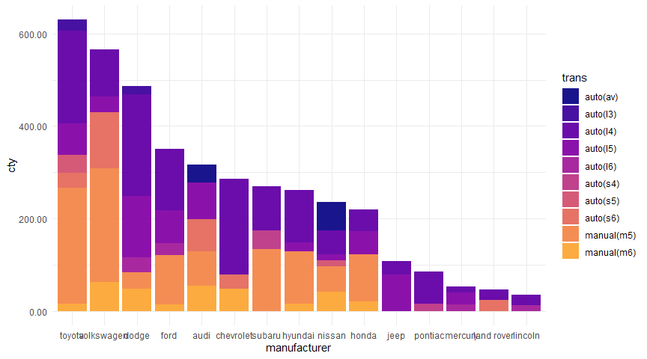

Slide 11
Horizontally

Slide 12
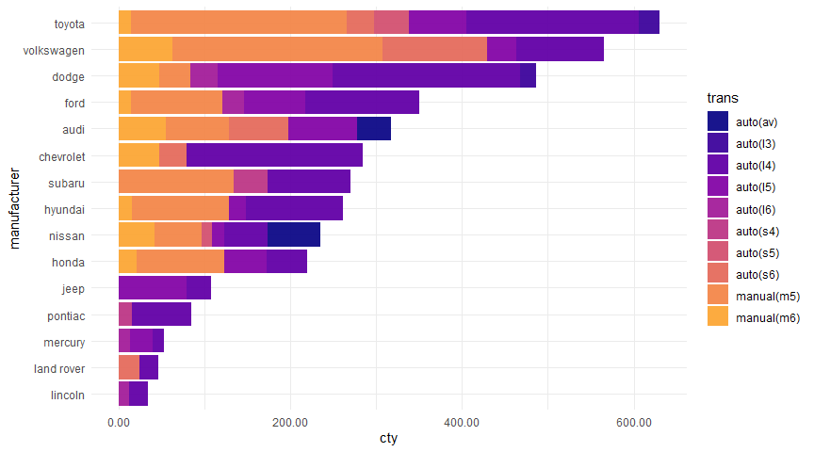

Slide 13
Boxplots
chronicle::add_boxplot()
Simple box plot

Slide 14
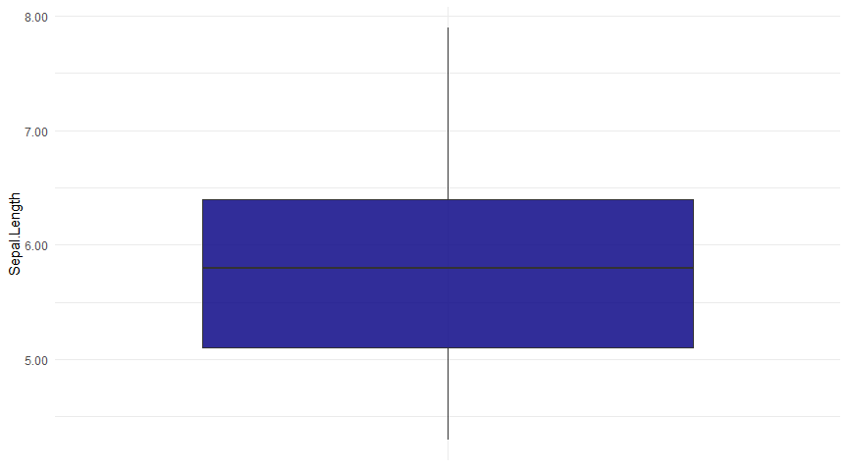

Slide 15
Box plot by groups

Slide 16
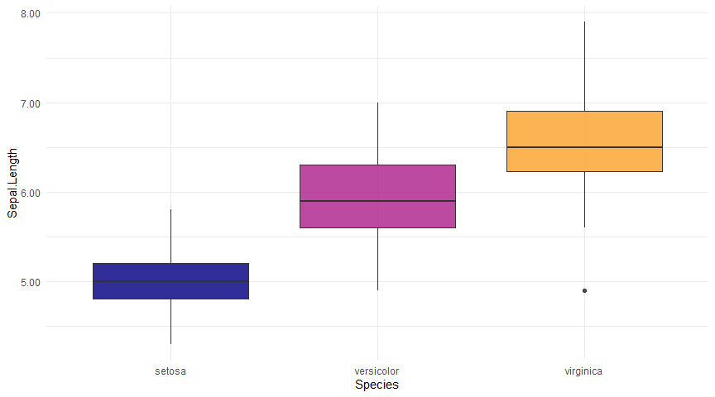

Slide 17
Box plot with jitter

Slide 18
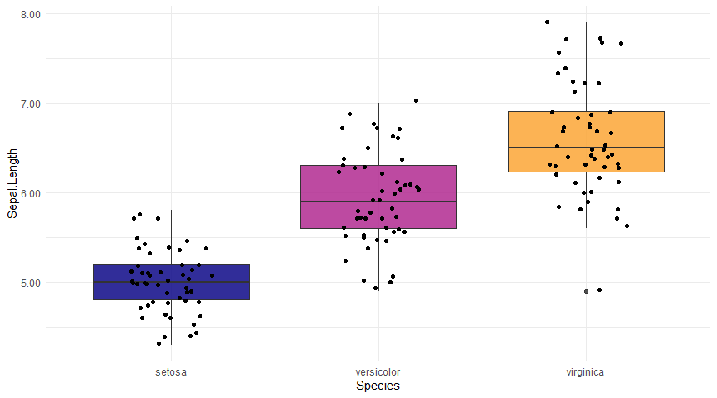

Slide 19
Code
chronicle::add_code()
This is an empty canvas for you to include any code you want.
This is some code:
data.table(iris)[, .N, Species]
It can also be evaluated!
library(data.table) data.table(iris)[, .N, Species]
## Species N ## 1: setosa 50 ## 2: versicolor 50 ## 3: virginica 50

Slide 20
Densities
chronicle::add_density()
Basic density

Slide 21
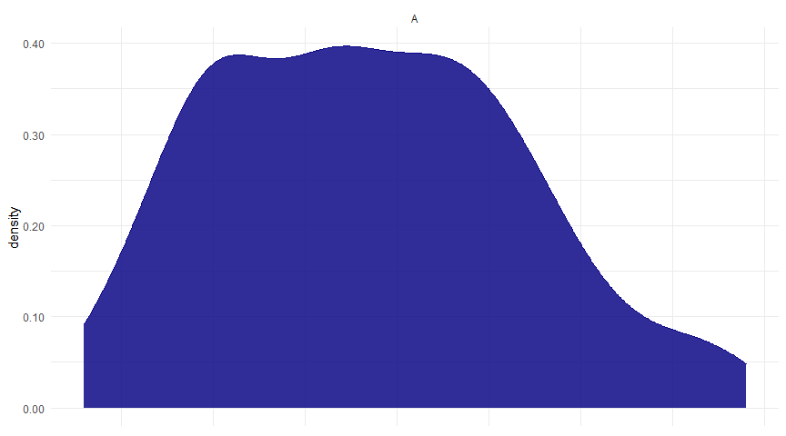

Slide 22
Density by group

Slide 23
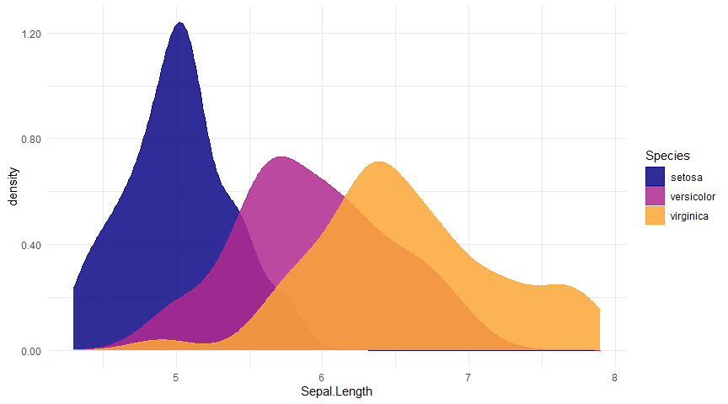

Slide 24
Faceted densities

Slide 25
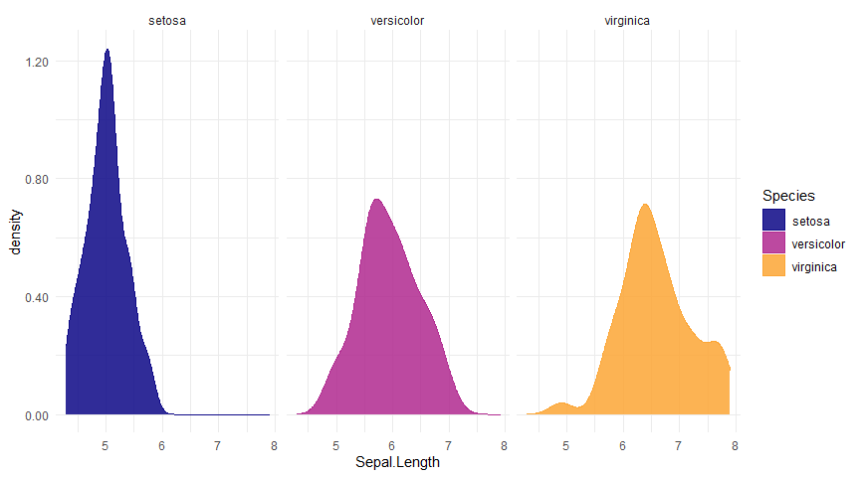

Slide 26
dygraphs
chronicle::add_dygraph()
Simple dygraph (in static outputs it will be replaced by line plots)

Slide 27
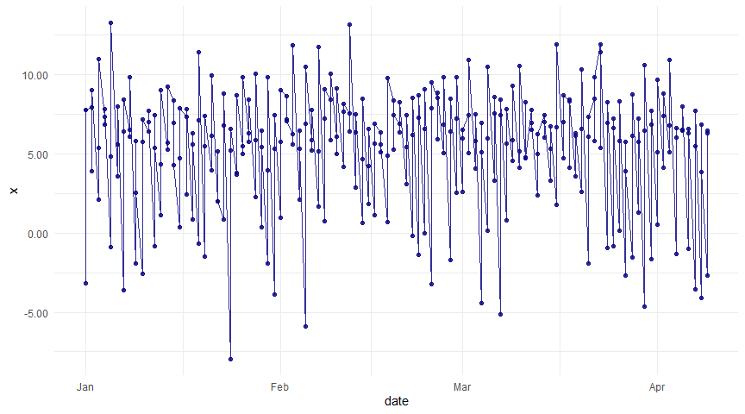

Slide 28
Dygraph by groups

Slide 29
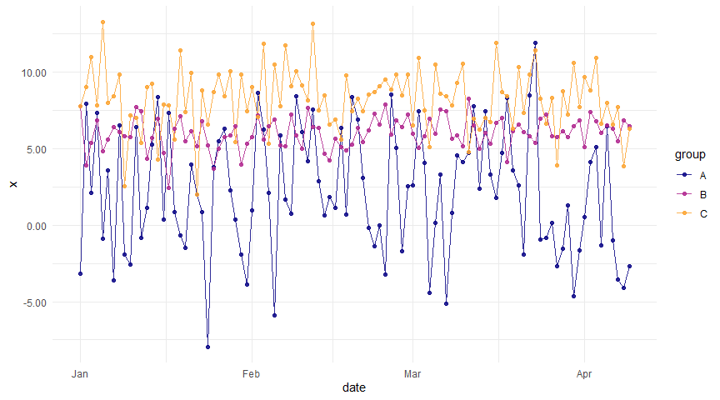

Slide 30
Histograms()
chronicle::add_histogram
Basic histogram

Slide 31
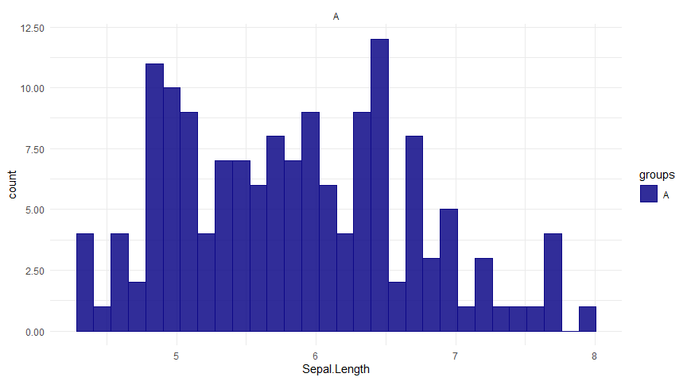

Slide 32
Faceted histogram by groups

Slide 33
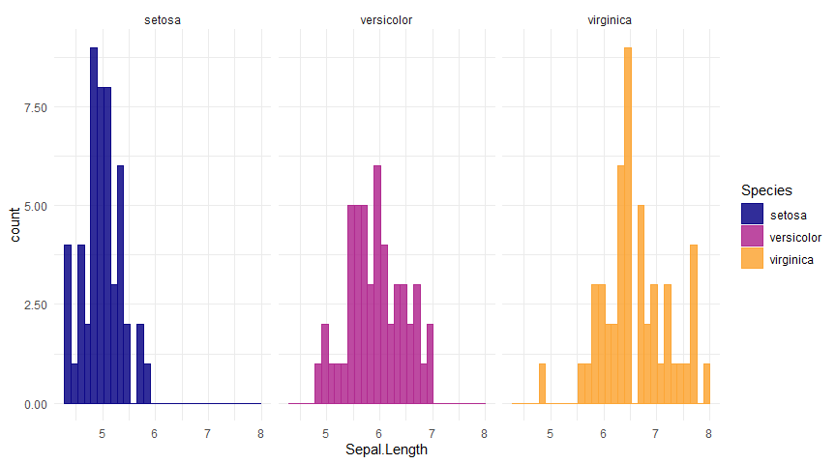

Slide 34
Line plots
chronicle::add_lineplot()
Simple line plot

Slide 36
Line plot with trend

Slide 37
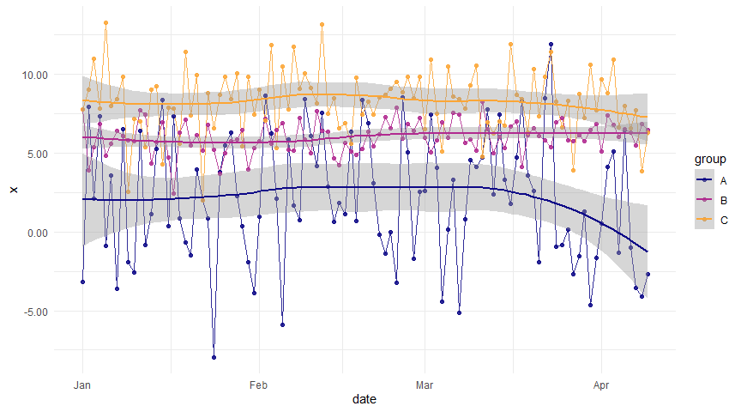

Slide 38
Line plot with linear trend

Slide 39
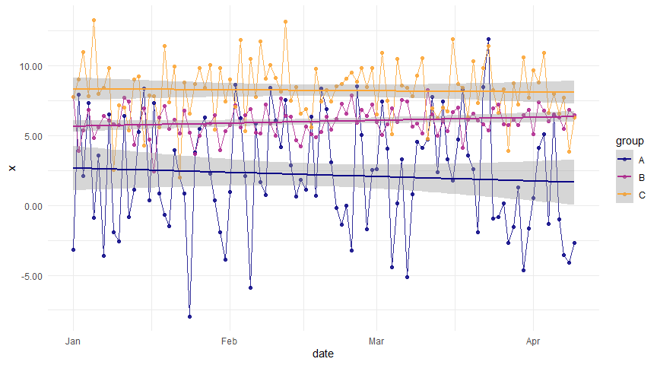

Slide 40
Faceted line plot

Slide 41
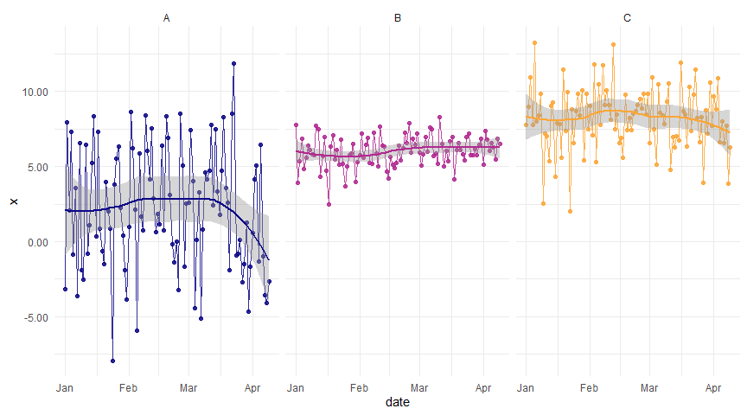

Slide 42
Rain cloud plots
chronicle::add_raincloud()
Simple rain cloud

Slide 43
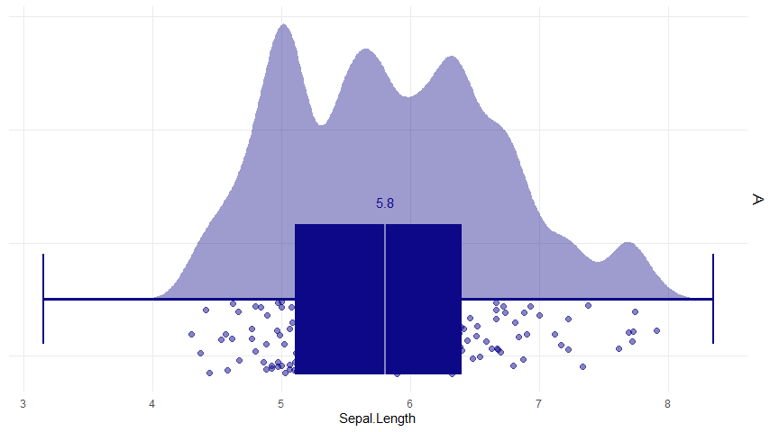

Slide 44
Rain cloud by group

Slide 45
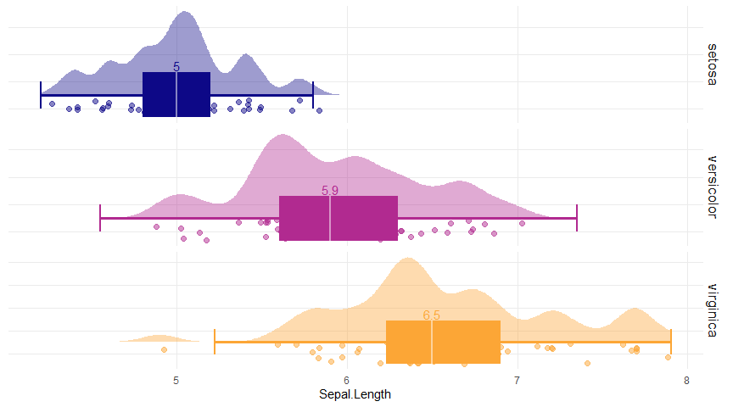

Slide 46
Larger denisty kernel

Slide 47
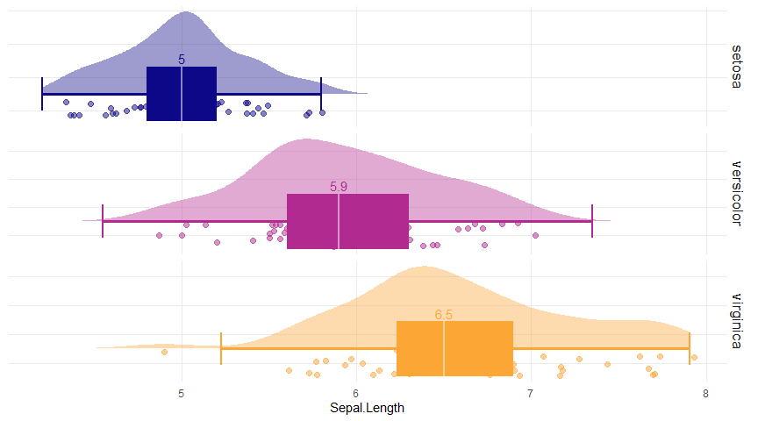

Slide 48
No boxplot, just the median

Slide 49
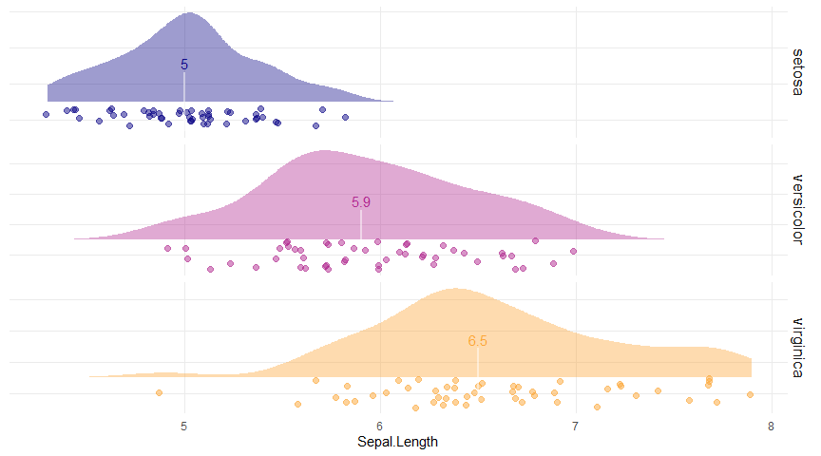

Slide 50
With the mean instead of the boxplot

Slide 51
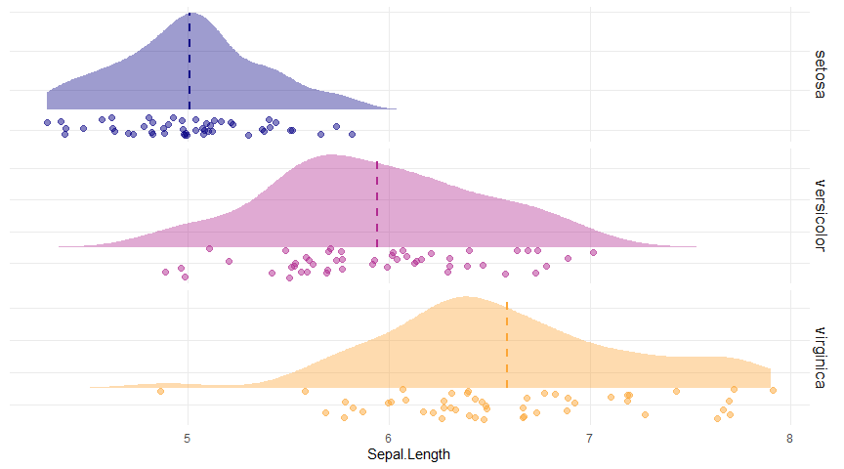

Slide 52
Scatter plots
chronicle::add_scatterplot()
Simple scatter plot

Slide 53
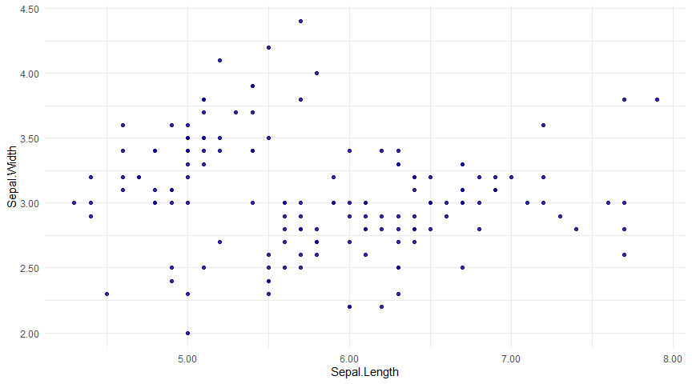

Slide 54
Scatter plot with groups

Slide 55
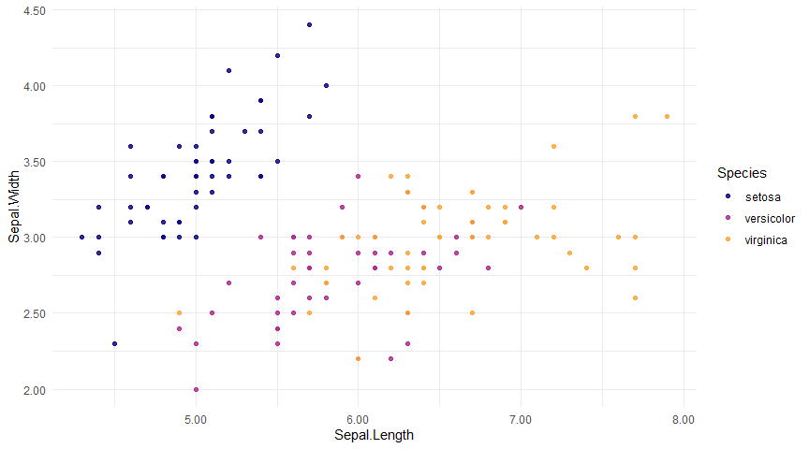

Slide 56
Faceted scatter plot with trend

Slide 57
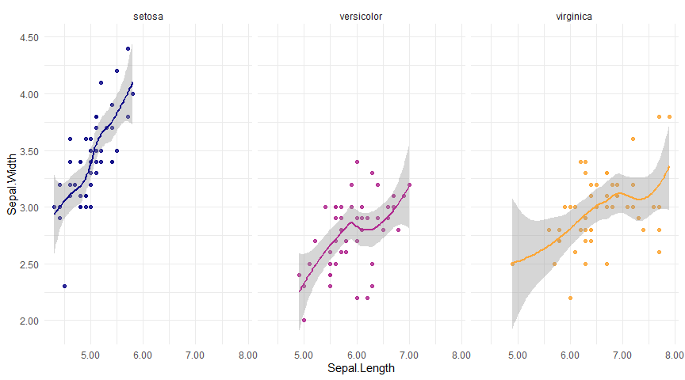

Slide 58
Tables
chronicle::add_table()
kable

Slide 59
Sepal.Length | Sepal.Width | Petal.Length | Petal.Width | Species
5.1 | 3.5 | 1.4 | 0.2 | setosa
4.9 | 3.0 | 1.4 | 0.2 | setosa
4.7 | 3.2 | 1.3 | 0.2 | setosa
4.6 | 3.1 | 1.5 | 0.2 | setosa
5.0 | 3.6 | 1.4 | 0.2 | setosa
5.4 | 3.9 | 1.7 | 0.4 | setosa

Slide 60
DT

Slide 61
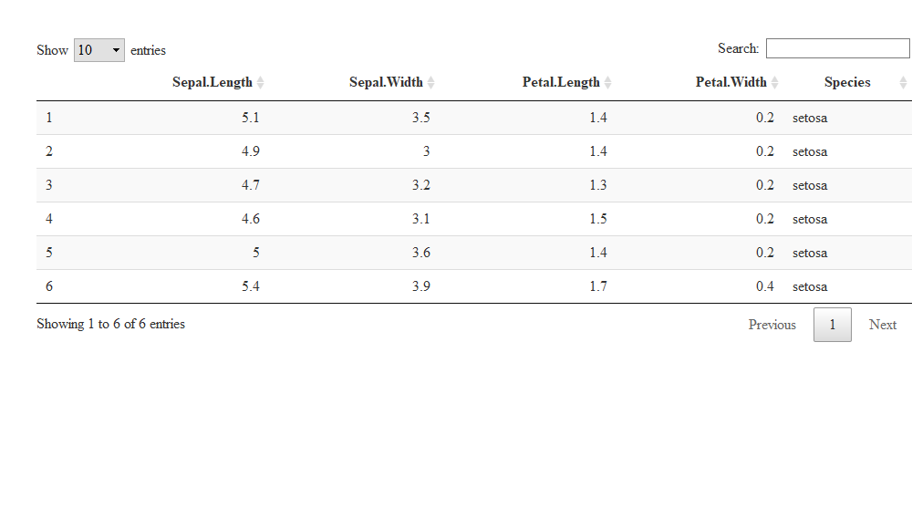

Slide 62
Violins
chronicle::add_violin()
Simple violin plot

Slide 63
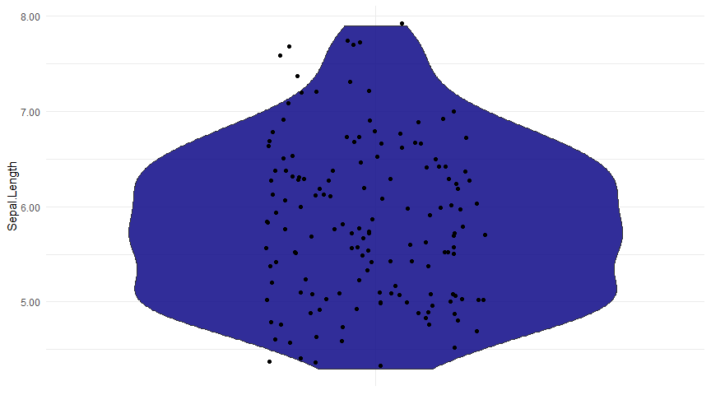

Slide 64
Violin plot by group

Slide 65
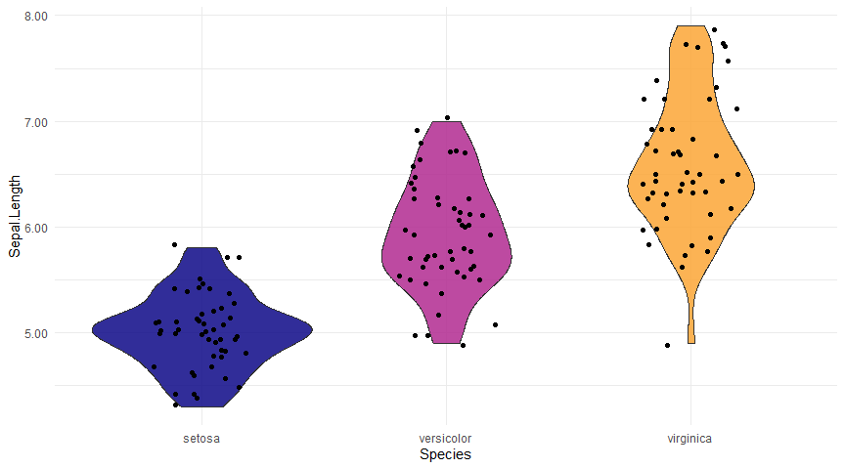

Slide 66
Big Bonus! report_columns()
chronicle also includes a function called report_columns(), that will create an entire chronicle report for a single dataset. It includes a comprehensive summary of the data through the skimr::skim() function, along with one plot for each column present in the data: bar plots for categorical variables and rain cloud plots for numerical variables. This gives you an immediate view of a dataset with a single line of code!
report_columns(dt = palmerpenguins::penguins, by_column = 'species')
you can see the example of this output here
sessionInfo
sessionInfo()
## R version 4.0.3 (2020-10-10) ## Platform: x86_64-w64-mingw32/x64 (64-bit) ## Running under: Windows 10 x64 (build 19042) ## ## Matrix products: default ## ## locale: ## [1] LC_COLLATE=English_United States.1252 LC_CTYPE=English_United States.1252 LC_MONETARY=English_United States.1252 ## [4] LC_NUMERIC=C LC_TIME=English_United States.1252 ## ## attached base packages: ## [1] stats graphics grDevices utils datasets methods base ## ## other attached packages: ## [1] stringr_1.4.0 chronicle_0.2.5 data.table_1.13.6 magrittr_2.0.1 rlang_0.4.10 ## ## loaded via a namespace (and not attached): ## [1] tufte_0.9 lattice_0.20-41 tidyr_1.1.2 ps_1.5.0 zoo_1.8-8 digest_0.6.27 ## [7] R6_2.5.0 evaluate_0.14 httr_1.4.2 xaringan_0.19 ggplot2_3.3.3 highr_0.8 ## [13] pillar_1.4.7 tictoc_1.0 lazyeval_0.2.2 rstudioapi_0.13 callr_3.5.1 Matrix_1.2-18 ## [19] DT_0.17 rmarkdown_2.6 labeling_0.4.2 splines_4.0.3 webshot_0.5.2 flexdashboard_0.5.2 ## [25] rolldown_0.1 readr_1.4.0 htmlwidgets_1.5.3 munsell_0.5.0 tinytex_0.28 compiler_4.0.3 ## [31] xfun_0.20 pkgconfig_2.0.3 mgcv_1.8-33 htmltools_0.5.0 tidyselect_1.1.0 tibble_3.0.4 ## [37] gridExtra_2.3 bookdown_0.21 viridisLite_0.3.0 crayon_1.3.4 dplyr_1.0.2 withr_2.3.0 ## [43] grid_4.0.3 nlme_3.1-151 jsonlite_1.7.2 gtable_0.3.0 lifecycle_0.2.0 scales_1.1.1 ## [49] rmdformats_1.0.1 stringi_1.5.3 farver_2.0.3 viridis_0.5.1 dygraphs_1.1.1.6 ellipsis_0.3.1 ## [55] xts_0.12.1 generics_0.1.0 vctrs_0.3.6 tools_4.0.3 glue_1.4.2 purrr_0.3.4 ## [61] hms_0.5.3 crosstalk_1.1.0.1 prettydoc_0.4.1 processx_3.4.5 yaml_2.2.1 colorspace_2.0-0 ## [67] plotly_4.9.3 knitr_1.31 pagedown_0.13

