Slide 1
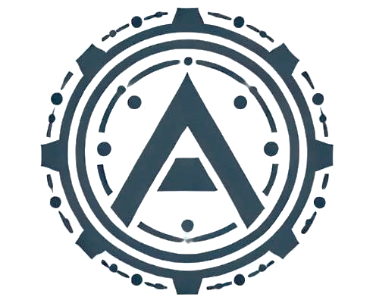
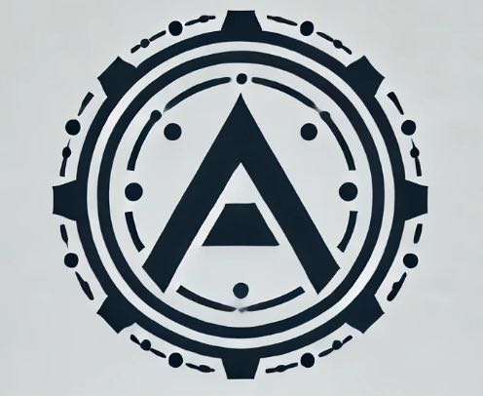
The Team Minimize downtime, maximize productivity – because every minute counts.
Bachynskyi Roi, Dietl Tobias, Gasser Philipp, Kacarevic Nikola, Mark Kathrin, Pouryousefi Ashkan, Pillwein Patrick

Slide 2
Table of contents
01
02
03
04
05
What We Offer
How It Works
How We Work
Why Choose Us
Why We Need
Your Trust

Slide 3
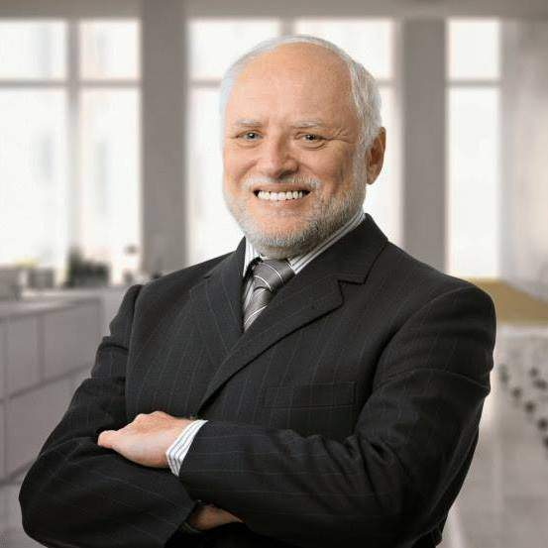
01
What We Offer

Slide 4
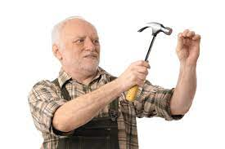
Predictive maintenance
Reduction of downtime
Machine learning to predict failure
Enabling a smart schedule
Automatically and dynamically integratable into your production
Saving real ressources
Save money, time, ressources and personell hours
Notes:
Using sensor data to identify patterns of failing machine parts. Using machine learning to predict failure before it happens. Our model enables you to automatically and dynamically integrate maintenance tasks into your production schedule. The model will use data from production to further enhance itself.
Due to the prediction the model cannot only save you money, but also time, personell hours and ressources, thus reducing the impact on the environment.

Slide 5

Up to 9,700,000 €
loss due to inefficient usage of data yearly

Slide 6

—Dave Waters
“Predicting the future isn‘t magic, it‘s artificial intelligence.”

Slide 7

02
How It Works

Slide 8

298.1 K Air temperature
Input from Sensor Data:
M
Machine Type
308.6 K
Process temperature
1551 rpm
Rotational speed
42.8 Nm
Torque
Output:
Probability of failure

Slide 9

Best Practices
Enhanced Code Quality
Following PEP-8 Guidelines
Suitable variable names
Modularized code snippets Input data validation
Collaboration via Version control system
18+ commits to private GitHub repository from several team members
Notes:
Using sensor data to identify patterns of failing machine parts. Using machine learning to predict failure before it happens. Our model enables you to automatically and dynamically integrate maintenance tasks into your production schedule. The model will use data from production to further enhance itself.
Due to the prediction the model cannot only save you money, but also time, personell hours and ressources, thus reducing the impact on the environment.

Slide 10
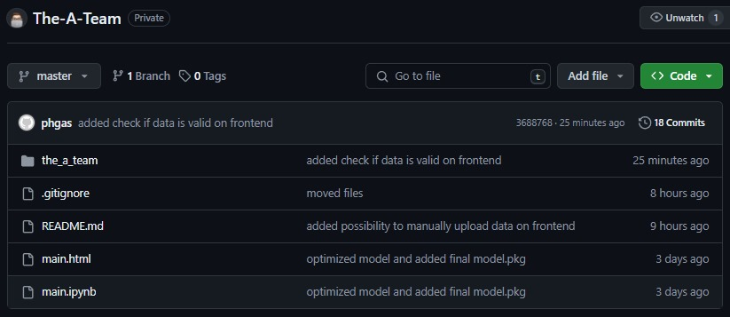

Slide 11
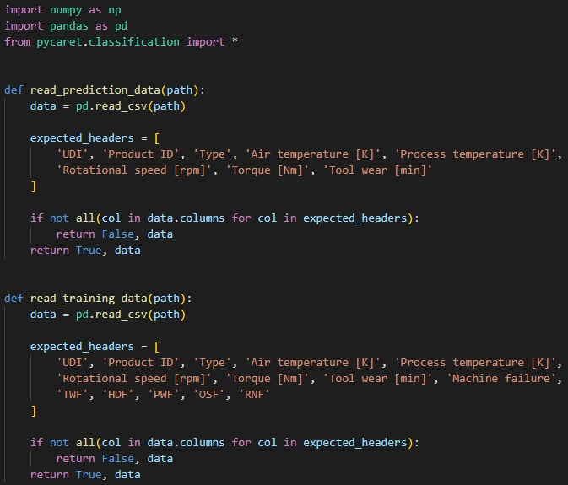

Slide 12
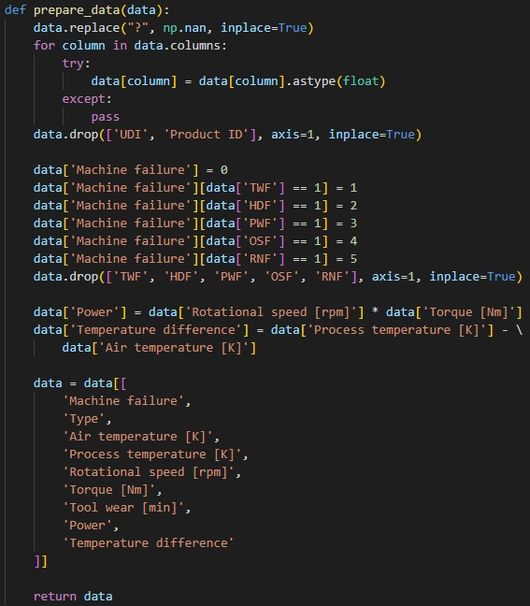

Slide 13
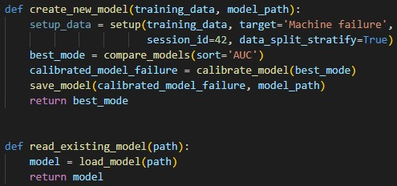

Slide 14
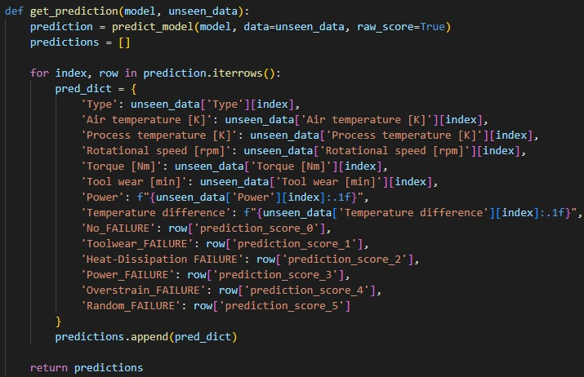

Slide 15
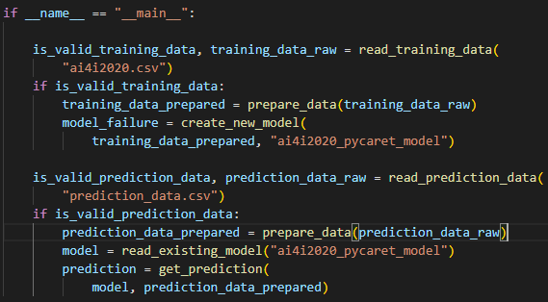

Slide 16

03
How we work

Slide 17
Implementation Process
01
02
03
Three easy steps
Training
Testing
Connecting
Once you specify the information you need from our model, implementation into your processes requires only three steps.
Using your data, we meticulously train our model for optimal performance.
Evaluating test datasets to demonstrate model precision and accuracy.
Connecting your live data to our model and predicting future trends.
Problems

Slide 18
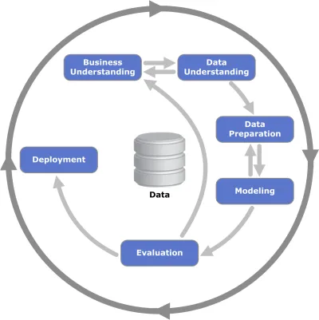
CRISP-DM
Business Understanding
Data Understanding
Data Preperation
Deployment
Modeling
Evaluation

Slide 19

04
Why Choose Us

Slide 20

Your Key benefits
01
02
03
Tailored Support
Comprehensive support and customized solutions tailored to your specific needs
Integration Capabilities
Seamlessly integrates with existing systems
wide range of industrial equipment
ensuring smooth adoption
Data Security
robust encryption and compliance with industry standards
ensuring your sensitive information is always protected
Notes:
Tailored Support
We offer comprehensive support and customized solutions tailored to your specific needs, ensuring you maximize the benefits of our predictive maintenance system.
Integration Capabilities
Seamlessly integrates with existing systems and a wide range of industrial equipment, ensuring smooth adoption and minimal disruption to current operations.
Data Security
We prioritize data security with robust encryption and compliance with industry standards, ensuring your sensitive information is always protected.

Slide 21

05
Why We Need Your Trust

Slide 22
Your Key benefits
01
02
03
Improve Service Delivery
Funding will allow us to enhance our service infrastructure, providing faster, more reliable, and more comprehensive support to our clients, ensuring they get the most out of our technology.
Develop Custom Solutions
Funding will enable us to tailor our predictive maintenance solutions to meet the specific needs of diverse industries, providing customized and highly effective solutions.
Optimize User Experience
We aim to continuously improve the user interface and user experience of our platform. Your funds will support ongoing enhancements that make our tools more intuitive and effective for all users.

Slide 23

Thank you for choosing us!

Slide 24
Hard Facts
Django
Licensing system with subscription types on a monthly basis:
FREE: 1000
BASIC: 5000
PREMIUM: 10000
Backend → REST-API
Frontend
Failure above 33% → Yellow
Failure above 66% → Red
Notes:
Using sensor data to identify patterns of failing machine parts. Using machine learning to predict failure before it happens. Our model enables you to automatically and dynamically integrate maintenance tasks into your production schedule. The model will use data from production to further enhance itself.
Due to the prediction the model cannot only save you money, but also time, personell hours and ressources, thus reducing the impact on the environment.

