Slide 1
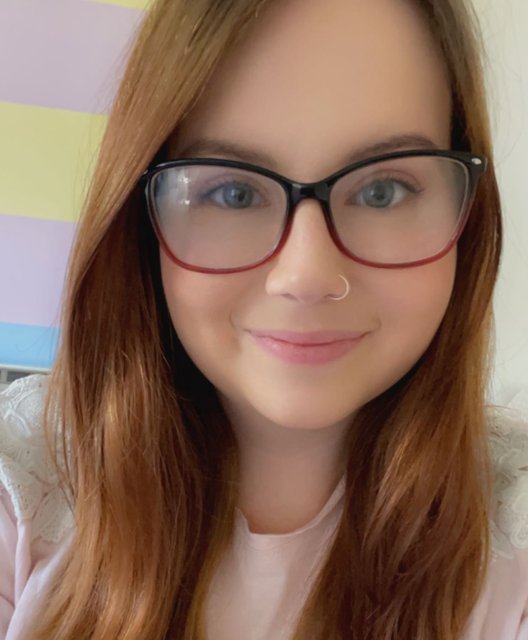
Paige is a creative and curious individual who embarked on an exciting reskilling journey in November 2023. Having a background largely in customer service management, Paige’s transition to full-stack software engineering has been both challenging and overwhelmingly rewarding. As demonstrated not only through this transition, but her journey from customer service advisor, through to coaching and then leading a team, Paige embraces challenges with enthusiasm, seeking out opportunities to learn and evolve.
Achievements
Completed 12 weeks of reskill training to become full-stack engineer covering topics such as agile and scrum methodologies, front end development in react with HTML, CSS & JavaScript, databases in mySQL, API’s in Spring Boot with Java, and testing with Selenium. As well as an overview of CI/CD pipelines in Jenkins, Cloud fundamentals and DevOps principles.
Supported the business with change delivery as a best bank connector for several years, including the requirements and testing of a new internal direct debit indemnity system, addressing and eradicating issues that had been present for colleagues for many years.
Supported the introduction of the banking telephony skill in Andover as a test and learn for 6 weeks. Successfully training and leading approx 100 colleagues, setting up best practice for the teams to continue to succeed independently.
Worked in the homeworking controls team post covid, building and improving on existing processes for onboarding and putting forward business cases to remove unnecessary controls.
Key skills and experience
Customer-Centric Mindset: Paige’s experience in customer service brings empathy and a user-focussed approach to software development. Having taken countless customer calls since 2015, Paige understands the importance of creating intuitive and user-friendly solutions.
Team collaboration: Paige’s broad experience across roles and team sizes gives her the ability to collaborate effectively with all colleagues, working to deliver common goals and challenging processes where necessary.
Communication: Paige is able to communicate effectively not only with her peers, but her experience working with homeworking controls has prepared her to bridge the gap between technical and not technical stakeholders.
Problem solving: Drawing on all her first-hand experience of customer problems, and her experience working with the change and improvement teams, Paige excels at dissecting complex problems into their most basic form. From improving processes and customer journeys, to streamlining existing code, Paige’s analytical skills support her in finding simple and effective solutions.
Leadership: Paige’s leadership style is natural and honest. She believes in fostering an inclusive and supportive environment where every team member can thrive, evidenced by members of her team progressing their careers to line management and business support functions.
Paige’s goals are currently to continue to grow towards a competent full-stack engineer. She is looking for hands on experience and is eager to implement and practice the skills she’s learnt.
Paige aims to contribute towards real-world projects, building robust applications that impact users positively and support the business with their go digital initative.
Paige is currently based in South Wales. She has worked remotely successfully for many years and is able to travel to hubs and office locations across South Wales and West.
Paige Godwin
Trainee Junior Software Engineer
Contact: 07850280289 Paige.Godwin@lloydsbanking.com

