Slide 1

MINI PROJECT-2 CUSTOMER SEGMENATATION USING MACHINE LEARNING IN R
By
N.Srikar(19131A05G1)
P.Divyagandh(19131A05H7)
P. Hema Harsha Vardhan(19131A05H4)
Nitin Ancha(19131A05G0)
CSE - 3
Under the guidance of:
Dr. H.Parthasarathi Pathra
Associate Professor and
Department of C.S.E
GVP College of Engineering(A)

Slide 2

CONTENTS
ABSTRACT
INTRODUCTION
DRAWBACKS OF EXISTING WORK
PROPOSED WORK
DATA FLOW DIAGRAM
SOFTWARE AND HARDWARE REQUIREMENTS
IMPLEMENTATION
RESULTS
CONCLUSION
FUTUR SCOPE
REFERENCES

Slide 3
ABSTRACT
We all know that to run a business customers are important. The business people believe that “customers should be treated as Gods”. To maintain relationship between customer and owner and their trust is more important to run a business for long term. Here we get a solution for that, using our Customer Segmentation that company could know about the customer and produce products, give special offers and act according to customer needs, so there would be a great relationship between customer and owner. We used Machine Learning in R, we visualize and analyse the data based on age, gender, income and spending score. We also use clustering Techniques. We try increase the clusters of customers for more analysis.

Slide 4
INTRODUCTION
What is Customer Segmentation?
Customer Segmentation is the process of division of customer base into several groups of individuals that share a similarity in different ways that are relevant to marketing such as gender, age, interests, and miscellaneous spending habits.
There are different methodologies for customer segmentation, and they depend on four types of parameters:
1.Geographic
2.Demographic
3.Behavioral
4.Psychological.
It’s not wise to serve all customers with the same product model, email, text message campaign, or ad. Customers have different needs. A one-size-for-all approach to business will generally result in less engagement, lower-click through rates, and ultimately fewer sales. Customer segmentation is the cure for this problem

Slide 5
DRAWBACKS OF EXISTING WORK
One of the biggest issues with customer segmentation is data quality. Inaccurate data in source systems will usually result in poor grouping
Larger Inventory is to be maintained by both manufacturer and distributor
It is not Cost Effective
Expenditure increases based on the market
If there is a sudden change in the market all the investment made might be Useless

Slide 6
PROPOSED WORK
Creating clusters with more data quality which is more cost effective.
It is based in quality grouping.
Advantages of our Proposed Work
Implementing customer segmentation leads to plenty of new business opportunities.
You can do a lot of optimization in:
Budgeting
product design
Promotion
Marketing
customer satisfaction

Slide 7
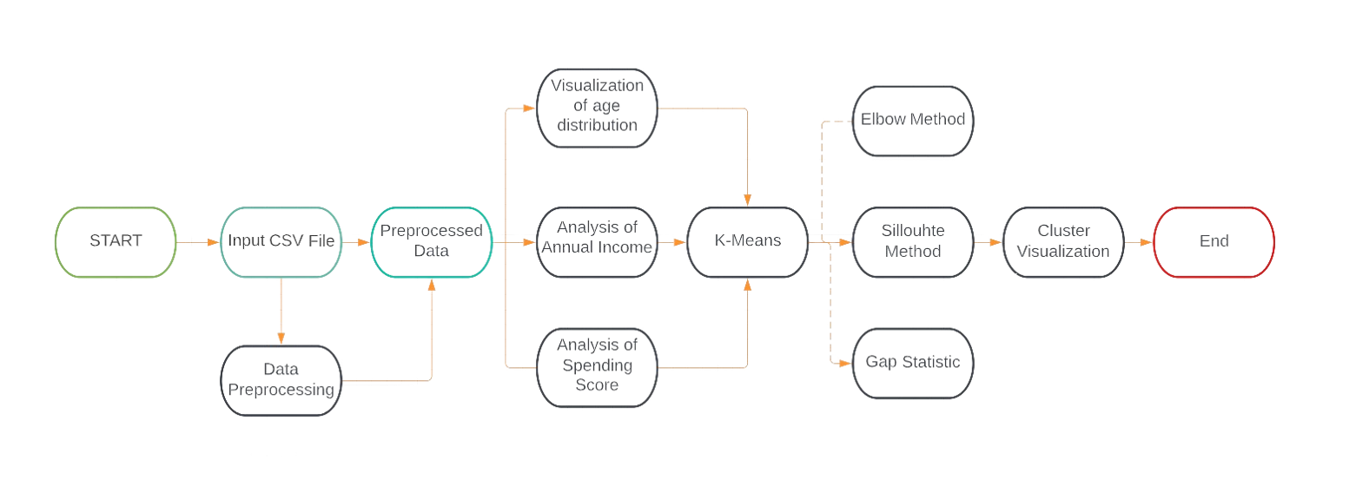
DATA FLOW DIAGRAM

Slide 8
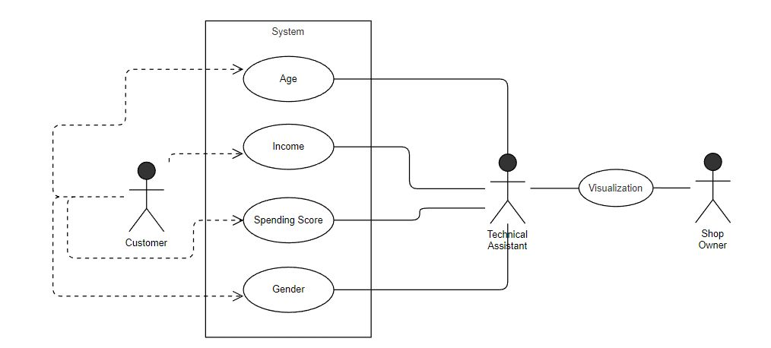
USECASE DIAGRAM

Slide 9
SOFTWARE AND HARDWARE REQUIREMENTS
HARDWARE REQUIREMENTS: Minimum hardware requirements for this project are
1.Processor -Intel Core i3
2.Hard Disk – 256GB
3.RAM - 4GB
SOFTWARE REQUIREMENTS: Minimum software requirements are
1. IDE – Google Colab
2. R Programming
Packages Required: All the Packages required are
1. Plotrix
2. GridExtra
3. NbClust
4. FactoExtra
5. Purrr

Slide 10
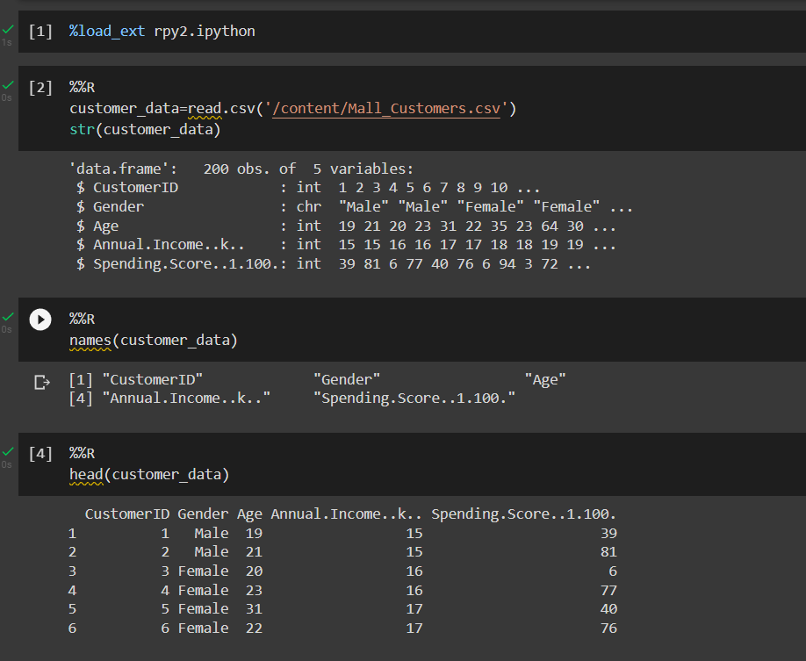
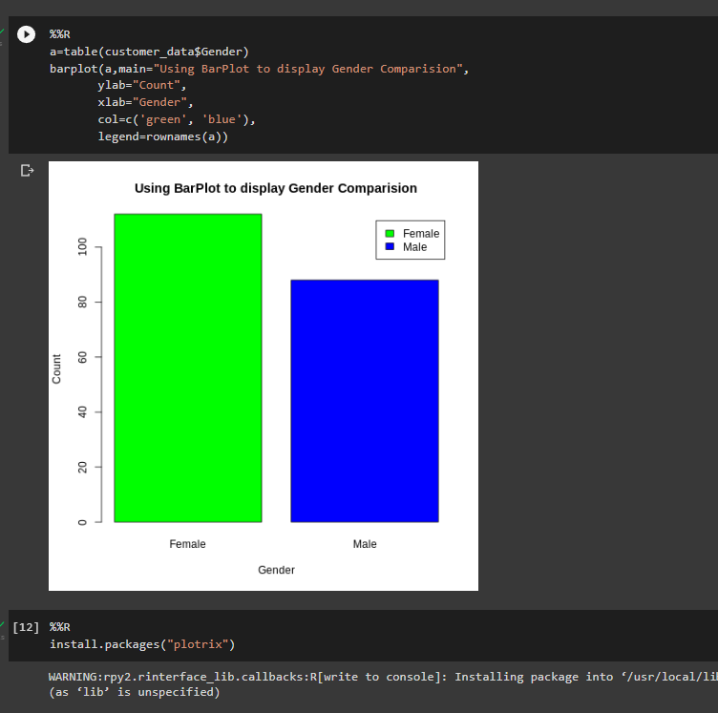
IMPLEMNTATION

Slide 11
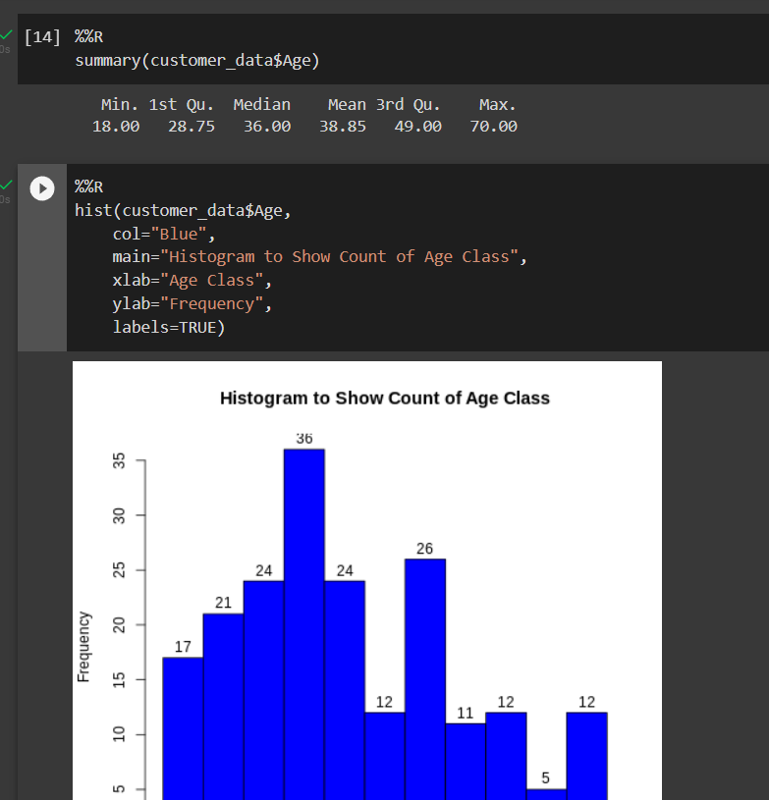
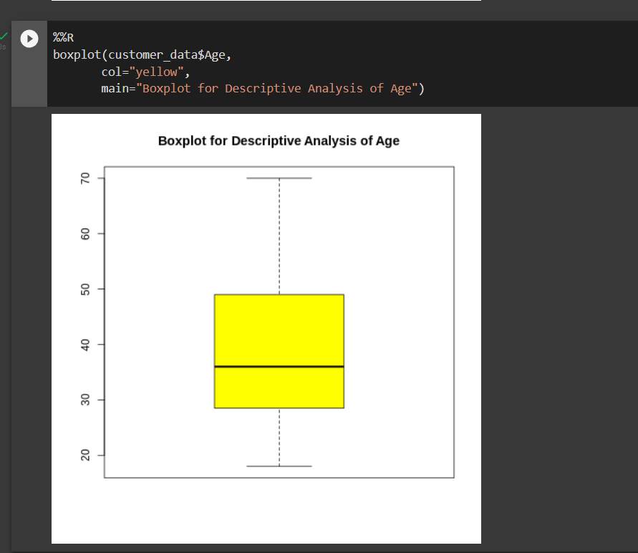
Visualization based on Age

Slide 12
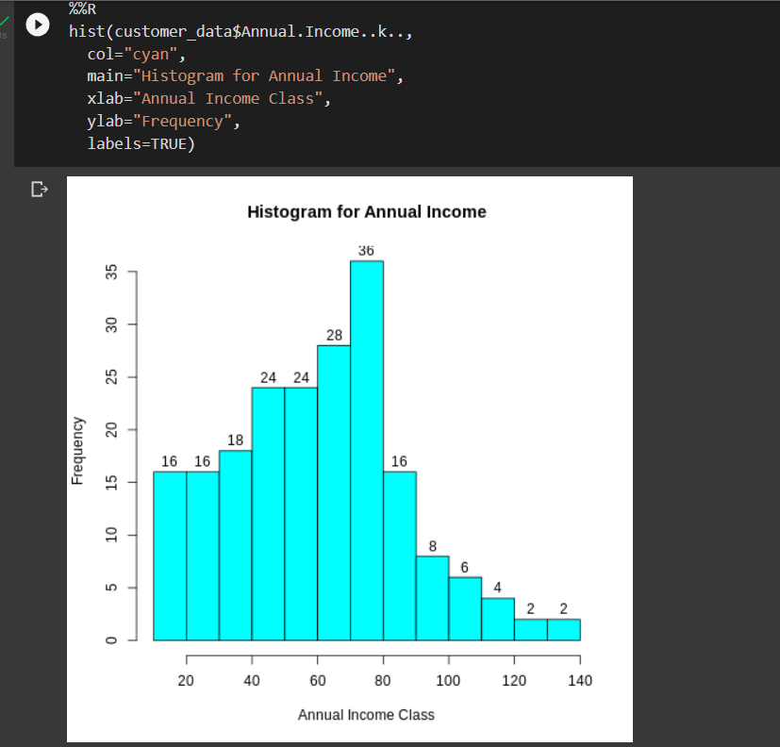
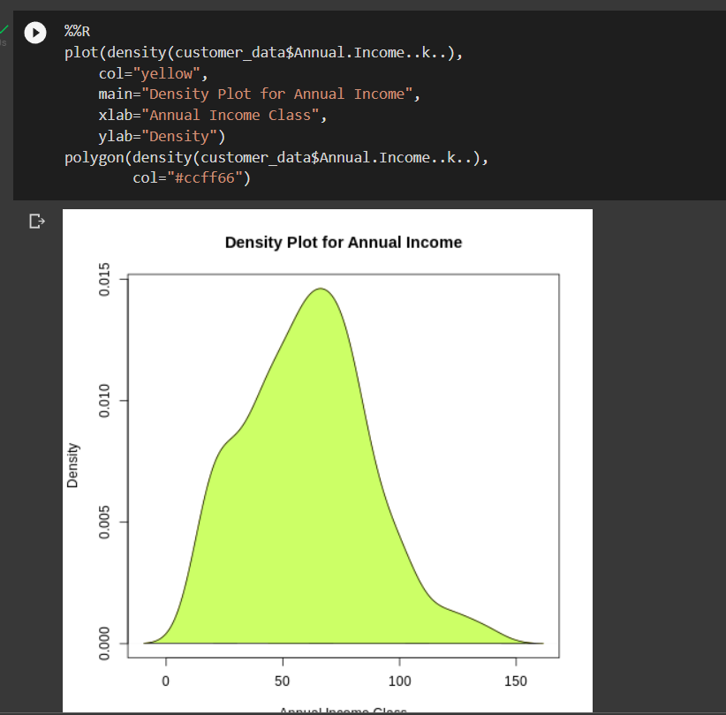
Analysis for Annual Income and Spending Score

Slide 13
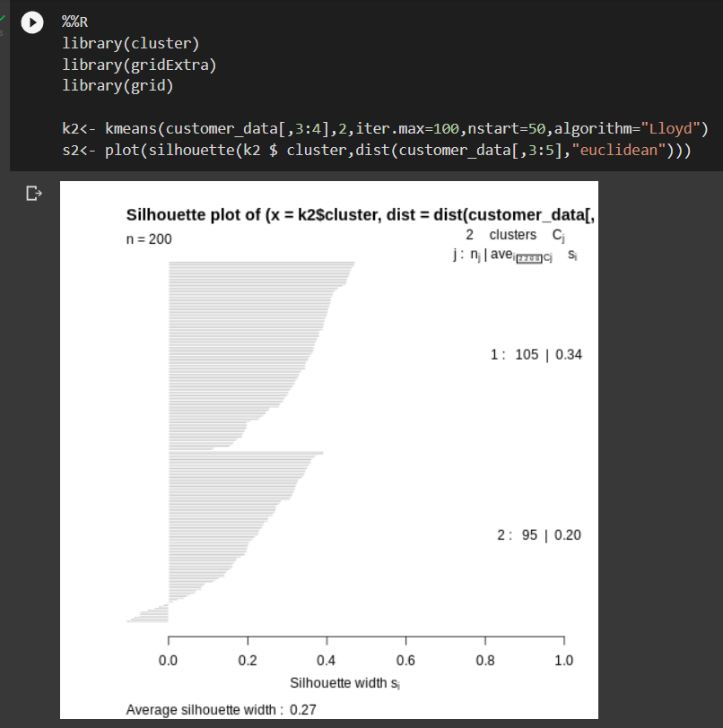
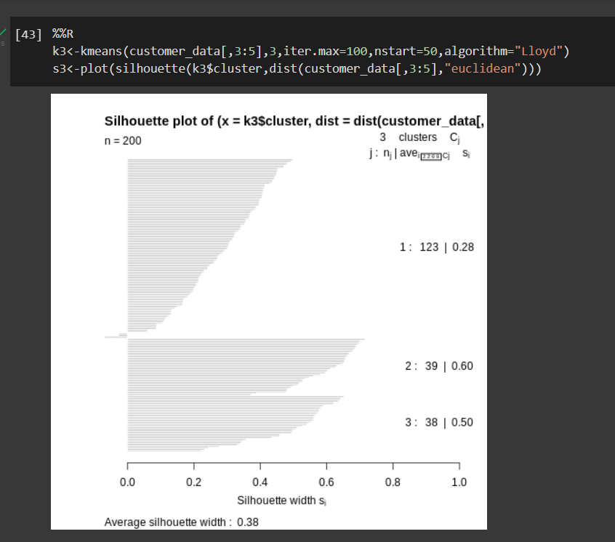
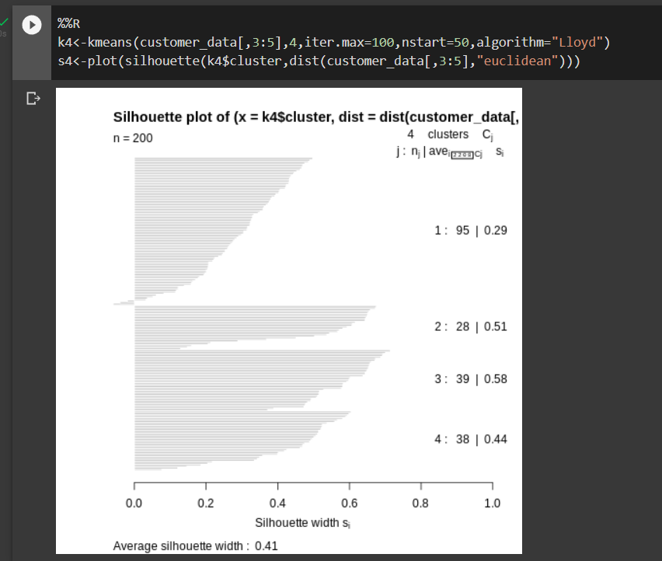
Silhouette Graphs

Slide 14
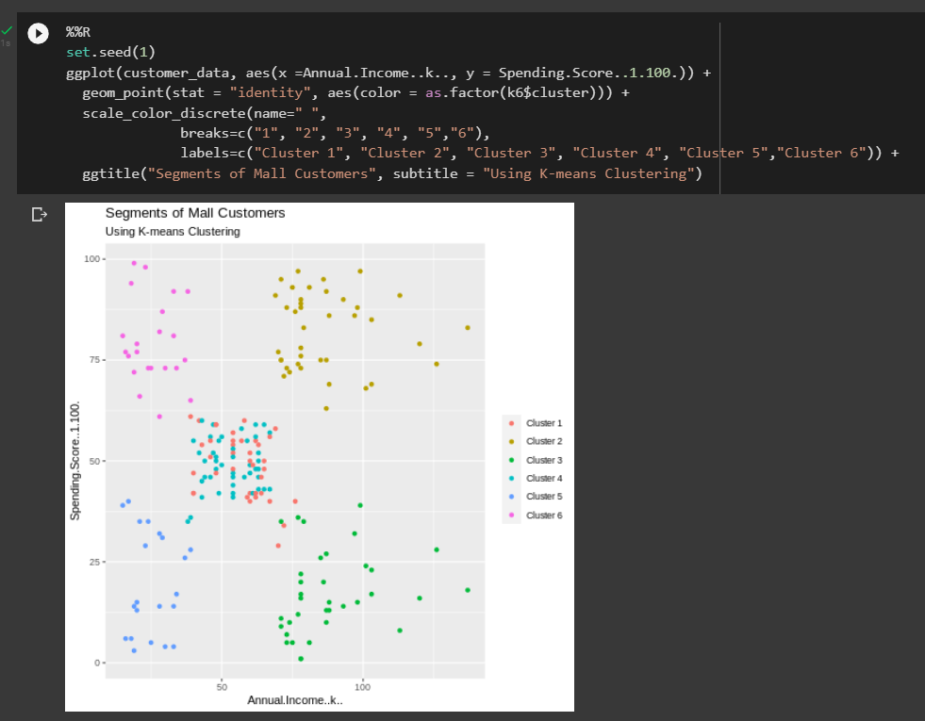
Scatter Plot based on the Age and Spending Score and Annual Income

Slide 15
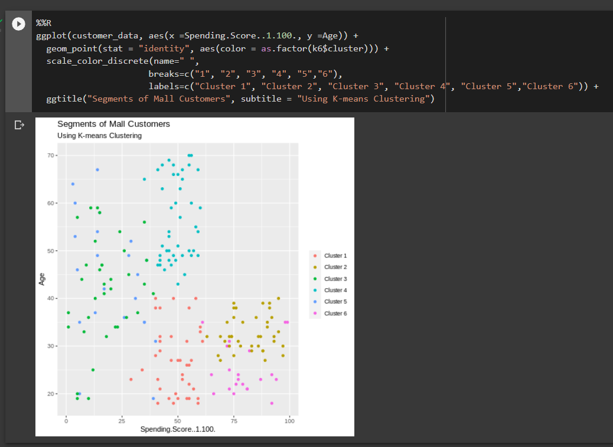
Scatter Plot based on the Age and Spending Score

Slide 16
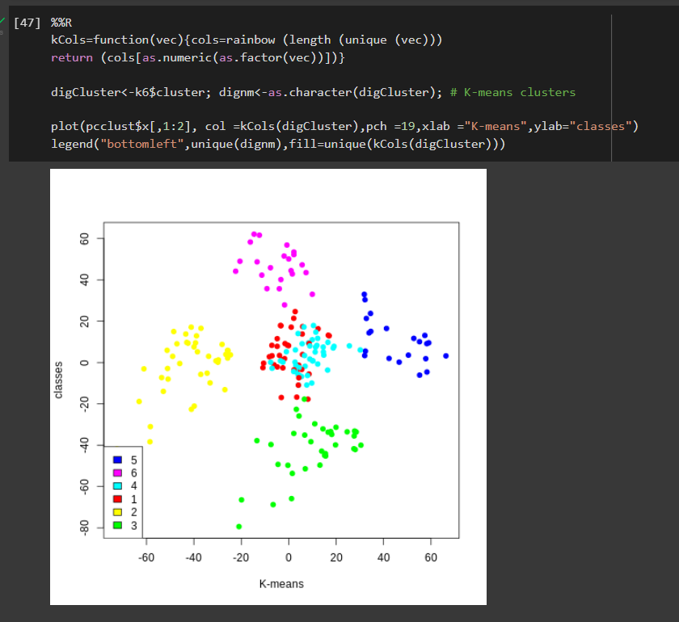
Final Customer segmented Clusters

Slide 17
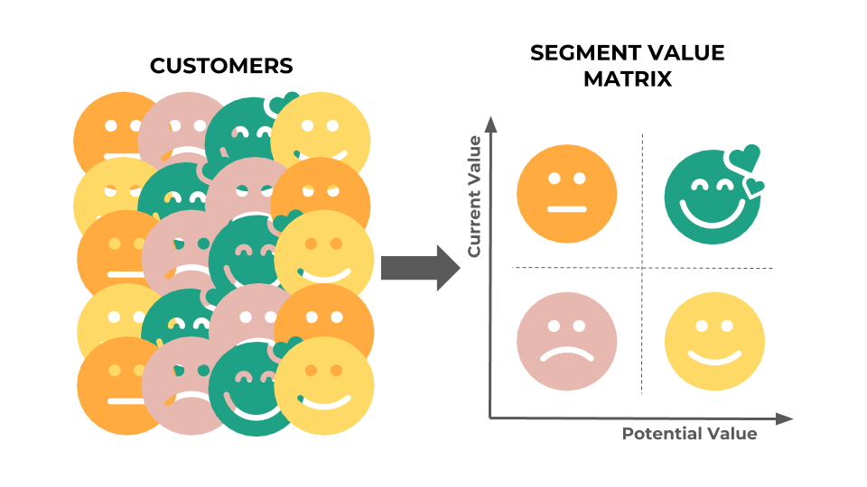
RESULTS
Input Must be given in a pre-formatted Excel File
When Compared with all the three algorithms in K-means which are Elbow method, silhouette and Gap statistic the silhouette has more accuracy
The Analysed Data will be Represented in the form of Various Clusters based on their segmentation

Slide 18
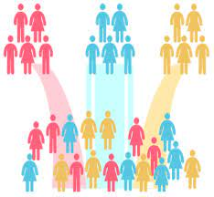
CONCLUSION
In this data science project, we went through the customer segmentation model. We developed this using a class of machine learning known as unsupervised learning. Specifically, we made use of a clustering algorithm called K-means clustering. We analyzed and visualized the data and then proceeded to implement our algorithm.

Slide 19

FUTURE SCOPE
In Future if required the project can be integrated to a website to develop and make the service available for anyone so that though a web page the csv file can be taken as an input and Directly display the clusters which is nothing but the segmented customers as per the given data.

Slide 20
REFERENCES
[1] https://towardsdatascience.com/mall-customers-segmentation-using-machine-learning-274ddf5575d
[2] https://analyticsindiamag.com/data-preprocessing-with-r-hands-on-tutorial/
[3] https://data-flair.training/blogs/r-data-science-project-customer-segmentation/
[4] https://neptune.ai/blog/customer-segmentation-using-machine-learning
[5] https://www.yourarticlelibrary.com/marketing/marketing-management/advantages-and-disadvantages-of-market-segmentation/27955

Slide 21
THANK YOU

