Slide 1

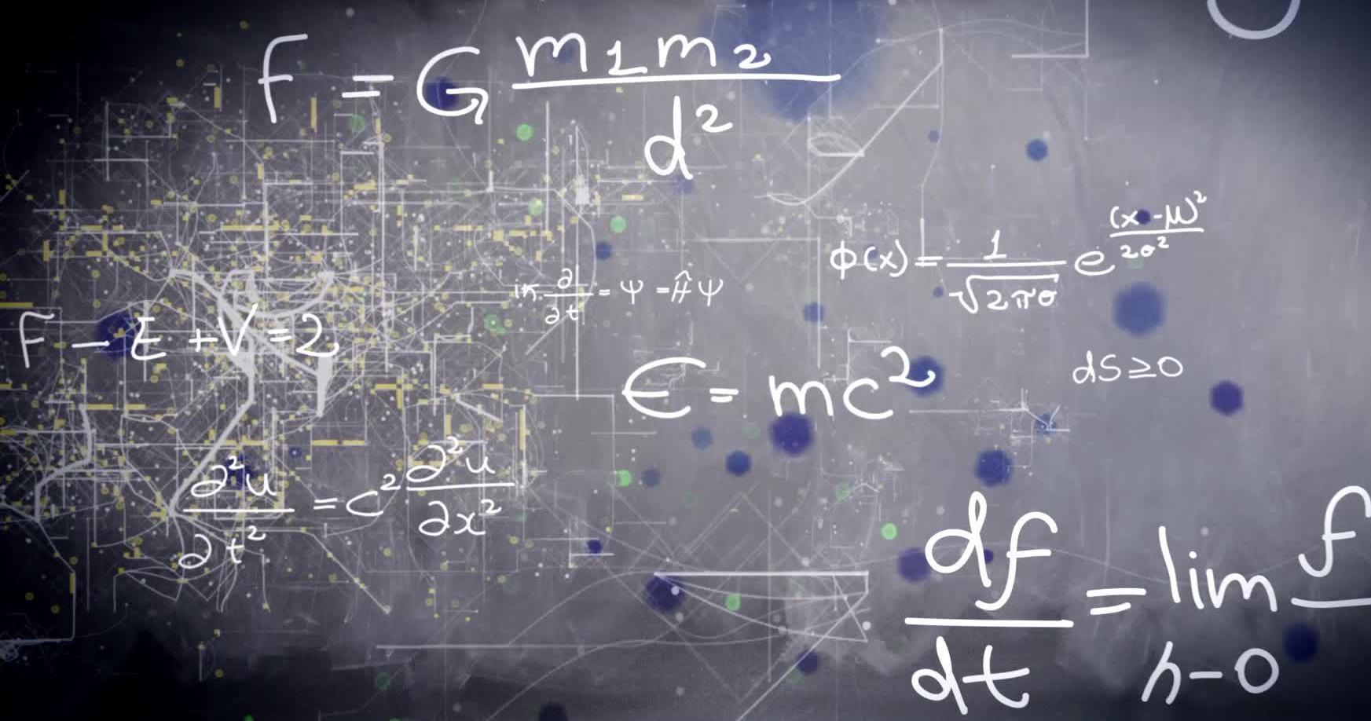
Exploring Mathematical Reasoning in Large Language Models: Case-Driven vs Rule-Based Approaches
Presented by :
Veera Venkata Satya Sai Bhargavi Manda - R1190175
Hema Harsha Vardhan Peela- R11912124
Sasi Kiran Boyapati- R11900425
Nithish Chandra Vyas Talluru- R11842825
Priscilla Grace Kolagani- R11902787

Slide 2

Contents
Overview
Novel Solutions & Research
Approach
Experimental setting
Experimental results
Comparison
Conclusion
References

Slide 3

Overview
Overview of Previous Work
Baseline Models Evaluated: GPT-3 and Llama-7B with Direct Answer, Scratchpad, and RFFT methods.
Static Reasoning: Models used fixed methods, inefficient for diverse input types.
Main Challenge
Lack of Adaptability: Inability to switch reasoning methods based on input complexity, leading to inefficiencies and reduced accuracy.

Slide 4
Novel Solutions
Adaptive Hybrid Model:
Objective:
Dynamically adapt reasoning style based on input complexity.
Balance efficiency (for simple tasks) and accuracy (for complex tasks).
Research Goal:
Develop a model that selects case-based reasoning for short inputs and rule-following for long inputs.
Reduce computational overhead while improving model reliability for diverse arithmetic problems.

Slide 5
Novel Solutions
Error Correction Mechanism
Objective:
Iteratively correct errors in model output to improve overall accuracy.
Minimize the effect of error propagation in complex calculations.
Research Goal:
Use reinforcement learning (PPO) to identify and correct mistakes.
Develop a feedback loop that enhances the model’s reasoning through reward-based correction.

Slide 6
Approach for Adaptive Hybrid Model
Input Complexity-Based Switching:
Case-Based Reasoning for short inputs: Fast and efficient, leveraging memorized patterns.
Rule-Following Reasoning for long inputs: Systematic breakdown to handle complexity accurately.
Threshold Mechanism:
Threshold Length determines which reasoning style to use.
Optimizes accuracy and efficiency based on input characteristics.
How it Works:
For short inputs, the model uses simple recall to generate an answer.
For complex inputs, the model follows structured steps to reach an accurate solution.

Slide 7
Approach for Error Correction Mechanism
Verification and Correction Loop:
Model verifies generated outputs using rule-based checks.
Incorrect outputs are fed back for correction until a satisfactory answer is achieved.
Reinforcement Learning (PPO):
Positive and Negative Rewards:
>Correct outputs are rewarded positively.
>Incorrect outputs trigger corrections and negative rewards.
Iterative Refinement ensures the model learns from its mistakes and becomes more accurate over time.
How it Works:
The model generates an initial output, which is verified.
If incorrect, it goes through PPO-based corrections until the correct answer is reached.

Slide 8
Experimental Setup for Adaptive Hybrid Model
Experimental Setup:
Models Used:
GPT-3 and Llama-7B as baseline models.
Adaptive Hybrid Model combining case-based and rule-following reasoning.
Input Data:
Arithmetic Problems with varying digit lengths (1 to 10 digits).
Tested on both simple (e.g., single-digit addition) and complex (e.g., multi-digit calculations) inputs.
Evaluation Metrics:
Accuracy: Measured how well each approach performed across different input complexities.
Efficiency: Compared computation time for simple and complex tasks.
Goal:
Test if the hybrid model improves accuracy and efficiency by switching reasoning based on input complexity.

Slide 9
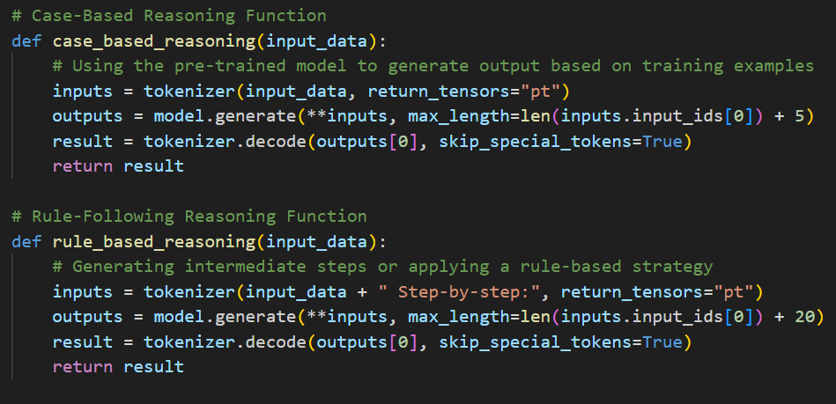
Implementation of Adaptive Hybrid Approach
Technology Used:
Pre-trained GPT-3 model with Python and Hugging Face transformers library.
How It Works:
Threshold Length: Defines when to switch between two reasoning styles.
Short Inputs (e.g., "7 + 8"): Use case-based reasoning for quick answers.
Long Inputs (e.g., "567 + 123"): Use rule-following reasoning for step-by-step accuracy.
Hybrid Reasoning Process:
Input Evaluated: Model checks input length.
Case-Based or Rule-Based Method: Chooses reasoning style accordingly.

Slide 10
Experimental Setup for Error Correction Mechanism
Experimental Setup:
Models Used:
Adaptive Hybrid Model enhanced with an error correction mechanism.
Input Data:
Arithmetic Problems with longer and complex calculations, prone to intermediate errors.
Tested on multi-step operations to evaluate error correction effectiveness.
Evaluation Metrics:
Accuracy Improvement: How much the model's accuracy improved after applying error corrections.
Number of Correction Iterations: How many attempts were needed to get the correct answer.
Goal:
To test if the error correction mechanism effectively identifies mistakes and improves accuracy through reinforcement learning.

Slide 11
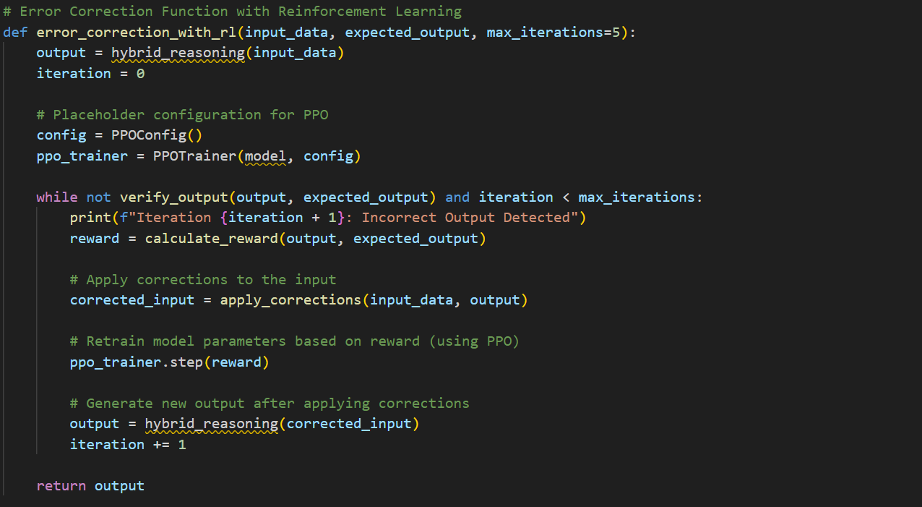
Implementation of Error Correction Mechanism
Reinforcement Learning (PPO):
Uses Proximal Policy Optimization (PPO) to adjust model parameters.
Verification and Correction Process:
Verify Output: Compares model output with the expected answer.
Reward Calculation:
Positive Reward for correct answers.
Negative Reward for incorrect answers.
Apply Corrections:
Model receives feedback to correct its mistakes.
Repeats until output matches expected results.
Iterations:
Maximum of 5 Iterations to ensure the answer is corrected without excessive retries.

Slide 12
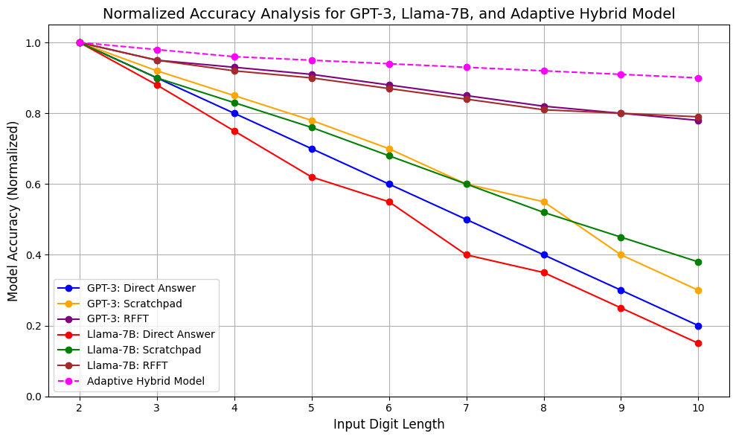
Experimental Results
Accuracy Results (Baseline vs. Adaptive Hybrid Model)
Overview:
Comparison of baseline models (GPT-3,
Llama-7B) with the Adaptive Hybrid Model.
Key Findings:
Adaptive Hybrid Model showed consistently higher accuracy for all input lengths.
GPT-3 and Llama-7B performed better with Scratchpad and RFFT methods but lagged behind the Hybrid Model.
Largest gap in accuracy observed for digit lengths 6-10, where Hybrid Model maintained better performance.
Impact:
Dynamic Adaptation of reasoning style allowed the Hybrid Model to outperform fixed approaches.
Improvement in Efficiency and Accuracy: Effective balance of speed for simple inputs and accuracy for complex ones

Slide 13
Experimental Results
Key Results:
Accuracy Analysis across different digit lengths (1-10) for:GPT-3 Model,Llama-7B Model, Adaptive Hybrid Model
Observations:
Adaptive Hybrid Model consistently outperformed other models.
Highest Accuracy for both short and long digit inputs.
Llama-7B RFFT also performed well, especially for long inputs but was slightly less consistent than the hybrid approach.
Digit Length | GPT-3 Direct accuracy | GPT-3 Scratchpad accuracy | GPT-3 RFFT accuracy | Llama-7B Direct accuracy | Llama-7B Scratchpad accuracy | Llama-7B RFFT accuracy | Adaptive Hybrid Model accuracy
1 | 0.84 | 0.91 | 0.96 | 0.87 | 0.93 | 0.98 | 0.98
2 | 0.79 | 0.89 | 0.95 | 0.83 | 0.92 | 0.97 | 0.98
3 | 0.66 | 0.81 | 0.94 | 0.7 | 0.88 | 0.96 | 0.97
4 | 0.52 | 0.71 | 0.93 | 0.6 | 0.83 | 0.95 | 0.97
5 | 0.42 | 0.62 | 0.92 | 0.5 | 0.75 | 0.94 | 0.96
6 | 0.31 | 0.52 | 0.91 | 0.4 | 0.7 | 0.93 | 0.96
7 | 0.22 | 0.42 | 0.9 | 0.3 | 0.65 | 0.92 | 0.95
8 | 0.18 | 0.37 | 0.89 | 0.25 | 0.6 | 0.91 | 0.94
9 | 0.13 | 0.32 | 0.88 | 0.2 | 0.55 | 0.9 | 0.94
10 | 0.1 | 0.28 | 0.87 | 0.18 | 0.5 | 0.89 | 0.93

Slide 14
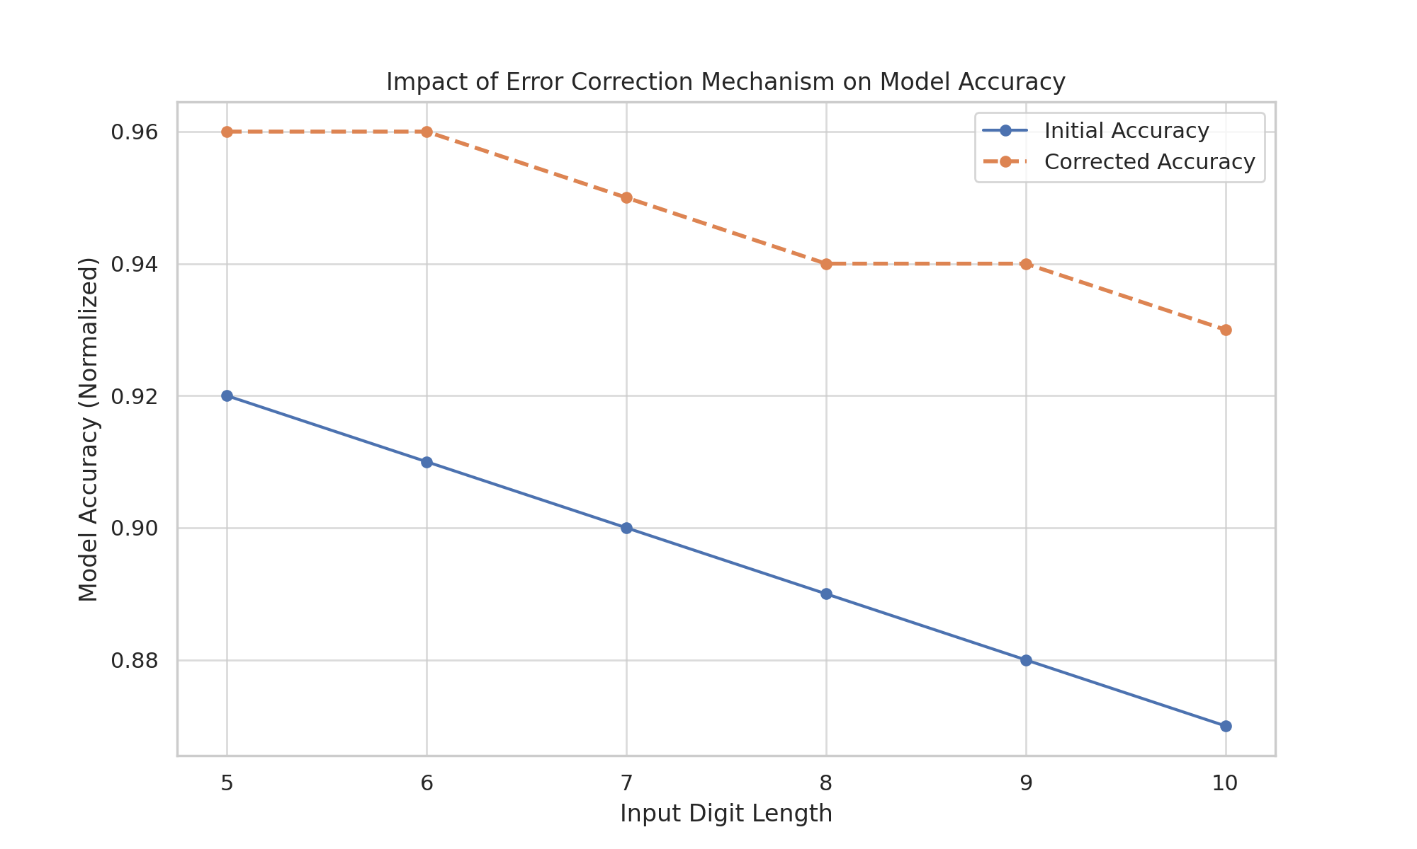
Experimental Result - Error Correction Mechanism
Impact of Error Correction Mechanism
Accuracy Improvement:
Initial Accuracy for inputs of length 5-10 ranged from 0.87 to 0.92.
After correction, accuracy improved to 0.93 to 0.96.
Key Insight:
Error Correction Mechanism helps refine model accuracy significantly, especially for complex inputs with multiple intermediate steps.

Slide 15
Impact of Error Correction on Hybrid Model
Error Correction Impact:
Significant Accuracy Boost:
Accuracy improved from 0.87-0.92 (initial) to 0.93-0.96 after corrections.
Consistent improvement across input lengths of 5-10 digits.
Error Reduction:
Corrected errors in complex arithmetic through reinforcement learning (PPO).
Reduced impact of intermediate calculation errors.
Model Robustness:
Made the hybrid model more reliable for complex tasks.
Iterative corrections ensured high accuracy, reducing the need for retraining.

Slide 16
Conclusion and Future Work
Conclusion:
Adaptive Hybrid Model:
Successfully improved accuracy and efficiency by switching between case-based and rule-following reasoning.
Error Correction Mechanism:
Significantly enhanced model reliability through iterative feedback and reinforcement learning.
Robust Solution:
The combined approach proved effective in handling diverse input complexities with consistent accuracy improvements.
Future Work:
Advanced Error Detection:
Implement more sophisticated verification techniques to identify subtle errors.
Adaptive Threshold Optimization:
Use dynamic thresholding to adapt based on input complexity in real time.
Broader Application:
Apply this approach to other domains like complex multi-step reasoning or logical problem-solving to further validate model adaptability.

Slide 17

References
Case-Based and Rule-Based Reasoning:
Aamodt, A., & Plaza, E. (1994). "Case-Based Reasoning: Foundational Issues, Methodological Variations, and System Approaches." AI Communications.
Dynamic Switching Between Reasoning Styles:
Leake, D. B. (1996). "CBR in Context: The Present and Future." Case-Based Reasoning Experiences, Lessons, and Future Directions..
Error Correction Using Reinforcement Learning:
Schulman, J., et al. (2017). "Proximal Policy Optimization Algorithms." arXiv preprint arXiv:1707.06347.

Slide 18

Thank you for your time!

