Slide 1
Unsupervised Learning Project
DISCOVERING Customer BEHAVIORAL PATTERNS

Slide 2
Problem Statement
- This project aims to understand customer purchasing behavior and uncover hidden patterns in the marketing campaign dataset without relying on labeled data.
- By identifying distinct groups of customers based on their demographic profiles, purchasing behavior, and engagement patterns:
+ Explore which customer groups share similar characteristics.
+ Provide insights that could support more effective marketing strategies: targeted campaigns, personalized promotions, and customer retention planning.

Slide 3
What ML approach
Focus on unsupervised clustering:
- Principal Component Analysis (PCA): to reduce dimensionality and capture the key structure of the data; Helps visualize clusters and improves clustering stability.
- K-Means Clustering: Creates customer groups by minimizing within-cluster variance; Provides fast and interpretable segmentation.
- Agglomerative Hierarchical Clustering: groups similar customers based on hierarchical relationships; Useful to compare against KMeans and validate cluster structure.
- A Random Forest classifier was trained on the actual “Response” label to evaluate whether the unsupervised clusters can approximate the true target.

Slide 4
Dataset Overview
Marketing campaign dataset, Kaggle
2240 samples
28 features (24 numeric, 3 categorical, 1 date)
Key features: Income, Education, Spending Score, Recency, Campaigns

Slide 5

EDA Summary
- Inspect the distribution of key numerical variables such as income, age, recency, and total spending.
- Explore relationships between features and the campaign response variable
- Identify correlations and possible multicollinearity among features, which motivates the use of PCA and careful feature scaling.
=> combine simple visualizations (histograms, boxplots, bar charts) with a correlation matrix.

Slide 6
Preprocessing
Use StandardScaler for scaling numeric features
Apply OneHotEncoder to transform all categorical features.
Since PCA and clustering algorithms require dense arrays -> converts the resulting sparse matrix to a dense NumPy array.
Use PCA for reducing dimension.

Slide 7
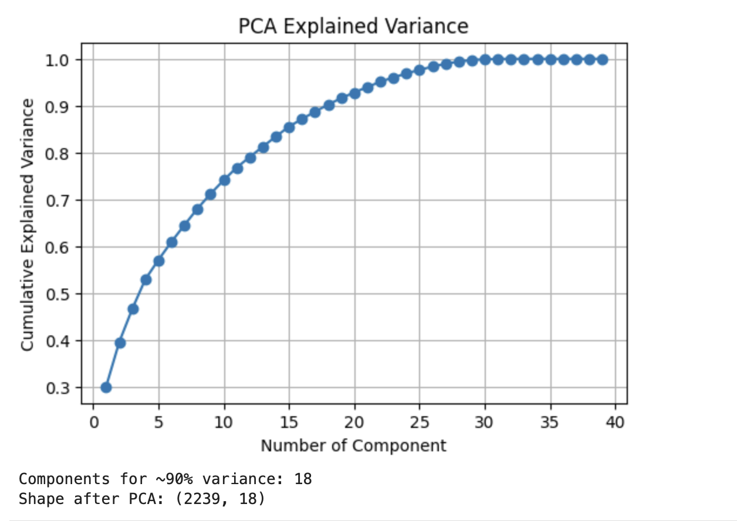
Dimensionality Reduction
The first 18 principal components capture approximately 90% of the total variance=> reduce the dataset from 40+ features to 18 while preserving most of the information.

Slide 8
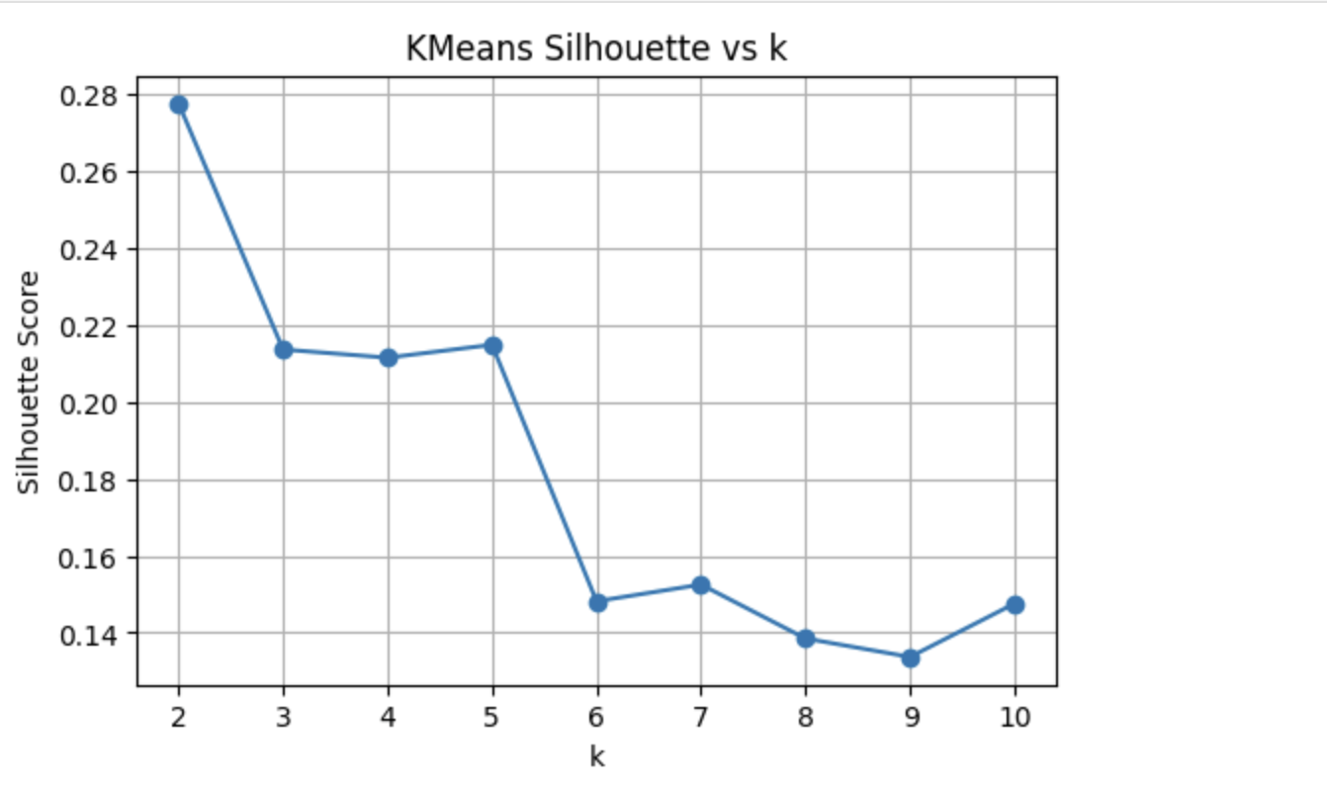
Clustering Models
KMeans and Agglomerative Hierarchical Clustering.
Scores drop noticeably after k=2=> dividing the data into more than two clusters result in poorer separation and less meaningful group structure.

Slide 9
Model Evaluation Metrics
Silhouette Score
Davies-Bouldin Score
Both metrics are computed on the PCA-transformed feature space with k = 2 clusters.

Slide 10
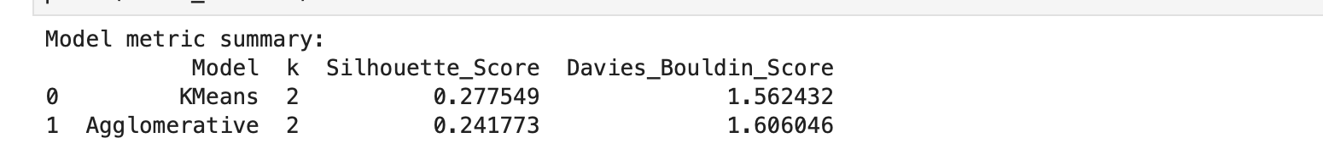
Clustering Results
Both methods achieve moderate Silhouette scores (~0.24–0.28)-> there is some cluster structure in the data, but not perfectly clean separation.
KMeans outperforms Agglomerative on both metrics: Slightly higher Silhouette (0.2775 vs 0.2418) and Slightly lower DB (1.56 vs 1.61).

Slide 11
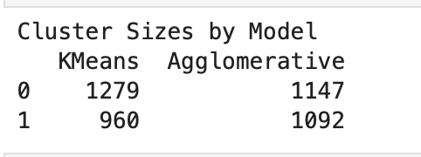
Cluster Size Summary
KMeans creates a mildly imbalanced split (about 57% vs 43% of customers).
Agglomerative produces a more balanced partition (roughly 51% vs 49%).
Both partitions are reasonable. The slight imbalance in KMeans is acceptable and may reflect a real difference between a larger customer group and a smaller, more distinct segment.

Slide 12
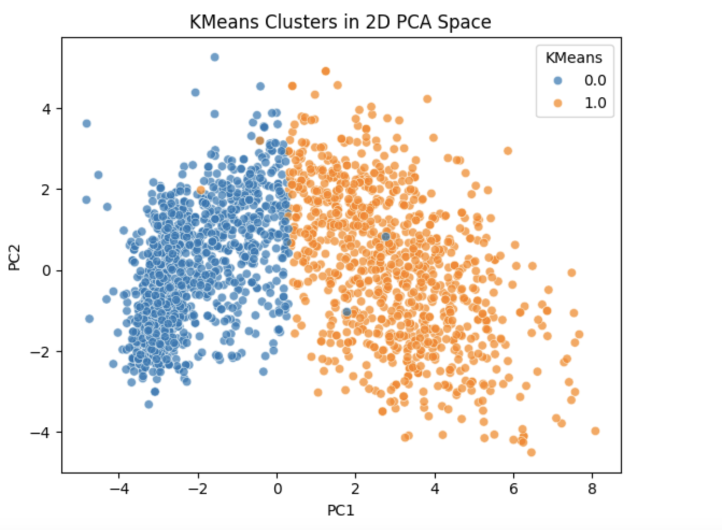
Kmeans Cluster Interpretation
KMeans: the two clusters form an almost diagonal separation: One cluster occupies mostly the left side and the other cluster occupies the right side. There is some overlap in the middle, but the boundary between the two segments is visually clear.

Slide 13
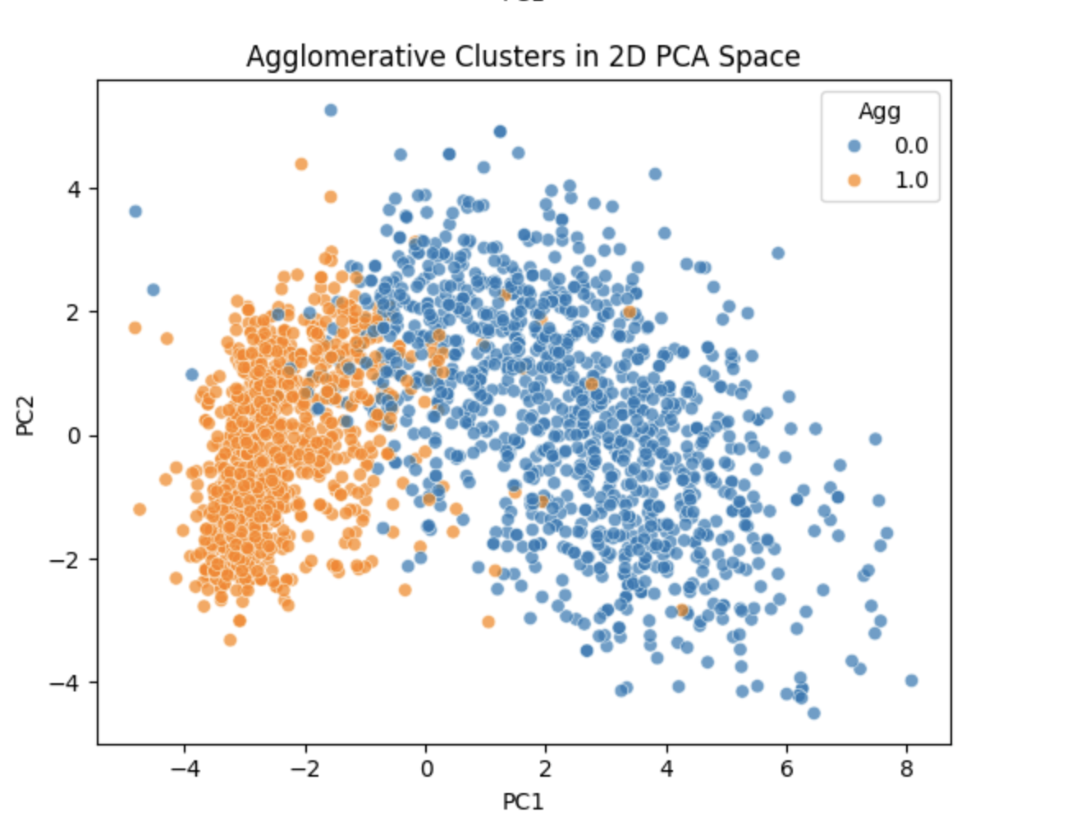
Agglomerative cluster interpretation
Agglomerative: one cluster is concentrated more strongly on the far left, while the other spreads across a larger region to the right. The overlap between orange and blue points is more noticeable, especially in the central region of the plot->the clusters are less cleanly separated compared to KMeans.

Slide 14
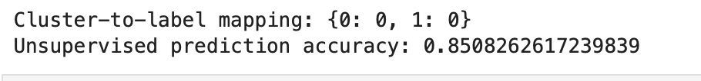
Predictive Evaluation
Evaluate if the unsupervised models can approximate label prediction by aligning clusters with the majority class.
Both clusters are dominated by customers with Response 0-> the dataset is heavily imbalanced in Response feature, with non-responders forming the majority in both behavioral segments.
Although clustering successfully identifies meaningful customer groups, the true campaign responders are too few and too mixed across the dataset to form their own cluster.

Slide 15

Supervised Comparison
Also train the data with a supervised model to highlight differences in predictive accuracy.
Supervised learning (Random Forest) provided better predictive performance (89%) because supervised models directly optimize for the target label, learn subtle interactions between features, and use minority-class patterns better than clustering.

Slide 16
Limitations
- Class imbalance in 'Response’ (most customers do not respond) -> both clusters to be dominated by label 0, removing the possibility of forming a “responder” cluster.
- Clusters reflect socio-economic and behavioral segmentation, not campaign outcome-> clustering is excellent for marketing insights, but not for direct prediction of campaign success.
- PCA keeps components with the highest variance => some fine-grained predictive information may be lost in dimensionality reduction.

Slide 17
Conclusion
Clustering remains valuable for customer profiling, understanding purchasing patterns, and designing tailored marketing strategies, while supervised models remain the preferred choice for predicting campaign outcomes.

Slide 18
Thank you for reviewing my project!
Github repository URL
https://github.com/phi-nguyen-95/Discovering-customer-behavioral-patterns

