Slide 1

Smartphone Price Prediction Using Machine Learning
Final Project Presentation

Slide 2
Problem Statement
Smartphone prices vary widely based on brand and specifications.
Consumers struggle to determine if a phone is priced fairly.
Goal: Predict smartphone price based on technical specifications.

Slide 3
Project Objectives
Perform Data cleaning and perform EDA to understand key price drivers.
Build machine learning models to predict smartphone price.
Compare multiple models and evaluate performance.

Slide 4
Dataset Overview
Source: Kaggle Smartphone Dataset
980 rows, 22 features
Mix of 18 numerical and 4 categorical features

Slide 5
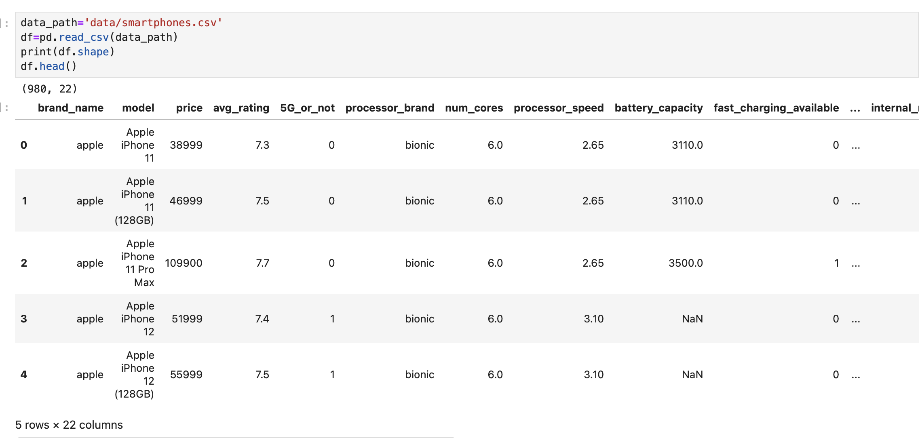
Data Description
Key features: Brand, OS, RAM, Storage, Battery, Camera, 5G, Processor
Target Variable: Price (and engineered price_capped)

Slide 6
Data Cleaning & Preprocessing
Handled missing values using imputation techniques
Converted text-based numbers into numeric format
Removed rows with missing target features and handled outliers

Slide 7
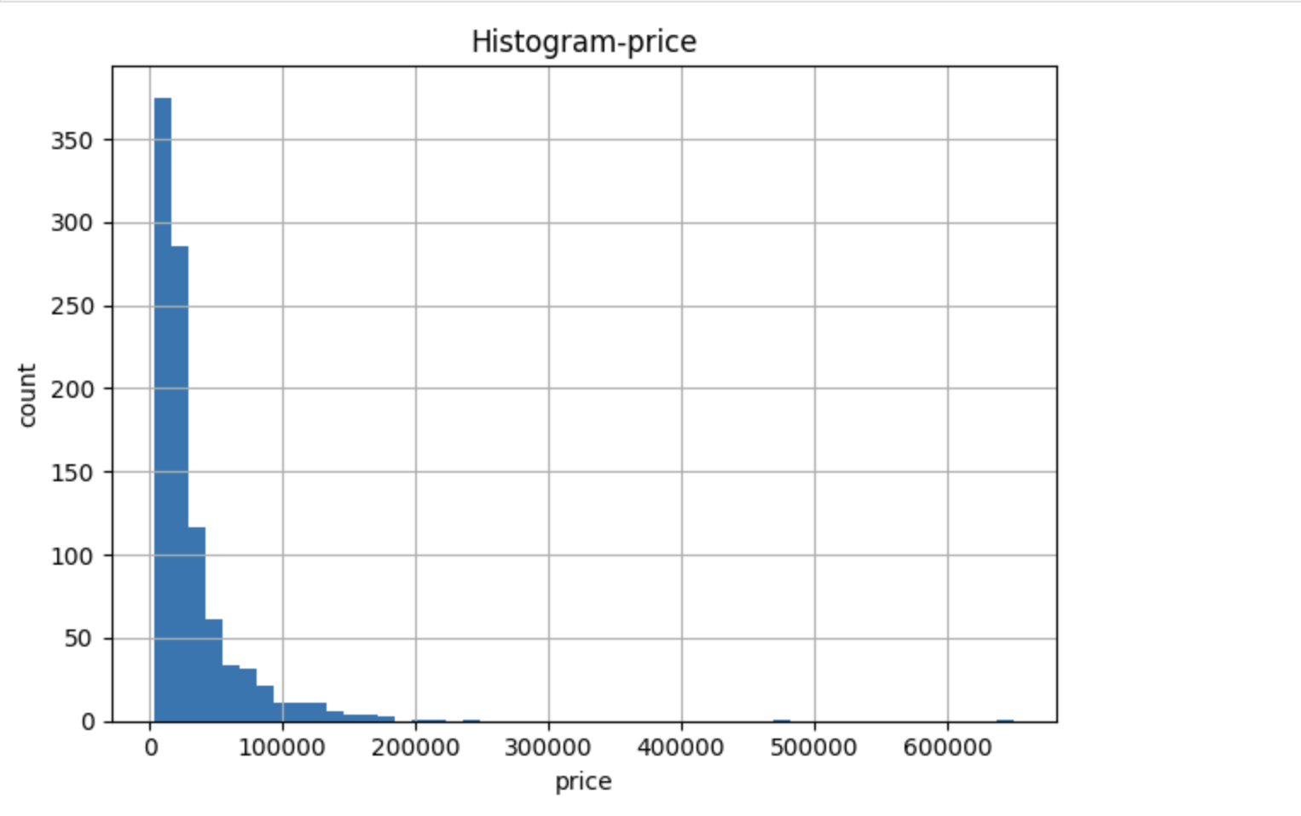
Exploratory Data Analysis
Examined data distribution and detected outliers
Analyzed correlations between features and price

Slide 8
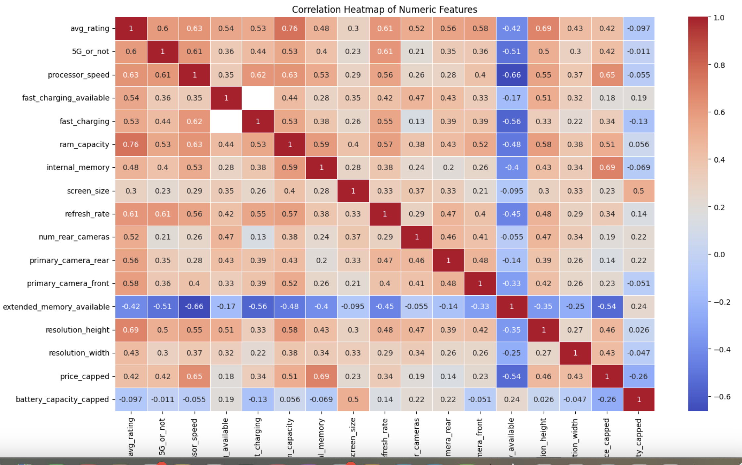
Correlation Insights
Strong correlations with price: RAM, internal memory, processor speed, brand
Brand and OS influence price significantly

Slide 9
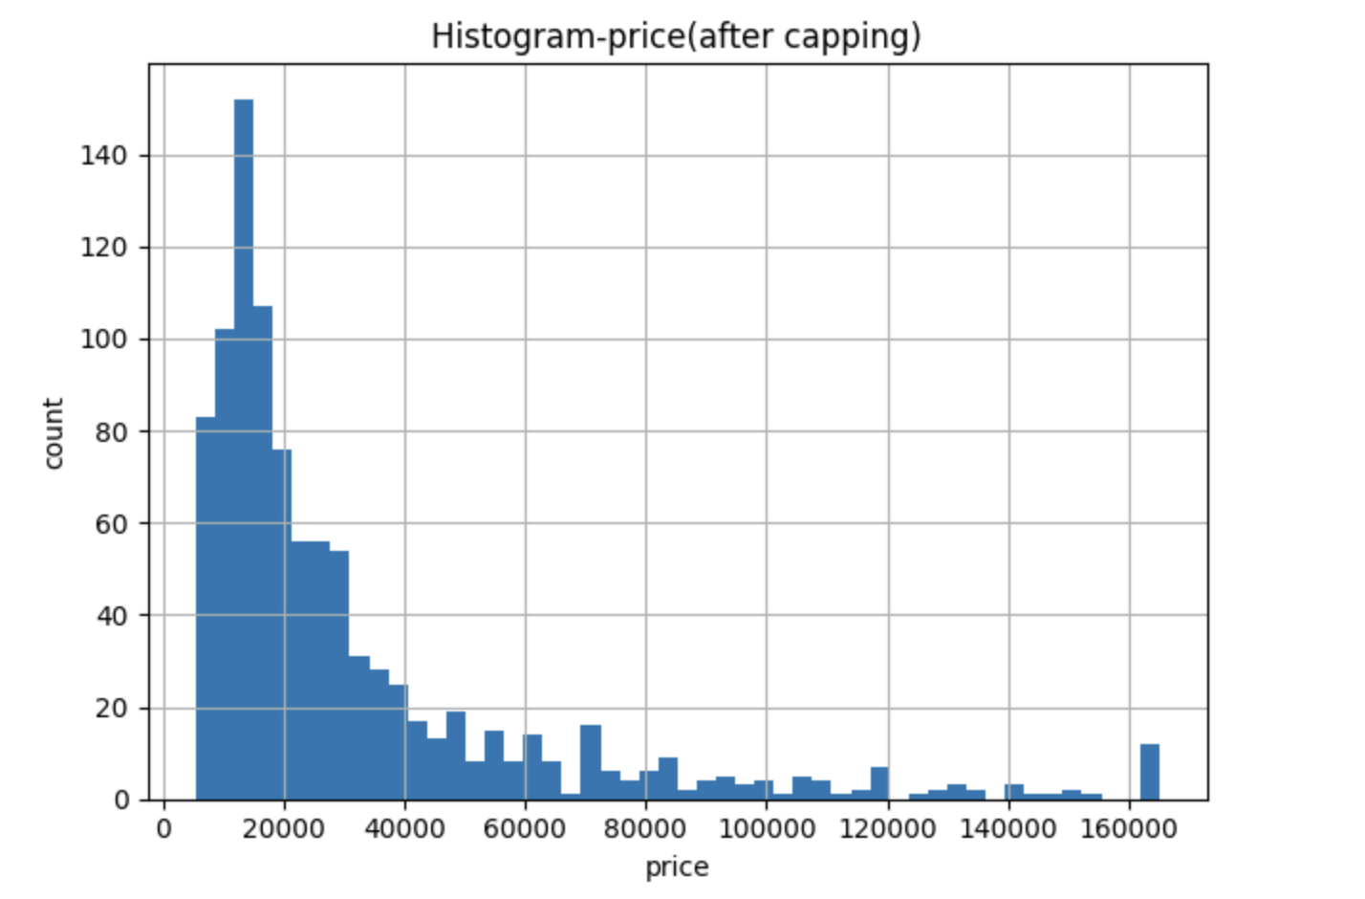
Feature Engineering
Created new features for better prediction results (price_capped and battery_capped)
Applied One-Hot Encoding for categorical variables

Slide 10
Modeling Approach
Supervised Learning – Regression Task
Models used: Ridge Regression, Random Forest, Gradient Boosting
Hyperparameter tuning with GridSearchCV

Slide 11
Modeling Pipeline
Train/Test Split: 80% Training, 20% Testing
Preprocessing using ColumnTransformer
Scaling numeric features, One-Hot Encoding categorical features

Slide 12
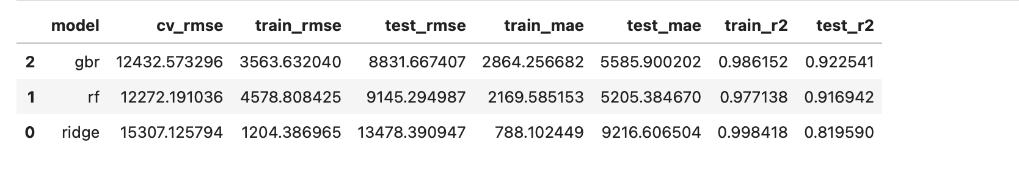
Model Performance Comparison
Gradient Boosting achieved the best results
Compared using RMSE, MAE, and R²

Slide 13
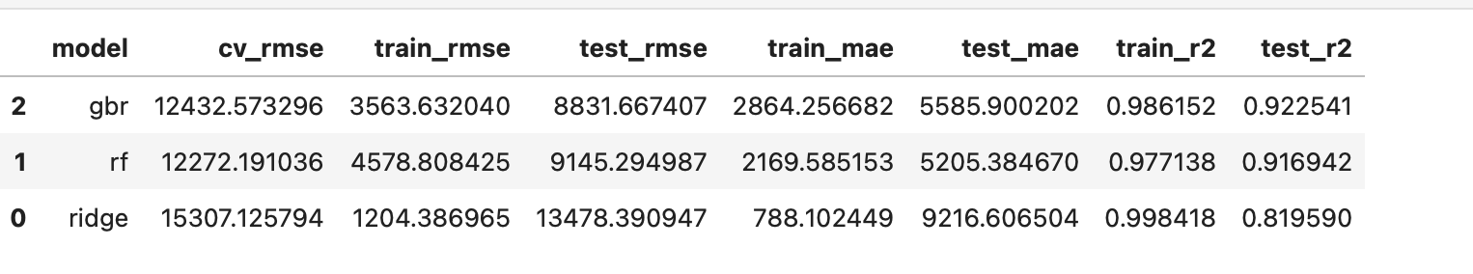
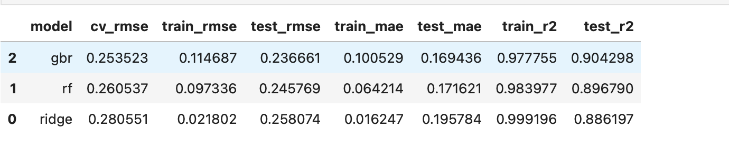
Improve the performance (‘log_price’)
‘price’
‘log_price’

Slide 14
Conclusion
Gradient Boosting provided the most accurate predictions
Smartphone specs strongly influence pricing patterns
Machine Learning can effectively support pricing decisions

Slide 15
Future Improvements
Group rare smartphone brands to avoid noise and overfitting.
Try different advanced models to improve performance.

Slide 16

Thank you for reviewing my project!
Github repository URL
https://github.com/phi-nguyen-95/Smartphone-price-prediction

