Slide 1
Smartphone Price Prediction Using Machine Learning
Final Project Presentation

Slide 2
Problem Statement
Smartphone prices vary widely based on brand and specifications.
Consumers struggle to determine if a smartphone is priced fairly.
Goal: Build a model that predicts smartphone prices based on technical specs.

Slide 3
Dataset Overview
Source: Kaggle – Smartphone Specifications & Price Dataset
Rows: ~980 samples, 22 features
Features include brand, RAM, storage, processor, battery, camera, OS, etc.
Data cleaning included missing value handling and type conversion.

Slide 4
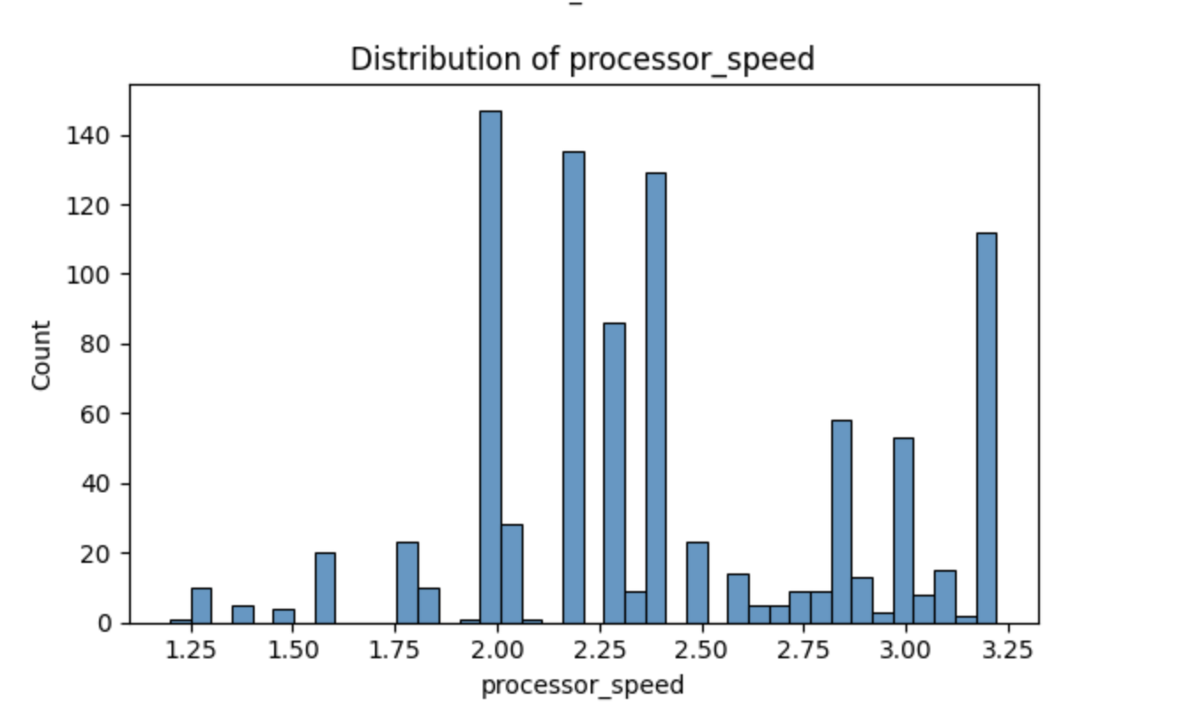
Exploratory Data Analysis (EDA)
Analyzed distributions and correlations between features and price.
Strong predictors found: RAM, internal memory, processor speed, brand.
Visualizations used: histograms, heatmap.

Slide 5
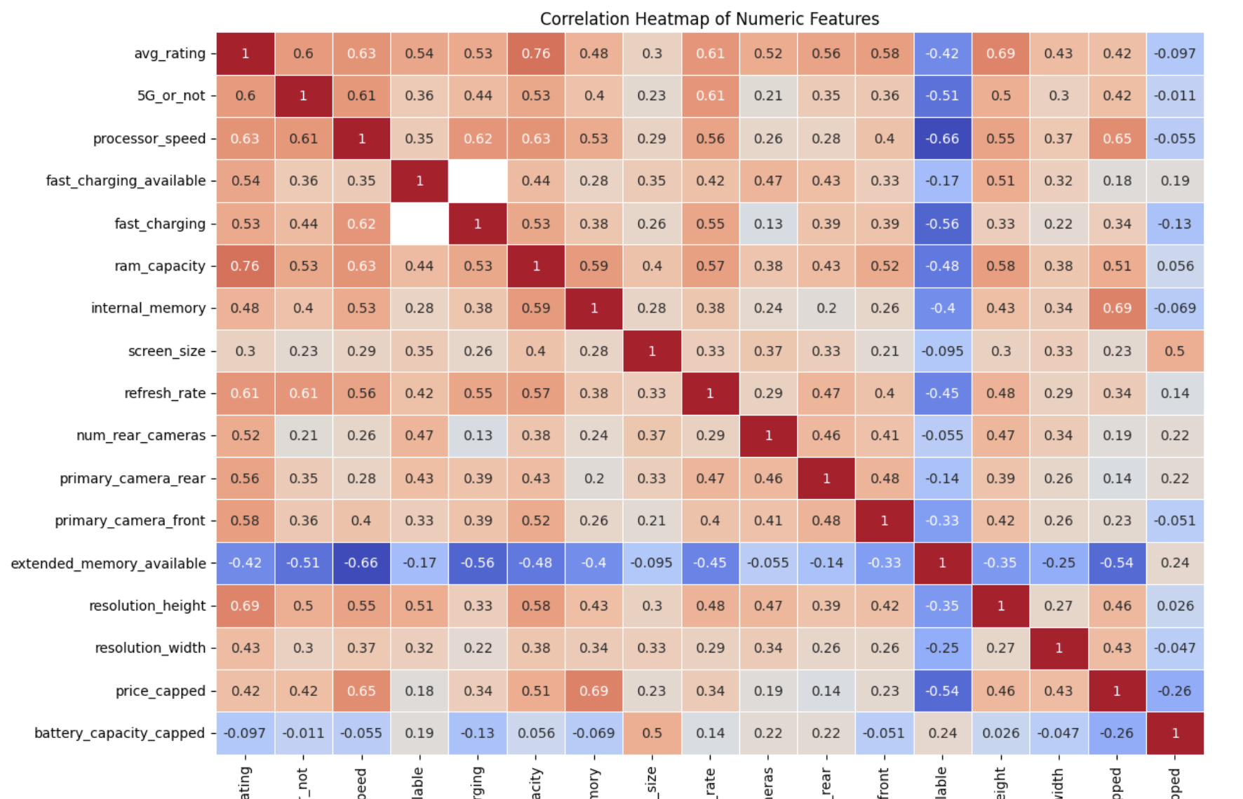
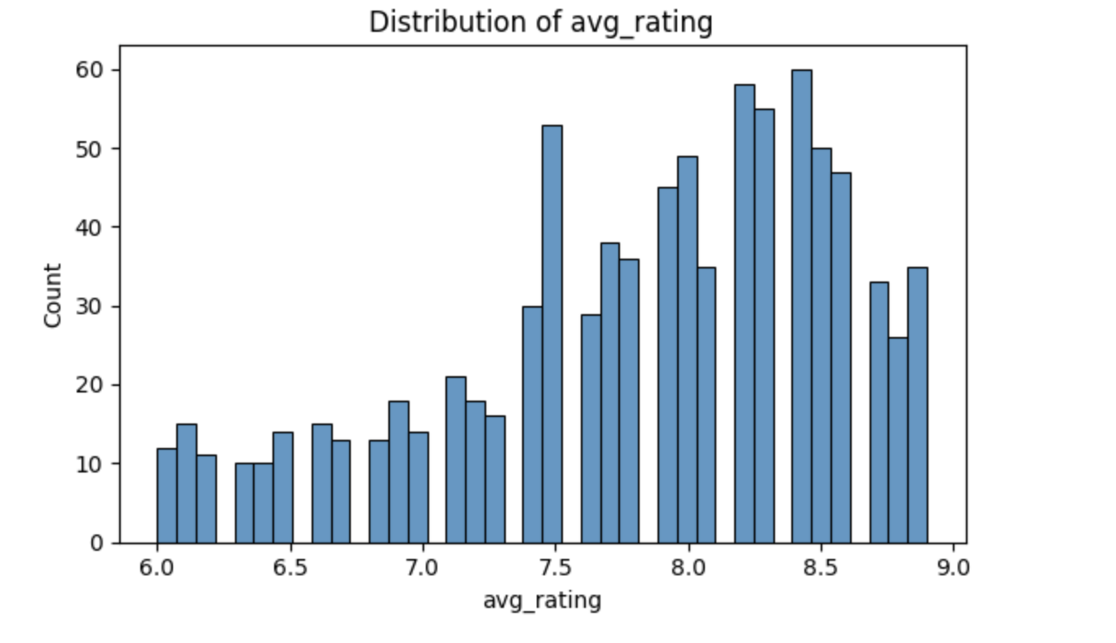
EDA Visuals

Slide 6
Machine Learning Approach
Supervised Learning – Regression Task
Models used: Ridge Regression, Random Forest, Gradient Boosting
Used 5-Fold Cross-Validation and GridSearch for hyperparameter tuning.

Slide 7
Modeling Pipeline
Preprocessing with ColumnTransformer
Numeric: Median Imputation + Scaling
Categorical: Most Frequent Imputation + One-Hot Encoding
Train/Test Split: 80/20 ratio

Slide 8
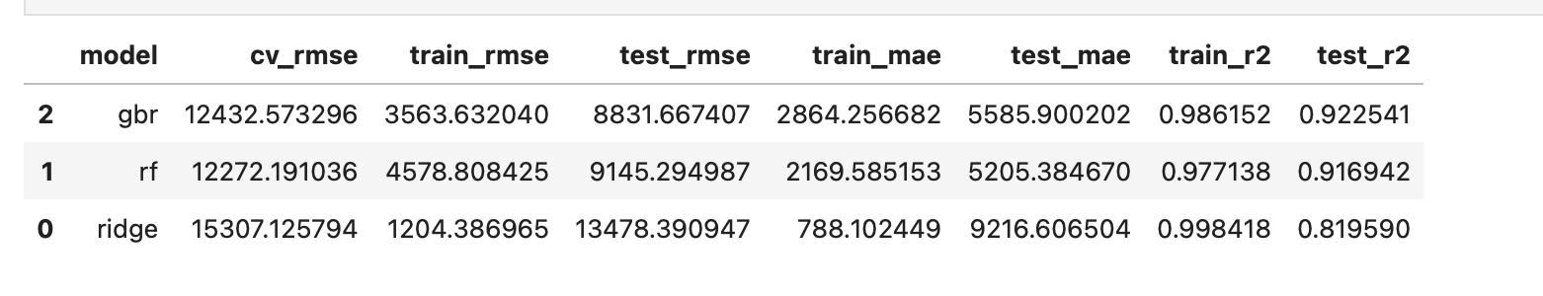
Model Performance Summary
Best model: Gradient Boosting Regressor
Metrics compared: RMSE, MAE, R²

Slide 9
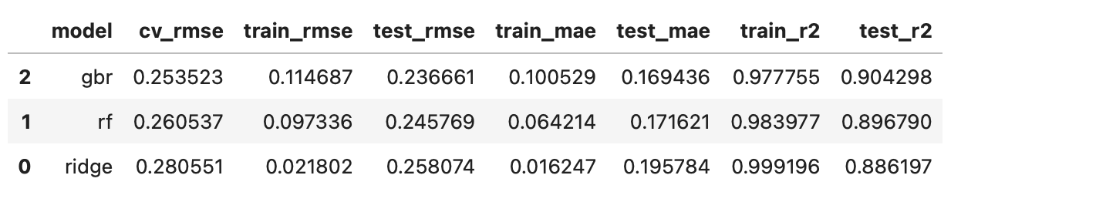
Improve the performance(log-price)
Use target ‘price’
Use target ‘log_price’

Slide 10
Conclusion & Future Work
Ensemble models outperformed the linear model.
Gradient Boosting achieved strongest accuracy and generalization.
Future Improvements: Try advanced models such as XGBoost/LightGBM and group brands.

Slide 11
Thank you for review my project!
Github repository URL:

