Slide 1
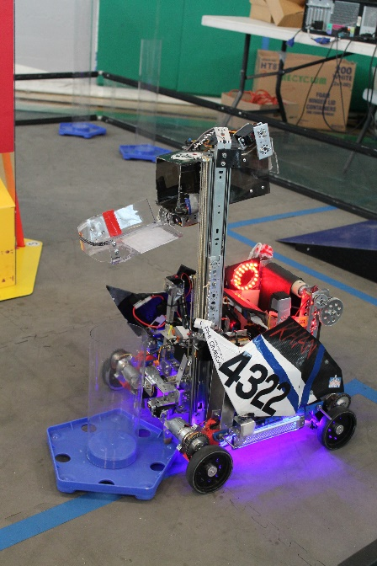
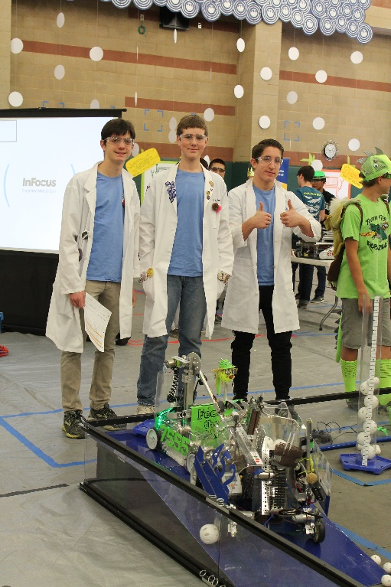

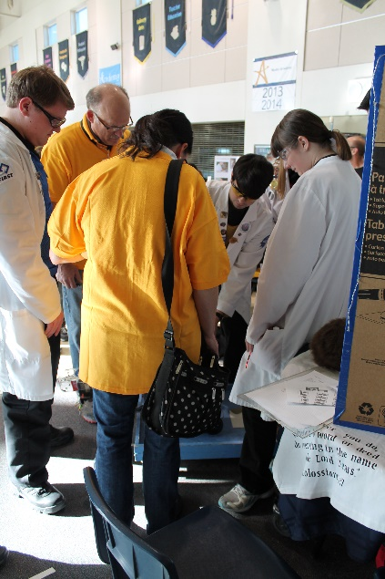
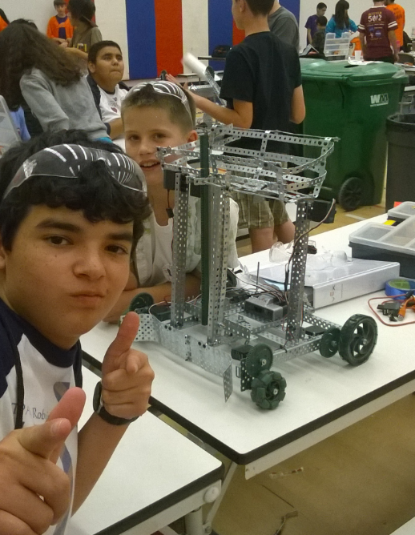
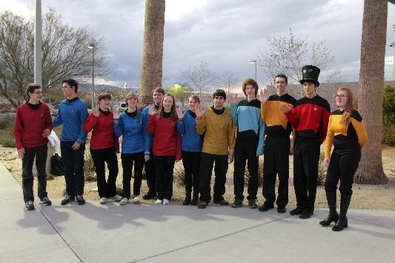
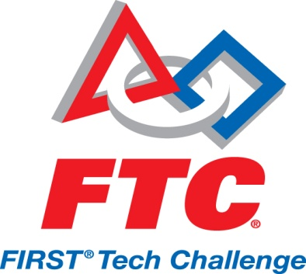
 | Phi Robotics Science and Technology Club Who We Are Phi Robotics Science and Technology Club promotes math, science, technology, leadership, and teamwork skills among middle school and high school students. We reach out to our community through workshops and presentations. We serve our fellow FTC community by hosting a qualifying tournament. We meet twice a week to develop robotic hardware, software, our innovation skills, and presentation skills.
Mentors:
Mike Mcmillian: 661-533-6403
Tim Cox: 661-
Quin Pierce: 661-618-0164
Check us out on FaceBook

Slide 2
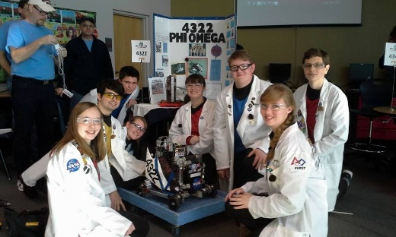
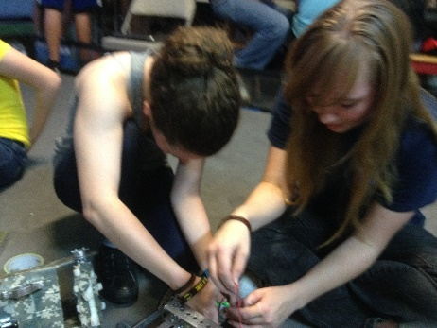
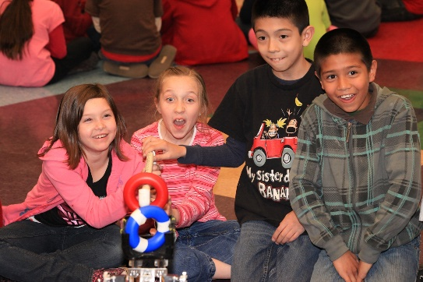
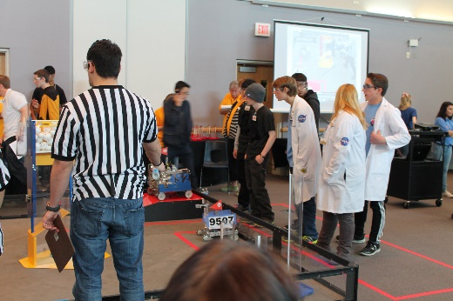
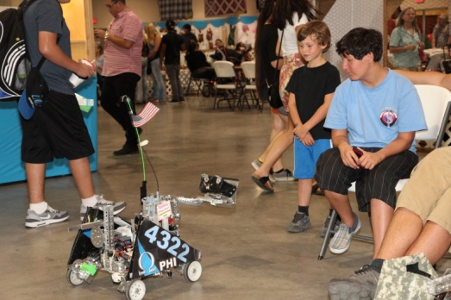
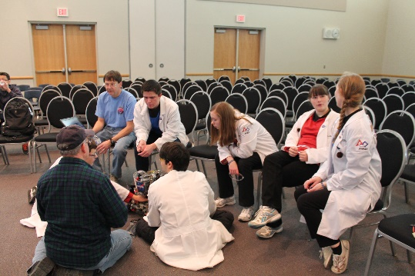
Our Teams FTC Team 452 4322 FLL Team Phi Apprentice Phi’dback Our Sponsors: Northrop Grumman Lockheed Martin NASA Jacobs Technologies Spirent Communications Sweet Frog | Community Outreach Phi Robotics puts together outreach programs every year, some by themselves and some joined with local teams. Here are our community outreach programs: Lockheed Martin Family Day, Palmdale CA VEX summer robotic workshop Joe Walker Middle School Thursday Night on the Square Antelope Valley Fair | Our Awards 2007-2008 Inspire Award Winning Alliance World Championships 2008-2009 Winning Alliance Judges Award World Championships 2009-2010 Winning Alliance Inspire Award World Championships 2010-2011 Finalist Alliance Winning Alliance Rockwell Collins World Championships 2011-2012 PTC Design Winning Alliance World Championships 2012-2013 Connect Award Inspire Award Winning Alliance Finalist Alliance 2014-2015 Winning Alliance PTC Design Inspire Award Finalist Alliance Innovate Award Promote Award Design Award

