Slide 1
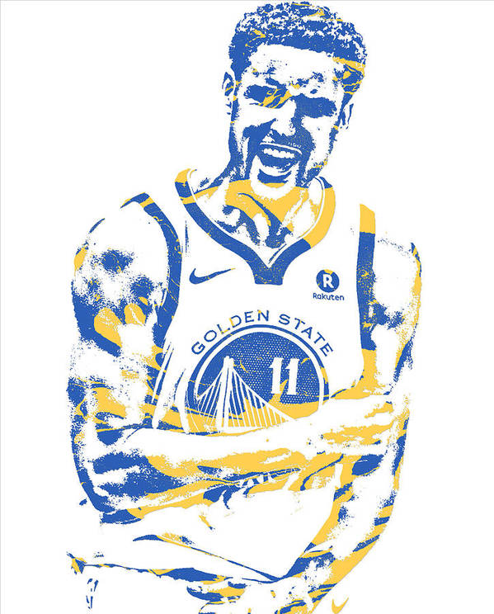
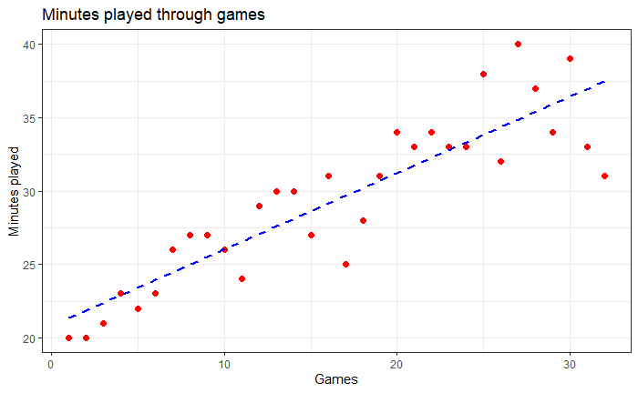
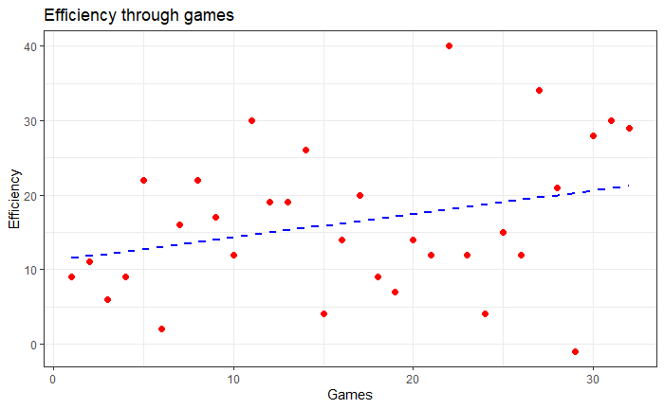
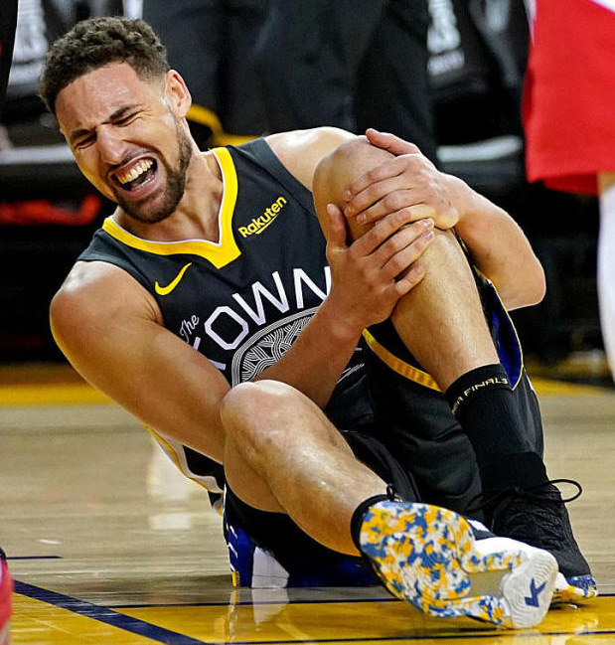
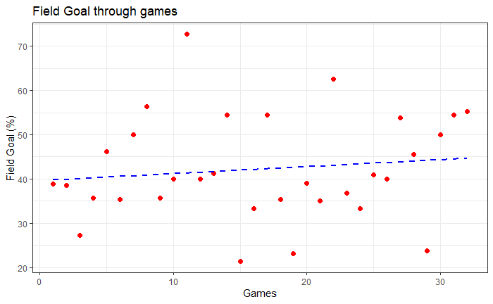
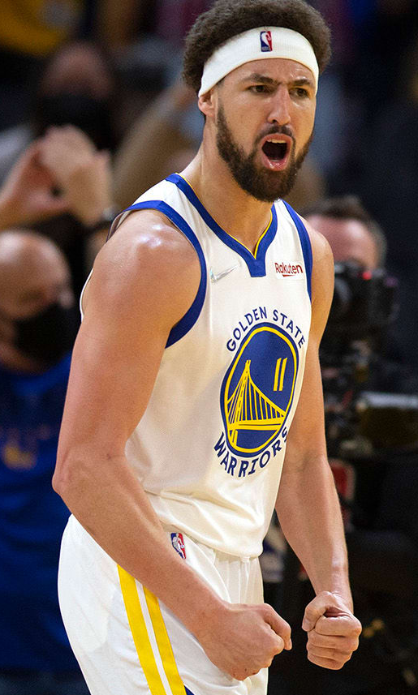
Can pro basketball player Klay Thompson recover from his injury and be the great player he once was?
DA-220 final project (Quan Phi, Minh Nguyen, Bach Pham)
Background
On June 13 2019, Klay Thompson, one of the best player in NBA had a terrible injury and had to spend 2 years off-court to recover. Until Jan 9 2022, he returned and the biggest question was can he be as great as he used to be.
We chose 3 of these stats because they represent the true effectiveness of player on the court, a good player is a player who can keep their efficiency and field goal high within high minute.
II. Purpose
According to his performance after he returned (32 games), we want to analyze and predict whether he can be the great old Klay again?
IV. Result
In this case, we picked the significant level of 0,1. From the 3 linear regression model, we have found that there is strong evidence to support the correlation between MIN (minutes played), EFF (efficiency) with number of games played, not FG (field goals). Using regression line equation (step 3 and step 4 in methods) of MIN and EFF, the expected number of games for Klay to return to his peak performance is about 20 games.
III. Methods
Step 1: As we want to learn about Klay Thompson’s changes in performance post-injury, we would look into his average statistics over the peak-performance seasons pre-injury, specifically, Minutes played (Min), Field Goal Percentage (FG%), and Efficiency (EFF).
Step 2: We use t-tests to compare Thompson’s performance (average statistics) from his 6 best seasons (2014 to 2018) to his current season (2021-2022).
Step 3: We use three linear regression models to predict Thompson’s performance based on the statistics collected from 32 games of the 2021-2022 season.
Dependent variables: Minutes Played, Field Goals, and Efficiency
Independent variable: number of games played
Step 4: Then, we determine the number of games it would take Thompson to return to his best form during peak-performance seasons by plugging in the statistics from those seasons into the models.
V. Conclusion
According to our analyzation of the stats (EFF and MIN), we can see an up-sloping trend of Klay’s performance post-injury. The calculation shows strong evident to support that It will take Klay about 20 games to reach his peak MIN and EFF (which are 2 of the most important stats).
The answer for our topic question is that he will great again and it will take him about 20 more games.
VI. Reference
https://www.proballers.com/basketball/player/55315/klay-thompson/games?fbclid=IwAR335F-uFs5OAEnCkm5Wo4cxwU7rwD9H2951fvYINbt3bIqgOddBew4tn2Y
https://mpra.ub.uni-muenchen.de/66373/1/MPRA_paper_66373.pdf

