Slide 1

DQAMP 2026
Schools Division Office of Lucena City
By the end of this session you can:
Welcome to DQAMP
1
Sign in and read the division at a glance
Onboarding for Administrators
2
Add users and set their role and division
About 20 minutes, plus practice
3
Publish reviewed activities and correct mistakes
Plan it. Track it. Prove it.
Notes:
Welcome everyone. In the next 20 minutes you will learn how to use DQAMP as an administrator.
Read the three objectives aloud. Tell participants they will practise at the end.
[DEMO CUE] Have DQAMP open on the host computer at the sign-in page.
[CHECK BEFORE PRESENTING] All names and figures in this deck are fictional sample data.

Slide 2

What DQAMP does
DQAMP is the Division Quality Assurance and Monitoring Portal for SDO Lucena City.
1
One chain from goals to evidence
Organizational goals, division objectives, projects, outputs and activities link together.
2
Quality assurance built in
An activity is published only after a QA Assessor reviews it.
3
Records stay on this computer
No cloud account. Your administrator backs up the data folder.
DQAMP 2026 · Onboarding for Administrators
2
Notes:
DQAMP is the Division Quality Assurance and Monitoring Portal.
1. Goals, objectives, projects, outputs and activities link together, so results are traceable from the top down.
2. Every activity goes through QA review before it is published.
3. Everything is stored on the computer where DQAMP runs. There is no cloud account. The administrator backs up the data folder, so nobody else should copy or delete it.

Slide 3
Who does what
A
Administrator
Top management and system administrators
Your role
P
Planning Admin
Division planning staff
Sees and changes everything
Publishes reviewed activities
Adds users and sets roles and divisions
Plans objectives, projects and outputs in their division
Reads all activities and reports
Does not edit or publish activities
Q
QA Assessor
Quality assurance
I
Implementer
Staff who run activities
Sees every activity
Starts reviews and records QAME results
Returns work with a note; does not publish
Works in their own division
Creates and submits activities
Adds evidence links and client feedback
Checked by the system: buttons you cannot use do not appear, and a change outside your role or division is refused.
DQAMP 2026 · Onboarding for Administrators
3
Notes:
DQAMP has four roles. Point to the highlighted card: that is the role this session covers.
The rules are enforced by the system, not just by the menus. If you cannot use a button, it does not appear; if a change is outside your role or division, DQAMP refuses it.
[CHECK BEFORE PRESENTING] Name your office's administrator here.

Slide 4
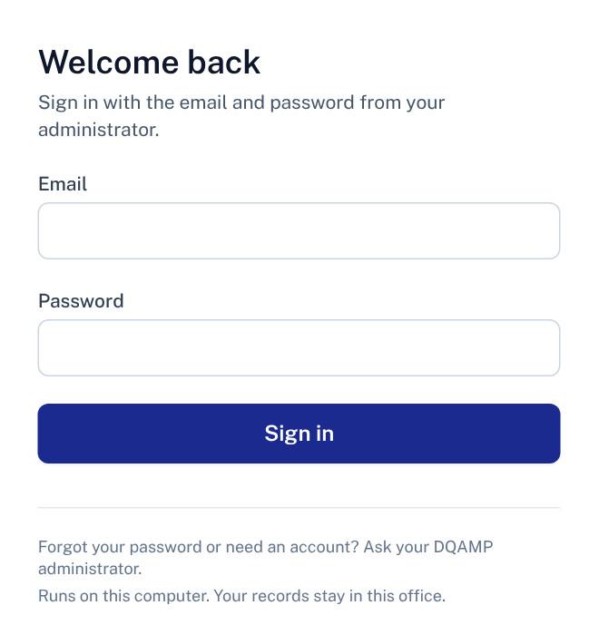
Signing in
1
Email
The address your administrator registered for you.
2
Password
The temporary password your administrator gave you.
1
3
Sign in
Opens the Dashboard.
2
Where: Open DQAMP on the computer where it runs, at http://127.0.0.1:3002.
3
No account yet? Your administrator creates it. DQAMP does not send email invitations.
DQAMP 2026 · Onboarding for Administrators
4
Notes:
DQAMP runs on one computer, and you sign in there in a web browser.
1. Type the email your administrator registered.
2. Type the temporary password your administrator gave you.
3. Click Sign in.
There is no email invitation and no password-reset screen. The administrator handles both.
[DEMO CUE] Sign in with a training account. Do not show a real password on screen.
[CHECK BEFORE PRESENTING] Confirm the address your office uses (the default is http://127.0.0.1:3002).

Slide 5
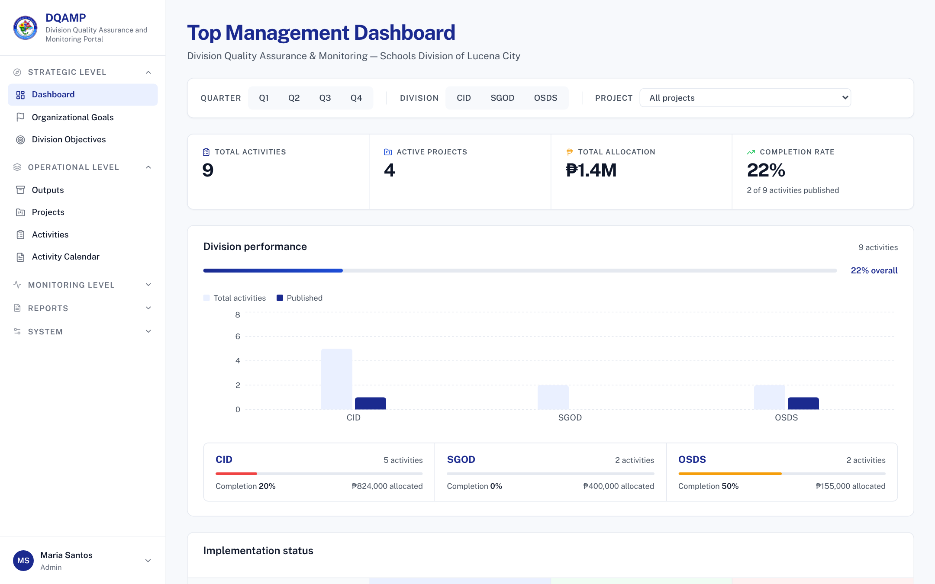
Finding your way
1
Menu
Pages grouped by level: strategic, operational, reports and system.
1
2
2
Filters
Quarter, division and project narrow every figure.
3
3
Headline figures
Activities, projects, allocation and completion.
4
4
Division performance
Total and published activities in each division.
5
Your account
Shows who is signed in. Sign out from here.
Completion counts published activities: reviewed by QA and published by you.
5
DQAMP 2026 · Onboarding for Administrators
5
Notes:
After signing in you land on the Dashboard.
1. The menu on the left.
2. The filters narrow every figure on the page.
3. The headline figures. Completion counts published activities only.
4. Division performance compares divisions.
5. Your account, where you sign out.
[DEMO CUE] Select SGOD in the division filter and show the figures change.

Slide 6
The workflow at a glance
1
2
3
4
Draft
Implementer writes it
Submitted
Implementer submits
Under Review
QA Assessor reviews
Published
Administrator publishes
You publish at step 4, and you can correct any step if a mistake needs fixing.
Returned for Revision: a QA Assessor sends an activity back with a note saying what to fix. The Implementer fixes it and submits again, so it returns to Submitted.
Locked when: an activity is Under Review or Published, only its reviewer or an administrator can change it.
DQAMP 2026 · Onboarding for Administrators
6
Notes:
Every activity follows these four steps. The filled circles are the steps this role performs.
Returned for Revision is the loop: the QA Assessor sends it back with a note, the Implementer fixes it and submits again.
Once an activity is Under Review or Published, it is locked for everyone except the reviewer and administrators.

Slide 7
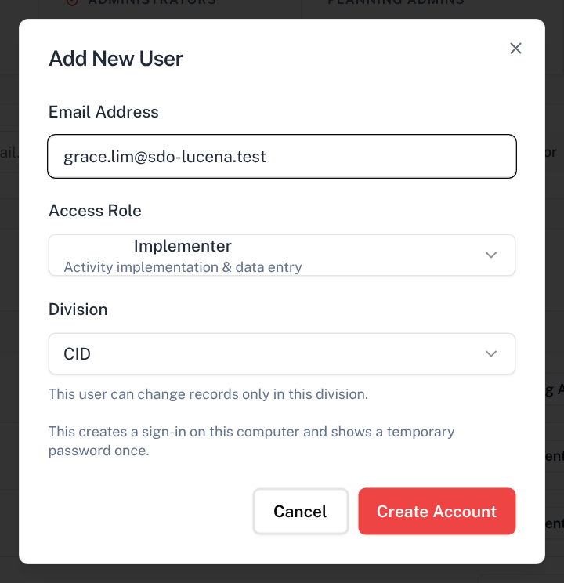
Add a user
Open: User Management → Invite User
1
Email Address
Their work email. It becomes their sign-in.
Access Role
Implementer, Planning Admin, QA Assessor or Administrator.
1
2
3
Division
Needed for Implementers and Planning Admins. Limits what they can change.
2
4
Create Account
Creates the sign-in. No email is sent.
3
4
Tip: QA Assessors and administrators see every division, so they have none.
DQAMP 2026 · Onboarding for Administrators
7
Notes:
Open User Management and click Invite User.
1. Type the email.
2. Choose the role.
3. For Implementers and Planning Admins, choose the division.
4. Click Create Account.
[DEMO CUE] Create the account grace.lim@sdo-lucena.test as an SGOD Implementer.

Slide 8
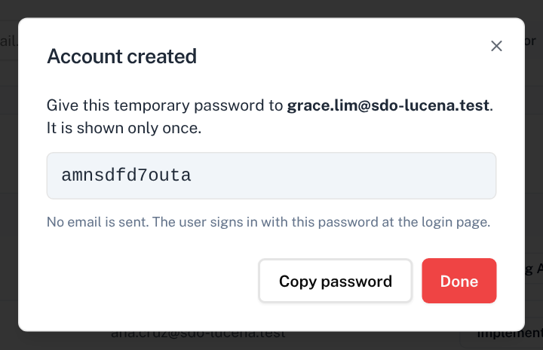
Give the temporary password
1
Temporary password
Shown only once. Copy it now.
2
Copy password
Copies it so you can paste it into a private message.
3
Done
Closes the dialog. The user can now sign in.
1
2
3
Important: share it privately. To set a new password later, run npm run set-password on the DQAMP computer.
DQAMP 2026 · Onboarding for Administrators
8
Notes:
The temporary password appears once. If you close the dialog without copying it, set a new one with npm run set-password -- email "new password" on the DQAMP computer.

Slide 9
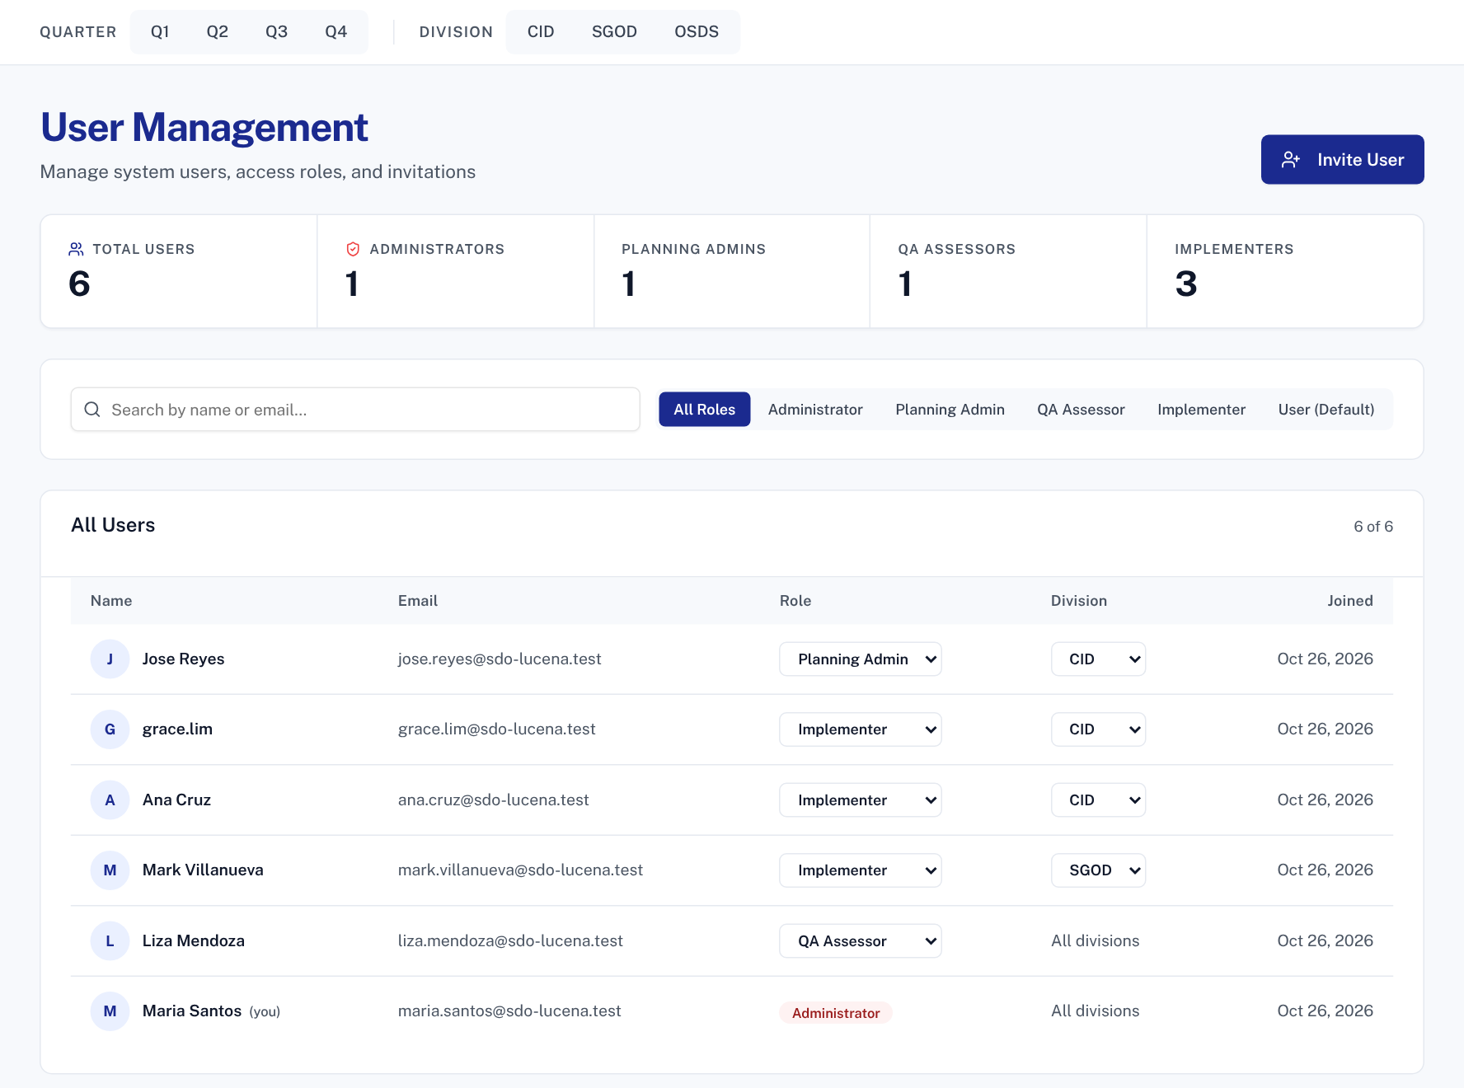
Roles and divisions
Open: User Management
1
1
Invite User
Adds a new account.
2
Role
Change it here. The division adjusts to match.
3
Division
CID, SGOD or OSDS. A warning shows if it is missing.
2
3
4
All divisions
QA Assessors and administrators are not limited.
4
Tip: every role and division change is recorded in the audit log.
DQAMP 2026 · Onboarding for Administrators
9
Notes:
An Implementer or Planning Admin without a division sees no records, so check this column after every import or invite.

Slide 10
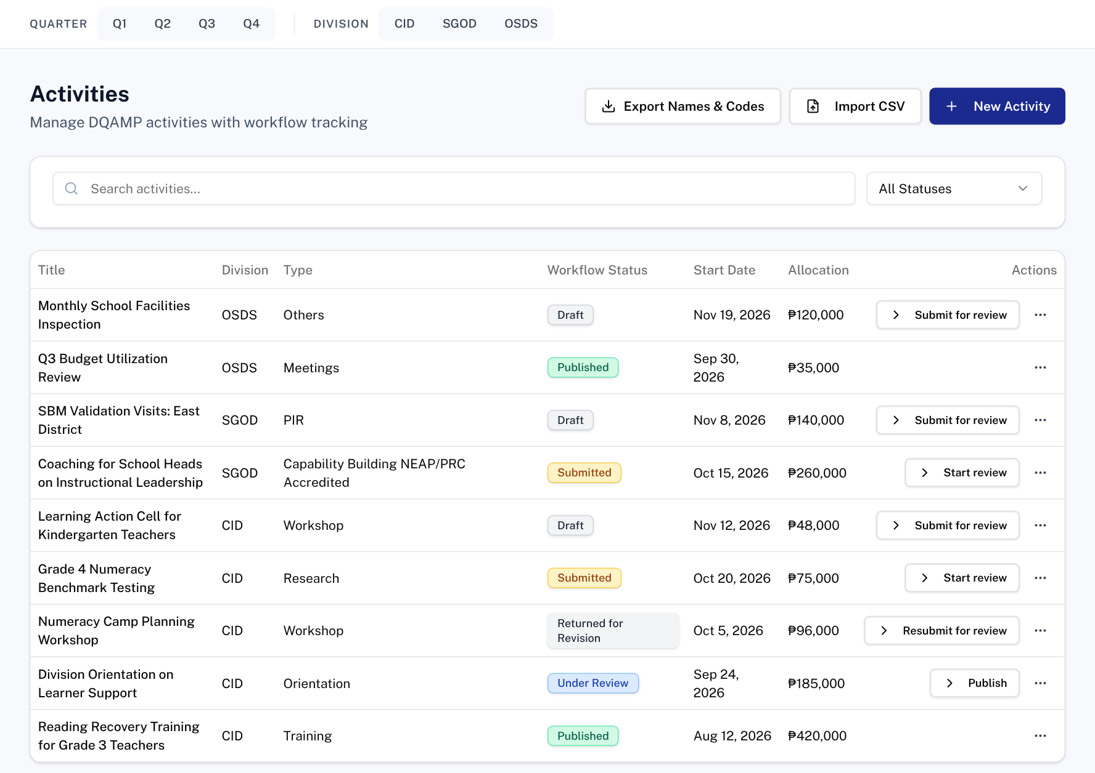
Publish a reviewed activity
Open: Activities
1
Under Review
The QA Assessor is reviewing or has reviewed it.
2
Publish
Moves it to Published. Only administrators can.
3
More actions
View details, download the report, edit or revert.
1
2
3
Rule: published activities are locked. Only an administrator can revert one.
DQAMP 2026 · Onboarding for Administrators
10
Notes:
Before publishing, open the activity and check the QAME evaluation and the evidence link.
[DEMO CUE] Publish Division Orientation on Learner Support.

Slide 11

Correct a status
Open: Activities → More actions
1
Revert status
Moves the activity back one step, for example from Published to Under Review.
1
Tip: use revert only to correct a mistake. It is logged.
DQAMP 2026 · Onboarding for Administrators
11
Notes:
Revert is for corrections, such as publishing too early.
[DEMO CUE] Revert the activity you just published.

Slide 12
Fixing mistakes
1
2
3
Wrong role or division
Published too early
Forgotten password
Change it in User Management. It takes effect the next time they open a page.
More actions → Revert status moves it back to Under Review.
On the DQAMP computer run: npm run set-password -- email "new password".
Rules: users cannot be deleted in this version. Change their role if they leave, and keep at least one other administrator.
DQAMP 2026 · Onboarding for Administrators
12
Notes:
Three common corrections for administrators. Users cannot be deleted in this version, so plan for staff changes by changing roles.

Slide 13
Common problems and fixes
Problem | What to do
A user sees no activities | Their division is not set. Set it in User Management.
Someone forgot their password | Run npm run set-password on the DQAMP computer.
A change is refused | Their role or division does not allow it. Check User Management.
DQAMP will not load | Keep the DQAMP window open on the host computer. Run start-dqamp.cmd.
The seal is missing | Save it as public\deped-lucena-logo.jpg and restart DQAMP.
DQAMP 2026 · Onboarding for Administrators
13
Notes:
Go through the table. These are the problems new users meet most often.
[CHECK BEFORE PRESENTING] Add your administrator's name and contact details.

Slide 14
Practice: set up a user and publish
1
Invite Grace
Implementer, division SGOD.
Scenario (fictional)
A new SGOD Implementer, Grace Lim, starts today. Set up her account, then publish an activity that QA has reviewed.
Use the practice accounts your facilitator gives you.
2
Copy the temporary password
Paste it into a note for her.
3
Change her division
Set CID, then back to SGOD.
4
Publish an activity
Division Orientation on Learner Support.
5
Revert it
Move it back to Under Review.
About 10 minutes
Work in pairs if computers are limited
Done when: Grace shows division SGOD, and the activity is back to Under Review.
DQAMP 2026 · Onboarding for Administrators
14
Notes:
Give participants about 10 minutes, in pairs if computers are limited.
Practice records go into the same database as real work. Use a training copy of DQAMP, or agree with your administrator which practice records to delete afterwards.
[CHECK BEFORE PRESENTING] Name the practice accounts and the sample OneDrive link to use.

Slide 15
Where to get help
1
2
3
Your administrator
This guide
Your DQAMP support contact
Accounts, passwords, roles, divisions, and anything DQAMP will not let you change.
Keep the checklist on the last slide beside you. Print it if that helps.
Name: ____________________
Contact: __________________
DQAMP 2026 · Onboarding for Administrators
15
Notes:
When you are stuck, start with your administrator.
[CHECK BEFORE PRESENTING] Fill in the support contact on this slide.
Close by thanking participants and asking for questions.

Slide 16
Quick-start checklist
Before you start
For each new user
I can open DQAMP at http://127.0.0.1:3002
User Management → Invite User
I have my own administrator account
Choose role, and division for Implementers and Planning Admins
I know where the data folder is
Create Account → Copy password → Done
Share the password privately
Every week
Publish activities QA has reviewed
Check every Implementer and Planning Admin has a division
Back up the data folder while DQAMP is closed
Help: your DQAMP administrator · README.md beside the launcher · http://127.0.0.1:3002
DQAMP 2026 · Onboarding for Administrators
16
Notes:
Hand out this checklist. It summarises the session on one page.

