Slide 1

DQAMP 2026
Schools Division Office of Lucena City
By the end of this session you can:
Welcome to DQAMP
1
Sign in and find your division's activities
Onboarding for Implementers
2
Create an activity and submit it for review
About 20 minutes, plus practice
3
Fix a returned activity and record client feedback
Plan it. Track it. Prove it.
Notes:
Welcome everyone. In the next 20 minutes you will learn how to use DQAMP as an Implementer.
Read the three objectives aloud. Tell participants they will practise at the end.
[DEMO CUE] Have DQAMP open on the host computer at the sign-in page.
[CHECK BEFORE PRESENTING] All names and figures in this deck are fictional sample data.

Slide 2

What DQAMP does
DQAMP is the Division Quality Assurance and Monitoring Portal for SDO Lucena City.
1
One chain from goals to evidence
Organizational goals, division objectives, projects, outputs and activities link together.
2
Quality assurance built in
An activity is published only after a QA Assessor reviews it.
3
Records stay on this computer
No cloud account. Your administrator backs up the data folder.
DQAMP 2026 · Onboarding for Implementers
2
Notes:
DQAMP is the Division Quality Assurance and Monitoring Portal.
1. Goals, objectives, projects, outputs and activities link together, so results are traceable from the top down.
2. Every activity goes through QA review before it is published.
3. Everything is stored on the computer where DQAMP runs. There is no cloud account. The administrator backs up the data folder, so nobody else should copy or delete it.

Slide 3
Who does what
A
Administrator
Top management and system administrators
P
Planning Admin
Division planning staff
Sees and changes everything
Publishes reviewed activities
Adds users and sets roles and divisions
Plans objectives, projects and outputs in their division
Reads all activities and reports
Does not edit or publish activities
Q
QA Assessor
Quality assurance
I
Implementer
Staff who run activities
Your role
Sees every activity
Starts reviews and records QAME results
Returns work with a note; does not publish
Works in their own division
Creates and submits activities
Adds evidence links and client feedback
Checked by the system: buttons you cannot use do not appear, and a change outside your role or division is refused.
DQAMP 2026 · Onboarding for Implementers
3
Notes:
DQAMP has four roles. Point to the highlighted card: that is the role this session covers.
The rules are enforced by the system, not just by the menus. If you cannot use a button, it does not appear; if a change is outside your role or division, DQAMP refuses it.
[CHECK BEFORE PRESENTING] Name your office's administrator here.

Slide 4
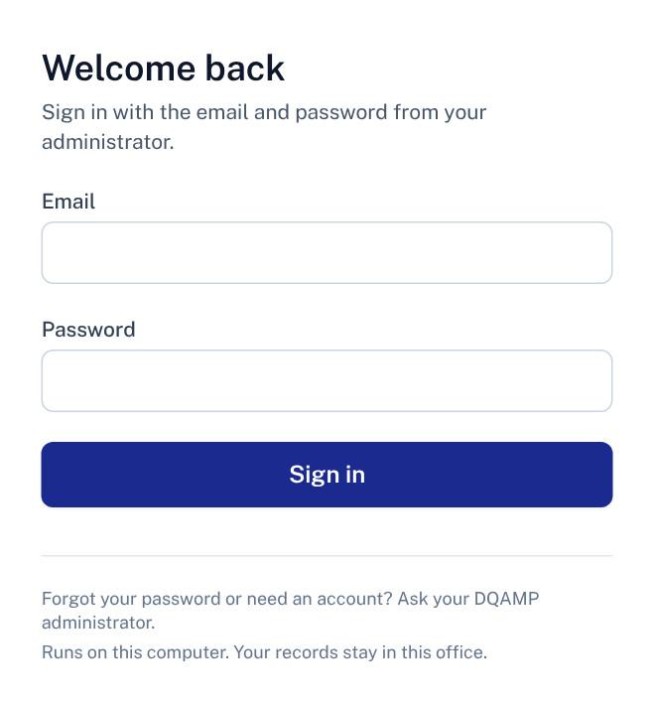
Signing in
1
Email
The address your administrator registered for you.
2
Password
The temporary password your administrator gave you.
1
3
Sign in
Opens the Dashboard.
2
Where: Open DQAMP on the computer where it runs, at http://127.0.0.1:3002.
3
No account yet? Your administrator creates it. DQAMP does not send email invitations.
DQAMP 2026 · Onboarding for Implementers
4
Notes:
DQAMP runs on one computer, and you sign in there in a web browser.
1. Type the email your administrator registered.
2. Type the temporary password your administrator gave you.
3. Click Sign in.
There is no email invitation and no password-reset screen. The administrator handles both.
[DEMO CUE] Sign in with a training account. Do not show a real password on screen.
[CHECK BEFORE PRESENTING] Confirm the address your office uses (the default is http://127.0.0.1:3002).

Slide 5
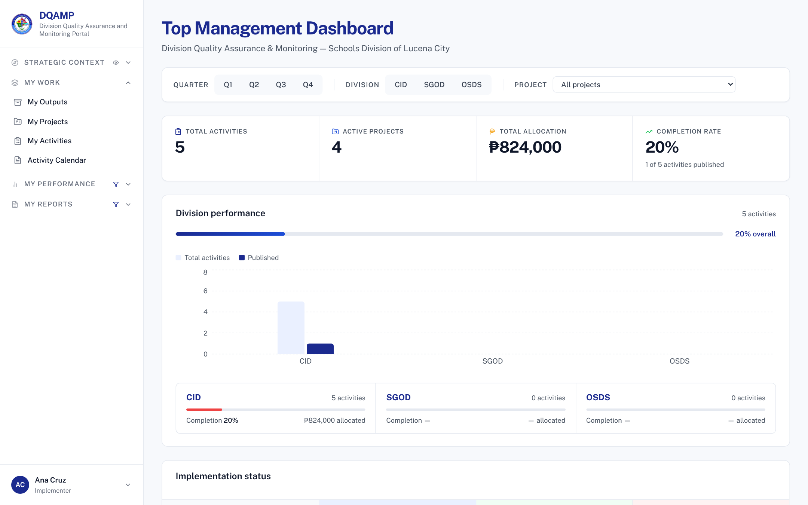
Finding your way
1
Menu
My Work: outputs, projects, activities and calendar.
1
2
2
Headline figures
Your division's activities, projects, allocation and completion.
Tip: you see your own division's activities only.
DQAMP 2026 · Onboarding for Implementers
5
Notes:
After signing in you land on the Dashboard. Your daily work is under My Work.

Slide 6
The workflow at a glance
1
2
3
4
Draft
Implementer writes it
Submitted
Implementer submits
Under Review
QA Assessor reviews
Published
Administrator publishes
You act at steps 1 and 2: write the activity, then submit it for review.
Returned for Revision: a QA Assessor sends an activity back with a note saying what to fix. The Implementer fixes it and submits again, so it returns to Submitted.
Locked when: an activity is Under Review or Published, only its reviewer or an administrator can change it.
DQAMP 2026 · Onboarding for Implementers
6
Notes:
Every activity follows these four steps. The filled circles are the steps this role performs.
Returned for Revision is the loop: the QA Assessor sends it back with a note, the Implementer fixes it and submits again.
Once an activity is Under Review or Published, it is locked for everyone except the reviewer and administrators.

Slide 7
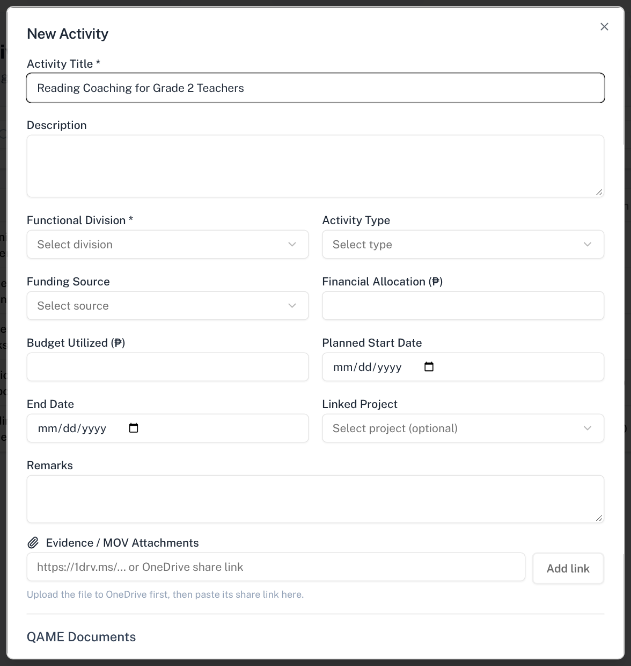
Create an activity
Open: My Activities → New Activity
1
Activity Title
Required. Use the full name of the activity.
1
2
Functional Division
Required. Choose your own division.
2
3
Evidence / MOV link
Paste a OneDrive share link, then select Add link.
Then: scroll down and select Create Activity. It saves as a Draft.
3
DQAMP 2026 · Onboarding for Implementers
7
Notes:
[DEMO CUE] Create Reading Coaching for Grade 2 Teachers in CID.

Slide 8
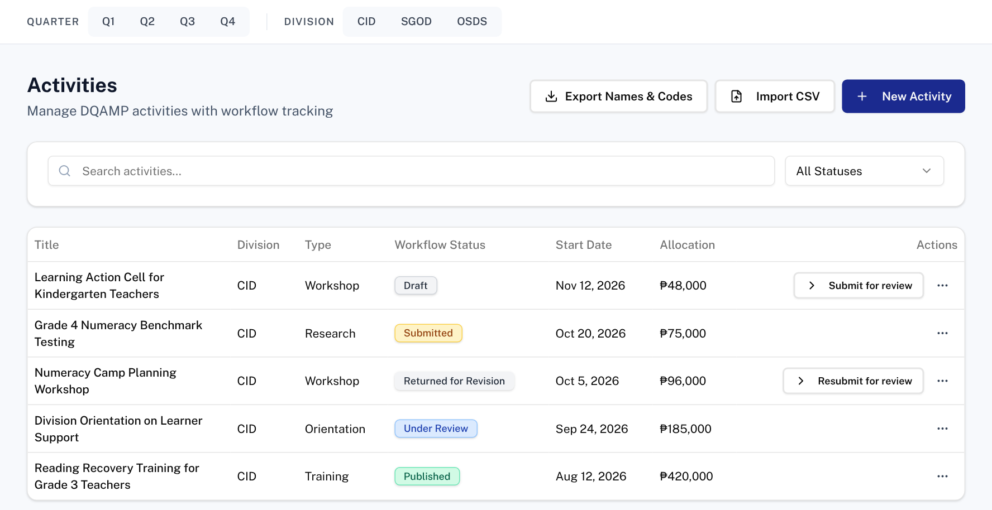
Submit for review
Open: My Activities
1
1
New Activity
Starts a new Draft.
2
Submit for review
Sends a Draft to QA. It becomes Submitted.
2
4
3
3
Resubmit for review
Sends a returned activity back after you fix it.
4
More actions
View details, download the report or edit.
Rule: you can edit while Draft, Submitted or Returned. Under review, it is locked.
DQAMP 2026 · Onboarding for Implementers
8
Notes:
The button names your next step. Activities under review or published have no button for you.

Slide 9
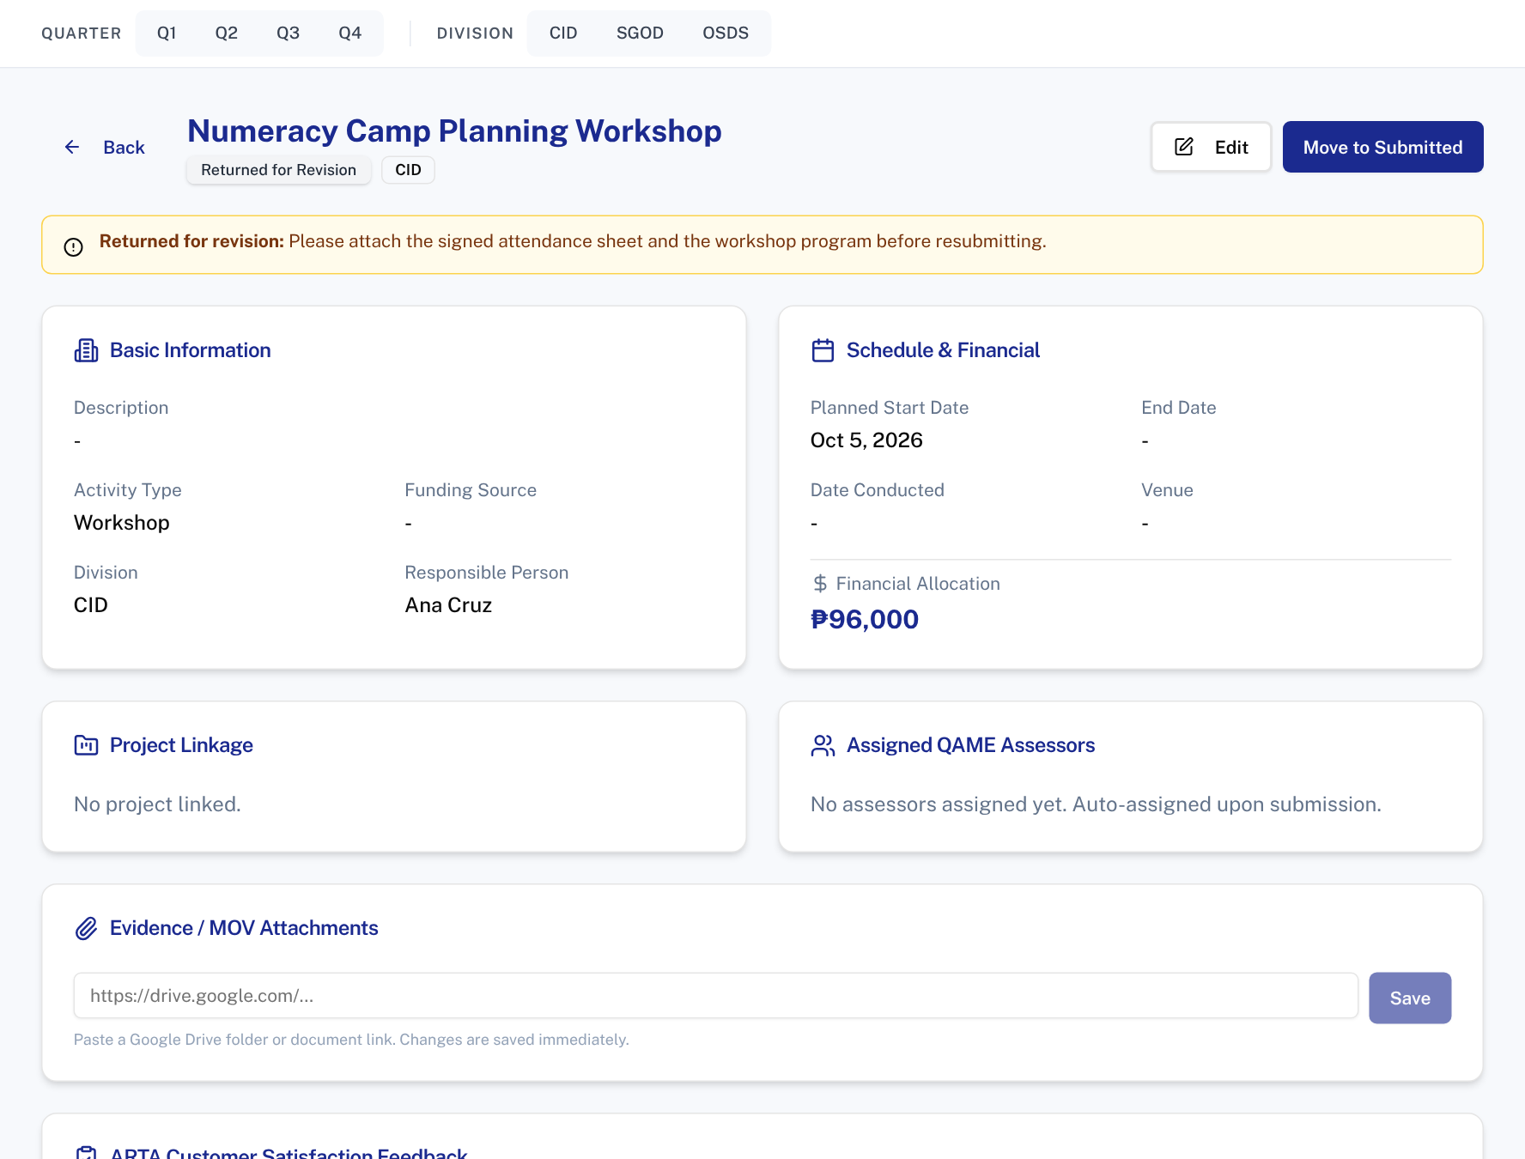
Fix a returned activity
Open: My Activities → View details → View Full Details
2
3
1
Reviewer's note
Says exactly what needs to change.
1
2
Edit
Opens the form so you can fix it.
3
Move to Submitted
Resubmits it for review.
Tip: fix everything in the note before resubmitting.
DQAMP 2026 · Onboarding for Implementers
9
Notes:
[DEMO CUE] Open Numeracy Camp Planning Workshop, read the note, and resubmit.

Slide 10
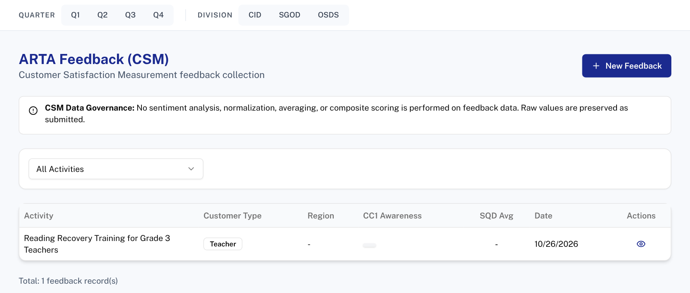
Record client feedback
Open: Client Feedback
1
1
New Feedback
Record the client satisfaction survey for your activity.
2
Filter by activity
See feedback for one activity.
2
Tip: feedback unlocks the QAME report download for that activity.
DQAMP 2026 · Onboarding for Implementers
10
Notes:
You can record feedback for activities in your own division.

Slide 11
Fixing mistakes
1
2
3
Typo in a Draft
Submitted too early
Wrong division
More actions → Edit, correct it and save.
You can still edit while Submitted. If QA has started, ask them to return it.
You can only choose your own division. Ask an administrator.
Rules: you change activities in your own division only, and only before review. You cannot delete activities or record QAME results.
DQAMP 2026 · Onboarding for Implementers
11
Notes:
Three common corrections for Implementers.

Slide 12
Common problems and fixes
Problem | What to do
Create Activity does nothing | A required field is empty: Activity Title or Functional Division.
I cannot see another division's activity | You see your own division only.
There is no Edit option | The activity is under review or published.
The QAME report is locked | Record ARTA feedback for that activity first.
The OneDrive link will not add | Paste the full https:// share link.
DQAMP 2026 · Onboarding for Implementers
12
Notes:
Go through the table. These are the problems new users meet most often.
[CHECK BEFORE PRESENTING] Add your administrator's name and contact details.

Slide 13
Practice: one activity, start to finish
1
New Activity
Title and your division.
Scenario (fictional)
You ran a reading coaching session for Grade 2 teachers. Record it, then fix an activity that QA sent back.
Use the practice account and sample OneDrive link your facilitator gives you.
2
Add the OneDrive link
Paste it under Evidence / MOV, then Add link.
3
Create Activity
It saves as a Draft.
4
Submit for review
From My Activities.
5
Fix the returned activity
Numeracy Camp Planning Workshop: read the note, then resubmit.
About 10 minutes
Work in pairs if computers are limited
Done when: Both activities show Submitted.
DQAMP 2026 · Onboarding for Implementers
13
Notes:
Give participants about 10 minutes, in pairs if computers are limited.
Practice records go into the same database as real work. Use a training copy of DQAMP, or agree with your administrator which practice records to delete afterwards.
[CHECK BEFORE PRESENTING] Name the practice accounts and the sample OneDrive link to use.

Slide 14
Where to get help
1
2
3
Your administrator
This guide
Your DQAMP support contact
Accounts, passwords, roles, divisions, and anything DQAMP will not let you change.
Keep the checklist on the last slide beside you. Print it if that helps.
Name: ____________________
Contact: __________________
DQAMP 2026 · Onboarding for Implementers
14
Notes:
When you are stuck, start with your administrator.
[CHECK BEFORE PRESENTING] Fill in the support contact on this slide.
Close by thanking participants and asking for questions.

Slide 15
Quick-start checklist
Before you start
For each activity
I can open DQAMP at http://127.0.0.1:3002
My Activities → New Activity → title and division → Create
My division is set (ask your administrator)
Add the OneDrive evidence link
I can upload to the OneDrive evidence folder
Submit for review
After the activity: record ARTA feedback
Every week
Check for Returned for Revision activities
Fix them and resubmit
Help: your DQAMP administrator · README.md beside the launcher · http://127.0.0.1:3002
DQAMP 2026 · Onboarding for Implementers
15
Notes:
Hand out this checklist. It summarises the session on one page.

