Slide 1

DQAMP 2026
Schools Division Office of Lucena City
By the end of this session you can:
Welcome to DQAMP
1
Sign in and find your division's plans
Onboarding for Planning Admins
2
Keep objectives, projects and outputs up to date
About 15 minutes, plus practice
3
Follow activities and pull reports
Plan it. Track it. Prove it.
Notes:
Welcome everyone. In the next 20 minutes you will learn how to use DQAMP as a Planning Admin.
Read the three objectives aloud. Tell participants they will practise at the end.
[DEMO CUE] Have DQAMP open on the host computer at the sign-in page.
[CHECK BEFORE PRESENTING] All names and figures in this deck are fictional sample data.

Slide 2
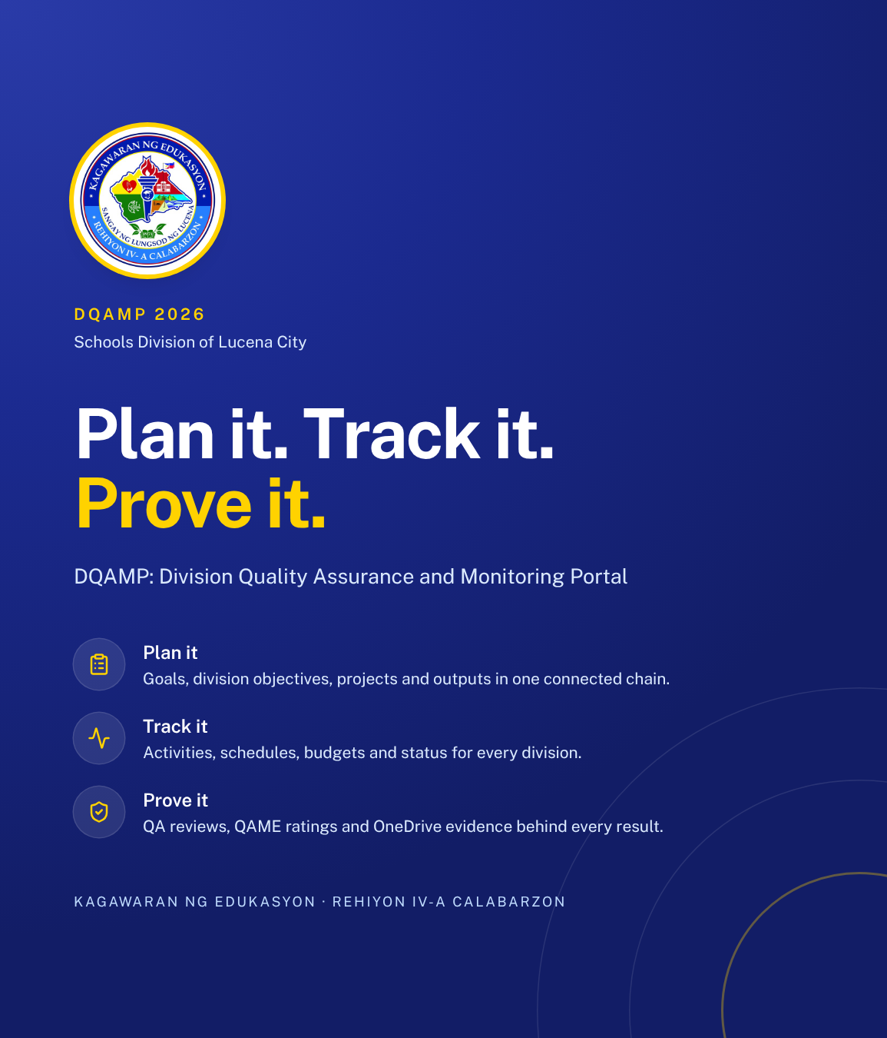
What DQAMP does
DQAMP is the Division Quality Assurance and Monitoring Portal for SDO Lucena City.
1
One chain from goals to evidence
Organizational goals, division objectives, projects, outputs and activities link together.
2
Quality assurance built in
An activity is published only after a QA Assessor reviews it.
3
Records stay on this computer
No cloud account. Your administrator backs up the data folder.
DQAMP 2026 · Onboarding for Planning Admins
2
Notes:
DQAMP is the Division Quality Assurance and Monitoring Portal.
1. Goals, objectives, projects, outputs and activities link together, so results are traceable from the top down.
2. Every activity goes through QA review before it is published.
3. Everything is stored on the computer where DQAMP runs. There is no cloud account. The administrator backs up the data folder, so nobody else should copy or delete it.

Slide 3
Who does what
A
Administrator
Top management and system administrators
P
Planning Admin
Division planning staff
Your role
Sees and changes everything
Publishes reviewed activities
Adds users and sets roles and divisions
Plans objectives, projects and outputs in their division
Reads all activities and reports
Does not edit or publish activities
Q
QA Assessor
Quality assurance
I
Implementer
Staff who run activities
Sees every activity
Starts reviews and records QAME results
Returns work with a note; does not publish
Works in their own division
Creates and submits activities
Adds evidence links and client feedback
Checked by the system: buttons you cannot use do not appear, and a change outside your role or division is refused.
DQAMP 2026 · Onboarding for Planning Admins
3
Notes:
DQAMP has four roles. Point to the highlighted card: that is the role this session covers.
The rules are enforced by the system, not just by the menus. If you cannot use a button, it does not appear; if a change is outside your role or division, DQAMP refuses it.
[CHECK BEFORE PRESENTING] Name your office's administrator here.

Slide 4
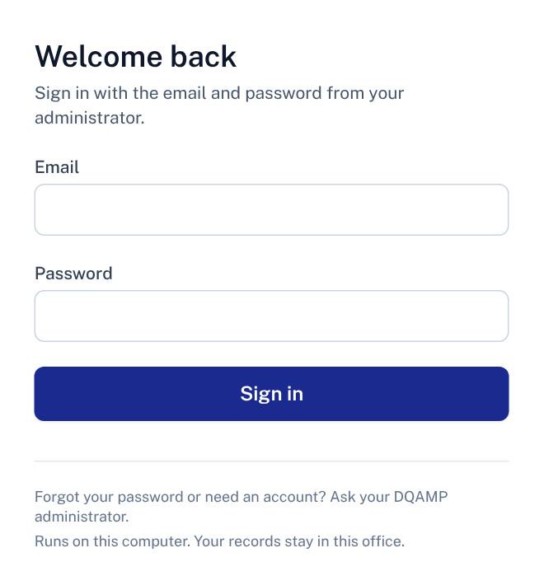
Signing in
1
Email
The address your administrator registered for you.
2
Password
The temporary password your administrator gave you.
1
3
Sign in
Opens the Dashboard.
2
Where: Open DQAMP on the computer where it runs, at http://127.0.0.1:3002.
3
No account yet? Your administrator creates it. DQAMP does not send email invitations.
DQAMP 2026 · Onboarding for Planning Admins
4
Notes:
DQAMP runs on one computer, and you sign in there in a web browser.
1. Type the email your administrator registered.
2. Type the temporary password your administrator gave you.
3. Click Sign in.
There is no email invitation and no password-reset screen. The administrator handles both.
[DEMO CUE] Sign in with a training account. Do not show a real password on screen.
[CHECK BEFORE PRESENTING] Confirm the address your office uses (the default is http://127.0.0.1:3002).

Slide 5
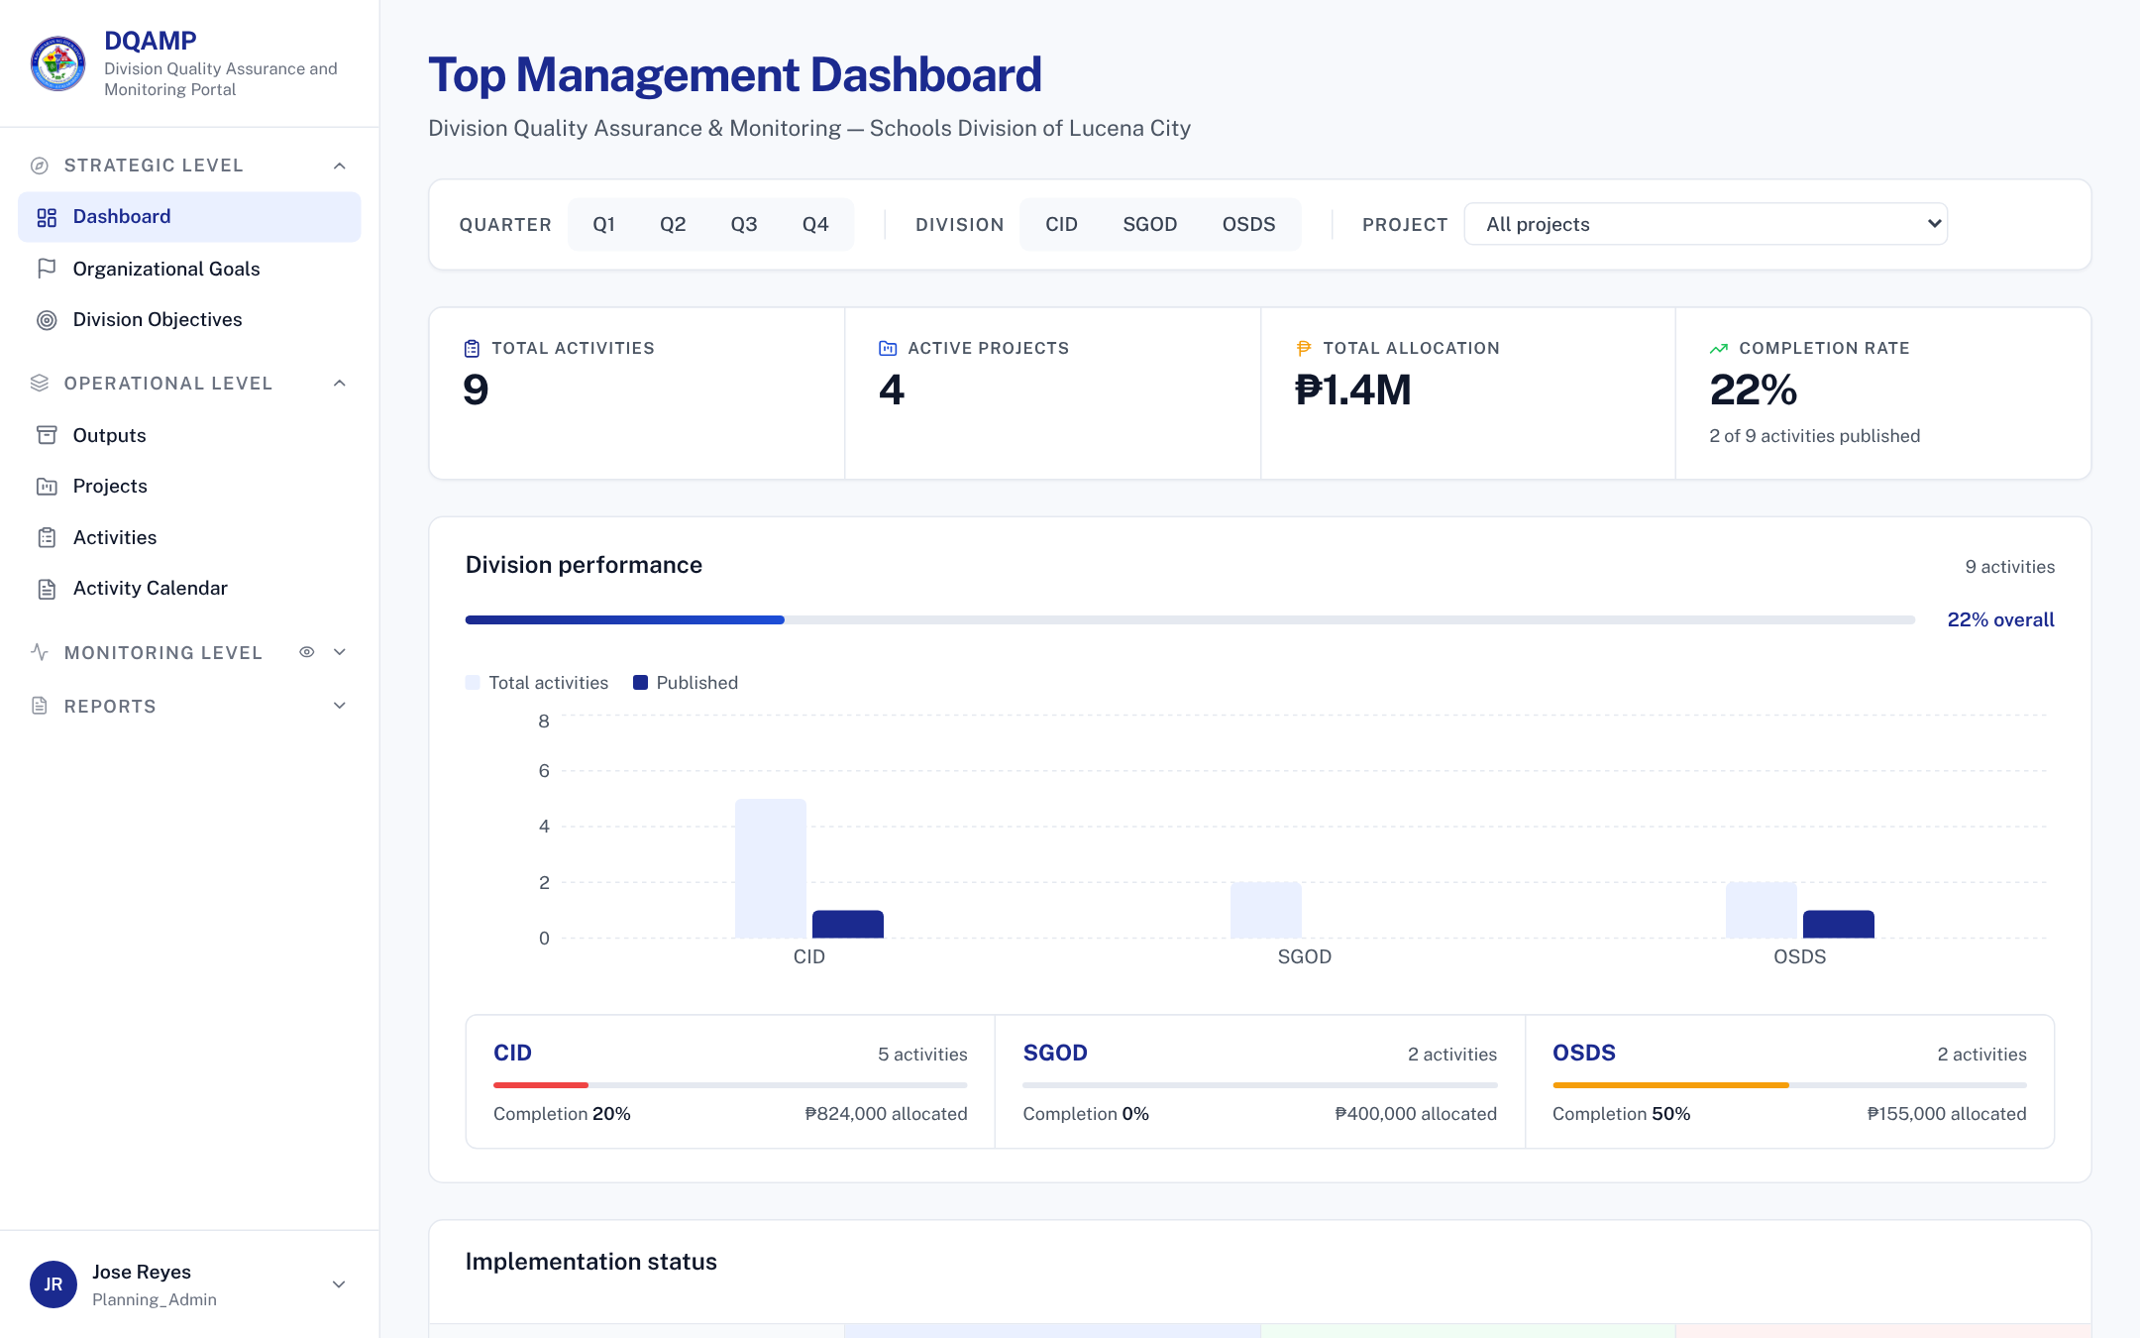
Finding your way
1
Menu
Strategic, operational and monitoring pages for planning.
1
2
2
Filters
Narrow every figure by quarter, division and project.
3
3
Headline figures
Activities, projects, allocation and completion.
Tip: you can read every division, and change only your own.
DQAMP 2026 · Onboarding for Planning Admins
5
Notes:
After signing in you land on the Dashboard. Point out the menu, the filters and the headline figures.
[DEMO CUE] Select CID in the division filter.

Slide 6
The workflow at a glance
1
2
3
4
Draft
Implementer writes it
Submitted
Implementer submits
Under Review
QA Assessor reviews
Published
Administrator publishes
You follow these steps, but you do not move activities between them.
Returned for Revision: a QA Assessor sends an activity back with a note saying what to fix. The Implementer fixes it and submits again, so it returns to Submitted.
Locked when: an activity is Under Review or Published, only its reviewer or an administrator can change it.
DQAMP 2026 · Onboarding for Planning Admins
6
Notes:
Every activity follows these four steps. The filled circles are the steps this role performs.
Returned for Revision is the loop: the QA Assessor sends it back with a note, the Implementer fixes it and submits again.
Once an activity is Under Review or Published, it is locked for everyone except the reviewer and administrators.

Slide 7
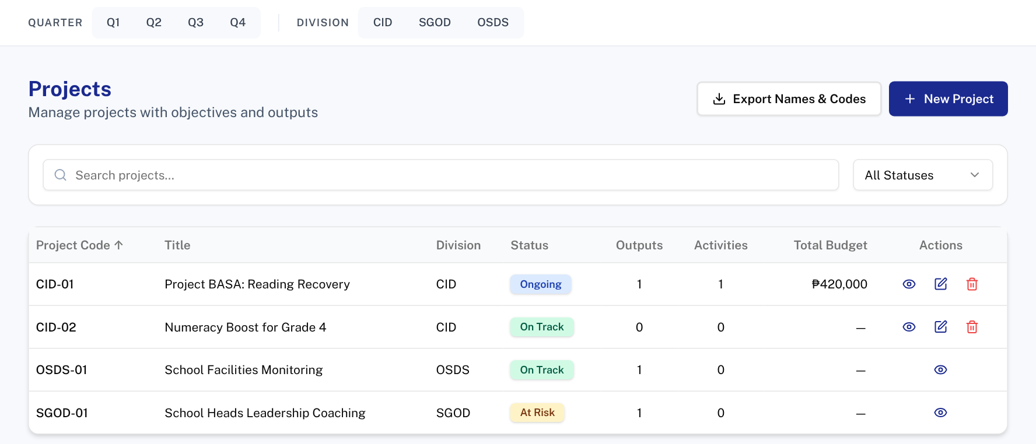
Plan projects for your division
1
Open: Projects
2
1
Division filter
Select your division to see only its projects.
2
New Project
Adds a project in your division.
3
4
3
Status
Ongoing, On Track, At Risk or Delayed.
4
Edit
Shown only on your division's projects.
Tip: a dash in Total Budget means no budget is set yet.
DQAMP 2026 · Onboarding for Planning Admins
7
Notes:
Projects carry the division. You can create and edit projects in your own division only.
[DEMO CUE] Edit CID-02 and set its status to At Risk.

Slide 8
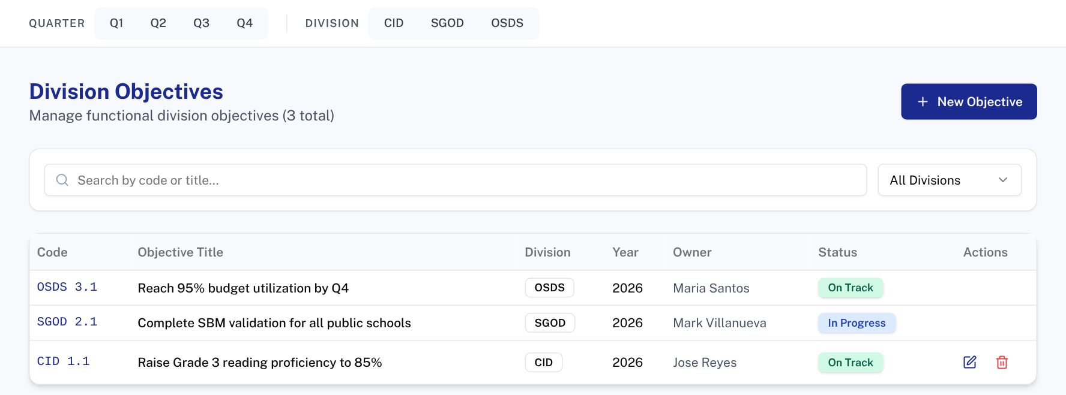
Set division objectives
Open: Division Objectives
1
1
New Objective
Code, title, year and owner for your division.
2
Your objective
CID 1.1 is in your division, so you can edit it.
2
Tip: organizational goals are set by an administrator. Link your objectives to them.
DQAMP 2026 · Onboarding for Planning Admins
8
Notes:
Division objectives sit under the organizational goals. Planning Admins keep them current for their division.

Slide 9
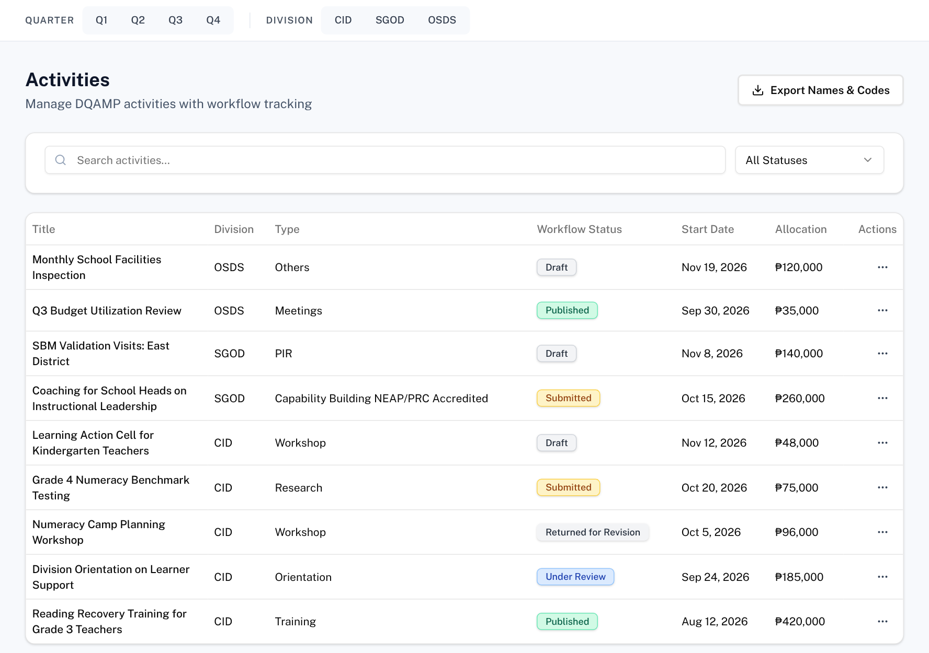
Follow activities (read only)
Open: Activities
1
Status
Where each activity is in the workflow.
2
More actions
View details or download the activity report.
1
2
Rule: Planning Admins read activities. Ask the Implementer for changes.
DQAMP 2026 · Onboarding for Planning Admins
9
Notes:
You see every division's activities so you can track delivery, but there are no workflow buttons for you here.

Slide 10
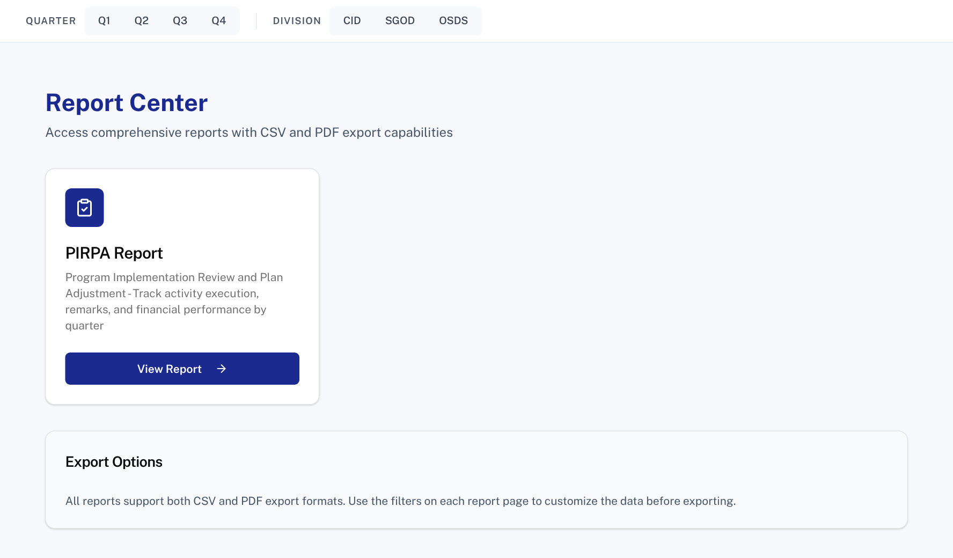
Pull a report
Open: Report Center
1
View Report
Opens the PIRPA report.
1
Tip: reports follow the quarter and division filters at the top of the page.
DQAMP 2026 · Onboarding for Planning Admins
10
Notes:
[DEMO CUE] Open the PIRPA report with the CID filter on.

Slide 11
Fixing mistakes
1
2
3
Typo in a project
Record in the wrong division
An activity needs a change
Click Edit (the pencil), correct it and save.
You can only set your own division. Ask an administrator to move it.
Ask the Implementer. QA Assessors change review fields only.
Rules: you change records in your own division only. Organizational goals belong to administrators.
DQAMP 2026 · Onboarding for Planning Admins
11
Notes:
Three common corrections for Planning Admins.

Slide 12
Common problems and fixes
Problem | What to do
I cannot save a project from another division | Only your division's records can change. Ask that division's Planning Admin.
I see no projects | Check the division filter at the top. Clear it to see all.
I cannot edit an activity | Planning Admins read activities. Ask the Implementer.
I cannot edit an organizational goal | Only administrators set goals.
DQAMP will not load | The DQAMP window on the host computer must stay open.
DQAMP 2026 · Onboarding for Planning Admins
12
Notes:
Go through the table. These are the problems new users meet most often.
[CHECK BEFORE PRESENTING] Add your administrator's name and contact details.

Slide 13
Practice: update a project
1
Filter to CID
Use the division filter at the top.
Scenario (fictional)
CID's Numeracy Boost for Grade 4 project is behind schedule. Record that and check the related activity.
Use the practice account your facilitator gives you.
2
Edit CID-02
Set the status to At Risk and save.
3
Add an output
Outputs → New Output, linked to CID-02.
4
Check the activity
Grade 4 Numeracy Benchmark Testing → View details.
5
Pull the PIRPA report
Report Center → View Report.
About 10 minutes
Work in pairs if computers are limited
Done when: CID-02 shows At Risk and the new output appears under Outputs.
DQAMP 2026 · Onboarding for Planning Admins
13
Notes:
Give participants about 10 minutes, in pairs if computers are limited.
Practice records go into the same database as real work. Use a training copy of DQAMP, or agree with your administrator which practice records to delete afterwards.
[CHECK BEFORE PRESENTING] Name the practice accounts and the sample OneDrive link to use.

Slide 14
Where to get help
1
2
3
Your administrator
This guide
Your DQAMP support contact
Accounts, passwords, roles, divisions, and anything DQAMP will not let you change.
Keep the checklist on the last slide beside you. Print it if that helps.
Name: ____________________
Contact: __________________
DQAMP 2026 · Onboarding for Planning Admins
14
Notes:
When you are stuck, start with your administrator.
[CHECK BEFORE PRESENTING] Fill in the support contact on this slide.
Close by thanking participants and asking for questions.

Slide 15
Quick-start checklist
Before you start
Every month
I can open DQAMP at http://127.0.0.1:3002
Update project status and budgets
My division is set (ask your administrator)
Add or update outputs
Review division objectives
When something is wrong
Check activities in your division
Fix your own division's records with Edit
Pull the PIRPA report
Ask the Implementer about activity changes
Ask an administrator about goals and divisions
Help: your DQAMP administrator · README.md beside the launcher · http://127.0.0.1:3002
DQAMP 2026 · Onboarding for Planning Admins
15
Notes:
Hand out this checklist. It summarises the session on one page.

