Slide 1

DQAMP 2026
Schools Division Office of Lucena City
By the end of this session you can:
Welcome to DQAMP
1
Sign in and find activities waiting for review
Onboarding for QA Assessors
2
Record the QAME evaluation
About 20 minutes, plus practice
3
Return work with a clear note
Plan it. Track it. Prove it.
Notes:
Welcome everyone. In the next 20 minutes you will learn how to use DQAMP as a QA Assessor.
Read the three objectives aloud. Tell participants they will practise at the end.
[DEMO CUE] Have DQAMP open on the host computer at the sign-in page.
[CHECK BEFORE PRESENTING] All names and figures in this deck are fictional sample data.

Slide 2

What DQAMP does
DQAMP is the Division Quality Assurance and Monitoring Portal for SDO Lucena City.
1
One chain from goals to evidence
Organizational goals, division objectives, projects, outputs and activities link together.
2
Quality assurance built in
An activity is published only after a QA Assessor reviews it.
3
Records stay on this computer
No cloud account. Your administrator backs up the data folder.
DQAMP 2026 · Onboarding for QA Assessors
2
Notes:
DQAMP is the Division Quality Assurance and Monitoring Portal.
1. Goals, objectives, projects, outputs and activities link together, so results are traceable from the top down.
2. Every activity goes through QA review before it is published.
3. Everything is stored on the computer where DQAMP runs. There is no cloud account. The administrator backs up the data folder, so nobody else should copy or delete it.

Slide 3
Who does what
A
Administrator
Top management and system administrators
P
Planning Admin
Division planning staff
Sees and changes everything
Publishes reviewed activities
Adds users and sets roles and divisions
Plans objectives, projects and outputs in their division
Reads all activities and reports
Does not edit or publish activities
Q
QA Assessor
Quality assurance
Your role
I
Implementer
Staff who run activities
Sees every activity
Starts reviews and records QAME results
Returns work with a note; does not publish
Works in their own division
Creates and submits activities
Adds evidence links and client feedback
Checked by the system: buttons you cannot use do not appear, and a change outside your role or division is refused.
DQAMP 2026 · Onboarding for QA Assessors
3
Notes:
DQAMP has four roles. Point to the highlighted card: that is the role this session covers.
The rules are enforced by the system, not just by the menus. If you cannot use a button, it does not appear; if a change is outside your role or division, DQAMP refuses it.
[CHECK BEFORE PRESENTING] Name your office's administrator here.

Slide 4
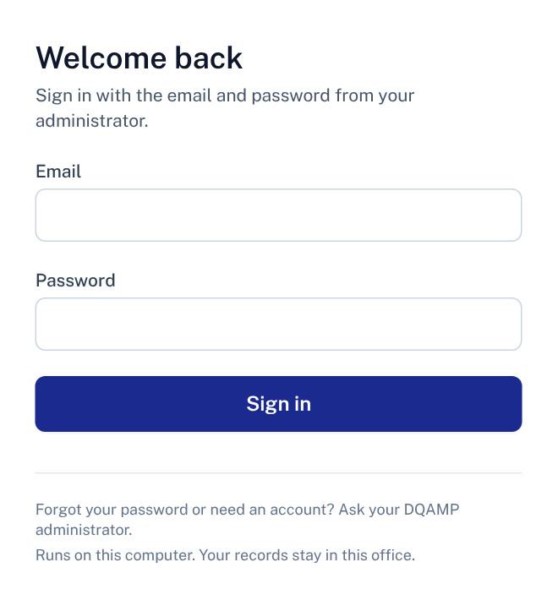
Signing in
1
Email
The address your administrator registered for you.
2
Password
The temporary password your administrator gave you.
1
3
Sign in
Opens the Dashboard.
2
Where: Open DQAMP on the computer where it runs, at http://127.0.0.1:3002.
3
No account yet? Your administrator creates it. DQAMP does not send email invitations.
DQAMP 2026 · Onboarding for QA Assessors
4
Notes:
DQAMP runs on one computer, and you sign in there in a web browser.
1. Type the email your administrator registered.
2. Type the temporary password your administrator gave you.
3. Click Sign in.
There is no email invitation and no password-reset screen. The administrator handles both.
[DEMO CUE] Sign in with a training account. Do not show a real password on screen.
[CHECK BEFORE PRESENTING] Confirm the address your office uses (the default is http://127.0.0.1:3002).

Slide 5
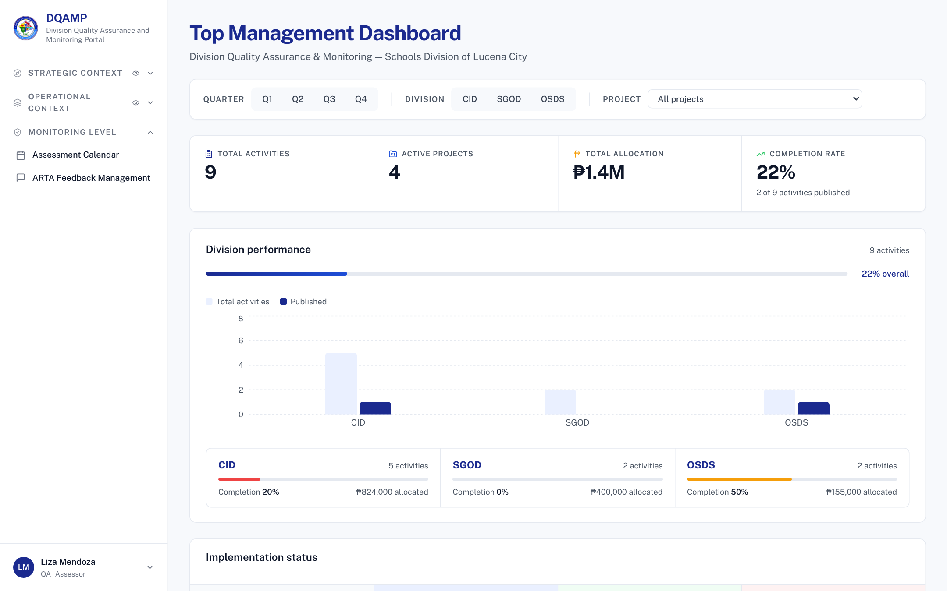
Finding your way
1
Menu
Activities, the assessment calendar and ARTA feedback.
1
2
2
Filters
Narrow every figure by quarter, division and project.
3
3
Headline figures
Activities, projects, allocation and completion.
Tip: you see every division's activities.
DQAMP 2026 · Onboarding for QA Assessors
5
Notes:
After signing in you land on the Dashboard. Your review work starts on the Activities page.

Slide 6
The workflow at a glance
1
2
3
4
Draft
Implementer writes it
Submitted
Implementer submits
Under Review
QA Assessor reviews
Published
Administrator publishes
You act at step 3: start the review, record the QAME evaluation, or return the activity.
Returned for Revision: a QA Assessor sends an activity back with a note saying what to fix. The Implementer fixes it and submits again, so it returns to Submitted.
Locked when: an activity is Under Review or Published, only its reviewer or an administrator can change it.
DQAMP 2026 · Onboarding for QA Assessors
6
Notes:
Every activity follows these four steps. The filled circles are the steps this role performs.
Returned for Revision is the loop: the QA Assessor sends it back with a note, the Implementer fixes it and submits again.
Once an activity is Under Review or Published, it is locked for everyone except the reviewer and administrators.

Slide 7
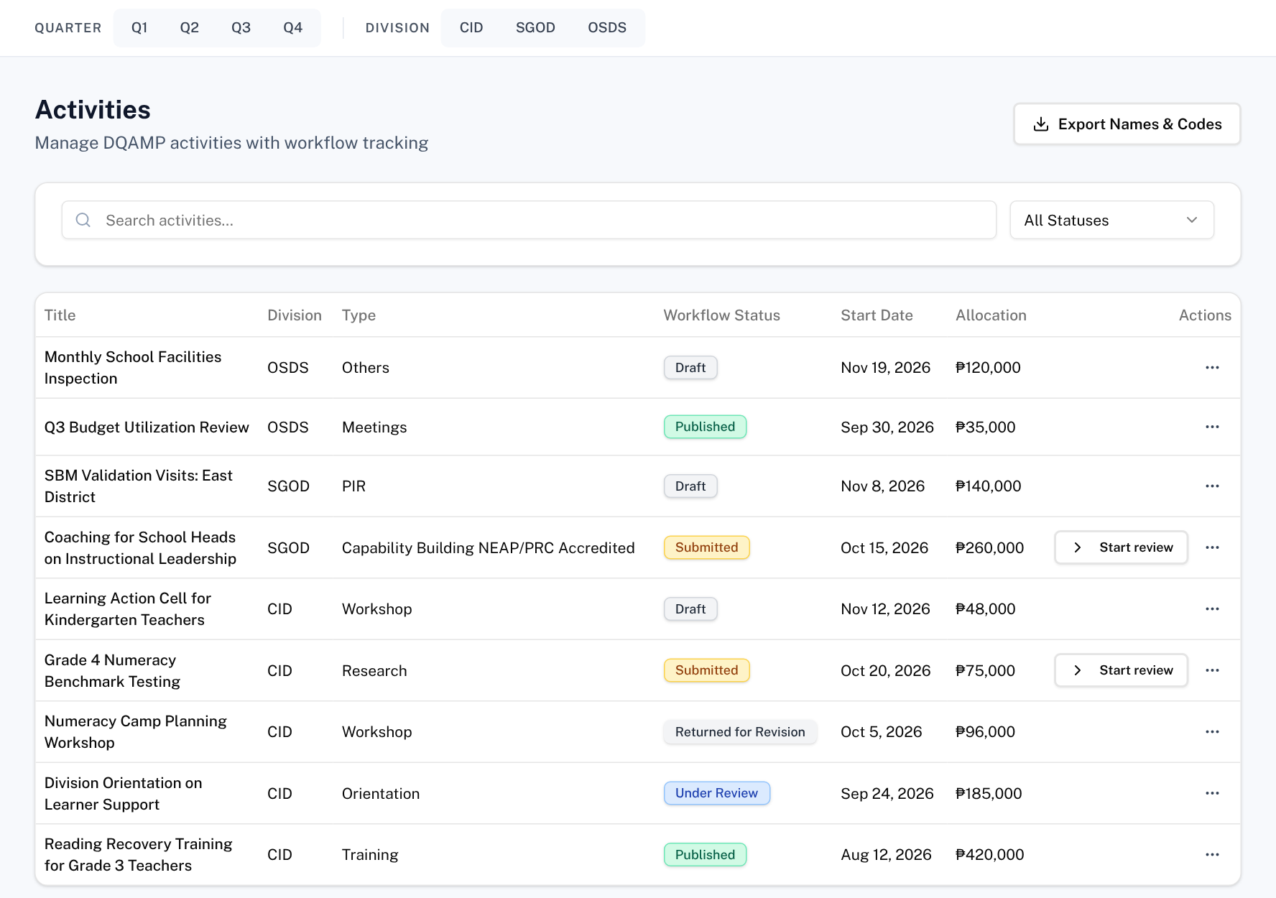
Start a review
Open: Activities
1
Workflow status filter
Choose Submitted to see what is waiting.
1
2
Start review
Moves the activity to Under Review.
3
Under Review
Activities already in review.
2
3
Tip: start the review before you assess, so others know it is in progress.
DQAMP 2026 · Onboarding for QA Assessors
7
Notes:
[DEMO CUE] Filter by Submitted and click Start review on Grade 4 Numeracy Benchmark Testing.

Slide 8
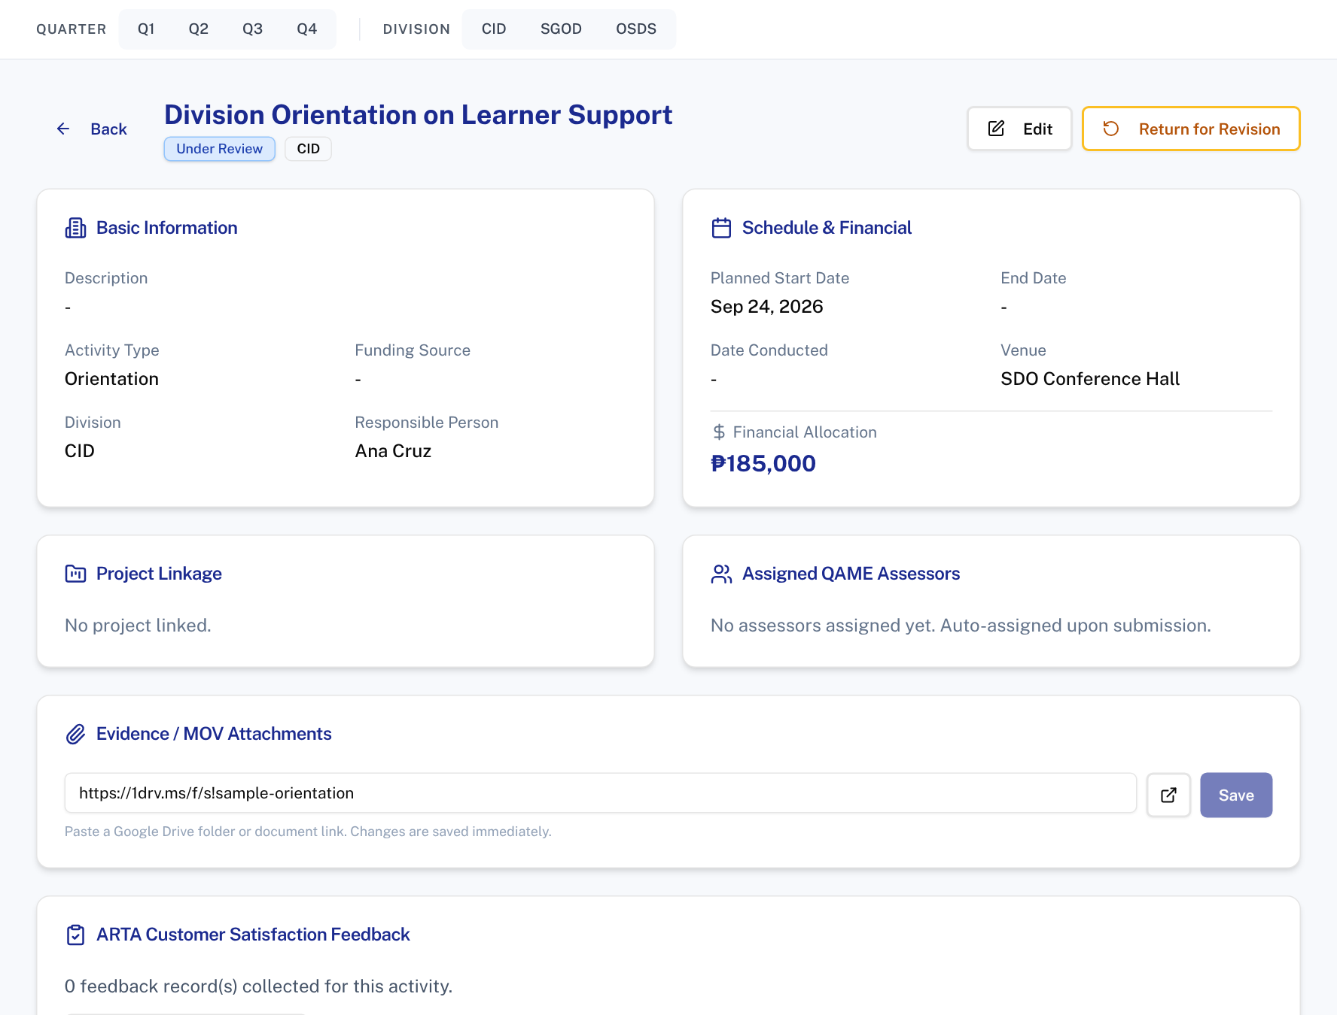
Open the activity
Open: More actions → View details → View Full Details
2
1
1
Status
Under Review while you assess it.
2
Return for Revision
Sends it back with a note when something is missing.
Rule: you do not publish. An administrator publishes after your review.
DQAMP 2026 · Onboarding for QA Assessors
8
Notes:
The full view shows the details, evidence link and the QAME section further down.

Slide 9
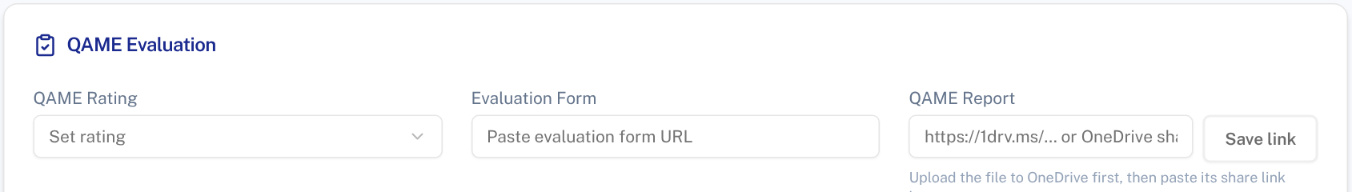
Record the QAME evaluation
Open: Activity view → QAME Evaluation
1
2
1
QAME Rating
Choose the rating.
2
QAME Report
Paste the OneDrive share link to the report, then Save link.
Tip: upload the report to OneDrive first, then share the link.
DQAMP 2026 · Onboarding for QA Assessors
9
Notes:
Review fields can be changed only while the activity is Under Review.

Slide 10
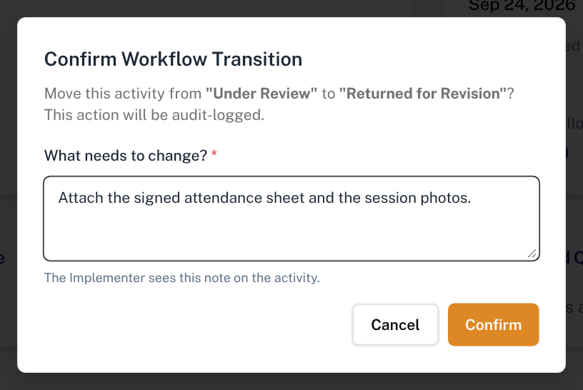
Return for revision
1
What needs to change?
Required. The Implementer sees this note on the activity.
2
Confirm
Moves it to Returned for Revision.
1
2
Tip: be specific: name the missing document or figure.
DQAMP 2026 · Onboarding for QA Assessors
10
Notes:
Confirm stays disabled until the note is written.

Slide 11
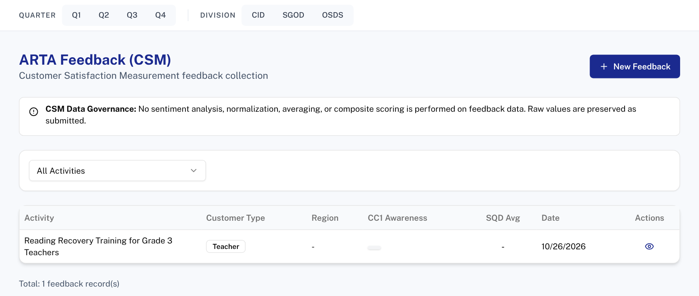
Client feedback (ARTA)
Open: ARTA Feedback Management
2
1
Filter by activity
See feedback for one activity.
1
New Feedback
Record a client satisfaction survey.
2
Rule: Implementers must record feedback before they can download the QAME report.
DQAMP 2026 · Onboarding for QA Assessors
11
Notes:
QA Assessors can record feedback for any activity.

Slide 12
Fixing mistakes
1
2
3
Wrong rating saved
Returned by mistake
Started the wrong review
Choose the right rating. It saves again while the activity is Under Review.
Ask an administrator to revert the status.
Ask an administrator to move it back to Submitted.
Rules: you change review fields only, and only while the activity is Under Review.
DQAMP 2026 · Onboarding for QA Assessors
12
Notes:
Three common corrections for QA Assessors.

Slide 13
Common problems and fixes
Problem | What to do
I cannot change the title or budget | Return the activity with a note. The Implementer fixes it.
There is no Publish button | Only administrators publish.
Confirm is greyed out | Write the note first. It is required.
The report link will not save | Paste the full https:// OneDrive share link.
DQAMP will not load | The DQAMP window on the host computer must stay open.
DQAMP 2026 · Onboarding for QA Assessors
13
Notes:
Go through the table. These are the problems new users meet most often.
[CHECK BEFORE PRESENTING] Add your administrator's name and contact details.

Slide 14
Practice: review one activity
1
Filter by Submitted
On the Activities page.
Scenario (fictional)
Grade 4 Numeracy Benchmark Testing (CID) was submitted this morning. Review it and send it back for one missing item.
Use the practice account and sample OneDrive link your facilitator gives you.
2
Start review
On Grade 4 Numeracy Benchmark Testing.
3
Set the QAME rating
In the QAME Evaluation section.
4
Add the report link
Paste the sample OneDrive link and save.
5
Return it
Note: Attach the test results summary.
About 10 minutes
Work in pairs if computers are limited
Done when: The activity shows Returned for Revision, with your note on it.
DQAMP 2026 · Onboarding for QA Assessors
14
Notes:
Give participants about 10 minutes, in pairs if computers are limited.
Practice records go into the same database as real work. Use a training copy of DQAMP, or agree with your administrator which practice records to delete afterwards.
[CHECK BEFORE PRESENTING] Name the practice accounts and the sample OneDrive link to use.

Slide 15
Where to get help
1
2
3
Your administrator
This guide
Your DQAMP support contact
Accounts, passwords, roles, divisions, and anything DQAMP will not let you change.
Keep the checklist on the last slide beside you. Print it if that helps.
Name: ____________________
Contact: __________________
DQAMP 2026 · Onboarding for QA Assessors
15
Notes:
When you are stuck, start with your administrator.
[CHECK BEFORE PRESENTING] Fill in the support contact on this slide.
Close by thanking participants and asking for questions.

Slide 16
Quick-start checklist
Before you start
For each review
I can open DQAMP at http://127.0.0.1:3002
Activities → filter Submitted → Start review
I can open the OneDrive folder for QAME reports
More actions → View details → View Full Details
QAME Evaluation → rating → report link → Save link
Every week
If something is missing: Return for Revision with a clear note
Check for Submitted activities
Record ARTA feedback you have received
Help: your DQAMP administrator · README.md beside the launcher · http://127.0.0.1:3002
DQAMP 2026 · Onboarding for QA Assessors
16
Notes:
Hand out this checklist. It summarises the session on one page.

