Slide 1

🜂 THE PROPHECY · THE FOUNDING DOCUMENT OF PHIERS
BLACK MEN… WELCOME
For Us. By Us.
Let that land.
WWW.PHIERS.ORG / PROPHECY
A GIFT FROM FOUNDATIONAL BLACK AMERICAN MEN TO HUMANITY.
FIRST EDITION
Notes:
Black men, welcome. For us, by us. Let that land.

Slide 2
🜂 BEFORE YOU CONTINUE
PHIERS was built by Foundational Black American men.
This document speaks directly to Black American men because every movement begins somewhere, and every generation is called to answer its own challenges.
For years — long before PHIERS became a movement — we referred to this vision simply as “The Prophecy.” The name remained because great movements often begin as ideas before they become institutions.
It was built for everyone.
When we speak about race, it is never to divide people or elevate one group above another. It is to acknowledge the community from which this movement emerged — and the responsibility we believe comes with that history.
When Black American men rise to our highest potential, everyone benefits. Stronger fathers build stronger families. Stronger families build stronger communities. Stronger communities build a stronger America.
If you are not the audience this document speaks to first, we still hope you’ll continue reading — because the future we are trying to build belongs to all of us.
Notes:
PHIERS was built by Foundational Black American men. It was built for everyone. This document speaks directly to Black American men because every movement begins somewhere. When we speak about race, it is never to divide, but to acknowledge the community this movement emerged from and the responsibility that comes with that history. When Black American men rise to our highest potential, everyone benefits. If you are not the audience this speaks to first, we still hope you will continue reading, because the future we are building belongs to all of us.

Slide 3
🜂 TAKE A KNEE
We’ve been carrying weight a long time.
Nobody’s coming to save us. We learned something from that.
Notes:
We have carried weight a long time. Nobody is coming to save us. We learned from that.

Slide 4
🜂 WHAT WE LEARNED
Power doesn’t come from shouting louder.
It comes from enough disciplined people moving together.
Notes:
Power does not come from shouting louder. It comes from enough disciplined people moving together.

Slide 5
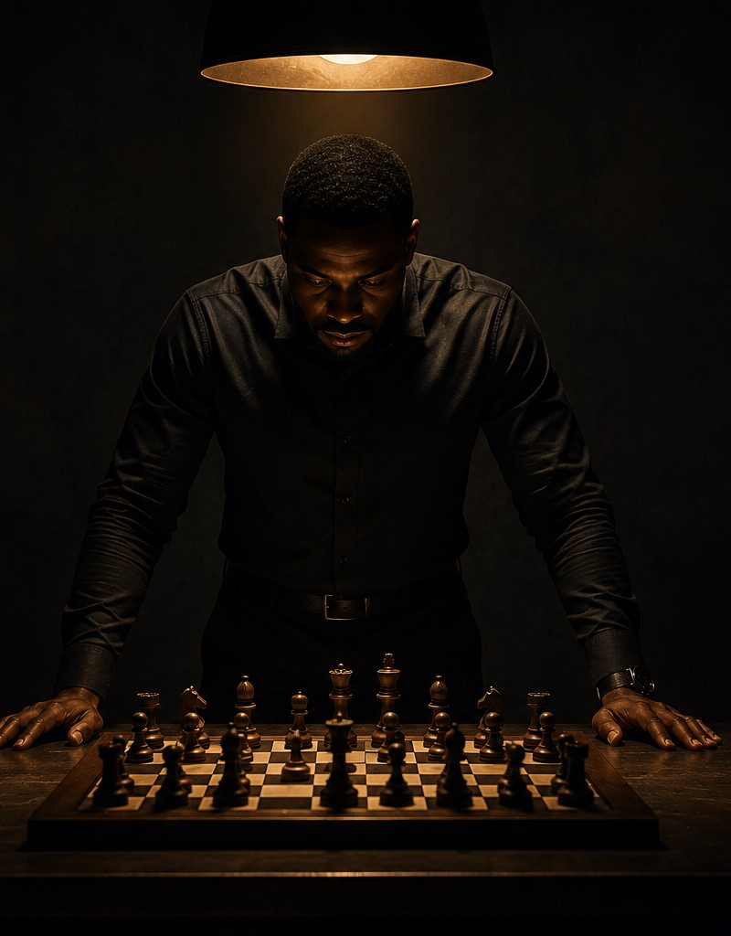
🜂 NOT NOISE — STRUCTURE
Not a protest. Not a political party. A structure.
A structure that helps men get whole, build leverage, and solve problems together. When we get whole, everybody wins.
Notes:
Not a protest. Not a political party. A structure that helps men get whole, build leverage, and solve problems together.

Slide 6
Choose.
Notes:
A pause. The choice is yours. Nothing else.

Slide 7
No one can build this for us.
What becomes possible depends on how many of us choose to build it.
PARTICIPATION IS VOLUNTARY.
Notes:
This only works if enough of us choose to build it. Participation is voluntary. The opportunity belongs to everyone.

Slide 8

🜂 THE PROPHECY · WHY WE’RE HERE
The prophecy wasn’t metaphor. It was a timeline.
Notes:
The prophecy was not metaphor. It was a timeline.

Slide 9
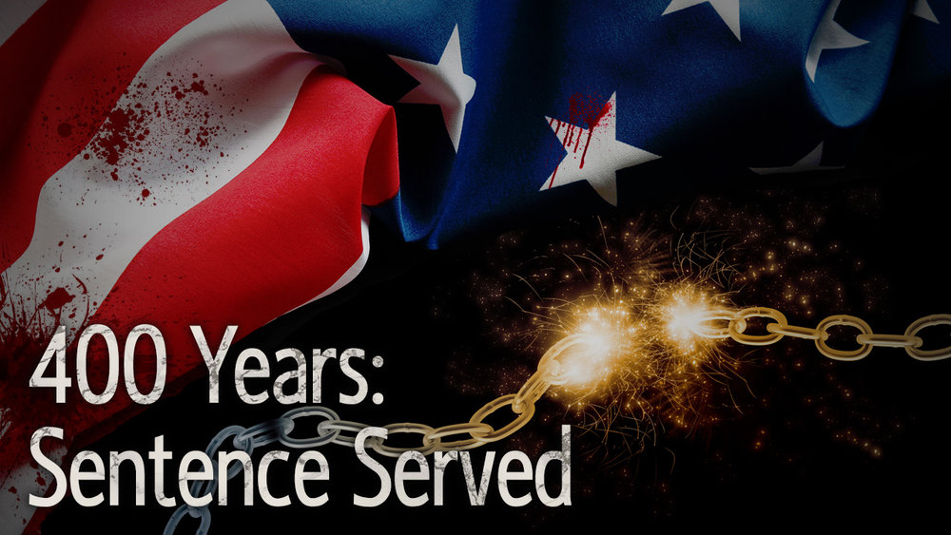
🜂 GENESIS 15:13–14
“Know for certain that your descendants will be strangers in a land not their own… where they will be enslaved and mistreated for four hundred years. But afterward, they will leave with great substance.”
Substance becomes leverage. · Leverage becomes respect.
Notes:
Genesis 15:13-14. Four hundred years, then they leave with great substance. Substance becomes leverage.

Slide 10
🜂 FOUR HUNDRED YEARS
Endurance turned into structure.
Memory turned into coordination.
Pressure turned into leverage.
Survival turned into forward motion.
Not all at once. One disciplined man at a time. Then fifteen hundred.
Notes:
Endurance into structure. Memory into coordination. Pressure into leverage. One disciplined man at a time. Then fifteen hundred.

Slide 11
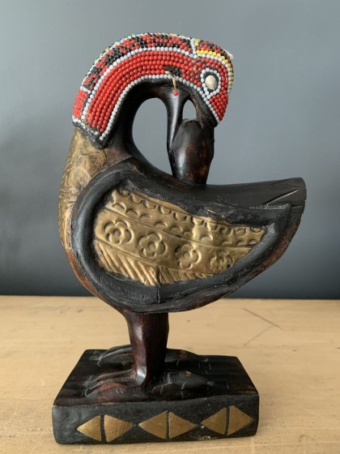
🜂 WHY BLACK MEN
Because we carried weight nobody else was asked to carry.
Used. Feared. Hated. Disposable when convenient. And somehow we still built. That leaves marks. It also leaves wisdom.
SANKOFA — LOOK BACK TO MOVE FORWARD.
Notes:
Because we carried weight nobody else was asked to carry. And somehow we still built. Sankofa: look back to move forward.

Slide 12
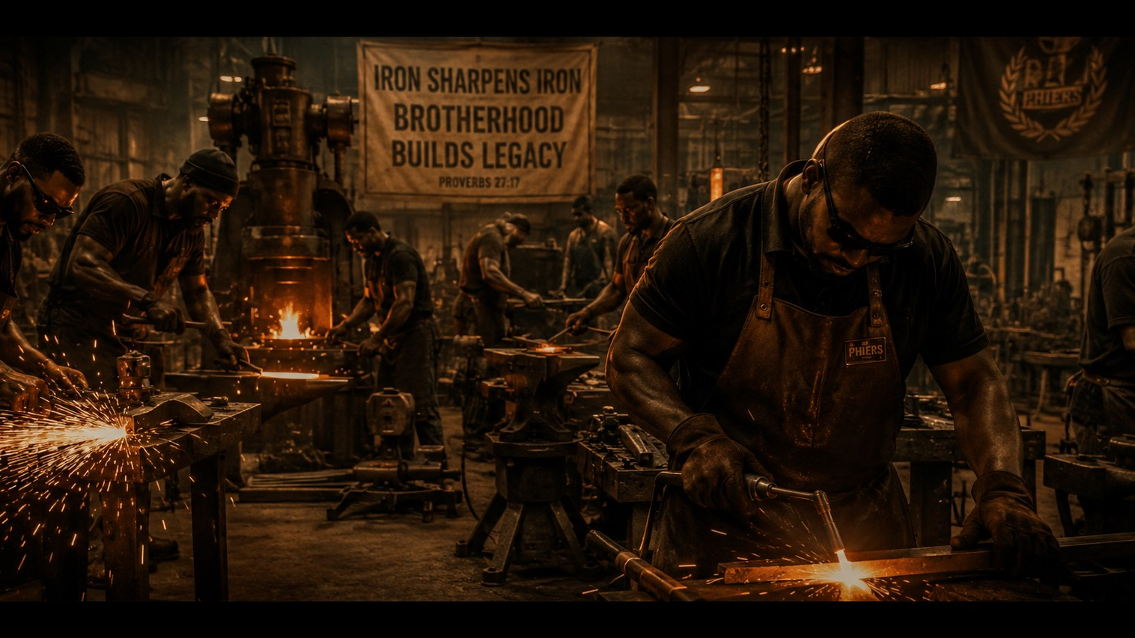
🜂 PRESSURE DIDN’T JUST HURT US
It sharpened us.
To think under strain.
To build without help.
To read danger early.
To protect what matters.
To improvise when things change.
To endure what should’ve ended us.
Notes:
Pressure did not just hurt us. It sharpened us. To think under strain, build without help, read danger early.

Slide 13
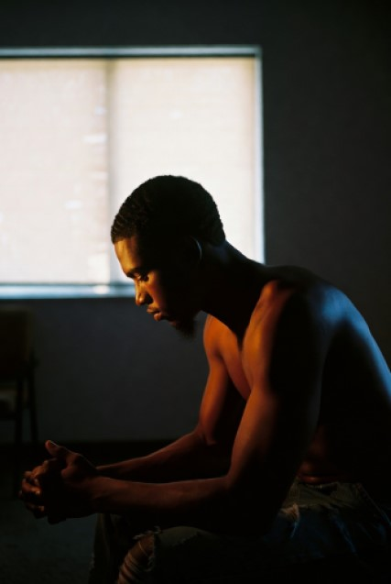
🜂 HEALING IS STRATEGIC
Before we build, we repair.
Broken men get played. Grounded men respond.
Disconnected men drift. Disciplined men coordinate.
Unhealed men react. Clear men carry weight.
That’s why healing matters. Not as self-help. As infrastructure — and infrastructure gets built.
Notes:
Before we build, we repair. Healing not as self-help, as infrastructure.

Slide 14
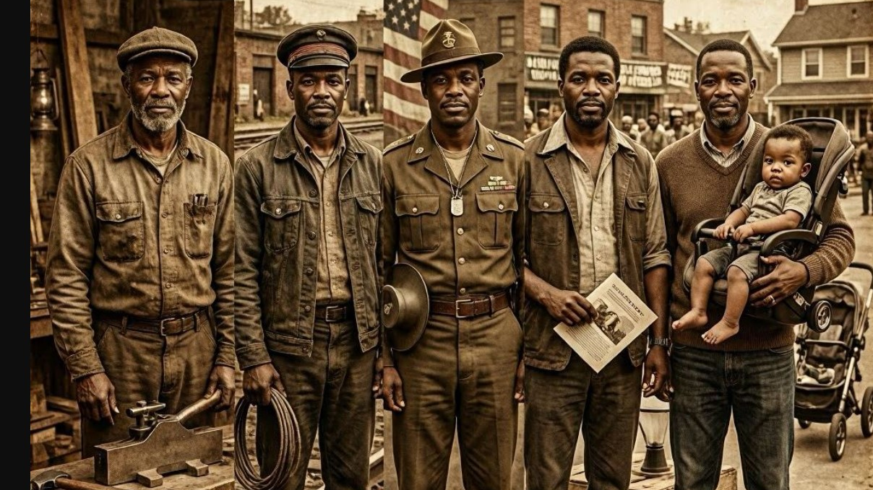
AFTER RECONSTRUCTION. AFTER JIM CROW. AFTER CONVICT LEASING. AFTER COINTELPRO.
We built again.
Every. Single. Time.
THAT’S NOT MYTH. THAT’S INHERITANCE.
Notes:
After Reconstruction, Jim Crow, convict leasing, COINTELPRO. We built again. Every single time. That is inheritance.

Slide 15
🜂 THE MOVEMENT · WHAT WE DO
Scattered men get ignored. Organized men change outcomes.
Fifteen hundred organized men can change outcomes that fifteen thousand scattered men cannot. Not men who agree on everything — men disciplined enough to build anyway.
Notes:
Scattered men get ignored. Organized men change outcomes. 1500 organized beats 15000 scattered.

Slide 16
🜂 WHAT WE BUILD
We’re not building a list of programs. We’re building leverage — and leverage makes everything else possible.
THE HOW COMES NEXT.
Notes:
We are not building a list of programs. We are building leverage, and leverage makes everything else possible. The how comes next.

Slide 17
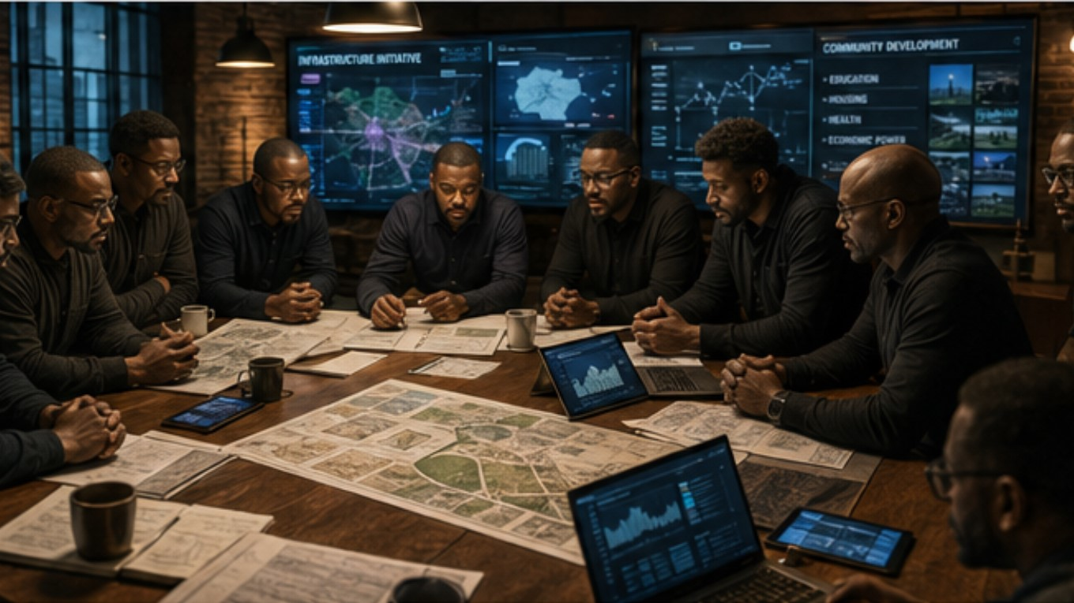
🜂 LEVERAGE · HOW WE BUILD
Organized people, by district, with real consequences.
THAT’S HOW CHANGE ACTUALLY HAPPENS.
Notes:
Organized people, by district, with real consequences. That is how change actually happens.

Slide 18
🜂 POWER HELD IN EVERY REP’S SEAT
Elected officials should know when fifteen hundred engaged men in their district are organized.
Too coordinated to ignore.
Too aligned to dismiss.
Notes:
Elected officials should know when 1500 engaged men in their district are paying attention. Too coordinated to ignore.

Slide 19
🜂 THREE DOORS — NO WRONG DOOR
01 / WHY
02 / WHAT
03 / HOW
The Prophecy
The Movement
Leverage
Why we’re here. The timeline, the inheritance, the weight made into wisdom.
What we do. Organized men, disciplined enough to change outcomes together.
How we build. By district, with real consequences. Power held in every seat.
Choose the one that speaks to you.
Notes:
Three doors. The Prophecy, the Movement, Leverage. Choose the one that speaks to you. No wrong door.

Slide 20
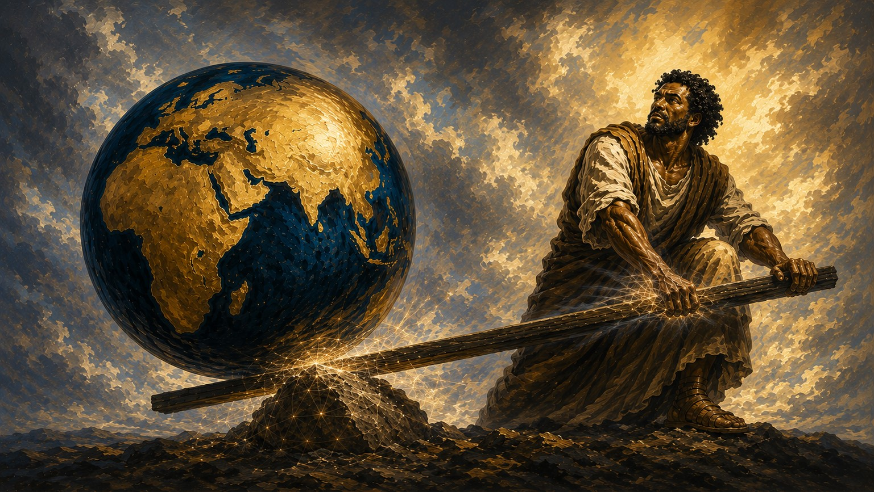
🜂 WHERE IT STARTS
It starts with the first fifteen hundred.
It doesn’t start with millions. Everything else grows from there.
Notes:
It does not start with millions. It starts with the first fifteen hundred. Everything else grows from there. Enter at phiers.org.

Slide 21
History doesn’t remember the movements that waited.
It remembers the ones that organized.
Notes:
History does not remember the movements that waited. It remembers the ones that organized.

Slide 22
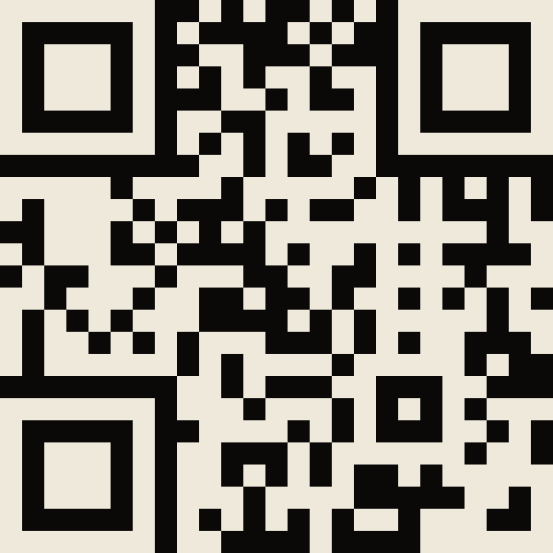
The prophecy was never the destination. It was the invitation.
Now we build.
CONTINUE THE JOURNEY
www.PHIERS.org/ Prophecy
A GIFT FROM FOUNDATIONAL BLACK AMERICAN MEN TO HUMANITY. BUILT BY BLACK MEN.
Notes:
The prophecy was never the destination. It was the invitation. Now we build. Enter at PHIERS.org.

