Slide 1


PHIERS.ORG THE LEVERAGE CONGRESS CAN’T IGNORE
Organized people, by district, with real consequences.
That’s how change actually happens.
Notes:
The entry screen. You are not powerless. PHIERS.org — the leverage Congress can't ignore.

Slide 2
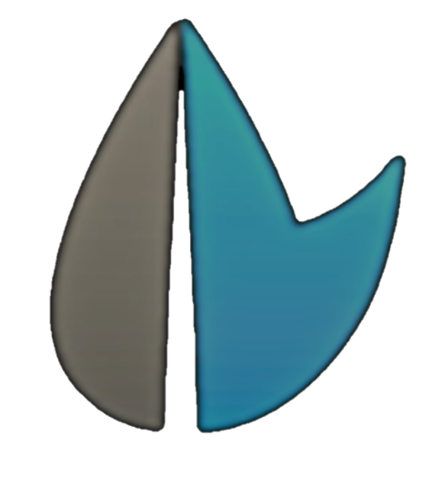
PAUSE.
Things are changing fast.
Before reacting, choose a response that actually works.
Notes:
Pause. Things are changing fast. Before reacting, choose a response that actually works.

Slide 3
THE PROBLEM
Congress works for you.
They just forgot.
Notes:
Congress works for you. They just forgot.

Slide 4
THE PROBLEM
Ignoring voters became politically safe.
Notes:
Ignoring voters became politically safe.

Slide 5
PHIERS changes that.
Notes:
PHIERS changes that.

Slide 6
A Few Minutes.
Enough to make Congress listen.
Notes:
A few minutes. Enough to make Congress listen.

Slide 7
Outrage doesn’t move Congress.
Organized people do.
Especially in their own district.
Notes:
Outrage doesn't move Congress. Organized people do — especially in their own district.

Slide 8
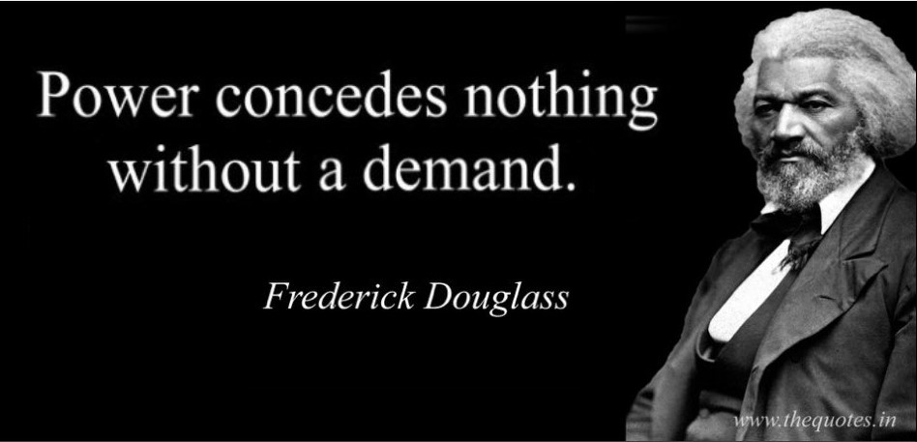
Notes:
Frederick Douglass: Power concedes nothing without a demand. It never did and it never will.

Slide 9
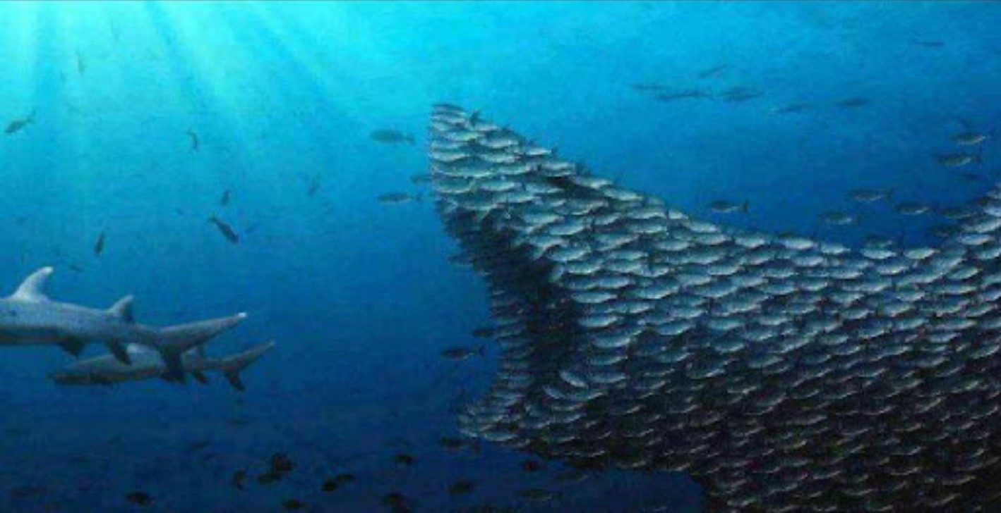
A demand that has TEETH.
Notes:
A demand that has teeth. Organized, the school of fish becomes the predator.

Slide 10
Power concedes nothing without a demand that has teeth.
We Are The Teeth.
Notes:
Power concedes nothing without a demand that has teeth. We are the teeth.

Slide 11
THE MECHANISM
How to make Congress listen.
500
signatures — your Representative shows up.
1,000
signatures — your Senator shows up.
1,500
— the district is organized.
→ Public town hall demanded.
Notes:
How to make Congress listen. 500 — your Rep shows up. 1,000 — your Senator shows up. 1,500 — the district is organized. A public town hall is demanded.

Slide 12
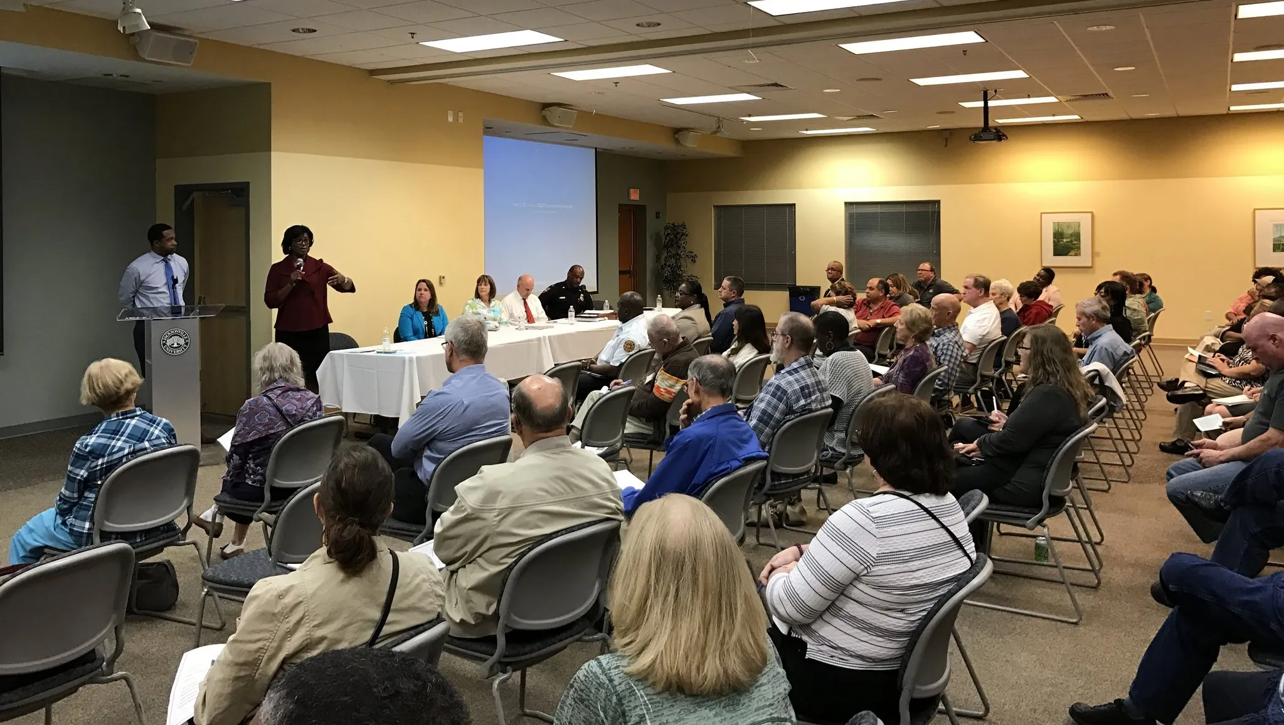
When 1,500 people organize, the district listens.
Notes:
When 1,500 people organize, the district listens.

Slide 13
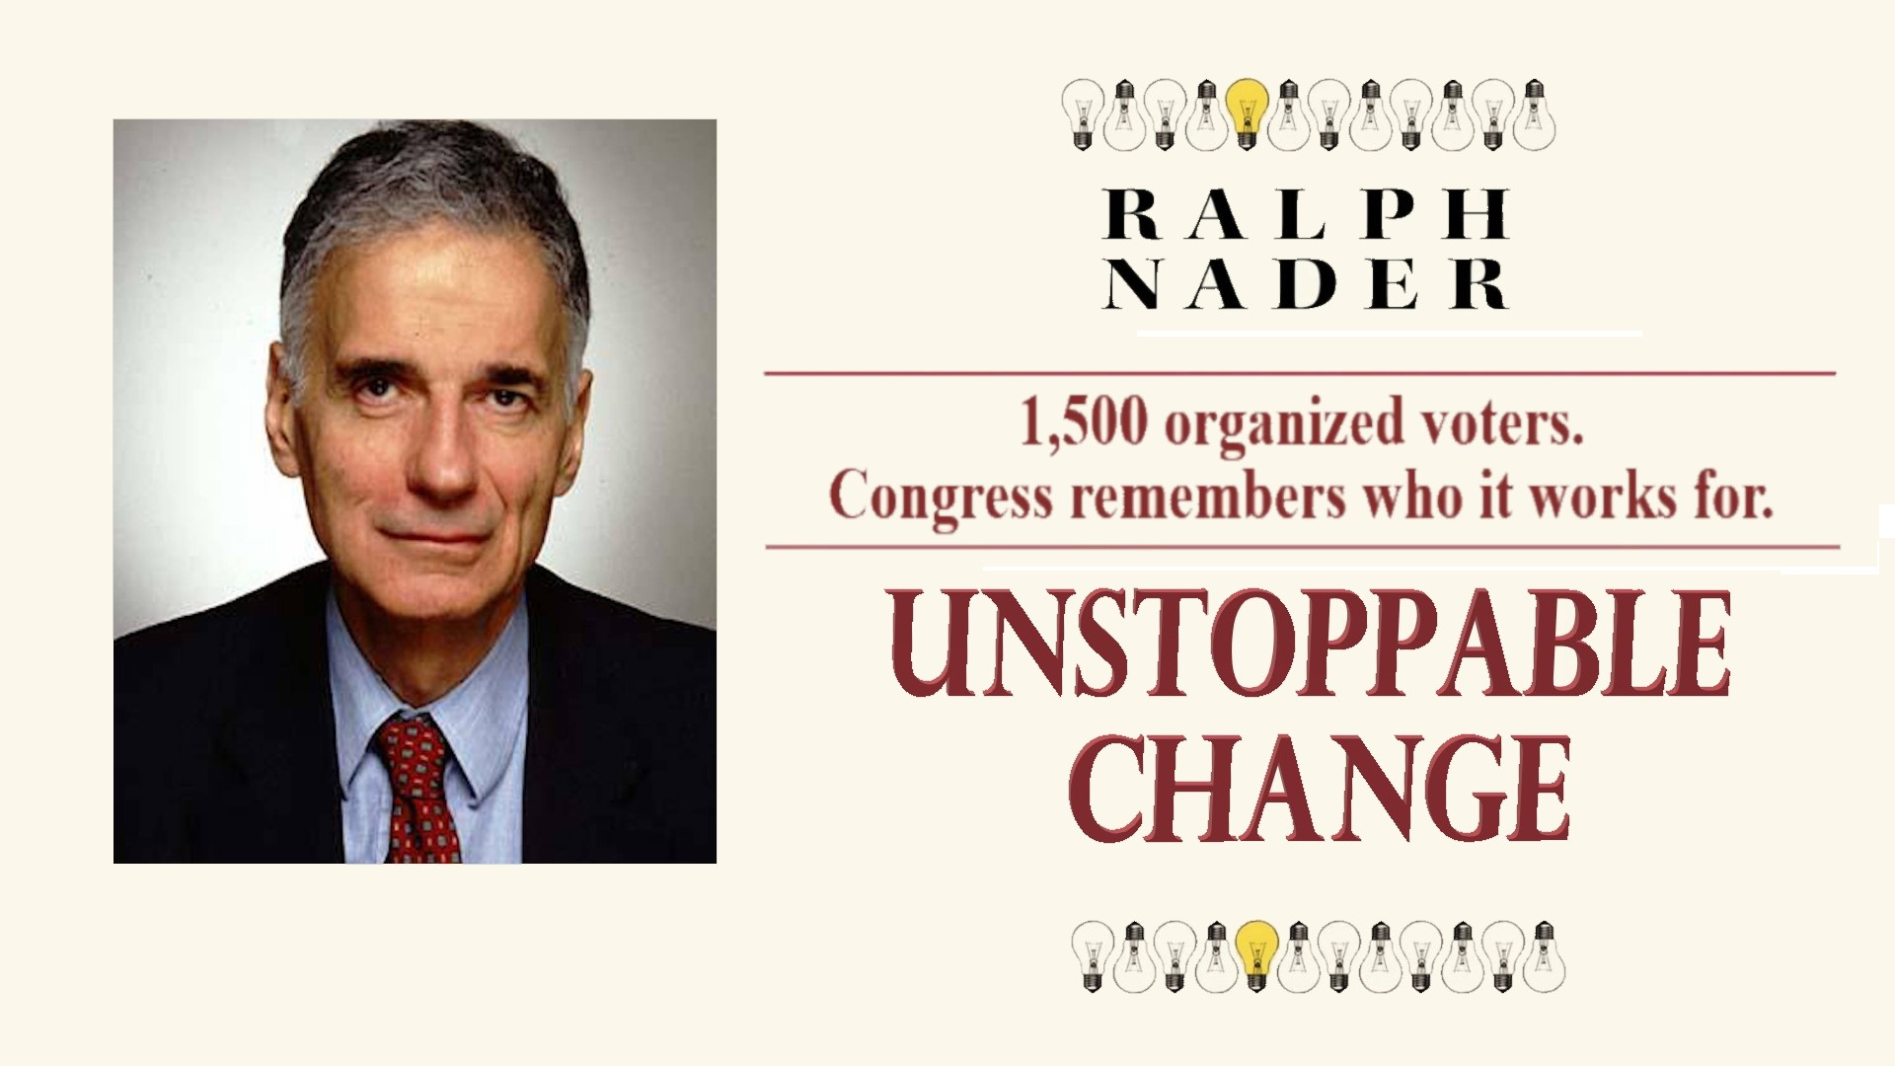
A PROVEN STRATEGY
“1,500 organized voters. Congress remembers who it works for.”
Drawing on Ralph Nader, “Breaking Through Power: It’s Easier Than We Think.” Source: nader.org
Notes:
A proven strategy. 1,500 organized voters and Congress remembers who it works for. Drawn from veteran civic organizer Ralph Nader.

Slide 14
If they refuse the meeting, they lose the seat.
Legally.
Before the next election.
No heat. No threats.
Just accountability.
Notes:
If they refuse the meeting, they lose the seat. Legally. Before the next election. No heat, no threats — just accountability.

Slide 15
TOOLS OF ACCOUNTABILITY
Recall.
Primary.
Investigate.
Expose.
If they refuse accountability, the public gets the truth.
Notes:
Tools of accountability: Recall. Primary. Investigate. Expose. If they refuse accountability, the public gets the truth.

Slide 16
P
H
I
E
R
S
POWER
HELD
IN
EVERY
REPS
SEAT
Power Held In Every Representative’s Seat (pronounced FIRES)
Notes:
PHIERS — Power Held In Every Representative's Seat. Pronounced FIRES.

Slide 17
One petition. Your district. On the record.
That’s how pressure starts. Name. Email. Zip code.
✍ MAKE THEM ANSWER
Notes:
One petition. Your district. On the record. That's how pressure starts. Name, email, zip code — make them answer.

Slide 18
What Makes Us Credible
Three independent validators. One public record. Zero hype.
Notes:
What makes us credible: three independent validators, one public record, zero hype.

Slide 19
INDEPENDENT VALIDATION
Pathos Communications
Voices of Accountability
DotCom Magazine
Global PR Firm · London Stock Exchange Listed
National Media · Cultural Leadership
Entrepreneur Spotlight · National Media
“This isn’t left or right. This is people trying to survive.”
“A serious, credible framework.”
“If you weren’t legit, we wouldn’t risk our name.”
Pathos · Feb 2026
Curry, Nader, Noah, Hunter · May 2026
DotCom Magazine · July 2022
Notes:
Independent validation. Pathos Communications, a London Stock Exchange listed PR firm. Voices of accountability in national media. DotCom Magazine's entrepreneur spotlight.

Slide 20
THE RECORD
22 years of documented public record.
2004
2007
2013
2019
2022
2026
NOW
Earliest documented PHIERS record
First video — the VA recruits Will after watching it
First full articulation of the PHIERS mission
MD Health Care Commission — school telehealth
DotCom Magazine Entrepreneur Spotlight
Pathos Communications — LSE listed
District organizing model — active
Notes:
The record: 22 years of documented public work — from the earliest PHIERS record in 2004 to the active district organizing model now.

Slide 21
WHY THE NUMBERS WORK
500
1,500
Creates leverage.
Creates the power to replace.
The tipping point where a district stops being ignorable — enough to force a meeting and put a representative on record.
Sustained pressure becomes real consequences: primary challenges, public exposure, and replacement if they don’t respond.
Notes:
Why 500 works. 500 creates leverage over your representative; 1,500 creates the power to replace them. They go hand in hand.

Slide 22
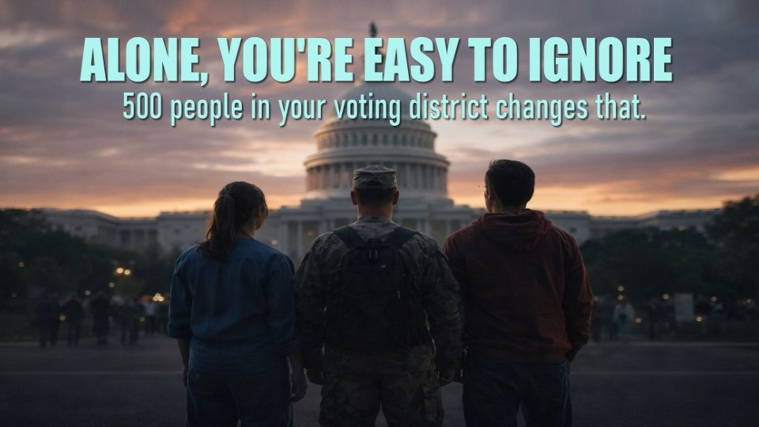
YOU’VE SEEN THE EVIDENCE
Alone, you’re easy to ignore.
Organized districts are not.
The problem isn’t awareness. Most Americans agree the problems are real. The problem is leverage.
Notes:
Alone, you're easy to ignore. Organized districts are not. The problem isn't awareness — it's leverage.

Slide 23
THE STAKES
$12K
77M+
$1.1–1.4T
committed per beneficiary, every year
people on Medicaid — ~150M with Medicare
in annual savings telehealth can redirect
The challenge isn’t whether solutions exist. It’s creating enough leverage to make Congress act.
Notes:
Medicaid commits roughly $12,000 per beneficiary across 77 million people. Telehealth can deliver most routine care for a fraction — redirecting 1.1 to 1.4 trillion dollars a year. The challenge isn't whether solutions exist; it's creating enough leverage to make Congress act.

Slide 24
WHAT HAPPENS NEXT
The Petition
The Survey
tells us who’s willing to stand up.
tells us what your district actually wants.
Not a petition. A constituency.
Notes:
The petition tells us who's willing to stand up. The survey tells us what your district actually wants. Together they create a measurable constituency. Not a petition — a constituency.

Slide 25








WHAT ORGANIZED DISTRICTS CAN BUILD
One system. Every priority.
HEALTHCARE
VETERANS
HOUSING
EDUCATION
PUBLIC SAFETY
JOBS
LOWER COSTS
GOVT. ACCOUNTABILITY
Different priorities. One accountability system.
PHIERS.ORG · THE LEVERAGE CONGRESS CAN’T IGNORE
Notes:
What organized districts can build: healthcare, veterans, housing, education, public safety, jobs, lower costs, government accountability. Different priorities, one accountability system.

Slide 26
YOUR CAUSE
Your cause. Our leverage.
✓
Healthcare
✓
Housing
STEP 01
District Organization
✓
Veterans
✓
Mental Health
✓
Working Families
✓
Education
→
STEP 02
Public Accountability
✓
Food Security
✓
Public Safety
✓
Transportation
STEP 03
Congress Responds
PHIERS doesn’t decide America’s priorities. Americans do.
Notes:
Your cause, our leverage. Healthcare, veterans, working families, food security, transportation, housing, mental health, education, public safety — district organization leads to public accountability leads to Congress responding. PHIERS doesn't decide America's priorities. Americans do.

Slide 27
Whatever brings you here…
Healthcare.
Veterans.
Housing.
Corruption.
Opportunity.
Justice.
Education.
You don’t have to agree on everything.
You only have to agree that Congress should answer to the people.
Notes:
Whatever brings you here — healthcare, veterans, housing, corruption, opportunity, justice, education. You don't have to agree on everything. You only have to agree that Congress should answer to the people.

Slide 28
The future is built district by district.
Different communities. Same leverage.
Notes:
The future is built district by district. Different communities. Same leverage.

Slide 29
America already has the solutions.
What we’ve been missing… is the leverage to make them happen.
Notes:
America already has the solutions. What we've been missing is the leverage to make them happen.

Slide 30
Be counted in your district.
✍ ADD YOUR NAME
📊 COMPLETE THE SURVEY
PHIERS.ORG · THE LEVERAGE CONGRESS CAN’T IGNORE
Notes:
Add your name and be counted in your district. Complete the district survey. PHIERS.org — the leverage Congress can't ignore.

