Slide 1
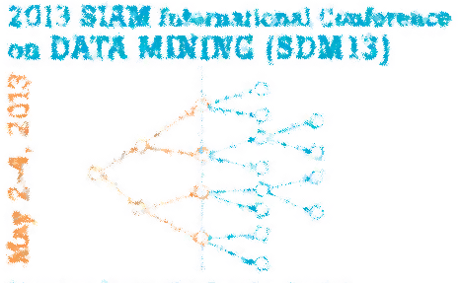

SMART: Semi-Supervised Music Emotion Recognition with Social Tagging
Bin Wu, Erheng Zhong, Derek Hao Hu, Andrew Horner, Qiang Yang
Hong Kong University of Science and Technology

Slide 2

Music & Emotion
Music is the shorthand of emotion. ~Leo Tolstoy
Music is the only means whereby we feel emotions in their universality. ~H.A. Overstreet
SMART: Semi-Supervised Music Emotion Recognition with Social Tagging

Slide 3

In CS…
SMART: Semi-Supervised Music Emotion Recognition with Social Tagging
Notes:
Unfortunately, the next question for computer scientists to ask is that how to turn these beautiful things, music and emotion, into digits. People may be familiar with music, because music is stored in daily devices as digital formats.

Slide 4
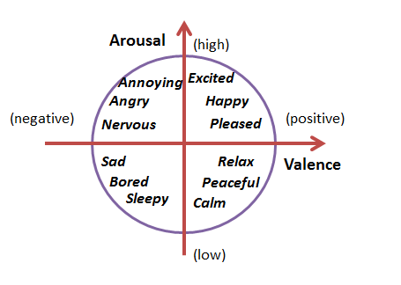
How to Represent Emotion
10
0
10
0
Thayer’s Valence-arousal model
SMART: Semi-Supervised Music Emotion Recognition with Social Tagging

Slide 5
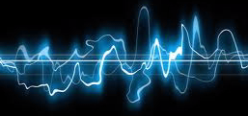
Music Emotion Recognition
[6.5,7.8]
SMART: Semi-Supervised Music Emotion Recognition with Social Tagging
Notes:
Input: audio waveform of music. Output: corresponding coordinates in the emotional plane.

Slide 6
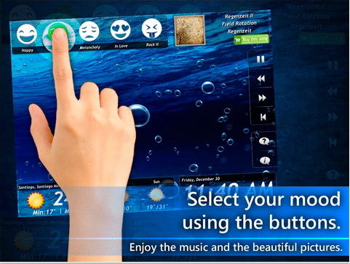
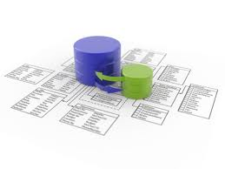


Application
Music Recommendation:
Emotionally Matched
Music
Emotion Extraction
(MoodPal)
MER
SMART: Semi-Supervised Music Emotion Recognition with Social Tagging

Slide 7
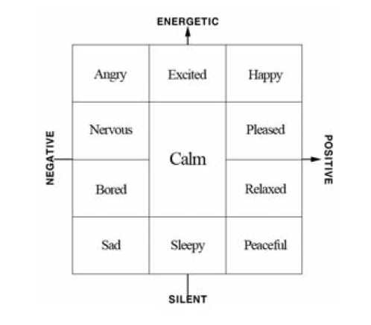
Related Work
Classification (e.g., [1])
Problem: Family gathering v.s. Carnival?
SMART: Semi-Supervised Music Emotion Recognition with Social Tagging
Notes:
Divide emotional plane into a number of categories. Problem: both events are happy, but desire different music.

Slide 8
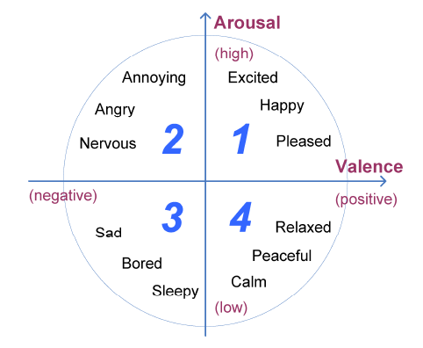
Related Work (cont’d)
Regression (e.g., [2])
Each emotion has a tuple of emotion value (v, a).
All are based on large amount of labeled data.
SMART: Semi-Supervised Music Emotion Recognition with Social Tagging

Slide 9
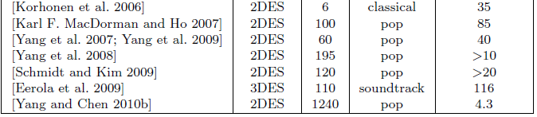
Problem
Available labeled data is scarce except for ‘Pop’ music [4], and music emotion is genre-specific [5].
Imagine: How a pop listener perceive emotions from different classical music?
SLEEPY
SMART: Semi-Supervised Music Emotion Recognition with Social Tagging

Slide 10
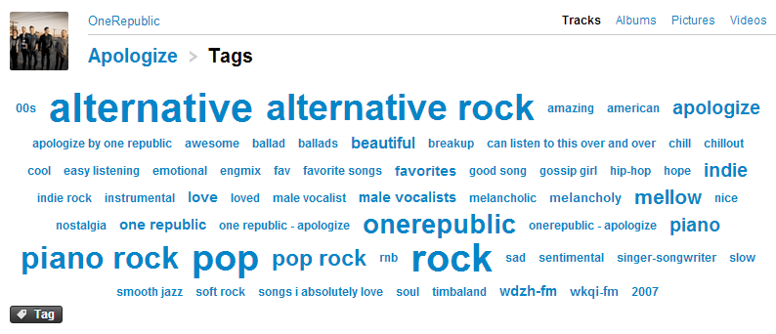

Idea
Make use of auxiliary data: unlabeled data and social tagging.
Incorporating social tags: BOW (e.g., [3])
SMART: Semi-Supervised Music Emotion Recognition with Social Tagging

Slide 11
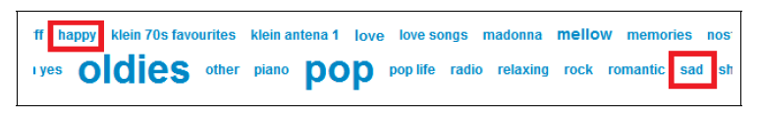
Problem (cont’d)
Social tagging is noisy.
Labeling by experts and casual users have different distributions [6].
Spammers and novices (How about you?).
Tag list of `Yesterday Once More' from Last.fm, where `Happy' and `Sad' were both tagged by users. `Sad’ by the experts.
Noisy-label
SMART: Semi-Supervised Music Emotion Recognition with Social Tagging

Slide 12
Learning problem
Predict unlabeled data’s labels with labeled (by experts), noisy-labeled (by online users), unlabeled data (contents).
SMART: Semi-Supervised Music Emotion Recognition with Social Tagging

Slide 13
Methods
Label propagation via
contents
Noisy-labeled
ρ
f_{out}
Labeled
1-ρ
Unlabeled
Tag Refinement
Trade-off parameter
SMART: Semi-Supervised Music Emotion Recognition with Social Tagging

Slide 14
Methods – Label Propagation
Noisy-labeled
Labeled
Label propagation via
Unlabeled data
Unlabeled
SMART: Semi-Supervised Music Emotion Recognition with Social Tagging

Slide 15
Methods – Label Propagation
Graph-based Semi-supervised Learning (GSSL): Label propagation
Vertices:
Songs, Tags:
Edges:
Song-song similarity, Song-tag correlation
Labeled
λ
1-λ
Unlabeled
…
…
Tags (Noisy-labeled)
SMART: Semi-Supervised Music Emotion Recognition with Social Tagging

Slide 16
Methods – Tag Refinement
Noisy-labeled
Tag Refinement
Labeled
SMART: Semi-Supervised Music Emotion Recognition with Social Tagging

Slide 17

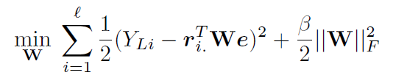


Methods – Tag Refinement
Learn a better song-tag correlation R (e is the emotional values of tags):
W can be obtained in closed form [8]. But W is too large to fit in memory:
low-rank approximate W as
Alternatively optimize
SMART: Semi-Supervised Music Emotion Recognition with Social Tagging

Slide 18
Experimental Setup
Data: 836 pop songs
Labels: Allmusic.com
Musical features: Million Song Dataset
Social tags: Last.fm
Musical Features
Timbre
Pitch
Loudness
Rhythm
Baseline: SVR with musical features and BOW of social tags (GSSL v.s. SVR)
Evaluation: Mean Square Error (MSE)
SMART: Semi-Supervised Music Emotion Recognition with Social Tagging

Slide 19
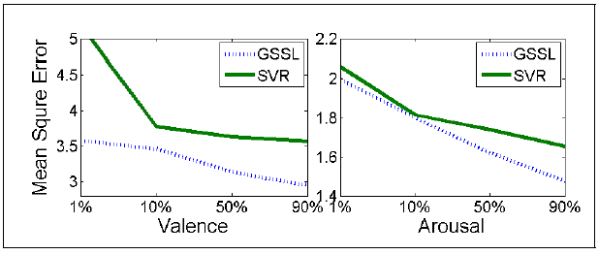
Experimental Results (cont’d)
MSE of both methods w.r.t. different number of training instances. The total number of instances is 836.
Our method trained with 10 instances EQUALS SVR with 750 instances
SMART: Semi-Supervised Music Emotion Recognition with Social Tagging

Slide 20
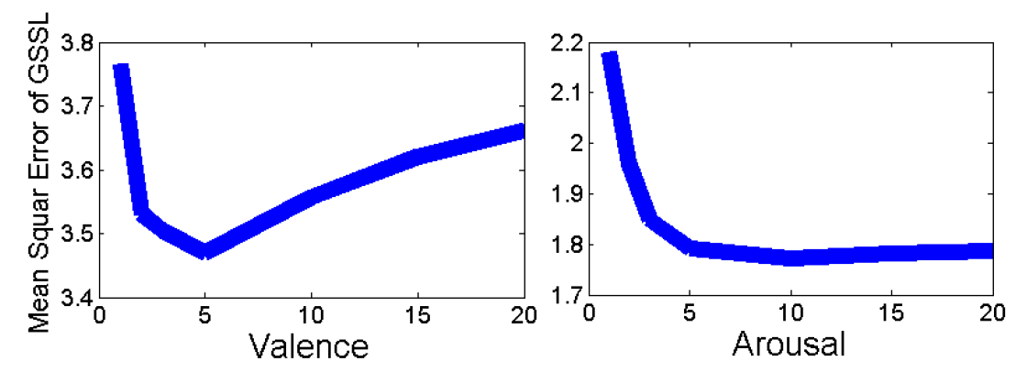
Experiments Results (cont’d)
MSE w.r.t. # nearest-neighbors for valence and arousal (trained by 10%).
Optimal K of Nearest-Neighbor is small
SMART: Semi-Supervised Music Emotion Recognition with Social Tagging

Slide 21
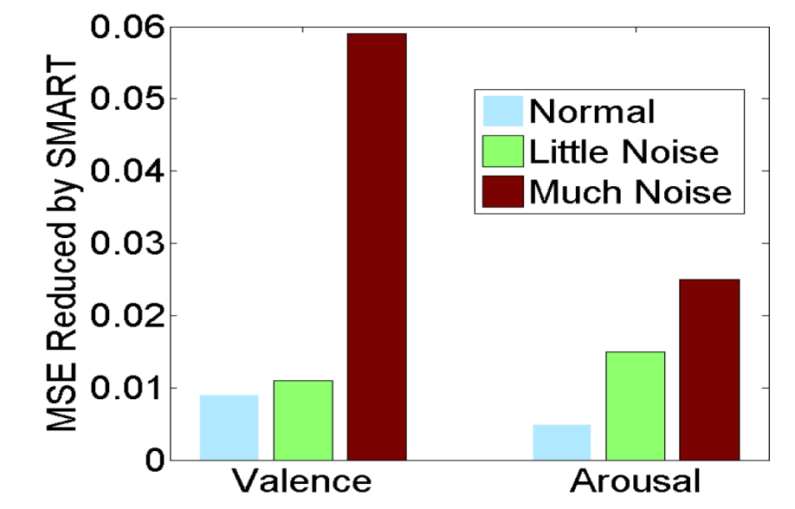
Experiments Results (cont’d)
Reduction in MSE by Tag Refinement under different noise modes (higher is better).
Normal
Little Noise: Remove the best 10% of tags for each song.
Much Noise: Boost the edge weight of the most deviated tag to 0.4 for each song.
SMART: Semi-Supervised Music Emotion Recognition with Social Tagging

Slide 22
Demo
Best predicted:
‘Bawitdaba’, Kid Rock: predicted as ‘aggressive’
Labeled as ‘aggressive’
Worst predicted:
‘$1000 Wedding’, Gram Parsons: predicted as ‘easy’
Labeled as ‘sad’
‘Sad’ is harder to perceive [4]
SMART: Semi-Supervised Music Emotion Recognition with Social Tagging

Slide 23
Summary
We propose to solve MER using unlabeled and noisy labeled data with a semi-supervised method.
Our method highly outperformed the baseline.
We propose a supervised method to refine the song-tag correlation.
Slight improvement, not as high as expected, though.
Possible future work:
User modeling (social network).
Knowledge transfer from one music genre to another.
Time-evolving music emotion recognition.
SMART: Semi-Supervised Music Emotion Recognition with Social Tagging

Slide 24
Thank you for listening!
SMART: Semi-Supervised Music Emotion Recognition with Social Tagging

Slide 25

SMART: Semi-Supervised Music Emotion Recognition with Social Tagging

Slide 26
Special Thanks to
Dr. Weike Pan
Dr. Nathan Liu
SMART: Semi-Supervised Music Emotion Recognition with Social Tagging

Slide 27
Reference
[1] L. Lu, D. Liu, and H. Zhang, “Automatic mood detection and tracking of music audio signals." IEEE TASLP, vol. 14, no. 1, pp. 5-18, 2006.
[2] Y.-H. Yang, Y.-C. Lin, Y.-F. Su, and H. H. Chen, “A regression approach to music emotion recognition.“ IEEE TASLP, vol. 16, no. 2, pp. 448-457, 2008.
[3] K. Bischo, C. S. Firan, R. Paiu, W. Nejdl, C. Laurier, and M. Sordo, Music mood and theme classification - a hybrid approach." in ISMIR, 2009, pp. 657-662.
[4] Y.-H. Yang and H. H. Chen, “Machine recognition of music emotion: A review," ACM TIST, vol. 3, pp. 1-10, 2012.
[5] T. Eerola, “Are the emotions expressed in music genre-specific? an audio-based evaluation of datasets spanning classical, film, pop and mixed genres," Journal of New Music Research, vol. 40, no. March 2012, pp. 37-41, 2011.
[6] C. Laurier, M. Sordo, J. Serr, and P. Herrera, “Music mood representations from social tags." in ISMIR, 2009, pp. 381-386.
[7] All Music Guide: http://www.allmusic.com.
[8] W. Pan, N. N. Liu, E. W. Xiang, and Q. Yang, “Transfer learning to predict missing ratings via heterogeneous user feedbacks." in IJCAI, 2011, pp. 2318-2323.
SMART: Semi-Supervised Music Emotion Recognition with Social Tagging

Slide 28









Problem Definition
Input:
A set of labeled songs:
A set of unlabeled songs:
A set of tags:
Similarity between songs:
Correlation between songs and tags:
Output:
Prediction of unlabeled songs:
SMART: Semi-Supervised Music Emotion Recognition with Social Tagging

Slide 29

Output
Linear combination of semi-supervised and supervised learning.
Semi-supervised: unlabeled and noisy-label data.
Supervised: refine song-tag correlation R based on labeled data.
Tradeoff parameter
SMART: Semi-Supervised Music Emotion Recognition with Social Tagging

Slide 30


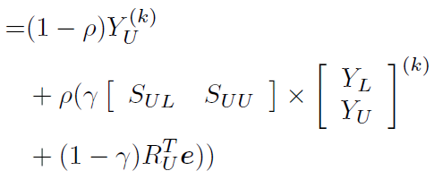


Methods – Semi-supervised
Graph-based Semi-supervised Learning: Label propagation
Vertices:
Songs:
Tags:
Edges:
Song-song similarity:
Song-tag correlation:
Tradeoff parameter
SMART: Semi-Supervised Music Emotion Recognition with Social Tagging

