Slide 1

CharAnalysis 2.0: June 2026 Update
SNI warning · Chronological uncertainty ensemble
GitHub “dev” branch:
NEWS https://github.com/phiguera/CharAnalysis/blob/dev/CharAnalysis_2_0_R/NEWS.md
Chronological Uncertainty Vignette: https://github.com/phiguera/CharAnalysis/blob/dev/CharAnalysis_2_0_R/vignettes/chronological_uncertainty_draft.md
Phil Higuera — 25 June, 2026
Notes:
Welcome. Two updates from the past month. Both expand what CharAnalysis tells users about the reliability of their results — first around signal quality (SNI), second around chronological precision and its effects on peak detection.

Slide 2
Today's updates
1
SNI warning
2
Chronological uncertainty
When SNI falls below 3.0, CharAnalysis now flags it explicitly in the console.
The vignette's recommended workflow was rewritten to position SNI evaluation as Step 2, before any fire-history interpretation.
New ensemble pipeline: runs CharAnalysis 1,000× across MCMC chronologies, propagating age uncertainty through all analytical steps.
Reports per-peak:
Detection frequency
Timing uncertainty (95% CI)
Ensemble-only candidate peaks.
Examples from CO, CH10, and SI17.
Notes:
Both updates are about uncertainty — about helping users understand where to trust the results and where to be cautious. The SNI advisory is in the released package; the chronological uncertainty tools are in development scripts on the dev branch.

Slide 3
1. SNI warning:
Before
SNI was computed and plotted (Fig 4), but no message appeared if it fell below the threshold of 3.0. Users could overlook low-SNI intervals.
After
CharAnalysis now emits a styled red advisory at the end of all console output when SNI < 3.0.
Local thresholds: reports % below threshold
Global threshold: reports the scalar SNI value
R Console
CAUTION
✖ 12.8% of samples have an SNI < 3.0, the minimum value recommended by Kelly et al. (2011) to identify records suitable for peak detection. Carefully consider whether and how to interpret portions of this record with SNI < 3.0.
ℹ Run ‘char_plot_sni(out)’ to visualize the SNI series and identify which portion(s) of the record fall below the threshold.
Notes:
The advisory uses the cli package — it appears after all other output so it stands out rather than being buried mid-run. It's placed in CharAnalysis() rather than inside char_thresh_local/global so it doesn't fire repeatedly during background sensitivity runs. CO shows 12.8% below threshold; CH10 and the other test datasets have higher SNI.

Slide 4
Vignette: SNI evaluation before interpretation
Background smoothing
1
Figs 1 & 3: check that C_{background} tracks low-frequency variation without absorbing peaks. Adjust smoothing window as needed.
Evaluate signal quality (SNI)
2
Fig 4: inspect SNI before any fire-history results. If SNI < 3 for substantial portions, peak detection in those intervals is not well justified.
Threshold diagnostics
3
Fig 2: examine fit of noise model to C_{peak} distribution. Most useful when Fig 4 suggests instability.
Analytical figures
4
Figs 6–9: zone comparisons, cumulative peaks, FRI distributions, fire history. Only after diagnostics are acceptable.
Notes:
The key change is making SNI a gate, not an afterthought. The vignette now says explicitly: if SNI is below 3.0 for substantial portions of the record, fire-history statistics from those intervals should not be interpreted without explicit acknowledgment of that limitation. Step 2 is highlighted because that's where users most commonly skip ahead.

Slide 5
2. Chronological uncertainty
CharAnalysis alone does not propagate uncertainty from an age-depth model into peak detection because it uses one age-depth model (e.g., median chronology).
Bayesian age-depth models (rbacon, MCAgeDepth) generate thousands of plausible chronologies via MCMC sampling. Each shifts sample ages and thus accumulation rates, CHAR, thresholds, and peak detection outcomes.
This tool integrates chronological uncertainty to address three questions:
How consistently is each peak identified?
What is the range of ages assigned to specific peaks?
Are there peaks common in the ensemble but absent from the main CharAnalysis run?
Most valuable for:
Identifying & timing individual peaks (e.g., for comparison to other events)
Records with meaningful age-model uncertainty
Less critical for:
Fire-regime statistics (mFRI, fire frequency), because timing shifts among peaks tend to covary.
Notes:
The key point here is that fire-regime statistics like mFRI are less sensitive to per-peak chronological uncertainty, because adjacent peaks share the same underlying age-depth model — errors tend to be correlated, and largely cancel when you subtract one peak age from another. The big payoff is for individual peak timing and detection consistency.

Slide 6
Ensemble workflow: four steps
1
2
3
4
Build age-depth model
Run the ensemble
Analyze ensemble results
Visualize
(external: rbacon / MCAgeDepth)
(char_run_ensemble.R)
(run_ensemble_analysis.R)
(plot_ensemble_figure.R)
Extract n = 1,000 chronologies from the MCMC output, preserving temporal covariance.
Any age-depth tool works; rbacon is the primary target.
CharAnalysis pipeline runs once per chronology.
Parallel processing: ~2 min for 1,000 iterations on a modern desktop (19 cores).
Use adaptive matching window for each reference peak.
Reports:
Detection frequency
95% CI on timing
Ensemble-only peaks (10% threshold).
Four-panel figure:
CHAR + benchmark
Detection frequency + peak types
SNI
Age-depth uncertainty ribbon.
Notes:
Step 1 is the only step outside CharAnalysis — users need rbacon or similar already run. Steps 2-4 are implemented as scripts in tests/ on the dev branch; packaging as exported functions with Roxygen docs is the next milestone. The 2-min runtime is on a 19-core machine; single-core is about 15-16 min.

Slide 7
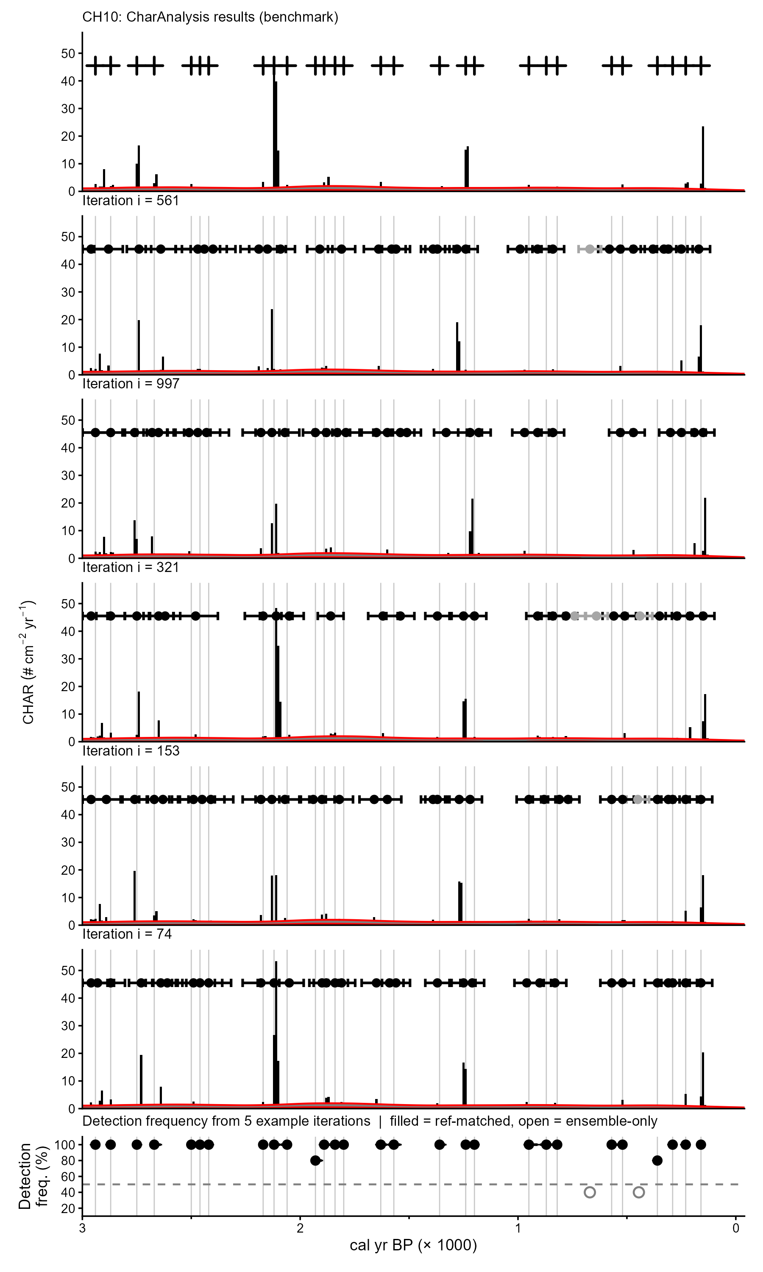
Chickaree Lake CharAnalysis (benchmark)
Adaptive matching window
For each benchmark peak k, the matching window defines how far an ensemble detection can lie and still be attributed to the same fire event:
window_{k} = max(mFRI_{z}/2, CI_{95,k}/2)
mFRI_{z} - mean FRI for the zone containing peak k
CI_{95,k} - 95% width of chronological uncertainty at peak k
mFRI_{z}/2: once a peak shifts > half the mean FRI, it is considered to be a different event
CI_{95,k}/2: expands window where chronology is poorly constrained. Ensemble detections of the same peak, shifted by an uncertain chronology, are still correctly attributed
In practice, CI_{95,k}/2 should define windows in most records; mFRI_{z}/2 is a min. bound in well-constrained records (e.g., CH10).
Iteration i,
with search windows
Matched peaks (black) Unmatched (white)
Notes:
The adaptive window is the key methodological decision. A fixed window would over-match in well-dated records and under-match in poorly dated ones. This formula scales the window to both chronological precision and ecological context (how close events typically are). The output table reports window_k for each peak, so users can see how it was applied.

Slide 8
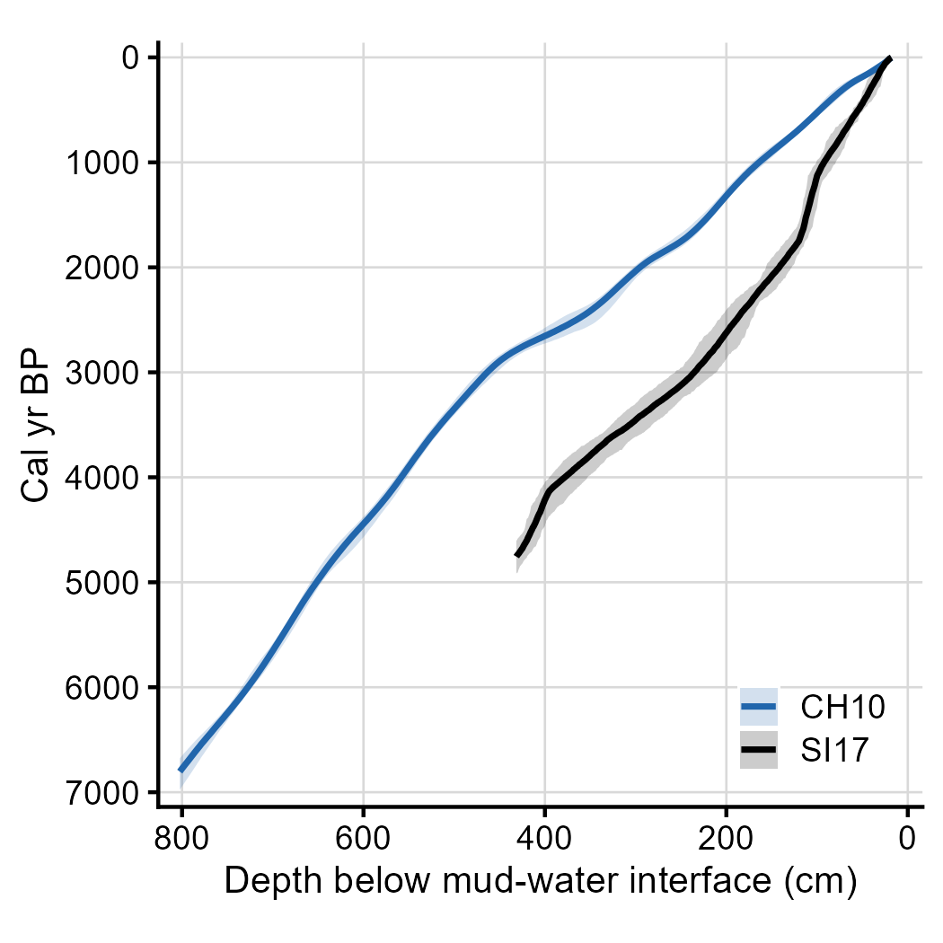
Site examples: CH10 and SI17
 | CH10 (Chickaree Lake, CO) | SI17 (Silver Lake, MT)
Chronological control | Unusually well-dated (25 ¹⁴C dates, ²¹⁰Pb) | Fewer dates (15 ¹⁴C, 3 tephra, 14 ²¹⁰Pb)
Age-depth model source | MCAgeDepth | Bacon
Benchmark peaks | 59 | 25
Mean FRI | 104 yr | 193 yr
Matching window (median ±) | ±72 yr | ±162 yr
Detection freq (median) | 99% | 99%
Timing SD (median) | 23 yr | 53 yr
Ensemble-only peaks | 9 (6 near-ref, 3 indep.) | 0 (coherence filter)
Median chronology ± 95% CI. CH10: narrow, uniform. SI17: wider.
Notes:
Both sites show 99% median detection frequency — peaks are robustly identified even with substantial chronological uncertainty. The key difference is timing precision: 23 yr SD for CH10 vs 53 yr for SI17, driven directly by age-model precision. The 9 ensemble-only peaks in CH10 are a real result of its narrow matching windows: secondary detections form coherent clusters. In SI17, wide windows absorb those detections as scatter — the null result is correct, not a failure.

Slide 9
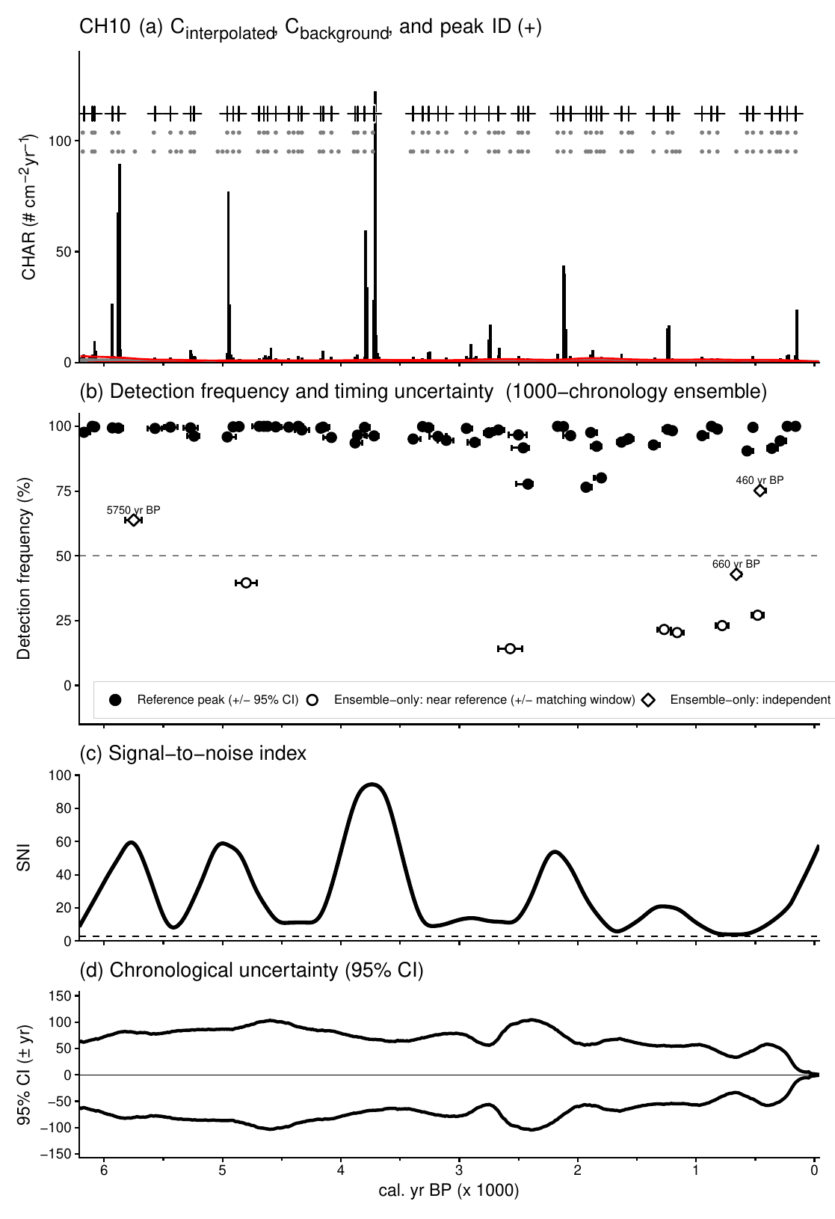
CH10 — ensemble results
Benchmark:
Detection frequency, with 95% timing CI:
Reference peaks (black circles)
Ensemble-only: near reference (white circles)
Ensemble-only: independent (white diamonds)
SNI:
Age-depth 95% CI:
Notes:
Panel (b) is the main diagnostic. Black bars = reference peaks; colored bars = ensemble-only. Horizontal bars show ±95% CI on peak timing. 56 of 59 reference peaks detected in ≥90% of 1,000 iterations. The 9 ensemble-only candidates are shown at bottom.

Slide 10
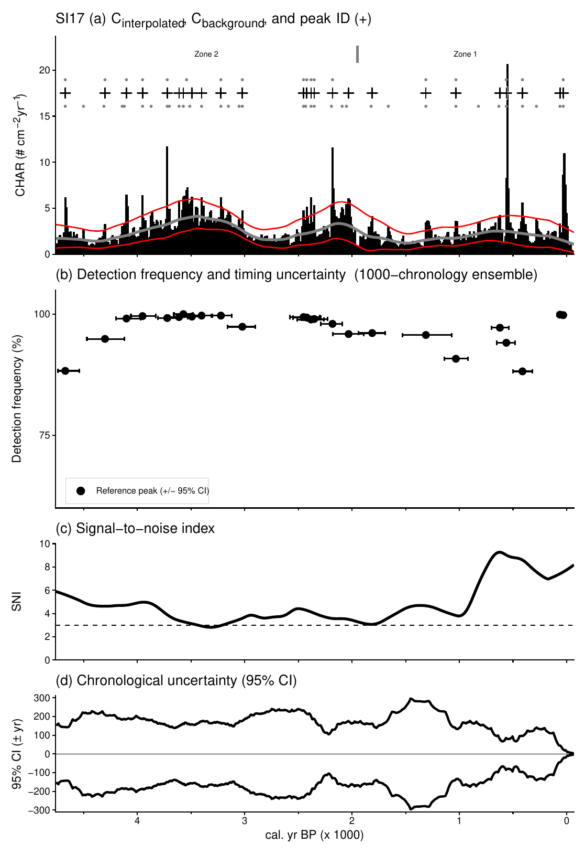
SI17 — ensemble results
Benchmark:
Detection frequency, with 95% timing CI:
Reference peaks (black circles)
Ensemble-only: near reference (NONE)
Ensemble-only: independent (NONE)
SNI:
Age-depth 95% CI:
Notes:
SI17 is the null case. Detection frequency is equally high — 24 of 25 peaks in ≥90% of iterations — but the timing CI ribbons are much wider. Wide matching windows mean secondary detections scatter rather than cluster, so they don't pass the coherence filter. This is the correct result for a less precisely dated record.

Slide 11
Status & next steps
Done
Up next
SNI < 3.0 advisory in console output and added as Step 2 in recommended workflow (vignette)
Figure reorganization: diagnostic (1–5) vs. analytical (6–9)
Background sensitivity function added to R, to match Matlab version
Chronological uncertainty working version
Package char_run_ensemble() as exported function with Roxygen docs
Add rbacon / rplum interface
Write chronological_uncertainty.Rmd vignette
Apply ensemble to additional sites beyond CH10 and SI17
Package dev work as v2.0.4 (SNI advisory, figure reorganization, age-uncertainty function)
Notes:
The SNI advisory and figure reorganization are in the dev branch now. The ensemble scripts are functional but not yet packaged — they're in tests/ as source scripts. Main work ahead is packaging the ensemble function, adding the rbacon interface, and writing the formal vignette.

