Slide 1
The German Educational System and Math Curriculum
Heinz SCHUMANN
University of Education Weingarten, Germany
    Prof. Dr. habil. Heinz Schumann Fakultät III, Mathematik/Informatik,
    University of Education (PH) Weingarten, D- 88250 Weingarten/Germany
    Email: schumann@ph-weingarten.de Homepage: www.mathe-schumann.de
Hong Kong Mathematics Education Conference, Chinese University of Hong Kong, 25th June 2002

Slide 2
Contents
1. Introduction
1.1 Preliminaries
1.2 Educational System of the German Federal Republic (Survey)
2. German Math Education after PISA
2.1. Conference of the Ministers of Education (KMK)
2.2. Association of the German Employers‘ Federation
2.3. Society for Didactics of Mathematics (GDM)
2.4. German Organisation for the Support of Math and Science Teaching and Learning (MNU)
2.5. Federation-States-Commission (BLK)
2.6. Suggestions for educating mathematic teachers for secondary schools in Germany (DMV/GDM)
3. Theoretical Debate about Common Mathematical Education Common Education and Mathematics (Heymann 1996)
4. New Teaching Curricula
5. Final Comment: Problems of the German Educational System
6. Contact

Slide 3
Institution of German Economy
Foundation for German Science
Federal association of German Employers’ Federation
Mathematics, Science and Technology: Knowledge for the world of tomorrow Memorandum of the mathematical, scientific and technological education
Association of the German Employers‘ Federations – Bundesvereinigung der Deutschen Arbeiterverbäbnde

Slide 4
Henry Ford:
“The competitive capability of a country doesn’t start in a manufacture or in a research-lab.
It starts in the classroom.“
Association of the German Employers‘ Federations – Bundesvereinigung der Deutschen Arbeiterverbäbnde

Slide 5
Mathematics, science and technology are bases of knowledge-society
Decreasing job orientated interest and missing intelligibly for mathematical-scientific and technological connections lead to deficits in economical parts, which makes out in long term the competitive capability of Germany.
Association of the German Employers‘ Federations – Bundesvereinigung der Deutschen Arbeiterverbäbnde

Slide 6
Sorrows about young talents on the labour market.
The importance of mathematical-scientific or technological apprenticeships in Germany is relatively low.
Of 100,000 employees between 25 and 34 years in 1995 just 813 had an appropriate university final examination.
It is much more in other countries.
Same with job-training just 300 of 100,000 Germans have a scientific-technological education. (1997)
Life-long-learning is just possible it the understanding between technological connections and the interest in technology and science was placed in school.
Association of the German Employers‘ Federations – Bundesvereinigung der Deutschen Arbeiterverbäbnde

Slide 7
German Students have troubles in mathematics and science
Therefore it is alarming that mathematics and science just have a secondary importance at school, although they are central knowledge domains.
German students have lacks in knowledge about mathematical and scientific subjects as we can see in international competitions of achievements at school.
Instead of 114 mathematic studies for 13 years olds in Germany, there are 148 in Hungary, 136 in France and 165 in Austria.
Association of the German Employers‘ Federations – Bundesvereinigung der Deutschen Arbeiterverbäbnde

Slide 8
In Eastern-European Countries there are nearly twice as much studies in science than in Germany.
Decreasing standard of knowledge in mathematics and science of students who leave school after the 13th class.
Mathematics, electronics, chemistry, physics, informatics or other technological courses of studies are regarded as difficult studies, because the school offers too less foundation for a secure knowledge of mathematics and science.
Therefore many students abandon their studies.
The technological efficiency of a country depends on the mathematical-scientific know-how of the coming generation.

Slide 9
Pro reform of the mathematical-scientific education
Mathematics, science and technology need to get a higher respect in community.
Learning in school needs to get a higher respect.
Mathematical studies and science studies need to get highbrow practise in new connections and systematical repetition.
Association of the German Employers‘ Federations – Bundesvereinigung der Deutschen Arbeiterverbäbnde

Slide 10
The level of achievements at school of individual subjects and age groups need to be defined unequivocally and its solution needs to be evaluated continuously.
The broad use of mathematical, scientific and technological way of thinking in daily life and job needs to be imparted at school.
Teacher education and further education need to orientate on new demands
Further generations can’t be prepared with the equipment from yesterday for the job-world of tomorrow.
Association of the German Employers‘ Federations – Bundesvereinigung der Deutschen Arbeiterverbäbnde

Slide 11
Generally valid is:
An education system, which isn’t flexible enough to react to the changing general conditions and demands of job-world and can’t provide students with the needed intellectual and practical tools, which are needed in vocational training or at university, wastes valuable resources.
Association of the German Employers‘ Federations – Bundesvereinigung der Deutschen Arbeiterverbäbnde

Slide 12
General problems of German educational system
Crisis of sense, also crisis of education in western affluent societies (materialism thinking)
Low meaning and acceptance of mathematical and scientific education
Students, parents and community have a low meaning and respect of the teacher. Teacher: “lazy bags” (Chancellor Schröder)
Insufficient discipline and readiness to learn of students (disregard of secondary virtues: diligence, punctuality, order,…; consume of unsuitable TV-programs, videos and computer games – “joy society”)
Some Problems of the German Educational System

Slide 13
Thirst of individualisation – missing thinking about society
Education expects too much of school (decay of family structure and its relevance for society)
Too big classes – too old teachers
Decay of language culture
Insufficient integration of foreign students (German language competence?)
Imminent loss of professional heart of studies (competence of subject of equal importance with communicative competence, social competence, personal competence, competence of methods, competence of acting)
Some Problems of the German Educational System

Slide 14
Missing concept of integration of information-technology (new medias) in studies (missing money for notebook technology)
Missing concepts of further education of teachers (lifelong learning?)
Schools become autonomous – administration of flaw?
Dramatic decrease of students in approx. 5 years
Too much school by introducing all-day schools
Youth crime and drug consumption
Some Problems of the German Educational System

Slide 15
Playground of educational ideas (Teacher is a coach,…)
Missing of a central instance of the state for education – a disadvantage of the federal system
Doubtful efficiency of education system in international comparison (results of TIMSS and PISA)
…
Some Problems of the German Educational System

Slide 16
Federation-States-Commission for education planning and research promotions
Program:
“Increasing the efficiency of mathematical-scientific studies”
Federation-States-Comission – Bund-Länder-Kommission, BLK

Slide 17
Modules of the program:
Lesson referential steps
A lesson referential focal point of the planned program should work with the integration of systematical revision of tasks, which are long ago, into acquisition, consolidation and practice of new tasks.
Scientific work
Experiments, observations, comparisms and systematic handling play a big role in scientific studies
Learning from mistakes
Rehabilitation of the mistake as a possibility of learning should be a focal lesson point of the promotion program
Federation-States-Comission – Bund-Länder-Kommission, BLK

Slide 18
Securing of basic knowledge – understanding learning on different levels
The model-program should try to optimise mathematical-scientific studies in a way that a relatively broad spectrum of students of a class of all schooling-forms are addressed cognitive and motivational.
Further development of a task culture in mathematical-scientific studies
To get to a bigger methodical variety, task types should be developed and tested as a focal point of the program, which allows several procedures and different ways of solving.
Varied tasks in varying context offer a stimulus and meaning to the practising student and help consolidate knowledge.
Federation-States-Comission – Bund-Länder-Kommission, BLK

Slide 19
Getting to know the growth of competence: cumulative learning
It is worth learning if you can see what you know afterwards.
Condition for getting to know the growth of competence is a coherent and cumulative partitioning of the learning subject. Mathematical and scientific studies gain coherence by vertical connections, which are made between former, actual and even future learning contents.
Federation-States-Comission – Bund-Länder-Kommission, BLK

Slide 20
Getting to know subject borders: subject spread and subject connecting working
In spite of its content special-quality, the subjects biology, chemistry, mathematics and physics have many things in common. Horizontal connection between contents, questions and procedure of mathematical-scientific studies can be used for working with complex problems and getting to see the reciprocal relationships of scientific studies.
Federation-States-Comission – Bund-Länder-Kommission, BLK

Slide 21
Promotion of boys and girls
Above all studies mathematics, physics and chemistry (but not biology) polarize between girls and boys. Girls are much less interested in these subjects and its contents than boys. Possibilities should be worked out to orientate the studies on the interests of girls to raise their interest and their learning success.
Federation-States-Comission – Bund-Länder-Kommission, BLK

Slide 22
Developing of tasks for cooperation of students
Cooperative working forms make students to bring thoughts into spoken words, to argumentate, to see other perspectives and go along with discrepant points of views and judgements. Cooperation creates a base for the feeling that one belongs to a society and being a participant of a group, that is working on special content problems.
Raising responsibility for ones own learning
Learning self-regulated and self-responsibility and using good strategies should be developed in school.
Federation-States-Comission – Bund-Länder-Kommission, BLK

Slide 23
Inspecting: registration and feedback of growth of competence
Parents and students tend to attach more importance to the formal exam result than to the content of gained learning.
Examination tasks which are used in mathematical-scientific studies have to be checked about validity.
Securing of quality within school and developing of school-spread standards
Professional handling encloses checking done work critical. For developing securing of quality, which is wanted in this model, school intern criteria for work and surveys are a concrete basis.
Federation-States-Comission – Bund-Länder-Kommission, BLK

Slide 24
Measures for increasing the visibility, acceptance and esteem of mathematic-scientific lesson within and outside school
  The mathematic-scientific lesson should be visualised with its most interesting intentions and best results in school. This is the first step of rewarding effort.
  The opportunity of getting involved with mathematics and science should be spread over studies
  The actual mathematic-scientific occurrence should be taken into school systematically.
  All measures should be taken into a long-term development perspective for mathematic-scientific part of school culture. There is no need of concrete visions, which enables long-term planning and is rewarded in perseverance.
Federation-States-Comission – Bund-Länder-Kommission, BLK

Slide 25
Supporting development measures
For optimising studies there is need to be able to get examples for specific tasks.
In the curricula the problem of horizontal and vertical connection needs special didactical effort.
Federation-States-Comission – Bund-Länder-Kommission, BLK

Slide 26
Recommendation for creating curricula for mathematics
German Association for promoting mathematical and scientific studies (MNU-1998)
German Organization for the Support of Math and Science Teaching and Learning –
Deutscher Verein zur Förderung des mathematischen und naturwisschnschaftliche Unterrichts, MNU

Slide 27
Mathematics in educational context
General public mainly reduces mathematics to arithmetic and algebra.
For seeing the general education function of mathematic studies both fundaments of mathematics in school need to get suitable validity:
On one hand mathematical acting comes from wanting to compare, count, calculate, draw, measure, describe forms,… of our surrounding qualitatively and quantitatively.
German Organization for the Support of Math and Science Teaching and Learning –
Deutscher Verein zur Förderung des mathematischen und naturwisschnschaftliche Unterrichts, MNU

Slide 28
On the other hand mathematical acting goes hand in hand with wanting to see connections, structures and abstractions, generalization, compactness and beauty of representations, etc.
With this background mathematics has been creating cultural achievements for millenniums.
Modern job-world requires a self-determined development of new contents.
The form of studies needs to assist self learning.
Mathematic studies need to cover the whole range from securing basis knowledge to developing problem-solving-capability.
German Organization for the Support of Math and Science Teaching and Learning –
Deutscher Verein zur Förderung des mathematischen und naturwisschnschaftliche Unterrichts, MNU

Slide 29
Education and further education for teachers
There needs to be a deepened specialized knowledge-study for mathematic teacher, which is completed by didactical offers.
The study should be orientated stronger on the job description and should have sufficient reference to the practice.
Regular further education has to be a part of every teaching activity, which should be credited to the studies.
German Organization for the Support of Math and Science Teaching and Learning –
Deutscher Verein zur Förderung des mathematischen und naturwisschnschaftliche Unterrichts, MNU

Slide 30
Designing the curricula for mathematic studies
studies should combine
“reception of knowledge” and
“constructing knowledge”
German Organization for the Support of Math and Science Teaching and Learning –
Deutscher Verein zur Förderung des mathematischen und naturwisschnschaftliche Unterrichts, MNU

Slide 31
“Mathematics as a product” “Mathematics as a process”
imparting and application of a calculation
acquire calculation and its insights
passing on knowledge and connections
build knowledge and discover connections
strive for completeness
wanting openness
from structure to usage
from problem to structure
working in the given model
modeling reality
isolated problems with unequivocal solution
linked problems with many solutions
give terms, prove theorems formally
develop terms, find theorems and reason them
convergent, solution-orientated lesson management
open, process-orientated lesson management
mistakes as a sign of lacking product-domination
mistakes as reason for constructive correction

Slide 32
Nowadays aspects of the left side have much more importance in mathematic studies than discovering and understanding of central ideas and aspects of the right side.
Emphasize shifting to the direction: “Mathematics as process”
New lesson culture make students capable of “learning how to learn” and linking contents of different subjects
Developing self-confidence and critical faculties , team-working, using tools intelligently (such as computer, pocket calculator with graphics,… ),…
German Organization for the Support of Math and Science Teaching and Learning –
Deutscher Verein zur Förderung des mathematischen und naturwisschnschaftliche Unterrichts, MNU

Slide 33
Rich software needs to emphasize explorative and operative working, problem solving, model creating and interpretation.
In this connection verbal describing of problem-solving processes and critical assessment of found solutions needs to get more importance.
German Organization for the Support of Math and Science Teaching and Learning –
Deutscher Verein zur Förderung des mathematischen und naturwisschnschaftliche Unterrichts, MNU

Slide 34
Mathematic basis knowledge, solid knowledge of arithmetic, algebra, geometry and stochastic, and in upper school analysis remain indispensable.
Curricula should be in a way that maximum 2/3 of available teaching time has binding contents and 1/3 is free for deepening contents with individual didactic-methodic focus.
German Organization for the Support of Math and Science Teaching and Learning –
Deutscher Verein zur Förderung des mathematischen und naturwisschnschaftliche Unterrichts, MNU

Slide 35
Grammar school (Gymnasium) base subjects need to have an own profile in contrast to performance/ advanced subjects.
On one hand it needs to be more interesting for students and
On the other hand it needs to teach base-mathematical terms, thinking and working.
In performance/advanced subjects there needs to be a deepened science preparatory understanding, both aspects “mathematics with inner mathematics reasoning- and exact standards” and “mathematics for describing the world” needs to be linked for being effective.
German Organization for the Support of Math and Science Teaching and Learning –
Deutscher Verein zur Förderung des mathematischen und naturwisschnschaftliche Unterrichts, MNU

Slide 36
Curricula needs to demand an appropriate usage or graphic pocket calculators and computer for studies in all grades.
It should be aimed that those tools are available for every student at home.
In creating curricula a bigger interlocking of lesson aims, contents and forms should be transparent.
German Organization for the Support of Math and Science Teaching and Learning –
Deutscher Verein zur Förderung des mathematischen und naturwisschnschaftliche Unterrichts, MNU

Slide 37
Securing and improving the quality of mathematic studies is necessary.
No improving of subjects is visible by just using standardized procedures as exams and securing of quality-standards.
A lowering of number of students at classes and lowering of duty-hours of teachers is needed.
German Organization for the Support of Math and Science Teaching and Learning –
Deutscher Verein zur Förderung des mathematischen und naturwisschnschaftliche Unterrichts, MNU

Slide 38
Creating teaching material with specialized and didactic persons and of course mathematic teacher.
Extension of an organized, federal spread platform for getting materials.
Discussion groups for actual questions concerning mathematic studies.
An appropriate platform on the German education server .
German Organization for the Support of Math and Science Teaching and Learning –
Deutscher Verein zur Förderung des mathematischen und naturwisschnschaftliche Unterrichts, MNU

Slide 39
Schoolbooks have a big influence on creating daily studies.
They need to fulfill the demands of schools and authorities and authors and publishing houses are included in the dynamic process.
School extern measures for securing quality. Education needs to be proved and measured on its own aims for efficiency.
German Organization for the Support of Math and Science Teaching and Learning –
Deutscher Verein zur Förderung des mathematischen und naturwisschnschaftliche Unterrichts, MNU

Slide 40
More difficult is to design “mathematical bases competences” independent of learning groups and fix an accepted catalogue of demands.
Aim of “mathematical basis education” and its normative effect in the beginning of an open solution process of discussion.
Trade and industry should have active interest in cooperating with education.
German Organization for the Support of Math and Science Teaching and Learning –
Deutscher Verein zur Förderung des mathematischen und naturwisschnschaftliche Unterrichts, MNU

Slide 41
The result of empiric examinations – such as TIMSS and PISA- do not give essential knowledge about success and situation of mathematic studies.
They can just show deficits and give ideas for useful and needed improvements.
In no way should the result of such examinations be practicing “test-tasks” as a focus in studies.
German Organization for the Support of Math and Science Teaching and Learning –
Deutscher Verein zur Förderung des mathematischen und naturwisschnschaftliche Unterrichts, MNU

Slide 42
The results of PISA
Society of didactics of mathematic
Dec 2001
Society for didactics of Mathematics – Gesellschaft für Didaktik der Mathematik, GDM

Slide 43
The “deficits of PISA” are a politic and social problem
Demanded is a bunch of measures, which support a problem-orientated, student-meeting and future-able mathematic lesson.
In the following problem-fields is work needed urgently
Society for didactics of Mathematics – Gesellschaft für Didaktik der Mathematik, GDM

Slide 44
1. Change of lesson culture
Good studies are a reciprocal game between teacher-managed and student-orientated lesson. Between instruction (teacher’s side) and construction (student’s side).
Connected with that a change in culture of tasks, which stress the mathematic penetration and modeling of problems.
Society for didactics of Mathematics – Gesellschaft für Didaktik der Mathematik, GDM

Slide 45
2. Development of interest
Interest is the base of every kind of learning
It is not important to process as many contents as possible in mathematic studies, but to process several problems with enough depth.
Society for didactics of Mathematics – Gesellschaft für Didaktik der Mathematik, GDM

Slide 46
3. Educating teacher
Teacher should bring students to be creative, able of teamwork and cooperation.
Future teacher need to learn those capabilities.
Society for didactics of Mathematics – Gesellschaft für Didaktik der Mathematik, GDM

Slide 47
4. New technologies
Working with technologies is nearly almost an individualized lesson, where working with partners and team work plays a big role.
Using new technology relieves of schematic calculations and gives time and room for creative thinking and alternative solutions.
Using new technology does not just give the solution of school-problems but using a computer can become a catalyst for a new lesson culture.
The consequence of PISA cannot be to throw all present approaches over board.
It rather shows us to keep useful contents but become open and learnable for new things.
Society for didactics of Mathematics – Gesellschaft für Didaktik der Mathematik, GDM

Slide 48
Tasks of general-educating schools
Concept of general education in mathematical studies
Heymann (1996): General education and mathematics, Basel: Beltz
Heymann

Slide 49
Preparing for life
Founding of cultural coherence
Orientation on the world
Directions for critical usage of owns intellect
Unfolding of readiness for taking over
responsibility
Practicing of communication and
cooperation
Strengthening of the “student-I“
Heymann

Slide 50
Preparing for life
Getting to know scales
Modeling of pertinent problems
Interpretation of statistic data and statements
Intelligent usage of technical tools
Heymann

Slide 51
Founding of cultural coherence
Imparting the idea of
Number
Measuring
Functional connections
Spatial structuring
Algorithm
Mathematical modeling
Heymann

Slide 52
Orientation on the world
Manifold experiences
How mathematics can help us to understand non-mathematical phenomena better
Heymann

Slide 53
Directions for critical usage of owns intellect
Put the intellect constructing and analyzing into action for understanding mathematics -
and for using it as reinforcement of daily-life-thinking
Heymann

Slide 54
Unfolding of readiness for taking over responsibility
Practicing of communication and cooperation
Strengthening of the “student-I“
Culture of studies, which gives room for
Subjective ways of sight
Alternative interpretation
Exchange of ideas
Detours
Playing dealing with mathematics
Self-responible dooing
Heymann

Slide 55
Suggestions for educating mathematic teachers for secondary schools in Germany
DMV/GDM-memorandum to education of teacher
Feb 2001
“Theses for educating teacher of mathematics“
Suggestions for educating mathematic teachers for secondary schools in Germany – DMV/GDM- Denkschrift zur Lehrerausbildung

Slide 56
The education bases as well on professional as on didactical research and thus can just be done at universities.
Professional and didactic teaching offers need to be coordinated and can be partly parallelized.
A separation of professional education from traditional mathematical course of studies in the basic study seems to be not realizable because of capacity reasons and not advisable because of content reasons.
Suggestions for educating mathematic teachers for secondary schools in Germany – DMV/GDM- Denkschrift zur Lehrerausbildung

Slide 57
The urge of students, who want to become a teacher, to get a compact knowledge of special parts needs to be fulfilled in a special completed survey arrangement of one semester in their main study.
The imparting of mathematical use in the study of teacher becomes an essential meaning.
The including of new medias in the education of teacher is an important task, which has to be fulfilled in the mathematic department
Obligatory and professional coaching of school practice studies is an essential part of educating teacher.
Suggestions for educating mathematic teachers for secondary schools in Germany – DMV/GDM- Denkschrift zur Lehrerausbildung

Slide 58
The academic homework is an integrated part of the education and has to be about a professional or a didactic topic of the subject.
For working against an uncoupling of school mathematic studies from developing a special field, DMV and GDM demand a continuative, self-responsible cooperation of subjects in developing curricula in school parts in all federal states.
Suggestions for educating mathematic teachers for secondary schools in Germany – DMV/GDM- Denkschrift zur Lehrerausbildung

Slide 59
Learning in school needs to be more orientated on application
Press information
KMK 4. Dec 2001
Practical realization of discoveries of PISA has highest priority
Results of the OECD-study PISA show central acting fields
Conference of the Ministers of Education - Kultusministerkonferenz

Slide 60
All results for 15-years old in German are plainly under OECD-average in all examinated parts of competence (reading-competence, mathematic-competence, science-competence)
In Germany the spread of performance is broader than in most OECD-states, actually in part of reading-competence the biggest.
Conference of the Ministers of Education - Kultusministerkonferenz

Slide 61
The part of those, which just achieved the lowest, elementary level of competence or lower, is biggest in Germany, bigger than in many other OECD-states
This mainly concerns reading-competence.
Here Germany is on the fifth latest place
In higher performance-parts the average performance of German students is almost the same as in other states
However no standing out achievements in supporting great feats could be proved.
Conference of the Ministers of Education - Kultusministerkonferenz

Slide 62
The international comparism shows that securing a mainly high level of performance and a decrease of difference of performance with appropriate support of all performance groups can be a combined aim.
Deficits are shown in all examined parts, especially in tasks, where a qualitative understanding of the subject is wanted and where there is no backing up by reproducing routine-knowledge.
Conference of the Ministers of Education - Kultusministerkonferenz

Slide 63
The orientation on working is neglected.
The connection of social background and acquisition of competence is in all of the three examined parts statistic very narrow in Germany
Especially in the part of reading-competence in comparism to other OECD-states
There is a high overlapping of performance distribution between the different schools
The distribution of 15-years olds to different grades is unusual broad in Germany
Causes for that is the intensively used practice of postponing the starting of school in primary school and repeating classes.
Conference of the Ministers of Education - Kultusministerkonferenz

Slide 64
Young people from families with migration background – especially such families, that have another daily language than German – are plainly under the average of the level of competence, that 15-years olds achieve.
Supporting students of families with comparable immigration-groups is in other states partly better than in Germany.
The low performance results of young people from migration-families show as well in an under proportional part-taking of educational ways which lead to a higher education.
Conference of the Ministers of Education - Kultusministerkonferenz

Slide 65
Boys achieve poorer performances in reading than girls
This difference is bigger than the lead of boys in mathematic
Computer are used much more seldom in German schools than in all other industrial nations.
German youngsters have a big interest in computers but in comparison much less experience
Their experience concentrates, much more than in other states, on computer games.
Conference of the Ministers of Education - Kultusministerkonferenz

Slide 66
Central fields of acting
Conference of the Ministers of Education - Kultusministerkonferenz

Slide 67
Supporting learning-poor students
Strengthened requests for supporting students of lower performance-level, especially through development of new concepts for learning in extended elementary school and supporting schools.
Conference of the Ministers of Education - Kultusministerkonferenz

Slide 68
Securing of quality
Improvement of lesson-related development of quality and its securing of all levels of school system as continuative process.
Formulation of highbrow but realistic and obligatory aims of learning, especially in central parts of competence and its securing of slightest standards.
Conference of the Ministers of Education - Kultusministerkonferenz

Slide 69
Reorganization of “weak readers”
Diagnosis of developing reading competence as perquisite for successful school learning in all subjects.
Conference of the Ministers of Education - Kultusministerkonferenz

Slide 70
Rule for school days
Optimal usage of learning time, especially
  time for putting a child in school,
  repeating classes,
  supporting of specially gifted students.
Conference of the Ministers of Education - Kultusministerkonferenz

Slide 71
Usage of learning time
In preschool and in primary school
Conference of the Ministers of Education - Kultusministerkonferenz

Slide 72
Personal and organization development
Improvement of professionalism of being a teacher
Primary education needs to be near practice.
Obligation for further education
Specific offers for improving studies
Conference of the Ministers of Education - Kultusministerkonferenz

Slide 73
Creating a “new learning culture”
determine the esteem of learning and responsibility for education new.
Investigation into teaching-learning-research and into professional-didactic research
Supporting the potential of parent’s homes
Conference of the Ministers of Education - Kultusministerkonferenz

Slide 74
New Teaching Curriculums
An example:
Mathematical syllabus for grades 11-13 Gymnasium (North Rhine Westfalia) created according to the conception of Heymann for general education in math:
http://www.du.nw.schule.de/gesmitte/infos/apogost/lp/mathe/lpmframe.htm
New Teaching Curriculums

Slide 75
Contact
    Prof. Dr. habil. Heinz Schumann Fakultät III, Mathematik/Informatik,
    University of Education (PH) Weingarten, D- 88250 Weingarten/Germany
    Email: schumann@ph-weingarten.de Homepage: www.mathe-schumann.de
Contact

Slide 76
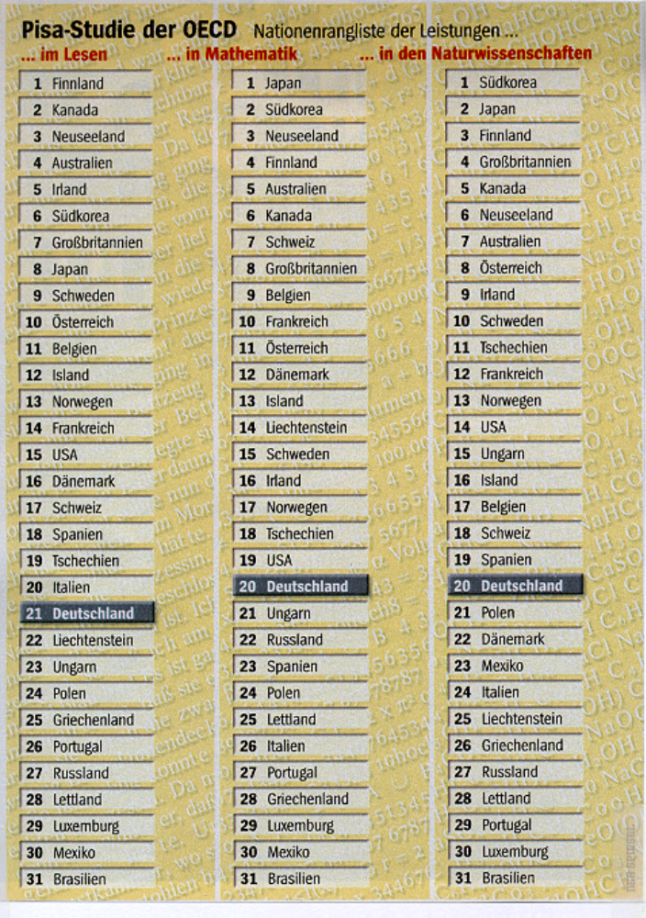
Issues of PISA
PISA placement
Reading Math Science
Issues of PISA and TIMSS

Slide 77
THE EDUCATIONAL SYSTEM
Governance and Decision Making
Each of the sixteen Laender have sole jurisdiction over it‘s educational policy.
Their authority includes regulation of curriculum and time schedules, professional requirements, school buildings and equipment, and teacher education/recruitment.

Slide 78
The Laender coordinate their educational policy through the Standing Conference of Laender Ministers of Education (KMK). Resolutions of the Conference of Ministers of Education are only recommendations.
The federal Ministry of Education and Science has a concurrent right to legislate on general principles for the university system.

Slide 79
The intended curriculum in mathematics and the sciences, as for all subjects, is defined at the state level according to school type and grade. All syllabi include the philosophy and rationale for the teaching of the subject, as well as a description of the content to be taught.
Authors and publishers develop schoolbooks and media based an the required state curricula.
Schoolbooks in Germany are an accurate reflection of the intended curriculum.

Slide 80
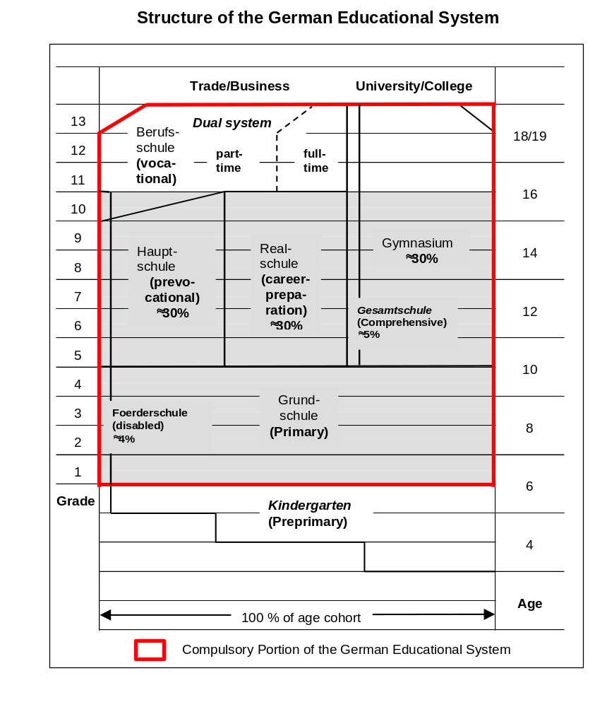

Slide 81
    Hauptschule provides a basis for subsequent vocational training
    Realschule equips young people for subsequent careers in positions located between the purely theoretical and the purely practical
    Gymnasium equips students for intellectual activity and prepares them for higher/academic education
Only about 6 percent of school-age children attend private schools.

Slide 82
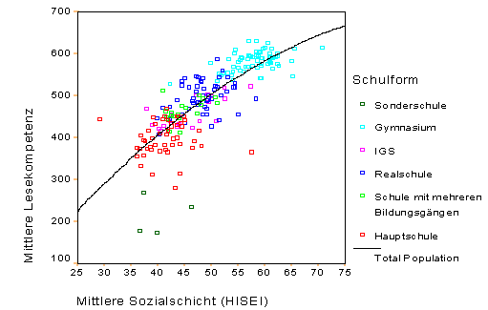
Correlation between social state of parents and reading competency
according kind of school

Slide 83
Secondary level Il, for students aged 16 to 19, offers a three-year course qualifying students to enter university by a system of basic and specialized courses combined with compulsory and optional ones.
Secondary level II also encompasses full-time and part-time vocational education. The German dual system of vocational education involves cooperative apprenticeships at two learning sites, the school and the workplace.

Slide 84
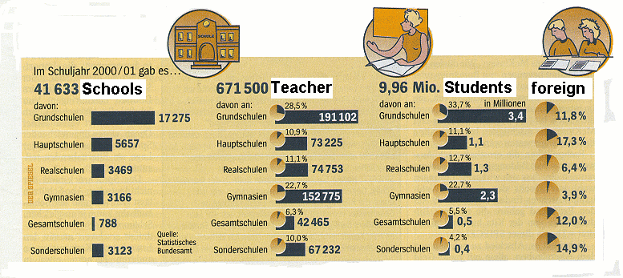
Some statistical informations

Slide 85
The average class size is about 30 students
The age profile of teachers shows a massive overrepresentation of older teachers due to both an unfavorable age pyramid caused by the Second World War and the hiring practices of the 1970s.
The ratio of male to female teachers shifted in favor of female teachers, from 42 to 62 percent.

Slide 86
The School Year
The school year includes about 38 weeks of instructional time, or between 190 and 220 days, depending on a five-day school week.
The School Day In Grades 1 to 4 the school day begins at about 8:00 a.m. and finishes at 1:15 p.m.

Slide 87
Funding the System
Personnel costs are paid by the states (Teachers are paid like civil servants).
Nonpersonnel costs (such as computers and schoolbooks) are paid by the county.
Parents do not pay for schoolbooks and learning materials.

Slide 88
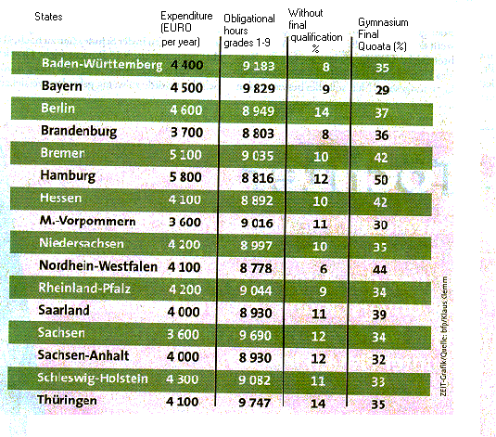
Different states: different input - different output

Slide 89
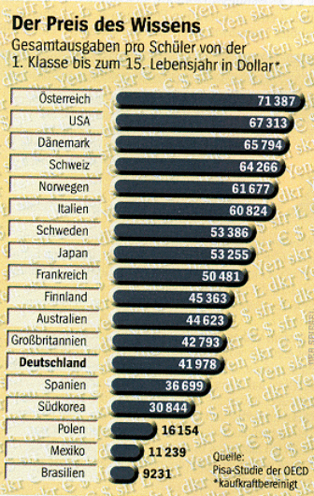
PISA comparison:
Education Investment for one student from grade 1 to 9 in US $

Slide 90
Enrollment in Mathematics
In all of the 16 Laender in Germany, mathematics is part of the core curriculum for Grades 1 to 10.

Slide 91
At Primary Schools about 20 percent of instructional time is devoted to mathematics
At Hauptschule, Realschule, and Gymnasium (grades 5 to 10) about 13 percent of instructional time is devoted to mathematics
At secondary level II (Grades 11 to 13) only about 9 percent are obligatorily devoted to mathematics

Slide 92
At Gymnasium (grades 11 to 13) students have to attend compulsory basic courses (Grundkurse) in math. They also can select mathematics as a special course (Leistungskurs) with a higher standard.

Slide 93
Teacher Education/Certification
Most teachers are trained at universities and institutes of higher education. Admission to training depends on possession of the Abitur.
Two training phases can be distinguished:

Slide 94
Phase I: Academic studies for a period of about 4 years, during which preservice teachers get a scientific education with respect to 2 subjects. They receive less educational and didactic information. Phase II finishes with scientific examinations.
Phase II: The introduction to school practice, usually taking 18 months. This phase comprises practical involvement in schools and complementary training at seminars. Phase II is completed with educational, didactical and practical examinations.

Slide 95
Teacher education for Primary schools Hauptschule and Realschule is completely integrated into universities (without Land Baden-Wuerttemberg).
In all Laender there is opportunity for teachers to take part to in-Service education.
The greatest number of further education courses for teachers are offered by the state institutes for continuing and further education

Slide 96
Goals for the Mathematics Curriculum
The Curriculum for mathematics in Germany is laid down in syllabi for each state and for each of the different types of schools. These syllabi advise teachers on aims, content, teaching approaches and methods of assessment.

Slide 97
In general, the Syllabi state that the general aims of mathematics education are to:
    Provide fundamental knowledge and skills in important areas of mathematics;
    Provide security in the techniques, algorithms, and concepts which are necessary for mastering everyday life in society;
    Develop the ability to state facts mathematically and to interpret the contents of mathematical formulae; it should make possible the solving of non-mathematical or environmental phenomenon through mathematics;

Slide 98
    Teach pupils to think critically and to question;
    Give examples of mathematics as a cultural creation in its historical development and in its importance in the development of civilization;
    Provide terms, methods, and ways of thinking that are useful in other subjects.

Slide 99
At the primary level, pocket calculators and Computers have played nearly no role up to the present. The overwhelming majority of primary school teachers reject the use of calculators and Computers in the classroom. In secondary schools, pocket calculators have been smoothly integrated, beginning in Grade 7. Computers are not a common tool, nor are they a subject of teaching. They are used as tools for calculations or simulations in secondary level II, as the subject of teaching in the newly defined "basic information technology education" in Grades 7 and 8 resp. 9 and 10

Slide 100
Mathematics research (e.g. fractals) has not influenced mathematics teaching.
Research in the psychology of mathematics education/didactics of mathematics has not really entered syllabi, schoolbooks or classroom practice.

Slide 101
Current Issues in the Mathematics Curriculum
(Pre PISA situation)
Trends in the changes to the intended curriculum are new goals for mathe-matics teaching are to:
    present mathematics both as a theoretical study and as a tool for solving problems of application

Slide 102
    Provide experience with fundamental mathematical ideas such as the idea of generalization, the need for proofs, structural aspects, algorithms, the idea of infinity, and deterministic versus stochastic thinking
    Use inductive and deductive reasoning, methods for proving, axiomatics, normalization, generalization and specification, and heuristic work
    Provide variation in argumentation and representation levels in all fields and aspects of mathematics teaching
    Teach historical aspects of mathematics

Slide 103
Mathematics Schoolbooks
Schoolbooks are used as a collection of tasks and exercises.
In Hauptschulen, Realschulen and Comprehensive schools schoolbooks lack theoretical consideration and presentation of proofs.
At all levels, schoolbooks do not include enough projects, real applications, or information about mathematics in working life.

Slide 104
Pedagogy and Didactics
The move from content-oriented towards more pedagogy-oriented didactic thinking fosters the development of innovative material, especially in primary mathematics.
Some main tendencies in mathematics pedagogy in Germany are:

Slide 105
Careful analysis of topics with respect to their pedagogical significance. Applied mathematics is used as a way of illuminating real world structures that are created in part by mathematics. Consequently, applied mathematics is taught as a method for stimulating creative behavior.

Slide 106
Detailed investigations of the principle of application; in particular, investigation of the prerequisites for genuinely carrying out applications by constructing mathematical models.

Slide 107
Developing and testing projects that are easy to understand and are oriented to subject matter, often with an emphasis an regional matters. These projects serve as unities of meaning where the principle of application can be experienced, for example "packaging milk," "railway traffic between cities", or the "jumbo jet."

Slide 108
Preliminary experience, which cannot be explained by means of concepts, with fundamental ideas of stochastic chance experiments; expressing observations in everyday language, statistical investigations of the students' everyday world using methods of clear representation; suitable and interesting distributions, statistical correlation of two variables.
These tendencies are expressed in some syllabi, but are still far from classroom reality.

