Slide 1
Introduction to Python for data scientists
workshop, 20.08.2019

Slide 2
Introduction to Python for data scientists
Final exercise:
Dataset: International Energy Statistics
Global energy trade & production 1990-2014
The Energy Statistics Database contains comprehensive energy statistics on the production, trade, conversion and final consumption of primary and secondary; conventional and non-conventional; and new and renewable sources of energy.
https://www.kaggle.com/unitednations/international-energy-statistics/
http://data.un.org/Explorer.aspx

Slide 3
Introduction to Python for data scientists
Final exercise:
Explore the dataset:
  How many countries are represented? (243)
  Which years are represented? (1990-2014)
  What are the most common (least common) categories?
  Which kinds of bio-fuel-based commodity transactions are represented?
  How many countries are represented after 2010? (231)

Slide 4
Introduction to Python for data scientists
Hints:
Use the notebook “Final exercise workshop 1” to solve the tasks
1a,b,c) Use value_counts() to aggregate the countries, or unique()
1d) Check if x starts with “Bio” using x.startswith(“Bio”)
1e) You can filter a DataFrame by its column ‘c’ like this: df[df[‘c’]>2000]

Slide 5
Introduction to Python for data scientists
Final exercise:
Wind energy (commodity_transation “Wind – Main activity”)
  Which country is the largest producer of wind energy?
  Which country is the largest producer of wind energy after 2010? (US)
  Plot the production of wind energy for all years for the TOP5 producers in 2014
  Plot the total worldwide wind production for all years
  Which countries have the biggest growth from 2010 to 2014 (in %)? Plot a barchart with the TOP10.

Slide 6
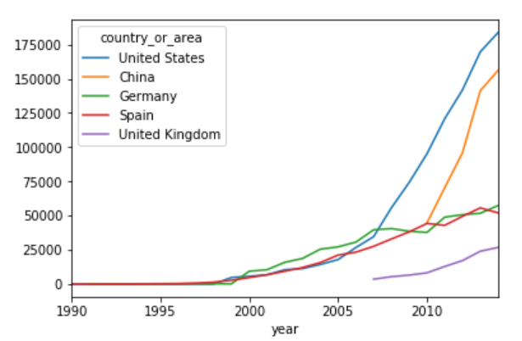
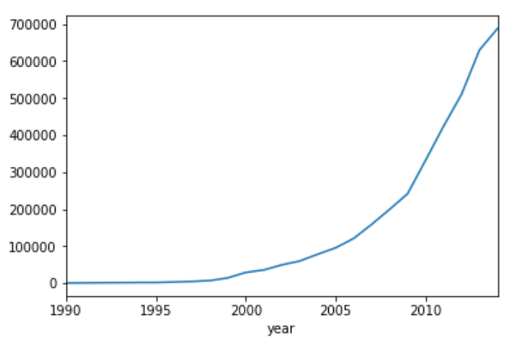
Introduction to Python for data scientists
2c) 2d)

Slide 7
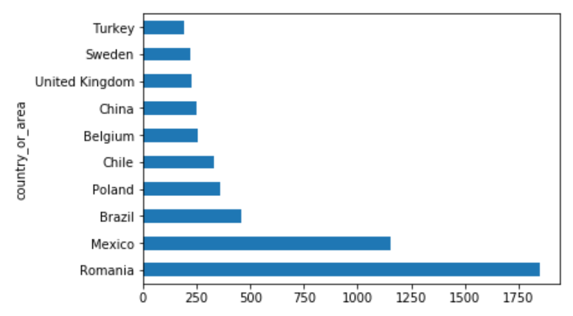
Introduction to Python for data scientists
2e)

Slide 8
Introduction to Python for data scientists
Hints:
2)
Reduce your dataset to wind-data: energy[energy['commodity_transaction']=="Wind – Main activity"]
Use pivot_table() to restructure the energy data to your needs, e.g.
pivot_table(index="country_or_area", columns="year", values="quantity")
Use sort_values(by=year, ascending=True/False) to sort the table
Use apply(lambda x: x…, axis=0/1) to calculate custom aggregations (e.g. a growth rate)
Watch out: column names can be strings (“2014”) or integers (2014)

Slide 9
Introduction to Python for data scientists
Tutorials:
The official Python tutorial: https://docs.python.org/3/tutorial/
Introduction to Pandas: https://pandas.pydata.org/pandas-docs/stable/getting_started/10min.html
An overview over available Python tutorials: https://hackr.io/tutorials/learn-python
E.g.:
  Python Tutorial for Beginners [Full Course] 2019 https://www.youtube.com/watch?v=_uQrJ0TkZlc&ref=hackr.io
  Welcome to Python for you and me https://pymbook.readthedocs.io/en/latest/index.html
  Udemy course

