Slide 1
Project Title:Movie Recommender
Guide :
Mr.Aneesh Chandran
Group No: 4
Members:
Riniya Mary Pradeep
Philipose Alexander
Praveen S
Rahul Renjith
‹#›
Notes:
‹#›
‹#›
‹#›
‹#›

Slide 2
DEPARTMENT OF COMPUTER SCIENCE & ENGINEERING
Vision of the Department
Creating eminent and ethical leaders in the domain of Computational Sciences through quality
professional education with a focus on holistic learning and excellence.
Mission of the Department
To create technically competent and ethically conscious graduates in the field of Computer
Science and Engineering by encouraging holistic learning and excellence.
To prepare students for careers in Industry, Academia and the Government.
To instill Entrepreneurial Orientation and research motivation among the students of the
department.
To emerge as a leader in education in the region by encouraging teaching, learning, industry
and societal connect.

Slide 3
Programme Educational Objectives (PEOs)
1. The graduates shall have sound knowledge of Mathematics, Science, Engineering and
Management to be able to offer practical software and hardware solutions for the problems of
industry and society at large.
2. The graduates shall be able to establish themselves as practicing professionals, researchers or
Entrepreneurs in computer science or allied areas and shall also be able to pursue higher
education in reputed institutes.
3. The graduates shall be able to communicate effectively and work in multidisciplinary teams
with team spirit demonstrating value driven and ethical leadership.

Slide 4
Programme Outcomes
Engineering Graduates will be able to:
1. Engineering knowledge: Apply the knowledge of mathematics, science, engineering fundamentals, and an engineering specialization to the solution of complex engineering problems.
2. Problem analysis: Identify, formulate, review research literature, and analyze complex engineering problems reaching substantiated conclusions using first principles of mathematics, natural sciences, and engineering sciences.
3. Design/development of solutions: Design solutions for complex engineering problems and design system components or processes that meet the specified needs with appropriate consideration for the public health and safety, and the cultural, societal, and environmental considerations.
4. Conduct investigations of complex problems: Use research-based knowledge and research methods including design of experiments, analysis and interpretation of data, and synthesis of the information to provide valid conclusions.
5. Modern tool usage: Create, select, and apply appropriate techniques, resources, and modern engineering and IT tools including prediction and modeling to complex engineering activities with an understanding of the limitations.

Slide 5
6. The engineer and society: Apply reasoning informed by the contextual knowledge to assess societal, health, safety, legal and cultural issues and the consequent responsibilities relevant to the professional engineering practice.
7. Environment and sustainability: Understand the impact of the professional engineering solutions in societal and environmental contexts, and demonstrate the knowledge of, and need for sustainable development.
8. Ethics: Apply ethical principles and commit to professional ethics and responsibilities and norms of the engineering practice.
9. Individual and team work: Function effectively as an individual, and as a member or leader in diverse teams, and in multidisciplinary settings.
10. Communication: Communicate effectively on complex engineering activities with the engineering community and with society at large, such as, being able to comprehend and write effective reports and design documentation, make effective presentations, and give and receive clear instructions.
11. Project management and finance: Demonstrate knowledge and understanding of the engineering and management principles and apply these to one’s own work, as a member and leader in a team, to manage projects and in multidisciplinary environments. 12. Life-long learning: Recognize the need for, and have the preparation and ability to engage in independent and life-long learning in the broadest context of technological change.

Slide 6
Programme Specific Outcomes (PSOs)
On the completion of Computer Science & Engineering program, the students will possess:
An ability to apply knowledge of data structures and algorithms appropriate to computational problems.
An ability to apply knowledge of operating systems, programming languages, data management, or networking principles to computational assignments.
An ability to apply design, development, maintenance or evaluation of software engineering principles in the construction of computer and software systems of varying complexity and quality.
An ability to understand concepts involved in modeling and design of computer science applications in a way that demonstrates comprehension of the fundamentals and trade-offs involved in design choices.

Slide 7
Contents
Introduction
Objectives
Literature Review
Problem statement
Proposed System
Architecture of Proposed System
Hardware and software requirements
Conclusion
References

Slide 8
Introduction
With the increasing amount of movies available in various genres, it can be a daunting task for movie enthusiasts to decide what movie to watch next. Our movie recommender software aims to solve this problem by providing personalized movie recommendations based on the user's movie preferences.
The software uses collaborative filtering techniques to suggest movies based on the ratings and reviews of other users with similar movie preferences. It also incorporates content-based filtering, which recommends movies based on their similarity to previously liked movies, considering the genre, actors, directors, and other relevant attributes.
The movie recommender software uses Python machine learning and data analysis libraries, such as pandas, numpy, to preprocess, clean, and analyze the movie dataset.

Slide 9
Objectives
To develop a personalized movie recommendation system using Python that helps users discover new movies based on their movie preferences.
The goal is to build a user-friendly web interface that allows users to input their movie preferences and receive tailored movie recommendations.
The movie recommender software aims to enhance the movie-watching experience for users and simplify the process of selecting movies.

Slide 10
Literature Survey
Paper Number:1
Paper type: Journal
Name of Publisher:IEEE
Year:2017
Title:A Content-based Movie Recommender System based on Temporal User Preferences
Authors: Bagher Rahimpour Cami,Hamid Hassanpour,Hoda Mashayekhi
Inferences:In this paper, a content-based movie recommender system is developed that captures temporal user preferences in user modeling and predicts the movies.The temporal preferences model is based on Bayesian non-parametric framework and its component: interest extraction, inferring of preferences, and prediction.

Slide 11
For user modeling, after extracting user interests from user profile, the priority of each interest is inferred as the user preference. The model is evaluated with MovieLens dataset.
Advantages
Because the recommendations are tailored to a person, the model does not require any information about other users. This makes scaling of a big number of people more simple.
New items may be suggested before being rated by a large number of users, as opposed to collective filtering.
Disadvantages
The model can only give suggestions based on the user's current interests. To put it another way, the model's potential to build on the users' existing interests is limited.

Slide 12
Literature Survey
Paper Number: 2
Paper type: Journal
Name of Publisher: IEEE
Year:2020
Title:Movie Recommender System Using Collaborative Filtering
Authors: Meenu Gupta ,Aditya Thakkar,Aashish,Vishal Gupta,Dhruv Pratap Singh Inferences:In this paper, the Item-based Collaborative filtering approach is used for obtaining better results. KNN collaborative recommendation system is proposed using cosine similarity by employing Movielens dataset.

Slide 13
Advantages
Both accuracy and efficiency increases.
No explicit data required.
Disadvantages
Data privacy
Cold start problem

Slide 14
Literature Survey
Paper Number: 3
Paper type: Journal
Name of Publisher: IEEE
Year: 2020
Title: Analysis of Movie Recommendation Systems; with and without considering the low rated movies.
Authors: Muppana Mahesh Reddy, R. Sujithra Kanmani, Dr. B. Surendiran.
Inferences: The technique used is “collaborative filtering” and the similarity measure used is the “Pearson correlation coefficient”.

Slide 15
Advantages
This experiment result shows that low rated movies are not significant in finding the movie predictions.
So it’s suggestable to ignore them while calculating movie predictions.
Disadvantages
Unable to identify synonyms
Sparisity
New user problem

Slide 16
Problem Statement
Create a Python-based collaborative filtering, content-based, and hybrid filtering algorithm-based movie recommendation system that makes suggestions for movies to users based on their viewing habits, preferences, and ratings. This project also entails data collection and preprocessing, the creation of a machine learning model, the creation of a user interface, and testing the system's efficacy and accuracy.

Slide 17
Proposed System
The goal of the movie recommendation system project is to create a system that can recommend appropriate movies to users based on their tastes, viewing habits, and ratings. In order to create individualised movie suggestions, this project will make use of a variety of techniques, including collaborative filtering, content-based filtering, and hybrid filtering. Additionally, the system will require testing for accuracy and efficiency, model creation, user interface development, and data preprocessing. A user-friendly movie recommendation system that offers users a seamless and customized movie experience will be the ultimate result. Python programming will be used to carry out the project.

Slide 18
Architecture of Proposed System
The proposed movie recommendation system will have three main components: data collection and preprocessing, machine learning model building, and user interface development.
In the data collection and preprocessing stage, data will be collected from various sources and preprocessed to prepare it for use in the machine learning model.
The machine learning model will utilize collaborative filtering, content-based filtering, and hybrid filtering algorithms to generate personalized movie recommendations for users. The model will take into account the user's watch history, ratings, and preferences to suggest movies that align with their interests.

Slide 19
Architecture of Proposed System
The user interface component will allow users to interact with the system, input their preferences, and view the recommended movies. The user interface will be designed to provide a seamless and intuitive user experience.
Overall, the proposed system architecture will provide users with personalized and relevant movie recommendations based on their preferences and watch history.

Slide 20
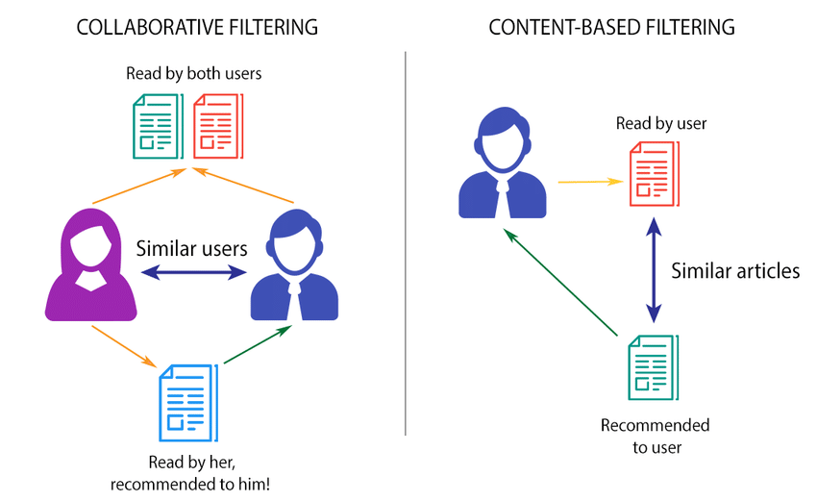
Architecture of Proposed System

Slide 21
Hardware Software Requirements
Hardware Requirements:
Server:Multi-core processor,8GB RAM,Sufficient storage.
Network:Capable of faster download and upload.
Software Requirements:
Operating System:Windows 10/11
Front-End: HTML, CSS, JavaScript
Back-End: Python

Slide 22
Conclusion
This project is proposed to help users to discover new movies based on their personal preferences and past viewing history. With the vast amount of movies available today, it can be overwhelming for users to sift through all the options to find something they will enjoy. Movie recommendation systems use algorithms to analyze a user's viewing history, preferences, and behavior to provide personalized movie recommendations. This can save users time and help them discover new movies that they may have never found on their own.

Slide 23
References
[1]https://ieeexplore.ieee.org/document/8311601
[2]https://ieeexplore.ieee.org/document/9155879
[3]https://ieeexplore.ieee.org/document/9077803
[4]GeeksforGeeks. https://www.geeksforgeeks.org
[5] Stackoverflow. https://stackoverflow.com/i.
[6]Building web application with flutter. https://docs.flutter.dev/get-started/web
[5]IEEE. https://ieeexplore.ieee.org/

