Slide 1
Evolutionary Programming
Chapter 5

Slide 2
EP quick overview
Developed: USA in the 1960’s
Early names: D. Fogel
Typically applied to:
  traditional EP: machine learning tasks by finite state machines
  contemporary EP: (numerical) optimization
Attributed features:
  very open framework: any representation and mutation op’s OK
  crossbred with ES (contemporary EP)
  consequently: hard to say what “standard” EP is
Special:
  no recombination
  self-adaptation of parameters standard (contemporary EP)

Slide 3
EP technical summary tableau
Representation | Real-valued vectors
Recombination | None
Mutation | Gaussian perturbation
Parent selection | Deterministic
Survivor selection | Probabilistic (μ+μ)
Specialty | Self-adaptation of mutation step sizes (in meta-EP)

Slide 4
Historical EP perspective
EP aimed at achieving intelligence
Intelligence was viewed as adaptive behaviour
Prediction of the environment was considered a prerequisite to adaptive behaviour
Thus: capability to predict is key to intelligence

Slide 5
Prediction by finite state machines
Finite state machine (FSM):
  States S
  Inputs I
  Outputs O
  Transition function δ : S x I → S x O
  Transforms input stream into output stream
Can be used for predictions, e.g. to predict next input symbol in a sequence

Slide 6
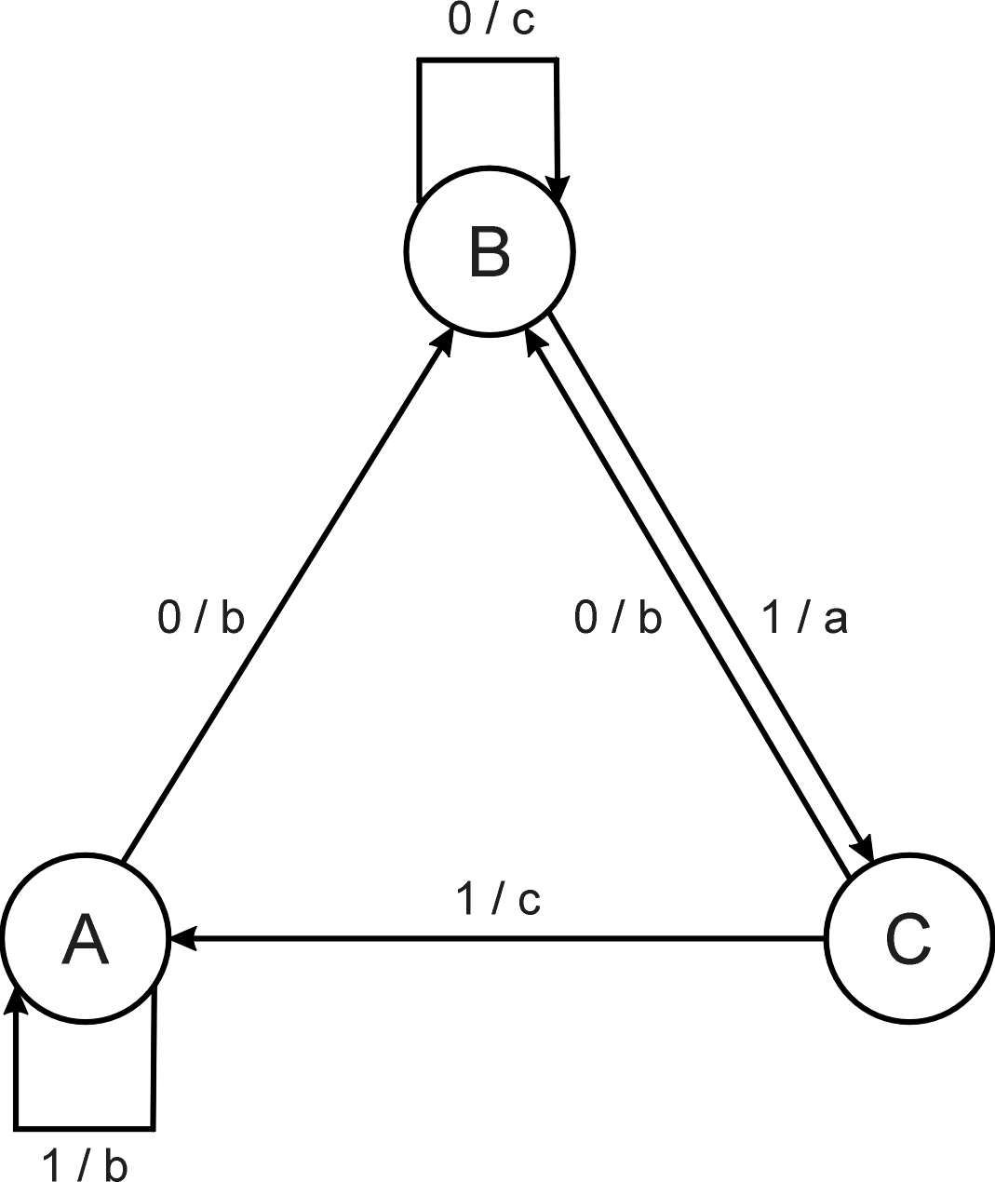
FSM example
Consider the FSM with:
  S = {A, B, C}
  I = {0, 1}
  O = {a, b, c}
  δ given by a diagram

Slide 7
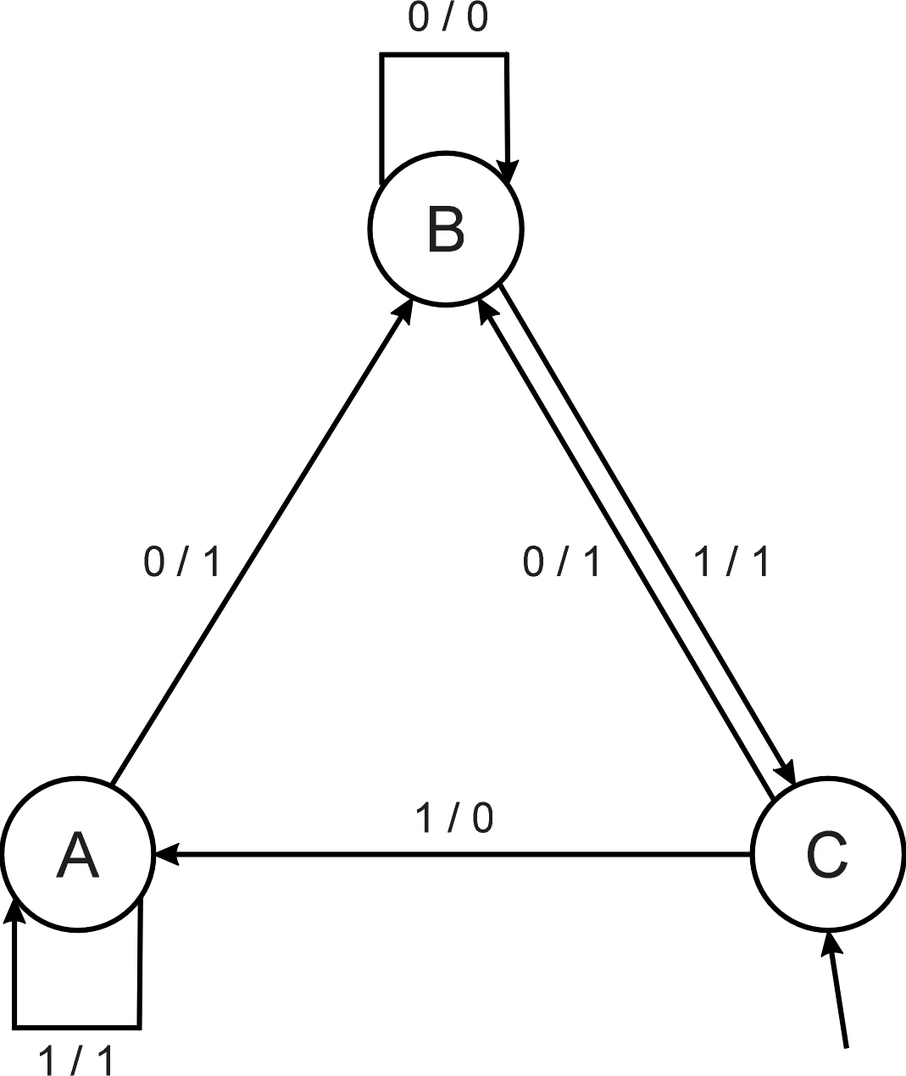
FSM as predictor
Consider the following FSM
Task: predict next input
Quality: % of in_{(i+1)} = out_{i}
Given initial state C
Input sequence 011101
Leads to output 110111
Quality: 3 out of 5

Slide 8
Introductory example: evolving FSMs to predict primes
P(n) = 1 if n is prime, 0 otherwise
I = N = {1,2,3,…, n, …}
O = {0,1}
Correct prediction: out_{i}= P(in_{(i+1)})
Fitness function:
  1 point for correct prediction of next input
  0 point for incorrect prediction
  Penalty for “too much” states

Slide 9
Introductory example: evolving FSMs to predict primes
Parent selection: each FSM is mutated once
Mutation operators (one selected randomly):
  Change an output symbol
  Change a state transition (i.e. redirect edge)
  Add a state
  Delete a state
  Change the initial state
Survivor selection: (μ+μ)
Results: overfitting, after 202 inputs best FSM had one state and both outputs were 0, i.e., it always predicted “not prime”

Slide 10
Modern EP
No predefined representation in general
Thus: no predefined mutation (must match representation)
Often applies self-adaptation of mutation parameters
In the sequel we present one EP variant, not the canonical EP

Slide 11
Representation
For continuous parameter optimisation
Chromosomes consist of two parts:
  Object variables: x₁,…,x_{n}
  Mutation step sizes: σ₁,…,σ_{n}
Full size: ⟨ x₁,…,x_{n}, σ₁,…,σ_{n} ⟩

Slide 12
Mutation
Chromosomes: ⟨ x₁,…,x_{n}, σ₁,…,σ_{n} ⟩
σ_{i}’ = σ_{i} • (1 + α • N(0,1))
x’_{i} = x_{i} + σ_{i}’ • N_{i}(0,1)
α ≈ 0.2
boundary rule: σ’ < ε₀ ⇒ σ’ = ε₀
Other variants proposed & tried:
  Lognormal scheme as in ES
  Using variance instead of standard deviation
  Mutate σ-last
  Other distributions, e.g, Cauchy instead of Gaussian

Slide 13
Recombination
None
Rationale: one point in the search space stands for a species, not for an individual and there can be no crossover between species
Much historical debate “mutation vs. crossover”
Pragmatic approach seems to prevail today

Slide 14
Parent selection
Each individual creates one child by mutation
Thus:
  Deterministic
  Not biased by fitness

Slide 15
Survivor selection
P(t): μ parents, P’(t): μ offspring
Pairwise competitions in round-robin format:
  Each solution x from P(t) ∪ P’(t) is evaluated against q other randomly chosen solutions
  For each comparison, a "win" is assigned if x is better than its opponent
  The μ solutions with the greatest number of wins are retained to be parents of the next generation
Parameter q allows tuning selection pressure
Typically q = 10

Slide 16
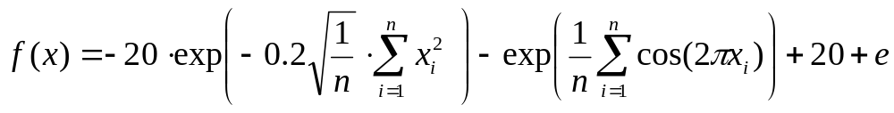
Example application: the Ackley function (Bäck et al ’93)
The Ackley function (here used with n =30):
Representation:
  -30 < x_{i} < 30 (coincidence of 30’s!)
  30 variances as step sizes
Mutation with changing object variables first !
Population size μ = 200, selection with q = 10
Termination : after 200000 fitness evaluations
Results: average best solution is 1.4 • 10 ^{–2}

Slide 17
Example application: the Ackley function (Bäck et al ’93)
The Ackley function (here used with n =30):
Representation:
  -30 < x_{i} < 30 (coincidence of 30’s!)
  30 variances as step sizes
Mutation with changing object variables first !
Population size μ = 200, selection with q = 10
Termination : after 200000 fitness evaluations
Results: average best solution is 1.4 • 10 ^{–2}

Slide 18
Example application: evolving checkers players (Fogel’02)
Neural nets for evaluating future values of moves are evolved
NNs have fixed structure with 5046 weights, these are evolved + one weight for “kings”
Representation:
  vector of 5046 real numbers for object variables (weights)
  vector of 5046 real numbers for σ‘s
Mutation:
  Gaussian, lognormal scheme with σ-first
  Plus special mechanism for the kings’ weight
Population size 15

Slide 19
Example application: evolving checkers players (Fogel’02)
Tournament size q = 5
Programs (with NN inside) play against other programs, no human trainer or hard-wired intelligence
After 840 generation (6 months!) best strategy was tested against humans via Internet
Program earned “expert class” ranking outperforming 99.61% of all rated players

