Slide 1
Introduction
Chapter 1

Slide 2
Contents
Positioning of EC and the basic EC metaphor
Historical perspective
Biological inspiration:
  Darwinian evolution theory (simplified!)
  Genetics (simplified!)
Motivation for EC
What can EC do: examples of application areas
Demo: evolutionary magic square solver

Slide 3
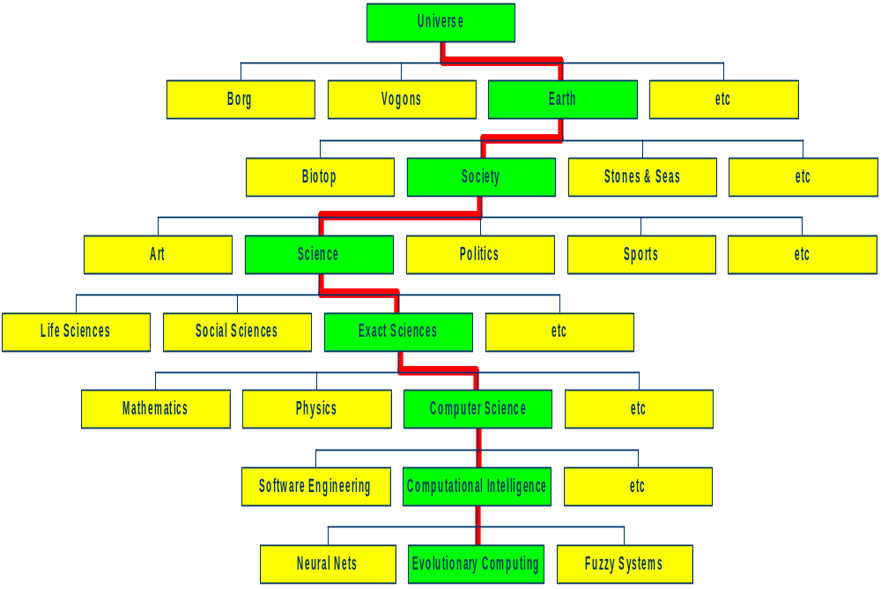
You are here

Slide 4
Positioning of EC
EC is part of computer science
EC is not part of life sciences/biology
Biology delivered inspiration and terminology
EC can be applied in biological research

Slide 5
The Main Evolutionary Computing Metaphor
EVOLUTION
Environment
Individual
Fitness
PROBLEM SOLVING
Problem
Candidate Solution
Quality
Fitness → chances for survival and reproduction
Quality → chance for seeding new solutions

Slide 6
Brief History 1: the ancestors
1948, Turing:
  proposes “genetical or evolutionary search”
1962, Bremermann
  optimization through evolution and recombination
1964, Rechenberg
  introduces evolution strategies
1965, L. Fogel, Owens and Walsh
  introduce evolutionary programming
1975, Holland
  introduces genetic algorithms
1992, Koza
  introduces genetic programming

Slide 7
Brief History 2: The rise of EC
1985: first international conference (ICGA)
1990: first international conference in Europe (PPSN)
1993: first scientific EC journal (MIT Press)
1997: launch of European EC Research Network EvoNet

Slide 8
EC in the early 21st Century
3 major EC conferences, about 10 small related ones
3 scientific core EC journals
750-1000 papers published in 2003 (estimate)
EvoNet has over 150 member institutes
uncountable (meaning: many) applications
uncountable (meaning: ?) consultancy and R&D firms

Slide 9
Darwinian Evolution 1:
Survival of the fittest
All environments have finite resources
  (i.e., can only support a limited number of individuals)
Lifeforms have basic instinct/ lifecycles geared towards reproduction
Therefore some kind of selection is inevitable
Those individuals that compete for the resources most effectively have increased chance of reproduction
Note: fitness in natural evolution is a derived, secondary measure, i.e., we (humans) assign a high fitness to individuals with many offspring

Slide 10
Darwinian Evolution 2:
Diversity drives change
Phenotypic traits:
  Behaviour / physical differences that affect response to environment
  Partly determined by inheritance, partly by factors during development
  Unique to each individual, partly as a result of random changes
If phenotypic traits:
  Lead to higher chances of reproduction
  Can be inherited
then they will tend to increase in subsequent generations,
leading to new combinations of traits …

Slide 11
Darwinian Evolution:Summary
Population consists of diverse set of individuals
Combinations of traits that are better adapted tend to increase representation in population
Individuals are “units of selection”
Variations occur through random changes yielding constant source of diversity, coupled with selection means that:
Population is the “unit of evolution”
Note the absence of “guiding force”

Slide 12
Adaptive landscape metaphor (Wright, 1932)
Can envisage population with n traits as existing in a n+1-dimensional space (landscape) with height corresponding to fitness
Each different individual (phenotype) represents a single point on the landscape
Population is therefore a “cloud” of points, moving on the landscape over time as it evolves - adaptation

Slide 13
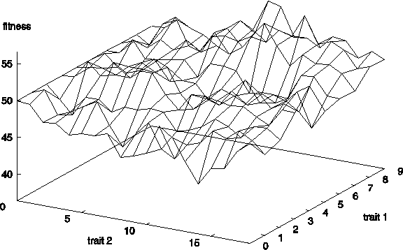
Example with two traits

Slide 14
Adaptive landscape metaphor (cont’d)
Selection “pushes” population up the landscape
Genetic drift:
  random variations in feature distribution
  (+ or -) arising from sampling error
  can cause the population “melt down” hills, thus crossing valleys and leaving local optima

Slide 15
Natural Genetics
The information required to build a living organism is coded in the DNA of that organism
Genotype (DNA inside) determines phenotype
Genes → phenotypic traits is a complex mapping
  One gene may affect many traits (pleiotropy)
  Many genes may affect one trait (polygeny)
Small changes in the genotype lead to small changes in the organism (e.g., height, hair colour)

Slide 16
Genes and the Genome
Genes are encoded in strands of DNA called chromosomes
In most cells, there are two copies of each chromosome (diploidy)
The complete genetic material in an individual’s genotype is called the Genome
Within a species, most of the genetic material is the same

Slide 17
Example: Homo Sapiens
Human DNA is organised into chromosomes
Human body cells contains 23 pairs of chromosomes which together define the physical attributes of the individual:

Slide 18
Reproductive Cells
Gametes (sperm and egg cells) contain 23 individual chromosomes rather than 23 pairs
Cells with only one copy of each chromosome are called Haploid
Gametes are formed by a special form of cell splitting called meiosis
During meiosis the pairs of chromosome undergo an operation called crossing-over

Slide 19
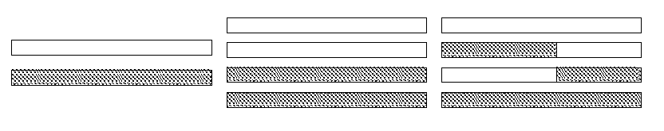
Crossing-over during meiosis
Chromosome pairs align and duplicate
Inner pairs link at a centromere and swap parts of themselves
Outcome is one copy of maternal/paternal chromosome plus two entirely new combinations
After crossing-over one of each pair goes into each gamete

Slide 20
Fertilisation
Sperm cell from Father
Egg cell from Mother
New person cell (zygote)

Slide 21
After fertilisation
New zygote rapidly divides etc creating many cells all with the same genetic contents
Although all cells contain the same genes, depending on, for example where they are in the organism, they will behave differently
This process of differential behaviour during development is called ontogenesis
All of this uses, and is controlled by, the same mechanism for decoding the genes in DNA

Slide 22
Genetic code
All proteins in life on earth are composed of sequences built from 20 different amino acids
DNA is built from four nucleotides in a double helix spiral: purines A,G; pyrimidines T,C
Triplets of these from codons, each of which codes for a specific amino acid
Much redundancy:
  purines complement pyrimidines
  the DNA contains much rubbish
  4³=64 codons code for 20 amino acids
  genetic code = the mapping from codons to amino acids
For all natural life on earth, the genetic code is the same !

Slide 23
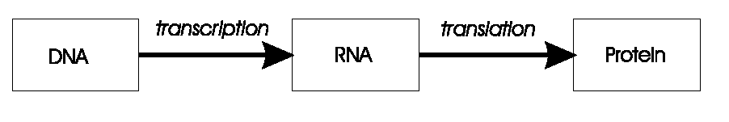
Transcription, translation
A central claim in molecular genetics: only one way flow
Genotype Phenotype
Genotype Phenotype
Lamarckism (saying that acquired features can be inherited) is thus wrong!

Slide 24
Mutation
Occasionally some of the genetic material changes very slightly during this process (replication error)
This means that the child might have genetic material information not inherited from either parent
This can be
  catastrophic: offspring in not viable (most likely)
  neutral: new feature not influences fitness
  advantageous: strong new feature occurs
Redundancy in the genetic code forms a good way of error checking

Slide 25
Motivations for EC: 1
Nature has always served as a source of inspiration for engineers and scientists
The best problem solver known in nature is:
  the (human) brain that created “the wheel, New York, wars and so on” (after Douglas Adams’ Hitch-Hikers Guide)
  the evolution mechanism that created the human brain (after Darwin’s Origin of Species)
Answer 1 → neurocomputing
Answer 2 → evolutionary computing

Slide 26
Motivations for EC: 2
Developing, analyzing, applying problem solving methods a.k.a. algorithms is a central theme in mathematics and computer science
Time for thorough problem analysis decreases
Complexity of problems to be solved increases
Consequence:
Robust problem solving technology needed

Slide 27
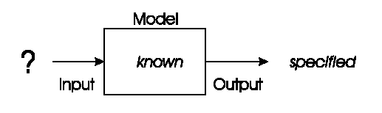
Problem type 1 : Optimisation
We have a model of our system and seek inputs that give us a specified goal
e.g.
  time tables for university, call center, or hospital
  design specifications, etc etc

Slide 28
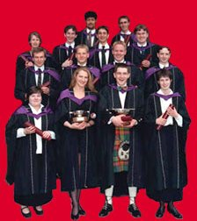
Optimisation example 1: University timetabling
Enormously big search space
Timetables must be good
“Good” is defined by a number of competing criteria
Timetables must be feasible
Vast majority of search space is infeasible

Slide 29
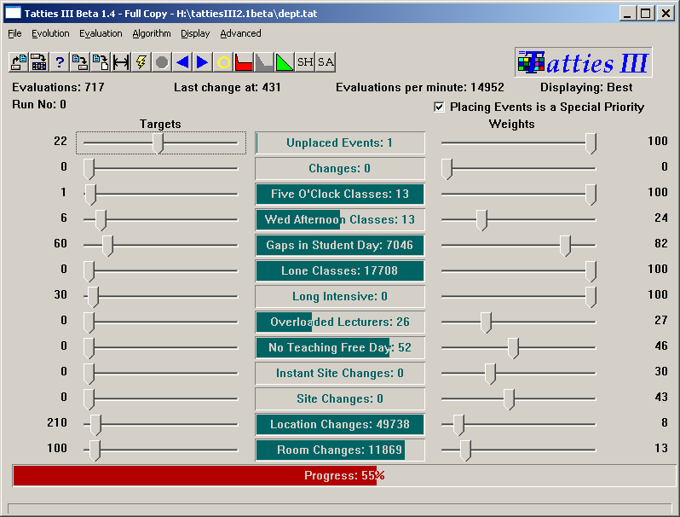

Slide 30
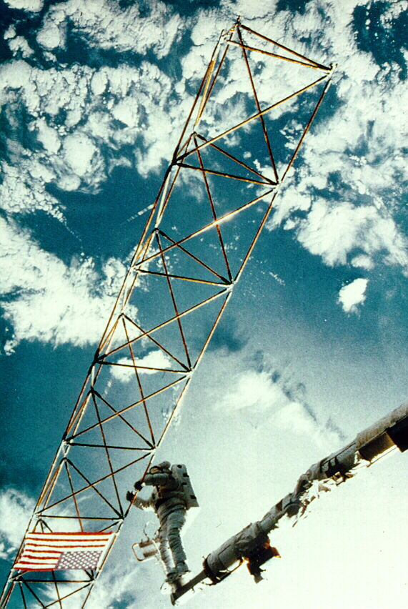
Optimisation example 2: Satellite structure
Optimised satellite designs for NASA to maximize vibration isolation
Evolving: design structures
Fitness: vibration resistance
Evolutionary “creativity”

Slide 31
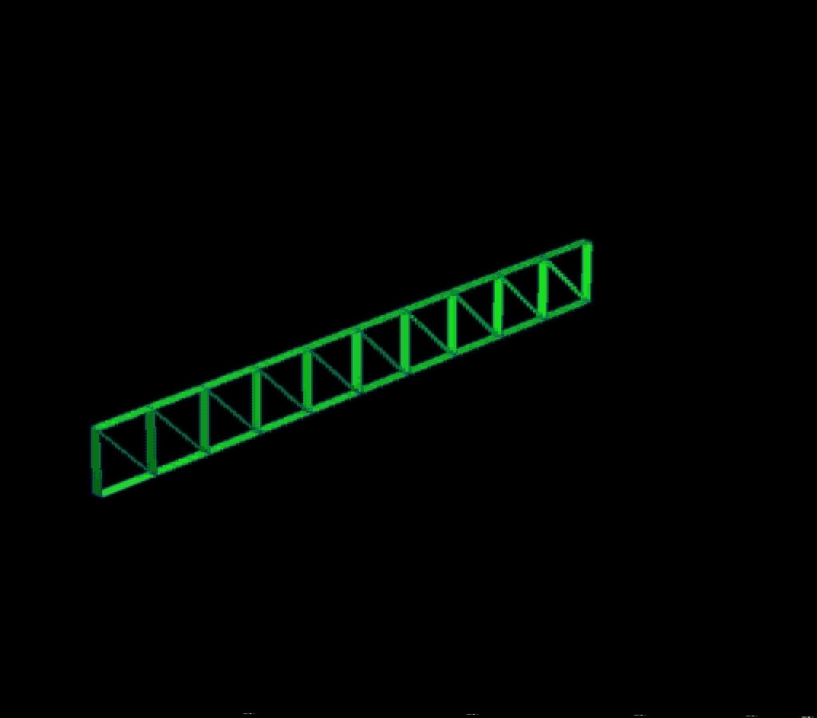

Slide 32
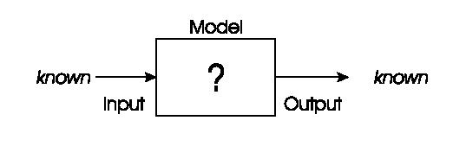
Problem types 2: Modelling
We have corresponding sets of inputs & outputs and seek model that delivers correct output for every known input
Evolutionary machine learning

Slide 33
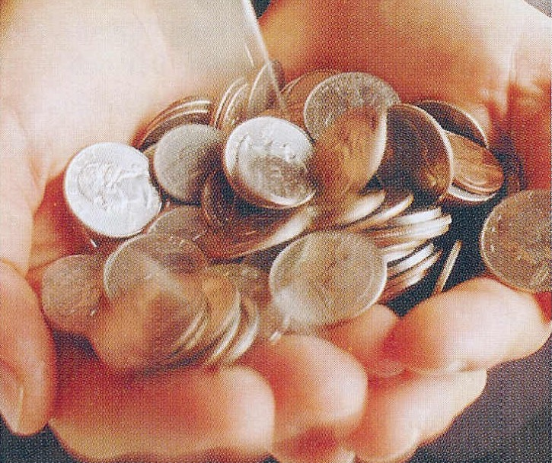
Modelling example: loan applicant creditibility
British bank evolved creditability model to predict loan paying behavior of new applicants
Evolving: prediction models
Fitness: model accuracy on
historical data

Slide 34
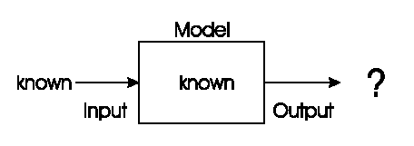
Problem type 3: Simulation
We have a given model and wish to know the outputs that arise under different input conditions
Often used to answer “what-if” questions in evolving dynamic environments
e.g. Evolutionary economics, Artificial Life

Slide 35
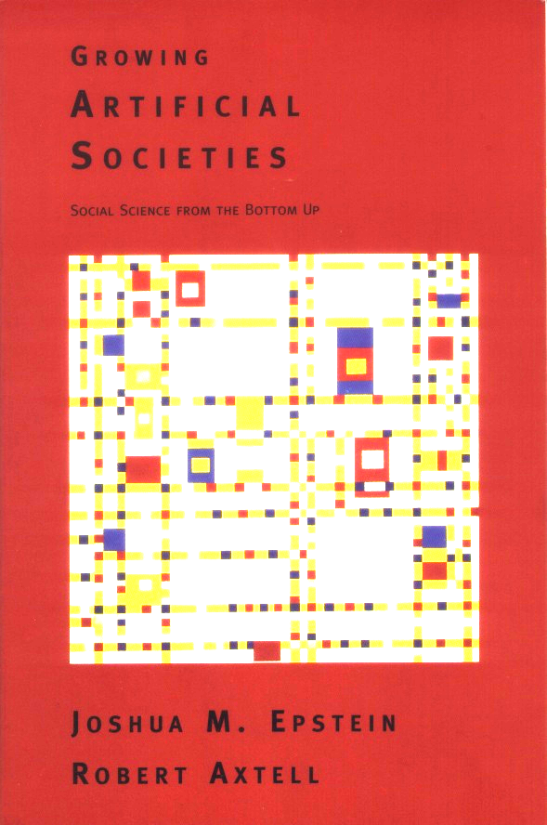
Simulation example: evolving artificial societies
Simulating trade, economic competition, etc. to calibrate models
Use models to optimise strategies and policies
Evolutionary economy
Survival of the fittest is universal (big/small fish)

Slide 36
Simulation example 2: biological interpetations
Incest prevention keeps evolution from rapid degeneration
(we knew this)
Multi-parent reproduction, makes evolution more efficient
(this does not exist on Earth in carbon)
2nd sample of Life
Picture censored

Slide 37
Demonstration: magic square
Given a 10x10 grid with a small 3x3 square in it
Problem: arrange the numbers 1-100 on the grid such that
  all horizontal, vertical, diagonal sums are equal (505)
  a small 3x3 square forms a solution for 1-9

Slide 38
Demonstration: magic square
Evolutionary approach to solving this puzzle:
Creating random begin arrangement
Making N mutants of given arrangement
Keeping the mutant (child) with the least error
Stopping when error is zero

Slide 39

Demonstration: magic square
Software by M. Herdy, TU Berlin
Interesting parameters:
  Step1: small mutation, slow & hits the optimum
  Step10: large mutation, fast & misses (“jumps over” optimum)
  Mstep: mutation step size modified on-line, fast & hits optimum
Start: double-click on icon below
Exit: click on TUBerlin logo (top-right)

