Slide 1
Hybrid Evolutionary Algorithms
Chapter 10

Slide 2
Overview
Why to Hybridise
Where to hybridise
Incorporating good solutions
Local Search and graphs
Lamarkian vs. Baldwinian adaptation
Diversity
Operator choice

Slide 3
Why Hybridise
Might want to put in EA as part of larger system
Might be looking to improve on existing techniques but not re-invent wheel
Might be looking to improve EA search for good solutions

Slide 4
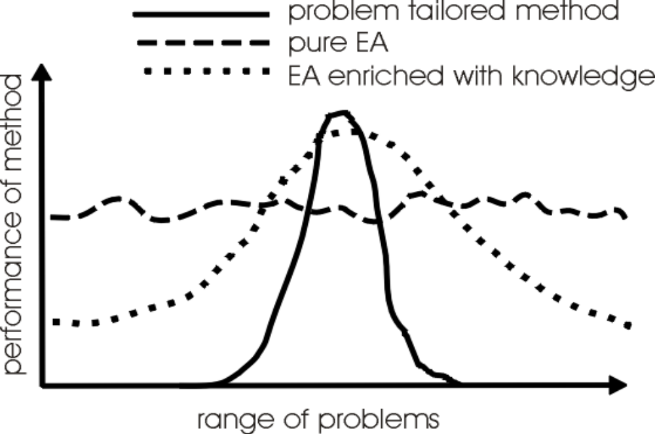
Michalewicz’s view on EAs in context

Slide 5
Memetic Algorithms
The combination of Evolutionary Algorithms with Local Search Operators that work within the EA loop has been termed “Memetic Algorithms”
Term also applies to EAs that use instance specific knowledge in operators
Memetic Algorithms have been shown to be orders of magnitude faster and more accurate than EAs on some problems, and are the “state of the art” on many problems

Slide 6
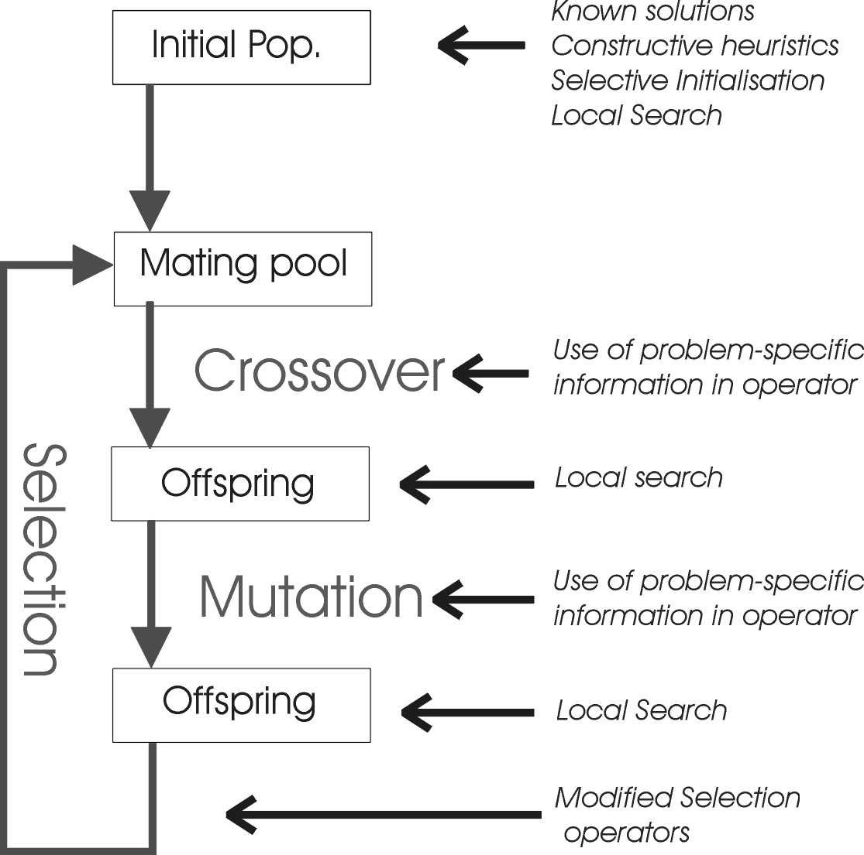
Where to Hybridise

Slide 7
Heuristics for Initialising Population
Bramlette ran experiments with limited time scale and suggested holding a n-way tournament amongst randomly created solutions to pick initial population
  (n.b. NOT the same as taking the best popsize of n.popsize random points)
Multi-Start Local Search is another option: pick popsize points at random to climb from
Constructive Heuristics often exist

Slide 8
Initialisation Issues
Another common approach would be to initialise population with solutions already known, or found by another technique (beware, performance may appear to drop at first if local optima on different landscapes do not coincide)
Surry & Radcliffe (1994) studied ways of “inoculating” population with solutions gained from previous runs or other algorithms/heuristics
  found mean performance increased as population was biased towards know solutions,
  but best performance came from more random solutions

Slide 9
“Intelligent” Operators
It is sometimes possible to incorporate problem or instance specific knowledge within crossover or mutation operators
  E.g. Merz’s DPX operator for TSP inherits common sub tours from parents then connects them using a nearesr neighbour heuristic
  Smith (97) evolving microprocessor instruction sequences: group instructions (alleles) into classes so mutation is more likely to switch gene to value having a similar effect
  Many other examples in literature

Slide 10
Local Search acting on offspring
Can be viewed as a sort of “lifetime learning”
Lots of early research done using EAs to evolve the structure of Artificial Neural Networks and then Back-propagation to learn connection weights
Often used to speed-up the “endgame” of an EA by making the search in the vicinity of good solutions more systematic than mutation alone

Slide 11
Local Search
Defined by combination of neighbourhood and pivot rule
Related to landscape metaphor
N(x) is defined as the set of points that can be reached from x with one application of a move operator
  e.g. bit flipping search on binary problems
g
h
d
N(d) = {a,c,h}
c
f
e
b
a

Slide 12
Landscapes & Graphs
The combination of representation and operator defines a graph G(v,E) on the search space. (useful for analysis)
v, the set of vertices, is the set of all points that can be represented (the potential solutions)
E, the set of edges, is the possible transitions that can arise from a single application of the operator
    note that the edges in E can have weights attached to them, and that they need not be symmetrical

Slide 13
Example Graphs for binary
example : binary problem as above
  v = {a,b,c,d,e,f,g,h,}
  Search by flipping each bit in turn
    E₁ = { ab, ad, ae, bc, bf, cd, cg, dh, fg, fe, gh, eh}
    symmetrical and all values equally likely
  Bit flipping mutation with prob p per bit
  E = p.E₁ ∪ p²{ac,bd,af,be,dg, ch, fh, ge, ah, de, bg, cf} ∪ p³ {ag, bh, ce, df}

Slide 14
Graphs
The Degree of a graph is the maximum number of edges coming into/out of a single point, - the size of the biggest neighbourhood
  single bit changing search: degree is l
  bit-wise mutation on binary: degree is 2^{l} -1
  2-opt: degree is O(N²)
Local Search algorithms look at points in the neighbourhood of a solution, so complexity is related to degree of graph

Slide 15
Pivot Rules
Is the neighbourhood searched randomly, systematically or exhaustively ?
does the search stop as soon as a fitter neighbour is found (Greedy Ascent)
or is the whole set of neighbours examined and the best chosen (Steepest Ascent)
of course there is no one best answer, but some are quicker than others to run ........

Slide 16
Variations of Local Search
Does the search happen in representation space or Solution Space ?
How many iterations of the local search are done ?
Is local search applied to the whole population?
  or just the best ?
  or just the worst ?
  see work (PhD theses) by Hart (www.cs.sandia.gov/~wehart), and Land

Slide 17
Two Models of Lifetime Adaptation
Lamarkian
    traits acquired by an individual during its lifetime can be transmitted to its offspring
    e.g. replace individual with fitter neighbour
Baldwinian
    traits acquired by individual cannot be transmitted to its offspring
    e.g. individual receives fitness (but not genotype) of fitter neighbour

Slide 18
The Baldwin effect
LOTS of work has been done on this
  the central dogma of genetics is that traits acquired during an organisms lifetime cannot be written back into its gametes
  e.g. Hinton & Nowlan ‘87, ECJ special issue etc
In MAs we are not constrained by biological realities so can do lamarkianism

Slide 19
Induced landscapes
“Raw”
Fitness
lamarkian
points
Baldwin landscape

Slide 20
Information Use in Local Search
Most Memetic Algorithms use an operator acting on a single point, and only use that information
However this is an arbitrary restriction
    Jones (1995), Merz & Friesleben (1996) suggest the use of a crossover hillclimber which uses information from two points in the search space
    Krasnogor & Smith (2000) - see later - use information from whole of current population to govern acceptance of inferior moves
    Could use Tabu search with a common list

Slide 21
Diversity
Maintenance of diversity within the population can be a problem, and some successful algorithms explicitly use mechanisms to preserve diversity:
    Merz’s DPX crossover explicitly generates individuals at same distance to each parent as they are apart
    Krasnogor’s Adaptive Boltzmann Operator uses a Simulated-Annealing like acceptance criteria where “temperature” is inversely proportional to population diversity

Slide 22
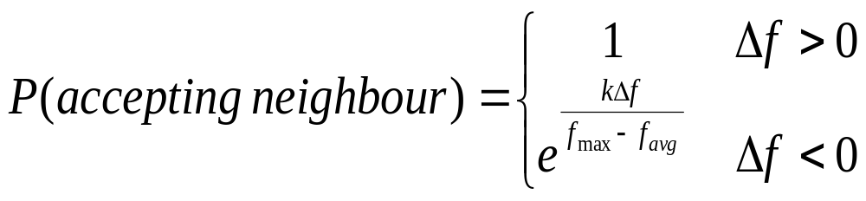
Boltzman MAs: acceptance criteria
Assuming a maximisation problem,
Let Δf = fitness of neighbour – current fitness

Slide 23
Boltzmann MAs:2
Induced dynamic is such that:
  Population is diverse => spread of fitness is large, therefore temperature is low, so only accept improving moves => Exploitation
  Population is converged => temperature is high, more likely to accept worse moves => Exploration
Krasnogor showed this improved final fitness and preserved diversity longer on a range of TSP and Protein Structure Prediction problems

Slide 24
Choice of Operators
Krasnogor (2002) will show that there are theoretical advantages to using a local search with a move operator that is DIFFERENT to the move operators used by mutation and crossover
Can be helpful since local optima on one landscape might be point on a slope on another
Easy implementation is to use a range of local search operators, with mechanism for choosing which to use. (Similar to Variable Neighbourhood Search)
This could be learned & adapted on-line (e.g. Krasnogor & Smith 2001)

Slide 25
Hybrid Algorithms Summary
It is common practice to hybridise EA’s when using them in a real world context.
this may involve the use of operators from other algorithms which have already been used on the problem (e.g. 2-opt for TSP), or the incorporation of domain-specific knowledge (e.g PSP operators)
Memetic algorithms have been shown to be orders of magnitude faster and more accurate than GAs on some problems, and are the “state of the art” on many problems

