Slide 1
Theory
Chapter 11

Slide 2
Overview
Motivations and problems
Holland’s Schema Theorem
  Derivation, Implications, Refinements
Dynamical Systems & Markov Chain Models
Statistical Mechanics
Reductionist Techniques
Techniques for Continuous Spaces
No Free Lunch ?

Slide 3
Why Bother with Theory?
Might provide performance guarantees
  Convergence to the global optimum can be guaranteed providing certain conditions hold
Might aid better algorithm design
  Increased understanding can be gained about operator interplay etc.
Mathematical Models of EAs also inform theoretical biologists
Because you never know ….

Slide 4
Problems with Theory ?
EAs are vast, complex dynamical systems with many degrees of freedom
The type of problems for which they do well, are precisely those it is hard to model
The degree of randomness involved means
  stochastic analysis techniques must be used
  Results tend to describe average behaviour
After 100 years of work in theoretical biology, they are still using fairly crude models of very simple systems ….

Slide 5
Holland’s Schema Theorem
A schema (pl. schemata) is a string in a ternary alphabet ( 0,1 # = “don’t care”) representing a hyperplane within the solution space.
  E.g. 0001# #1# #0#, ##1##0## etc
Two values can be used to describe schemata,
  the Order (number of defined positions) = 6,2
  the Defining Length - length of sub-string between outmost defined positions = 9, 3

Slide 6
Example Schemata
01#
111
H o(H) d(H)
001 3 2
01# 2 1
1#0 2 2
1## 1 0
1##
001
000
100
1#0

Slide 7
Schema Fitnesses
The true “fitness” of a schema H is taken by averaging over all possible values in the “don’t care” positions, but this is effectively sampled by the population, giving an estimated fitness f(H)
With Fitness Proportionate Selection P_{s}(instance of H) = n(H,t) * f(H,t) / (<f> * μ)
therefore proportion in next parent pool is:
m’(H,t+1) = m(H,t) * f(H,t) / <f>

Slide 8
Schema Disruption I
One Point Crossover selects a crossover point at random from the l-1 possible points
For a schema with defining length d the random point will fall inside the schema with probability = d(H) / (l-1).
If recombination is applied with probability P_{c} the survival probability is 1.0 - P_{c}*d(H)/(l-1)

Slide 9
Schema Disruption II
The probability that bit-wise mutation with probability P_{m} will NOT disrupt the schemata is simply the probability that mutation does NOT occur in any of the defining positions,
  P_{survive} (mutation) = ( 1- Pm)o^{(H)}
  = 1 – o(H) * P_{m} + terms in P_{m}² +…
For low mutation rates, this survival probability under mutation approximates to 1 - o(h)* P_{m}

Slide 10


The Schema Theorem
Put together, the proportion of a schema H in successive generations varies as:
Condition for schema to increase its representation is:
Inequality is due to convergence affecting crossover disruption, exact versions have been developed

Slide 11
Implications 1: Operator Bias
One Point Crossover
  less likely to disrupt schemata which have short defining lengths relative to their order, as it will tend to keep together adjacent genes
  this is an example of Positional Bias
Uniform Crossover
  No positional bias since choices independent
  BUT is far more likely to pick 50% of the bits from each parent, less likely to pick (say) 90% from one
  this is called Distributional Bias
Mutation
  also shows Distributional Bias, but not Positional

Slide 12
Operator Biases ctd
Operator Bias has been extensively studied by Eschelman and Schaffer ( empirically) and theoretically by Spears & DeJong.
Results emphasise the importance of utilising all available problem specific knowledge when choosing a representation and operators for a new problem

Slide 13
Implications 2:The Building Block Hypothesis
Closely related to the Schema Theorem is the “Building Block Hypothesis” (Goldberg 1989)
This suggests that Genetic Algorithms work by discovering and exploiting “building blocks” - groups of closely interacting genes - and then successively combining these (via crossover) to produce successively larger building blocks until the problem is solved.
Has motivated study of Deceptive problems
  Based on the notion that the lower order schemata within a partition lead the search in the opposite direction to the global optimum
    i.e. for a k-bit partition there are dominant epistatic interactions of order k-1

Slide 14
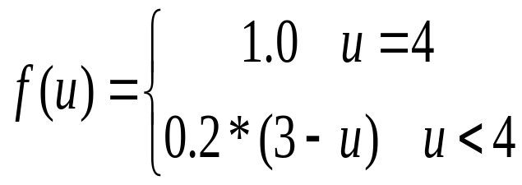
Deception and Walsh Transforms
Simple function of Unitation
Much analysis has concentrated on Walsh Transforms
  Similar to Fourier transform in continuous domain
  Natural link between schema and Walsh partitions
1.0
0.6
F(u)
0
2
1
0
4
3
u

Slide 15
Criticisms of the Schema Theorem
It presents an inequality that does not take into account the constructive effects of crossover and mutation
  Exact versions have been derived
  Have links to Price’s theorem in biology
Because the mean population fitness, and the estimated fitness of a schema will vary from generation to generation, it says nothing about gen. t+2 etc.
“Royal Road” problems constructed to be GA-easy based on schema theorem turned out to be better solved by random mutation hill-climbers
BUT it remains a useful conceptual tool and has historical importance

Slide 16
Other Landscape Metrics
As well as epistasis and deception, several other features of search landscapes have been proposed as providing explanations as to what sort of problems will prove hard for GAs
  fitness-distance correlation
  number of peaks present in the landscape
  the existence of plateaus
  all these imply a neighbourhood structure to the search space.
It must be emphasised that these only hold for one operator

Slide 17
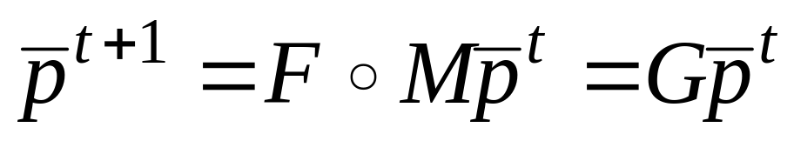
Vose’ Dynamical Systems Model
Let n be the size of a finite search space
Construct a population vector p with n elements giving the proportion of the population in each possible state.
n x n Mixing Matrix, M, represents operation of crossover and mutation on population
n x n Selection Matrix S represents action of selection

Slide 18
Dynamical Systems 2
The existence, location and stability of fixed points or attractors for this system is given by the set of coupled equations defining G
  For selection-mutation algorithms using fitness-proportion selection, G is linear and the fixed points are given by its Eigenvectors
Note that these are infinite population models
  extensions to finite populations are possible but computationally intractable
Lots of interests in ways of aggregating states
  schemata are one option,
  unitation is another that permits analysis of some well known problems e.g. deception, royal road

Slide 19
Markov Chain Analysis
A system is called a Markov Chain if
  It can exist only in one of a finite number of states
  So can be described by a variable X^{t}
  The probability of being in any state at time t+1 depends only on the state at time t.
Frequently these probabilities can be defined in a transition matrix, and the theory of stochastic processes allows us to reason using them.
Has been used to provide convergence proofs
Can be used with F and M to create exact probabilistic models for binary coded Gas, but these are huge

Slide 20
Statistical mechanics models
Use techniques borrowed from physics
Just as per schemata and equivalence classes such as unitation, these use a few statistics to model the behaviour of a complex system
Statistics chosen are the cumulants of the fitness distribution
  related to mean, variance, skewness etc of population fitness
  Cannot model e.g. best fitness
Can provide more accurate predictions of short term (rather than steady state) behaviour of finite pops. than dynamical systems approaches

Slide 21
Reductionist Approaches
“Engineering” type approach of studying different operator and processes in isolation
  Analysis of Takeover times for different selection operators via Markov Chains
  Analysis of “mixing times” for crossover to put together building blocks to create new solutons
  Analysis of population sizes needed based on schema variance, signal to noise ratios etc
Can provide useful pointers for designing EAs in practice, e.g.
  T(takeover) < T(mixing) =>premature convergence

Slide 22
Continuous Space models
Theory is probably more advanced than for discrete spaces, includes self-adaptation
Most analyses models two variables:
  Progress Rate: distance of centre of mass of pop from global optimum as a function of time
  Quality Gain : expected improvement in fitness between generations
Lots of theory describing behaviour on simple (sphere, corridor) models
  These are often good descriptors of local properties of landscapes
  Theory has been extended to noisy environments

Slide 23
No Free Lunch Theorems
IN LAYMAN’S TERMS,
  Averaged over all problems
  For any performance metric related to number of distinct points seen
  All non-revisiting black-box algorithms will display the same performance
Implications
  New black box algorithm is good for one problem => probably poor for another
  Makes sense not to use “black-box algorithms”
Lots of ongoing work showing counter-examples

