Slide 1
Working with
Evolutionary Algorithms
Chapter 14

Slide 2
Issues considered
Experiment design
Algorithm design
Test problems
Measurements and statistics
Some tips and summary

Slide 3
Experimentation
Has a goal or goals
Involves algorithm design and implementation
Needs problem(s) to run the algorithm(s) on
Amounts to running the algorithm(s) on the problem(s)
Delivers measurement data, the results
Is concluded with evaluating the results in the light of the given goal(s)
Is often documented (see tutorial on paper writing)

Slide 4
EA experimentation
EA objectives determined by problem context:
Design (engineering) problems – single ‘good’ solution required.
Control (optimization) problems – requiring many ‘good’ yet ‘timely’ solutions.

Slide 5

Example: Production Perspective
Optimizing Internet shopping
delivery routes
  Different destinations each day
  Limited time to run algorithm each day
  Must always be reasonably good route in limited time

Slide 6

Example: Design Perspective
Optimizing spending on improvements to national road network
  Total cost: billions of Euro
  Computing costs negligible
  Six months to run algorithm on hundreds computers
  Many runs possible
  Must produce very good result just once

Slide 7
Perspectives of an EA’s goals
Design perspective:
find a very good solution at least once
Production perspective:
find a good solution at almost every run
Academic perspective:
must meet scientific standards
These perspectives have very different implications when evaluating EA results.

Slide 8
Algorithm design
Design a representation
Design a way of mapping a genotype to a phenotype
Design a way of evaluating an individual
Design suitable mutation operator(s)
Design suitable recombination operator(s)
Decide how to select individuals to be parents
Decide how to select individuals for the next generation (how to manage the population)
Decide how to start: initialization method
Decide how to stop: termination criterion

Slide 9
Test problems for experimental comparisons
Use problem instances from an academic repository
Use randomly generated problem instances
Use real life problem instances

Slide 10
Test problems for experimental comparisons
5 DeJong functions
25 “hard” objective functions
Frequently encountered or otherwise important variants of given practical problem
Selection from recognized benchmark problem repository (“challenging” by being NP--- ?!)
Problem instances made by random generator
Choice has severe implications on
  generalizability and
  scope of the results

Slide 11
Bad example
I invented “tricky mutation”
Showed that it is a good idea by:
  Running standard (?) GA and tricky GA
  On 10 objective functions from the literature
  Finding tricky GA better on 7, equal on 1, worse on 2 cases
I wrote it down in a paper
And it got published!
Q: what did I learned from this experience?
Q: is this good work?

Slide 12
Bad example
What did I (my readers) did not learn:
  How relevant are these results (test functions)?
  What is the scope of claims about the superiority of the tricky GA?
  Is there a property distinguishing the 7 good and the 2 bad functions?
  Can the results be generalized ? (Is the tricky GA applicable for other problems? Which ones?)

Slide 13
Getting Problem Instances 1
Testing on real data
Advantages:
  Results are application oriented
Disadvantages
  Can be few available sets of real data
  May be commercial sensitive – difficult to publish and to allow others to compare
  Results are hard to generalize

Slide 14
Getting Problem Instances 2
Standard data sets in problem repositories, e.g.:
  OR-Library
  http://www.ms.ic.ac.uk/info.html
  UCI Machine Learning Repository www.ics.uci.edu/~mlearn/MLRepository.html
Advantage:
  Tried and tested problems and instances (hopefully)
  Much other work on these → results comparable
Disadvantage:
  Not real – might miss crucial aspect
  Algorithms get tuned for popular test suites

Slide 15
Getting Problem Instances 3
Problem instance generators produce simulated data for given parameters, e.g.:
  GA/EA Repository of Test Problem Generators
http://www.cs.uwyo.edu/~wspears/generators.html
Advantage:
  Allow systematic investigation of an objective function parameter range
  Can be shared allowing comparisons with other researchers
Disadvantage:
  Not real – might miss crucial aspect
  Given generator might have hidden bias

Slide 16
Basic rules of experimentation
EAs are stochastic →
never draw any conclusion from a single run
  perform sufficient number of independent runs
  use statistical measures (averages, standard deviations)
  use statistical tests to assess reliability of conclusions
EA experimentation is about comparison →
always do a fair competition
  use the same amount of resources for the competitors
  try different competition limits
  use the same performance measures

Slide 17
Things to Measure
Many different ways. Examples:
Average result in given time
Average time for given result
Proportion of runs within % of target
Best result over n runs
Amount of computing required to reach target in given time with % confidence
…

Slide 18
What time units do we use?
Elapsed time?
  Depends on computer, network, etc…
CPU Time?
  Depends on skill of programmer, implementation, etc…
Generations?
  Difficult to compare when parameters like population size change
Evaluations?
  Evaluation time could depend on algorithm, e.g. direct vs. indirect representation

Slide 19
Measures
Performance measures (off-line)
  Efficiency (alg. speed)
    CPU time
    No. of steps, i.e., generated points in the search space
  Effectivity (alg. quality)
    Success rate
    Solution quality at termination
“Working” measures (on-line)
  Population distribution (genotypic)
  Fitness distribution (phenotypic)
  Improvements per time unit or per genetic operator
  …

Slide 20
Performance measures
No. of generated points in the search space
= no. of fitness evaluations
(don’t use no. of generations!)
AES: average no. of evaluations to solution
SR: success rate = % of runs finding a solution (individual with acceptabe quality / fitness)
MBF: mean best fitness at termination, i.e., best per run, mean over a set of runs
SR ≠ MBF
  Low SR, high MBF: good approximizer (more time helps?)
  High SR, low MBF: “Murphy” algorithm

Slide 21
Fair experiments
Basic rule: use the same computational limit for each competitor
Allow each EA the same no. of evaluations, but
  Beware of hidden labour, e.g. in heuristic mutation operators
  Beware of possibly fewer evaluations by smart operators
EA vs. heuristic: allow the same no. of steps:
  Defining “step” is crucial, might imply bias!
  Scale-up comparisons eliminate this bias

Slide 22
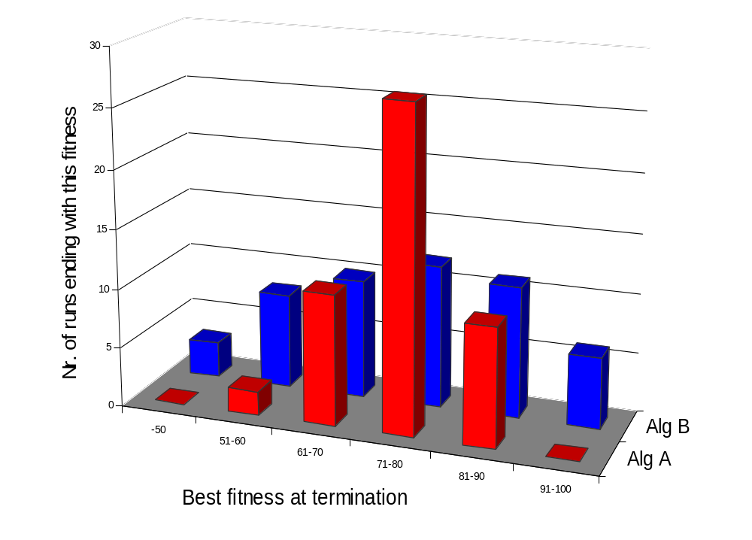
Example: off-line performance measure evaluation
Which algorith
is better?
Why?
When?

Slide 23
Example: on-line performance measure evaluation
Algorithm A
Algorithm B
Populations mean (best) fitness
Which algorith is better? Why? When?

Slide 24
Example: averaging on-line measures
Run 1
average
Run 2
time
Averaging can “choke” interesting onformation

Slide 25
Example: overlaying on-line measures
time
Overlay of curves can lead to very “cloudy” figures

Slide 26

Statistical Comparisons and Significance
Algorithms are stochastic
Results have element of “luck”
Sometimes can get away with less rigour – e.g. parameter tuning
For scientific papers where a claim is made: “Newbie recombination is better ran uniform crossover”, need to show statistical significance of comparisons

Slide 27
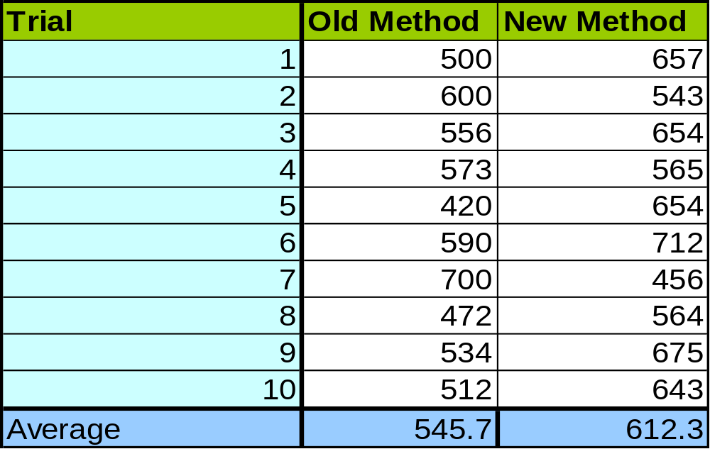
Example
Is the new method better?

Slide 28
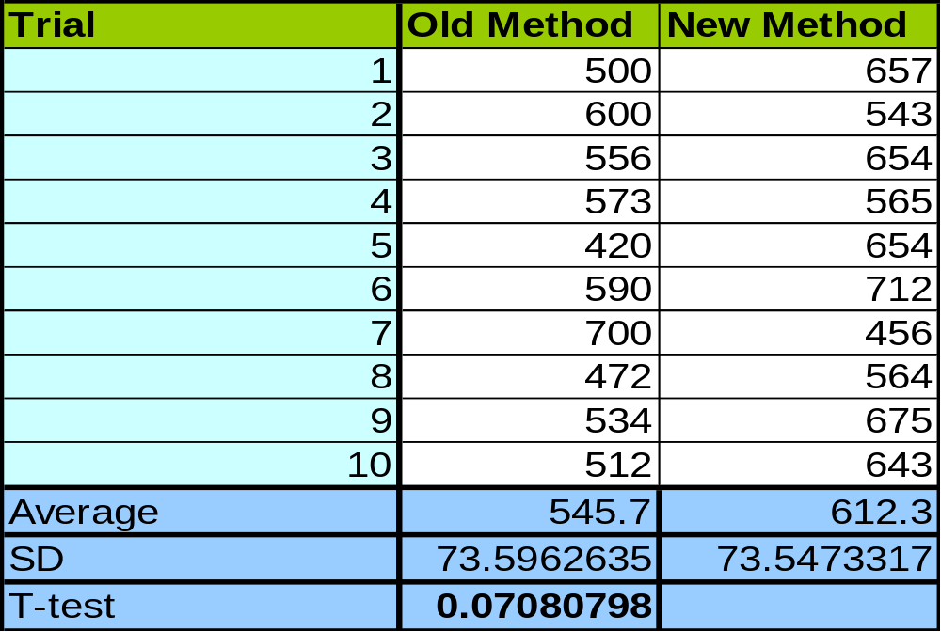
Example (cont’d)
  Standard deviations supply additional info
  T-test (and alike) indicate the chance that the values came from the same underlying distribution (difference is due to random effetcs) E.g. with 7% chance in this example.

Slide 29
Statistical tests
T-test assummes:
  Data taken from continuous interval or close approximation
  Normal distribution
  Similar variances for too few data points
  Similar sized groups of data points
Other tests:
  Wilcoxon – preferred to t-test where numbers are small or distribution is not known.
  F-test – tests if two samples have different variances.

Slide 30

Statistical Resources
http://fonsg3.let.uva.nl/Service/Statistics.html
http://department.obg.cuhk.edu.hk/ResearchSupport/
http://faculty.vassar.edu/lowry/webtext.html
Microsoft Excel
http://www.octave.org/

Slide 31
Better example: problem setting
I invented myEA for problem X
Looked and found 3 other EAs and a traditional benchmark heuristic for problem X in the literature
Asked myself when and why is myEA better

Slide 32
Better example: experiments
Found/made problem instance generator for problem X with 2 parameters:
  n (problem size)
  k (some problem specific indicator)
Selected 5 values for k and 5 values for n
Generated 100 problem instances for all combinations
Executed all alg’s on each instance 100 times (benchmark was also stochastic)
Recorded AES, SR, MBF values w/ same comp. limit
(AES for benchmark?)
Put my program code and the instances on the Web

Slide 33
Better example: evaluation
Arranged results “in 3D” (n,k) + performance
(with special attention to the effect of n, as for scale-up)
Assessed statistical significance of results
Found the niche for my_EA:
  Weak in … cases, strong in - - - cases, comparable otherwise
  Thereby I answered the “when question”
Analyzed the specific features and the niches of each algorithm thus answering the “why question”
Learned a lot about problem X and its solvers
Achieved generalizable results, or at least claims with well-identified scope based on solid data
Facilitated reproducing my results → further research

Slide 34
Some tips
Be organized
Decide what you want & define appropriate measures
Choose test problems carefully
Make an experiment plan (estimate time when possible)
Perform sufficient number of runs
Keep all experimental data (never throw away anything)
Use good statistics (“standard” tools from Web, MS)
Present results well (figures, graphs, tables, …)
Watch the scope of your claims
Aim at generalisable results
Publish code for reproducibility of results (if applicable)

